Slide 1
Zvončari
By Artur, Renato, Matej
Ta fotografija korisnika Nepoznat autor: licenca CC BY-SA

Slide 2
About Zvončari
Zvončari ("bellmen") is the characteristic folk custom maintained in the region around Rijeka, Croatia. It was added to UNESCO's Representative List of the Intangible Cultural Heritage of Humanity in 2009.
The custom dates to Slavic pagan antiquity and remains typical for this region. The primary task of Zvončari is to scare away evil spirits of winter and to stir up new spring-time cycle. During the Rijeka Carnival, Zvončari march from village to village throughout the region, following the same centuries-old route, making an extraordinary amount of noise, fueled in part by the wine provided by the locals en route.
Ta fotografija korisnika Nepoznat autor: licenca CC BY-SA

Slide 3
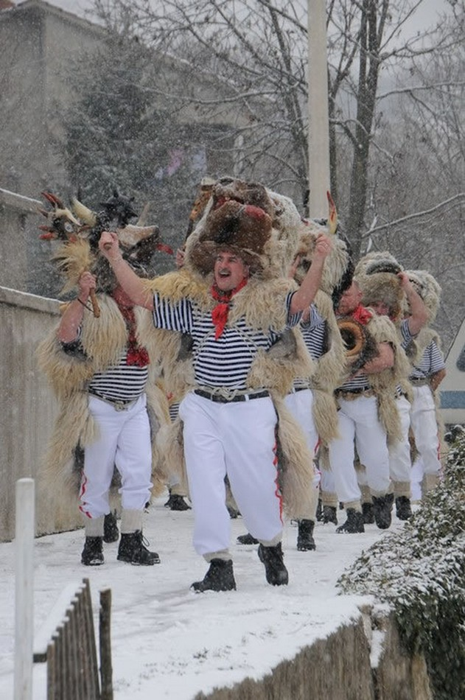
More about Zvončari
The standard Zvončar costume includes white trousers, striped shirt, and a sheepskin throw. In their hands they hold a "balta" or "bačuka" - a stylized mace, and around the waist one or more big brass bells. The costume varies from village to village; for example, Zvončari of Halubje and Grobnik [hr] (Dondolaši) wear special stylized masks representing fantastic animal heads, while Zvončari of Žejane and Brgud [hr] wear "flower hats". Local legend claims that it was the Zvončari that scared away invading Tatars or Turks during the Ottoman conquest, with shepherds doning masks on their heads, along with belted-on bells, produced a deafening noise that scared the enemy away. From that time on, a mace became part of the standard equipment of Zvončari.
Ta fotografija korisnika Nepoznat autor: licenca CC BY-SA

Slide 4
THE END
Ta fotografija korisnika Nepoznat autor: licenca CC BY-SA

