Slide 1
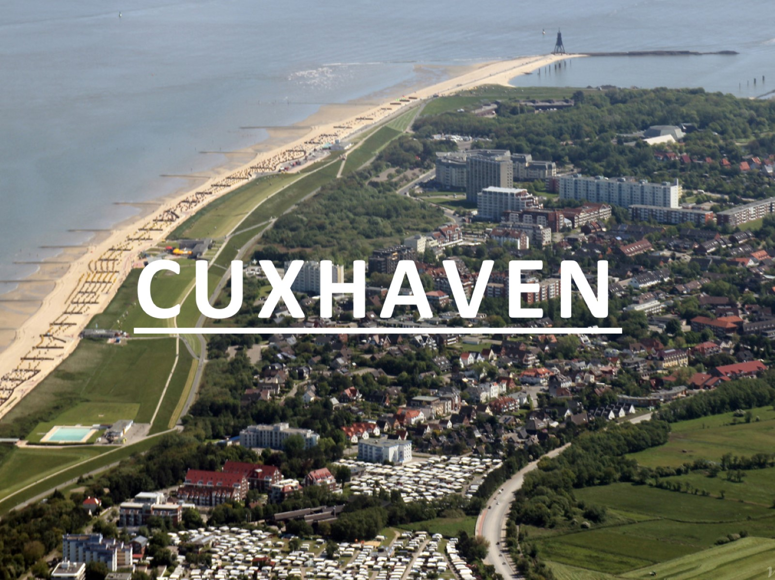
CUXHAVEN

Slide 2
Structure

Slide 3
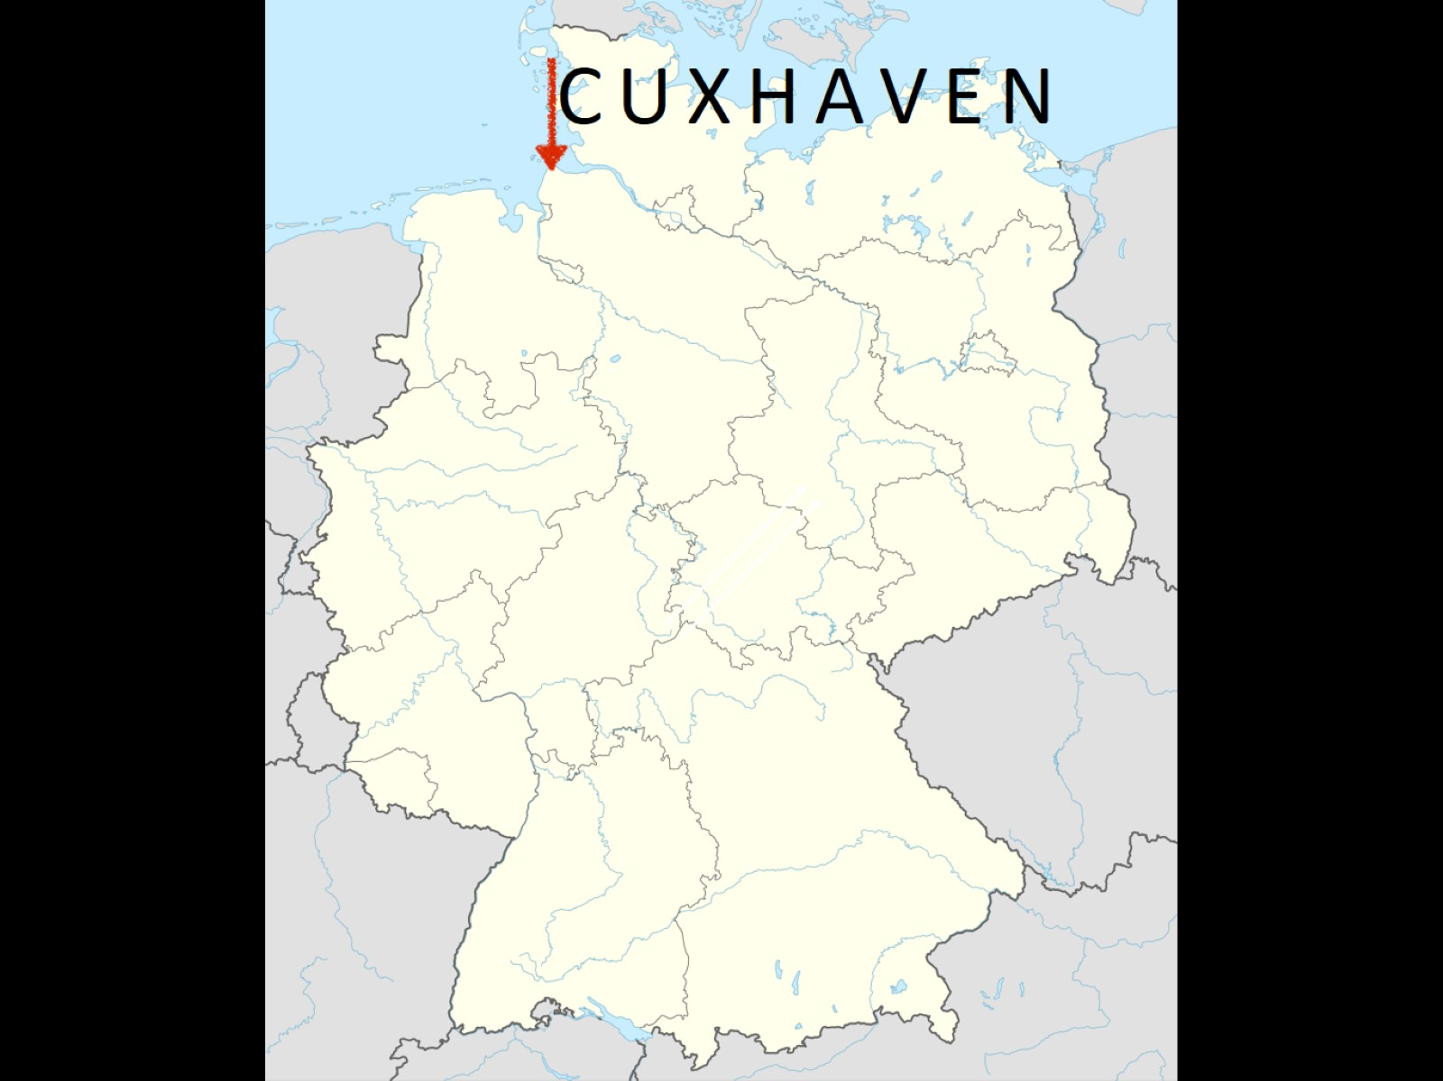
Cuxhaven

Slide 4
the city: general information:

Slide 5
geographical location:

Slide 6
Population

Slide 7
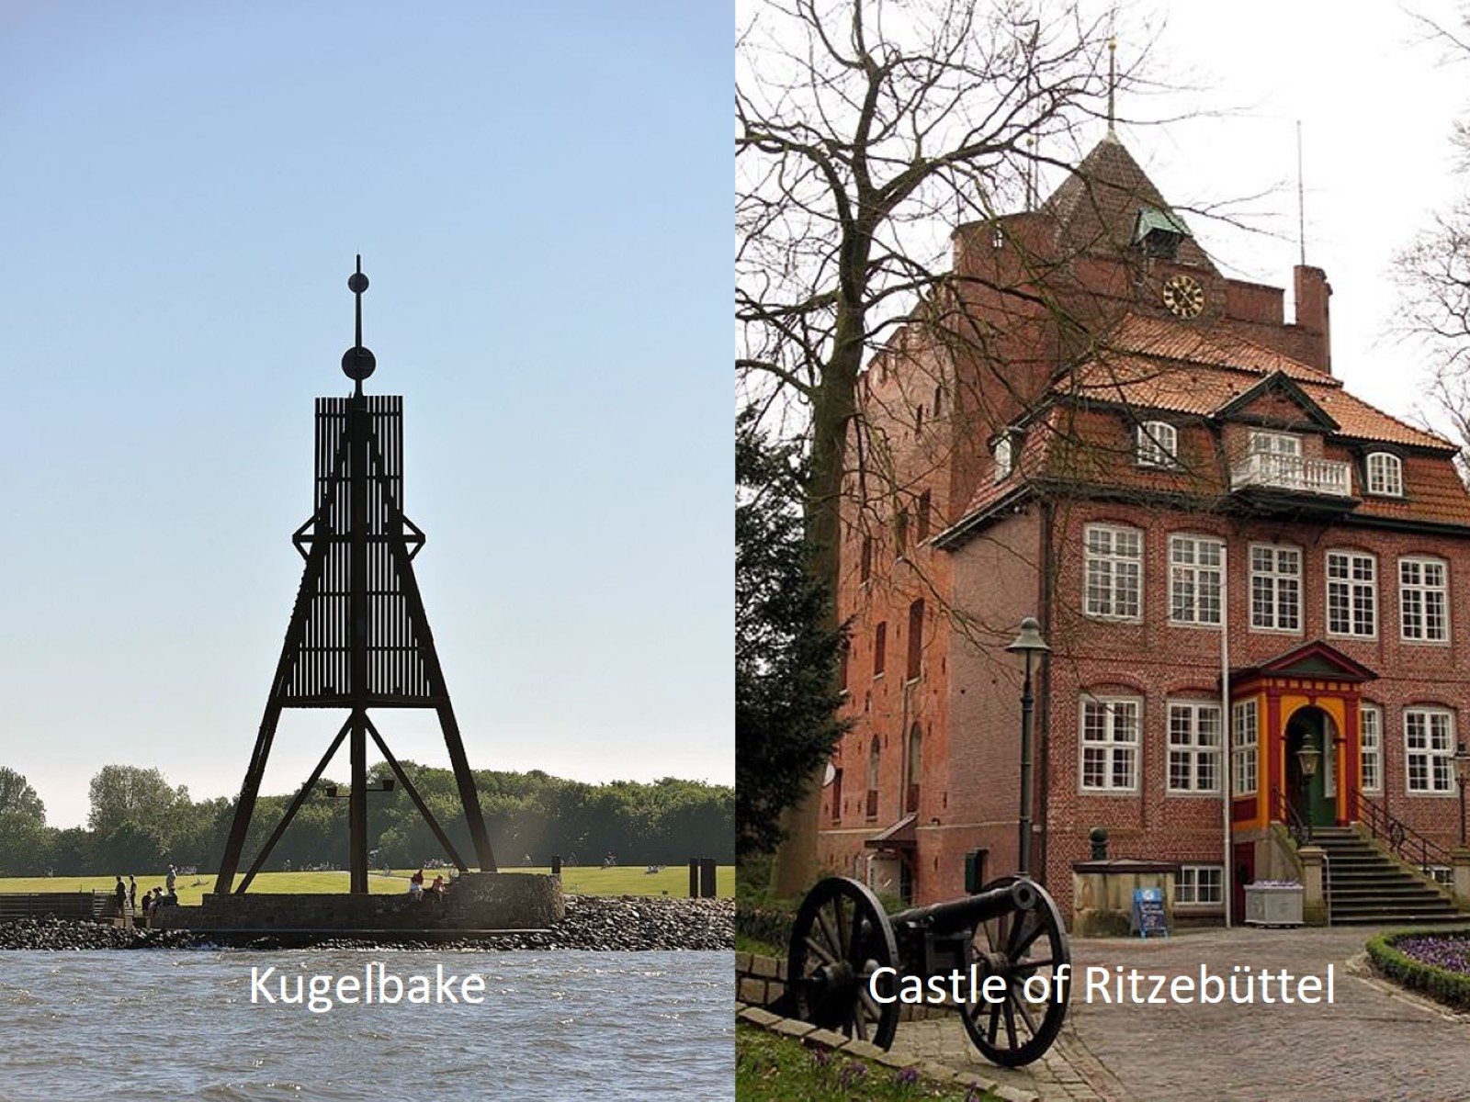

Slide 11
Events

