Slide 1
Data protection
How to protect your data when using the internet ?
Orange team: Ludovica Sfarra, Alessandro Rubini, Martina Rambaldi, Claudio Tubi, Sebastian Vascautan

Slide 2
What is data protection?
Data protection is the process of safeguarding important information from corruption, revelation or loss.The GDPR is aimed at giving citizens control over their personal data.
GDPR = The General Data Protection Regulation - European Regulation

Slide 3
Data protection in italy
Italy has adopted European Regulations with the IDPC in 2003.
IDPC = The Italian Data Protection Code

Slide 4
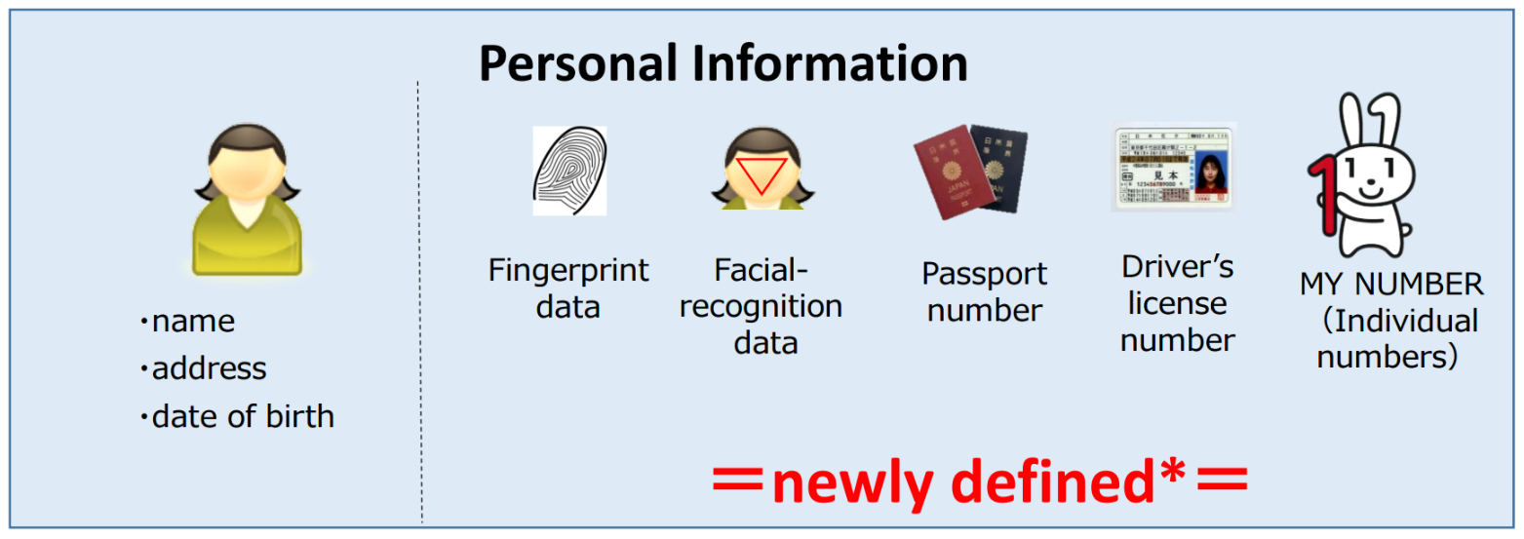
Privacy
Data protection is about your fundamental right to privacy
The EU directive states that is illegal to:
send spam;
use spyware;
use unauthorized digital tracking.
your personal information must be:
current;
useful,
available to the person on request.

Slide 5
TIPS TO PROTECT YOUR CREDENTIALS
use strong passwords: 14 characters: numbers/letters/symbols
don’t share your password
don’t use the same password everywhere

Slide 6
Sitography
Privacy
1° photo: https://www.google.com/url?sa=i&url=https%3A%2F%2Fwww.le-vpn.com%2Fwhat-is-spyware%2F&psig=AOvVaw006SkHa4876cpyq1rJ08XB&ust=1612612160561000&source=images&cd=vfe&ved=0CAIQjRxqFwoTCNj6psTY0u4CFQAAAAAdAAAAABAD
2° photo: https://www.google.com/url?sa=i&url=https%3A%2F%2Fmedium.com%2Ftokyo-fintech%2Fjapans-act-on-protection-of-personal-information-comes-into-effect-on-may-30-dd7c7d476ec4&psig=AOvVaw0c79rTpLrRYGQRopoz_-mE&ust=1612612347976000&source=images&cd=vfe&ved=0CAIQjRxqFwoTCMiY5qbX0u4CFQAAAAAdAAAAABAm
Philippa Bowen et al., “Business Plan - Companion book”, Dea Scuola
https://iclg.com/practice-areas/data-protection-laws-and-regulations/italy

