Slide 1
THE RIVER ELBE
By Mathilda Millhahn and Emma Yarlett ☺

Slide 2
STRUCTURE
FACTS (emma)
LOCATION (mathilda)
TRADES (mathilda)
SUNKEN SAILING BOAT (emma)

Slide 3
FACTS
Total length: 1,165 km
(727 km in Germany, 367 km in the Czech Republic)
Total area: 144.060 square km
One of the major waterways in central Europe

Slide 4
LOCATION
Starts in the north west Czech Republik
(Hradec Králové, Pardubice, Ústí nad Labem)
Runs through Germany into the North Sea in Cuxhaven
(Dresden, Magdeburg, Hamburg)

Slide 5
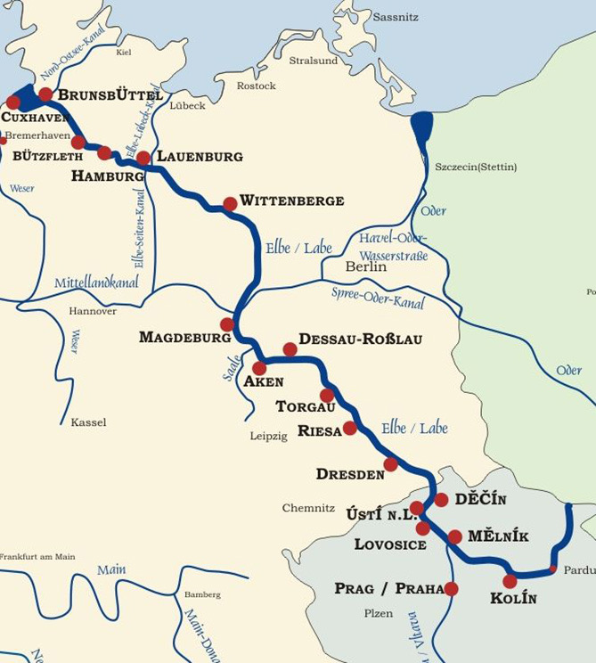
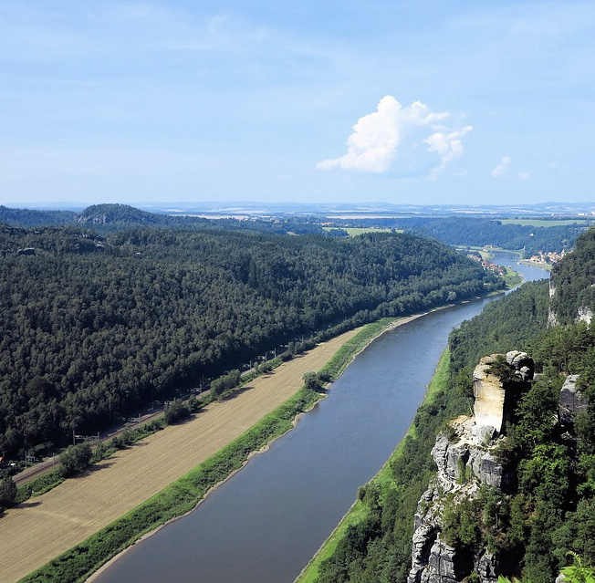

Slide 6
TRADE
The Elbe River is connected to:
Berlin
industrial areas of Germany
The Baltic Sea
Ships:
Aida (all of them)
MSC (many of them)
HMS (many of them)

Slide 7
SUNKEN SAILING BOAT NO. 5 ELBE
2019 a Historical sailing boat No. 5 Elbe sailed on the wrong side, collid with another ship and sunk
wanted to cross the containership „Astrosprinter“, didn‘t work
Video of a moment shortly before the collision
https://youtu.be/aXrTvVh4NOs

Slide 8
THANKS FOR WATCHING
☺

