Slide 1
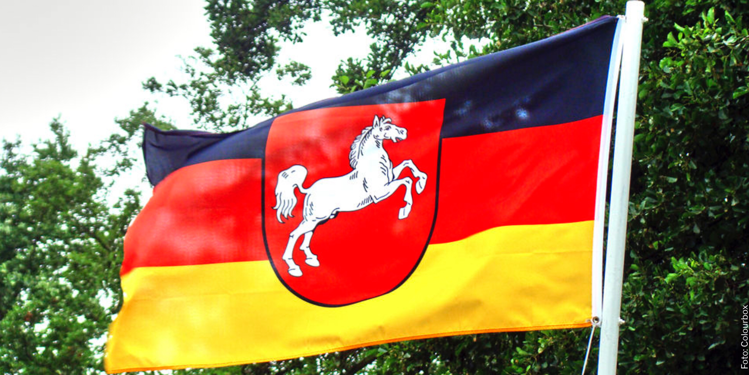
Lower Saxony
The second-biggest state of Germany

Slide 2
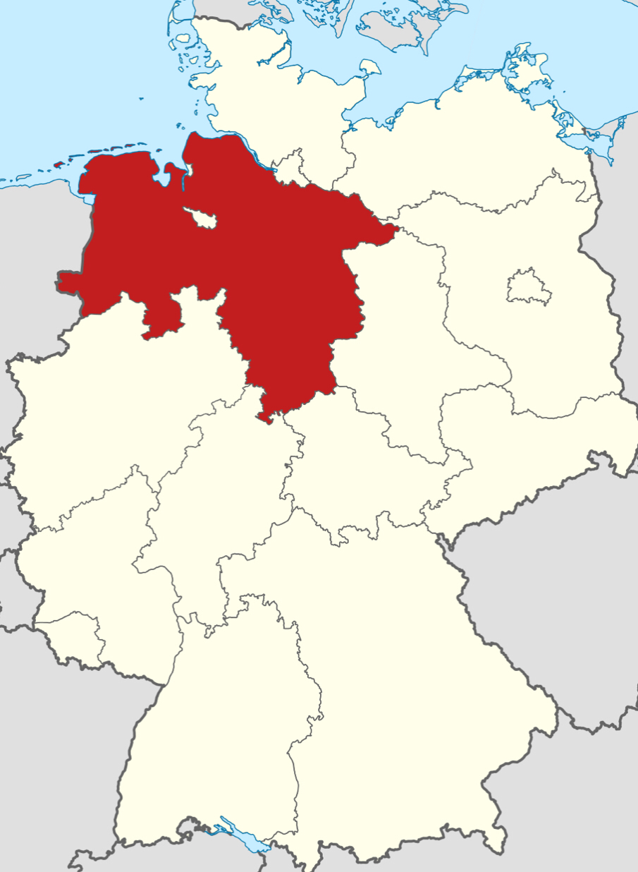
General facts
landarea 47.624 km2
4th biggest population(7,9mio)
governed by CDU and SPD
capital Hannover
Notes:
Hannover 536.925 inhabitants
More borders than any other

Slide 3
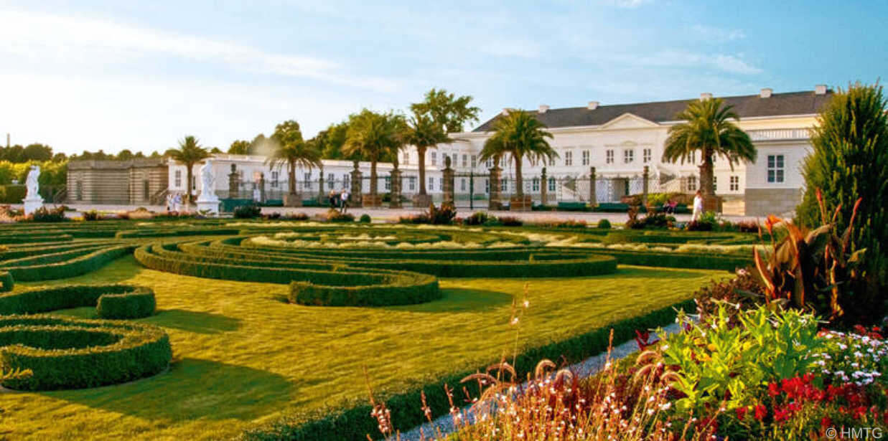
Towns and sights
Hannover 536.925: Herrenhäuser Gärten
Braunschweig 248.292: Braunschweiger Dom
Wolfsburg 124.151: Autostadt (VW)
Osnabrück 164.748: Botanischer Garten der Universität Osnabrück
Oldenburg

Slide 4
Quiz
Which animal was on the first page
How many inhabitants has Hannover?
A 476.258
B 536.925
C 531.625
What was the sight of Osnabrück?
What are the gorvening parties?
A SPD and Grüne
B CDU and Grüne
C SPD and CDU
Notes:
1 horse
2 B
3 Botanischer Garten der Universität Osnabrück
4 C

Slide 5
Sources
visit-hannover.com
ahgz.de
Wikipedia

Slide 6
Thank you for listening

