Slide 1
The Wadden Sea
Notes:
Hello…

Slide 2
Our topics:
Facts about the Wadden Sea (Kjell)
Animals in the sea (Tom)
Ressources (together)
Notes:
1 Kjell
2 Tom
3 Tom

Slide 3
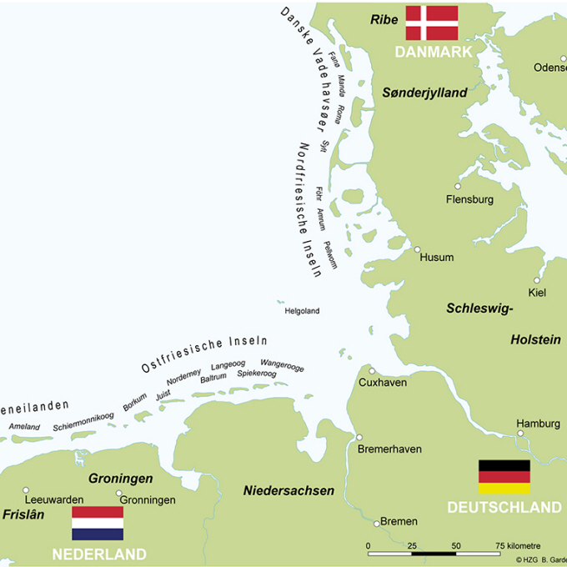
Facts about the Wadden Sea
The Wadden Sea size is over 9000 sqkm large
The Sea is stromgly influenced by the tide
Is bordered by Denmark, Netherlands and Germany
The Sea is a Nationalpark and a world heritage side
Notes:
Kjell

Slide 4
Animals in the Wadden Sea
10 main groups of animals
> is an important living space for them.
Notes:
Tom

Slide 5
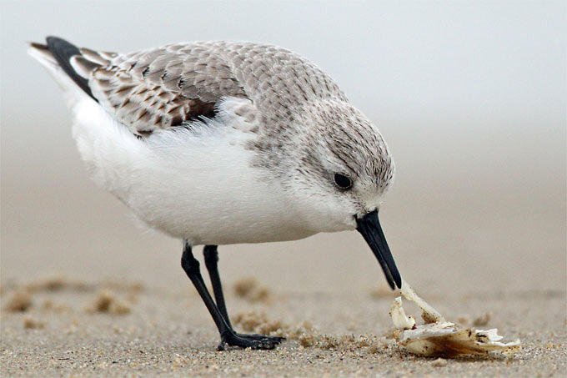

Slide 6
Recources in the sea
Wind
Oil
Gas
Food
Trading
Tourism
Water
Salt
Notes:
1. T
2. K
3. T
4. K
5. K
6. T
7. T
8. K

Slide 7
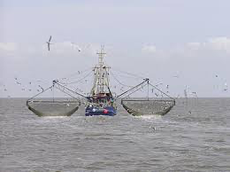
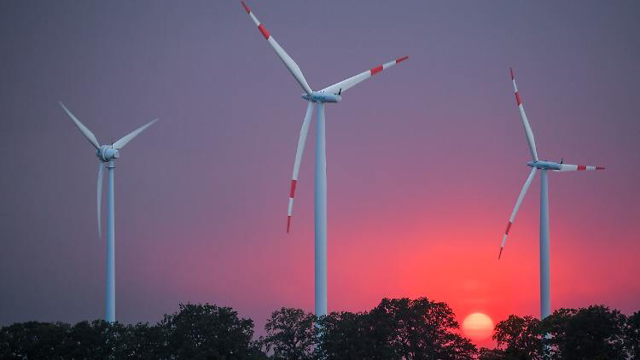

Slide 8
Thanks for your time
Notes:
Tom

