Slide 1
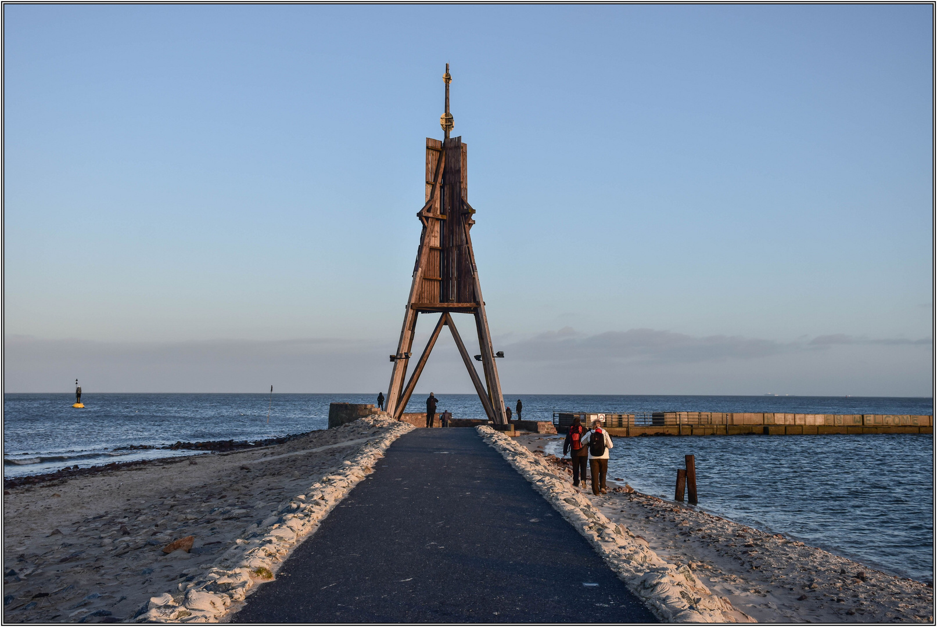
Cuxhaven sights
A presentation made by : Jonath Sawitzki and Rober Haji

Slide 2
Cuxhaven Sights
Alte Liebe
Kugelbake
Schloss Ritzebüttel
Hapag-Hallen
Fort Kugelbake
Wasserturm
Minensucher-Denkmal
St. Perti Kirche

Slide 3
Informations about the sights :
The Alte Liebe is a viewing platform which is build on top of three ships that sunk there. It is located where the river Elbe meets the North Sea.
The Kugelbake was a navigation mark for ships – built around 1700
Schloss Ritzebüttel was the home and headquarter of senators from Hamburg from 1340 to 1937. Today it is a museum and registry office
The Hapag Hallen is an old building which was a passenger terminal for ships, a train station and a travel agency. From Cuxhaven about 4 million people left to emigrate to the United States.

Slide 4
Information about more sights :
Fort Kugelbake is a former naval fortress
The Water Tower was build to get a central water supply for Cuxhaven
The Minensucher Denkmal is a memorial for the fallen minesweeper in the First and Second World War
The St.Petri Church is a Protestant church that was consecrated in 1911

