Slide 1
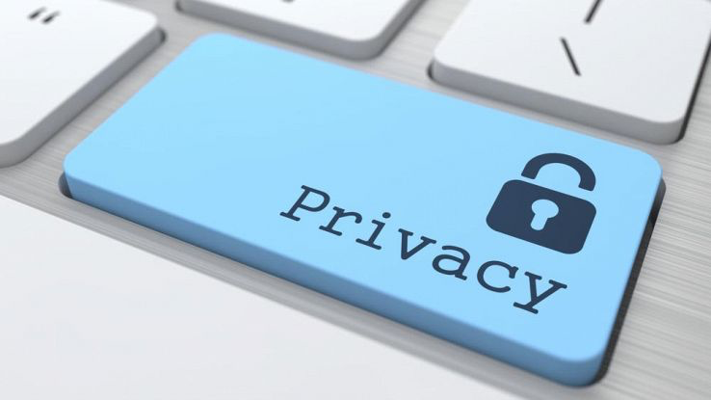
INTERNET-PRIVACY
The red team
The level of privacy protection that an individual has while connected to the Internet.
Privacy is in DANGER!
Mind the following malware:(
By: Luca Benazzi, Vittoria Bernini, Luca Borghetti, Sara De Biaggi, Giacomo Vallieri.

Slide 2
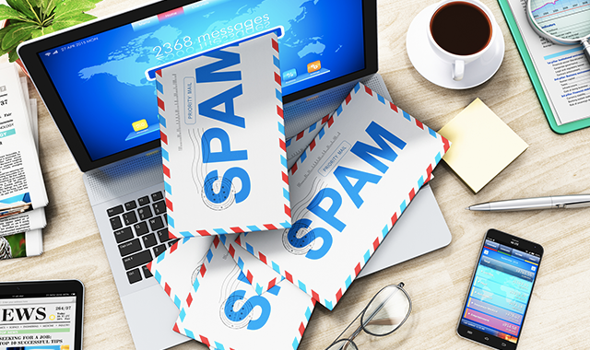
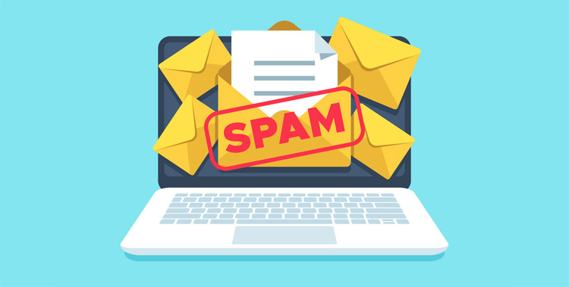
SPAM
Unwanted, unsolicited emails or messages sent over the Internet, for the purpose of advertising, phishing, spreading malware, and so on.

Slide 3
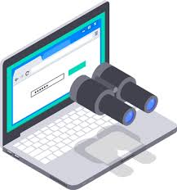
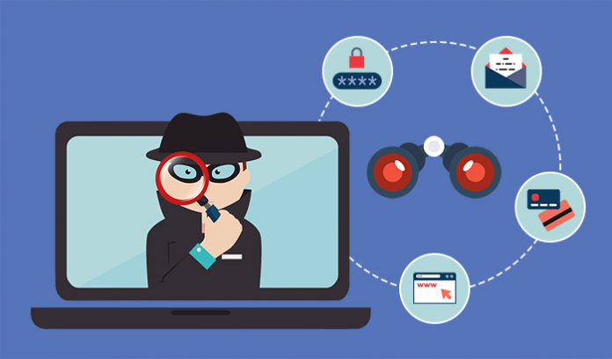
SPYWARE
A type of software that collects information about a user’s online business without their consent.

Slide 4
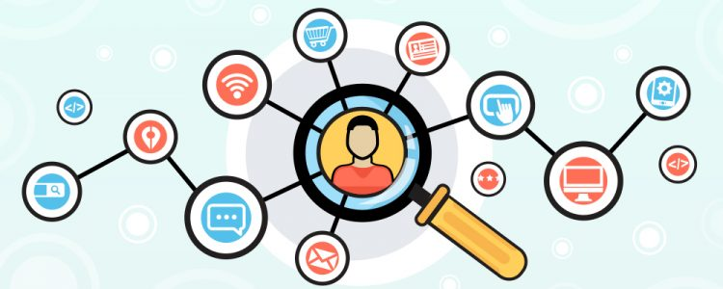
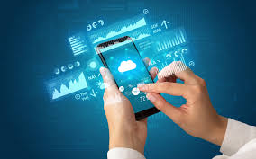
DIGITAL TRACKING
A service that logs your location and violates your privacy
Only companies benefit from it.

Slide 5
HOW TO PROTECT YOUR PRIVACY ONLINE
pay attention to what sites you visit
activate a firewall
inactivate geolocalization

Slide 6
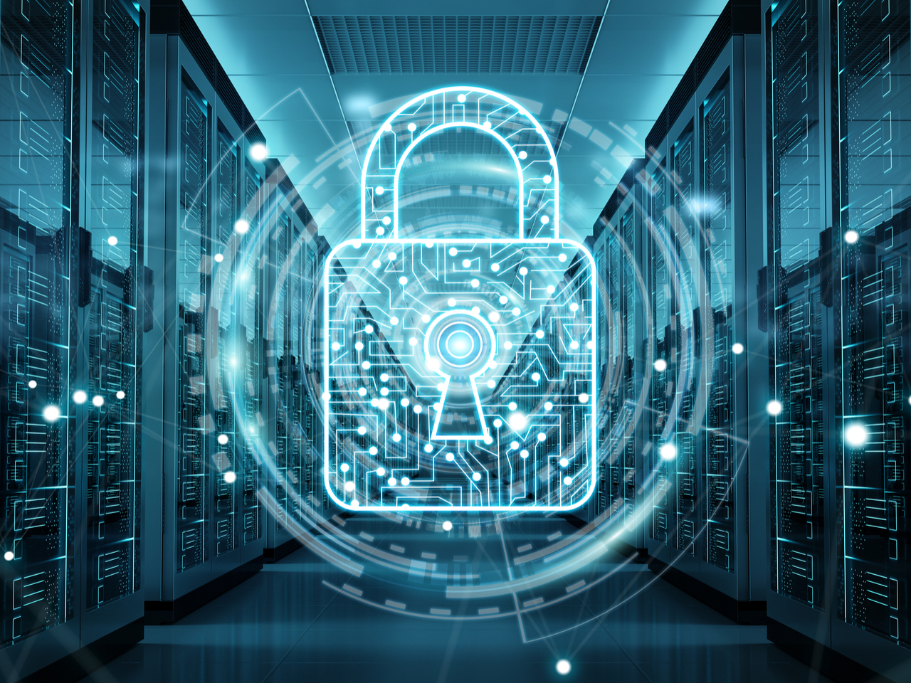
FIREWALL
A network security system that controls incoming and outgoing network traffic

Slide 7
Thanks a lot!
SITOGRAPHY
We got the pieces of information from:
https://it.wikipedia.org/wiki/Spyware
https://it.wikipedia.org/wiki/Firewall https://it.wikipedia.org/wiki/Sistema_di_tracciamento

