Slide 1
The history of Ariosto high school
Blue Team
Magri Luigi, Mainardi Emma, Melandri Federico, Micai Nicolò, Mohammadi Eman, Scotto Ettore, Labazanova Milana, Lenzerini Isabella, Marangoni Francesco, Mironica Mihaela, Pica Maria Luna, Romeo Elena Sofia.

Slide 2
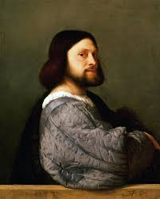
…………………………………………….
FOUNDING
…………………………………………………..
It is one of the first high schools in Ferrara and it was founded on December 3rd, 1860;
In 1865 the school was named in memory of the Reggio writer Ludovico Ariosto;
It was realized right in the heart of the Renaissance Ferrara;
Since 1988 it has been reviewing the profiles of the fields of study and active in 1991 the classic Brocca, followed in 1992 by the linguistic and scientific.

Slide 3
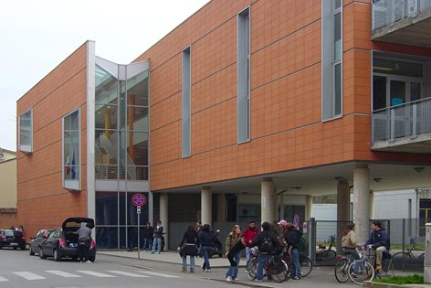
FOUNDING
…………………………………………….
…………………………………………………..
The Ariosto High School was founded in 1860. Attended by middle-class boys it was dedicated classical studies.
At the beginning there were few students, especially few girls (in 1925 there were only 5 girls).
Afterwards the number of students increased thanks to the presence of very talented teachers.
This high school was attended by important people such as the famous writer Giorgio Bassani and the director Michelangelo Antonioni.

Slide 4
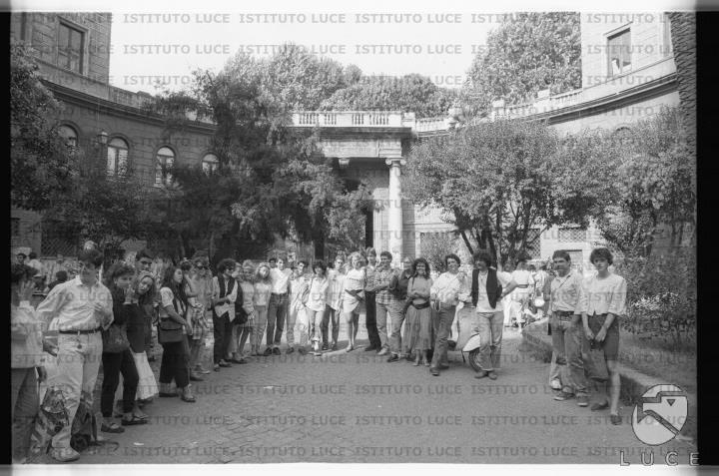
FOUNDING
………………………………………….....
…………………………………………………...
The Liceo Ariosto was meant to prepare the ruling class through a selection based on humanistic and classical training.
At the beginning of the 20th century the school had only male students.
In 1976 the new headquarters of the school was inaugurated:
it creates a school environment in which advanced architectural concepts know how to interpret the new requirements of school education.

Slide 5
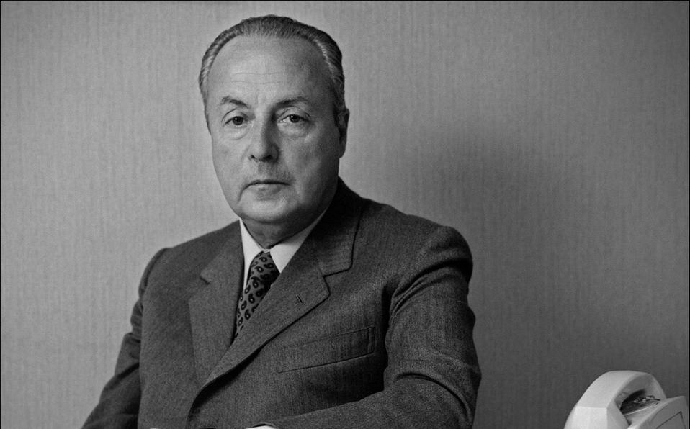
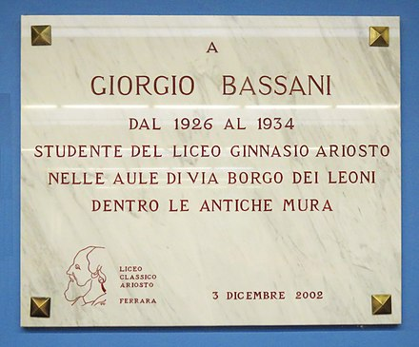
……….
Important people who attended Ariosto high school
……….
Giorgio Bassani: One of the most important student who attended Liceo Ariosto is the writer and politician Giorgio Bassani, that was born on 4 March 1916 in Bologna. His italian teacher Francesco Carli gave him the passion for literature, in fact he wrote many books like “The garden of the Finzi Contini” that talks about the racial persecution of a noble family from Ferrara. Another book by Bassani starring Ferrara, is the novel “Five stories from Ferrara”

Slide 6
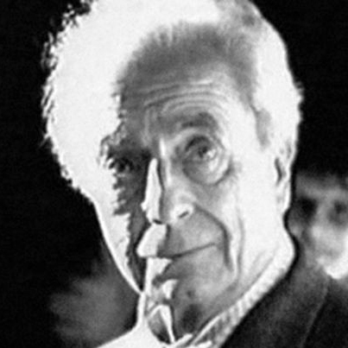
Michelangelo Antonioni
……………………………...
……………………………......
Michelangelo Antonioni was a post-neorealist director who determined the end of a cinematographic era and the beginning of a new one, he focused on issues concerning the crisis of man, incommunicability, a spiritual and moral dryness that has gripped yesterday, and still today, modernity, making it an instrument of filmic research.Michelangelo Antonioni in his career as director and screenwriter has signed works such as The Adventure, The Night, The Eclipse, The Red Desert, Blow-Up, Zabriskie Point.Profession: reporter. All films that have enjoyed enormous international success and which have given him numerous awards, making him a fundamental figure in the culture of the twentieth century.

Slide 7
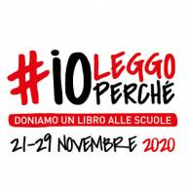
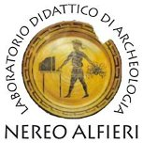
……………………..Important Projects………………………..
In our high school there are many projects underway, for example the Health Education Project, The «I read because project», the didactic archeological laboratory or there are competitions and prize competitions, and finally there is the International Certification of Foreign Languages project, where everyone is given the opportunity to improve their culture in foreign languages through free afternoon courses.

