Slide 1
Cuxhaven for Young People
Made by Caroline, Lea and Lili

Slide 2
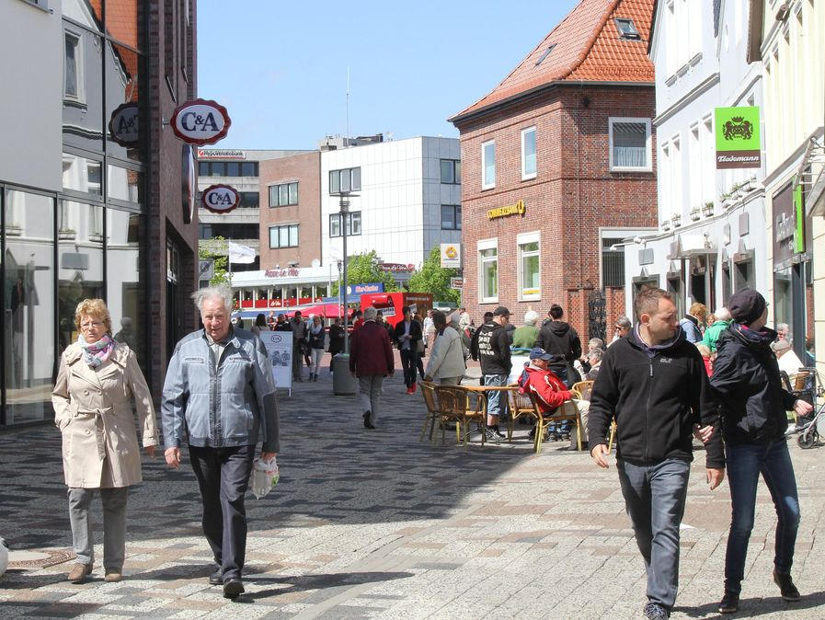
Cuxhaven City
Many hairdressers
City library
Street artists and homeless people
Small stores and big fashion stores
Bookstores
Butchers
Trainstation – 17€ - one ticket to Hamburg
Notes:
Twentyone hairdressers
Over 300.000 borrowed items
Over 100.000 items
Seidel

Slide 3
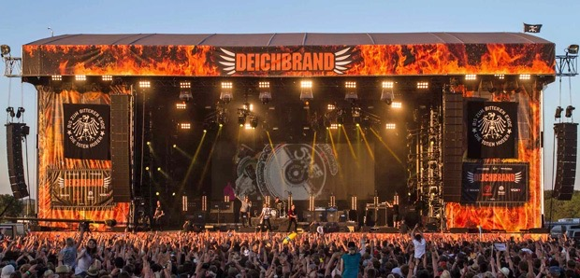
July every year
nice atmosphere
Delicious Food
Nice People
Unique Bands
Camp
-450€

Slide 4
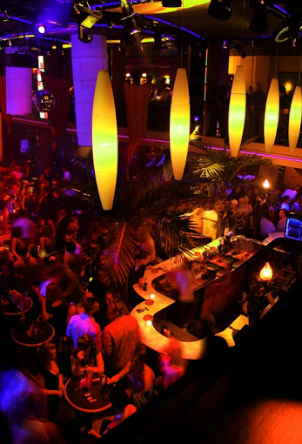
Clubs and bars
7 Clubs: Beach Club Cuxhaven, Janssens Tanzpalast, Diskothek Flair…
Janssens:
Countless Events
Mainarena, Swing, Airos, Rockkeller, Plaza, englisch pub
Jacobistreet 21
Arrival through the A73

Slide 5
Go to Cuxhaven!

