Slide 1
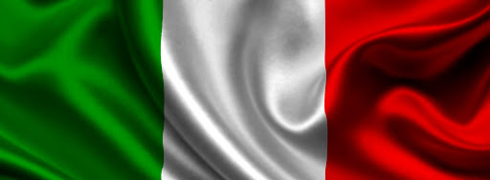
Italy
Italy is located in the south of Europe. It borders on Switzerland, France, Austria, Slovenia,the Tyrrhenian Sea, Adriatic Sea and Ionian Sea.
Made by
Matteo Stucci, Giulia Travagli, Ilaria Zanella, Claudio Tubi, Alessandro Rubini, Emma Segantini, Sebastian Vascautan, Emma Venturoli, Ludovica Sfarra, Vittoria Toselli, Omar Somrani e Martina Rimbaldi.

Slide 2
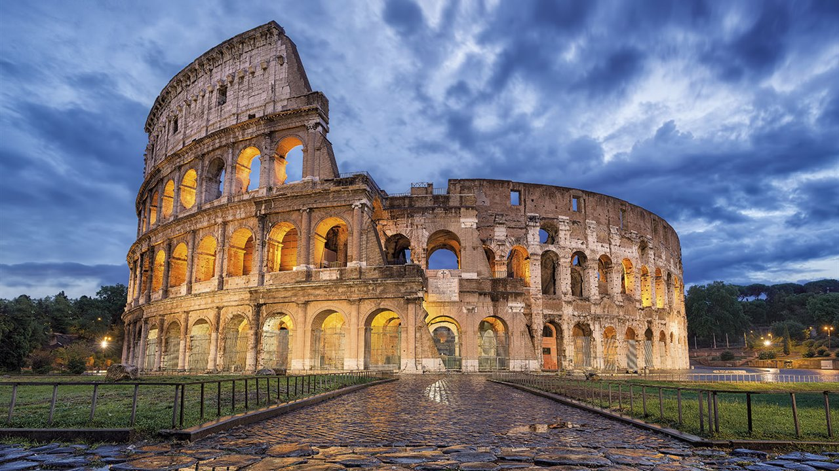
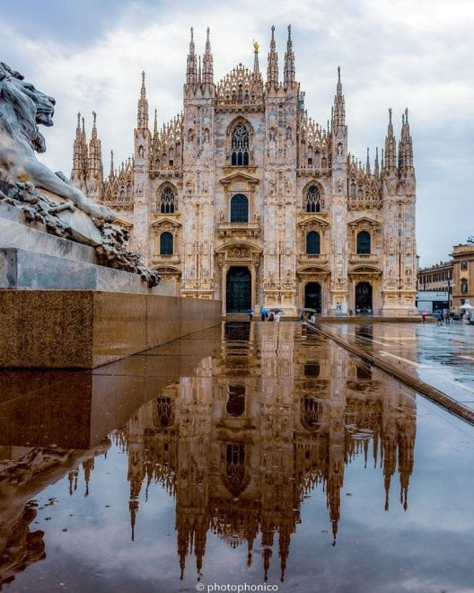
The most important cities in Italy
Italy is a Country at the centre of culture, history and art. The most important cities of Italy that have these characteristics are:
Rome
Milan
Naples
Turin
Bologna
Florence
Venice
Genoa
these cities have many theatres, museums and art galleries
By Emma Venturoli and Giulia Travagli

Slide 3
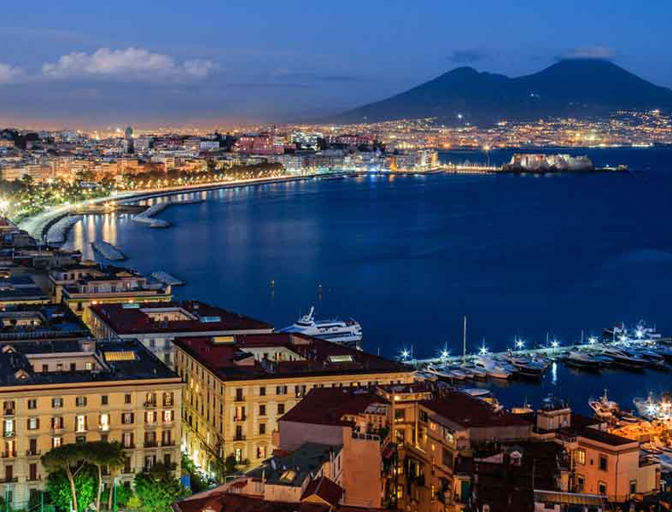
Naples is a city of a thousand colours, characterized by good food, hospitality and theatres that makes naples recognizable all over the world
Rome, the capital city of Italy, is a big cosmopolitan city with an artistic, architectural and cultural history that has influenced the whole world and that goes back almost 3000 years.
Milan, the world capital of fashion and design, is a metropolis in Northern Italy and is the capital of Lombardy. It is a financial centre also famous for restaurants and exclusive shops.
Turin is a city that offers architectural beauties and important museusm like the Egyptian Museum. It is also an industrial and dynamic city with places full of history.

Slide 4
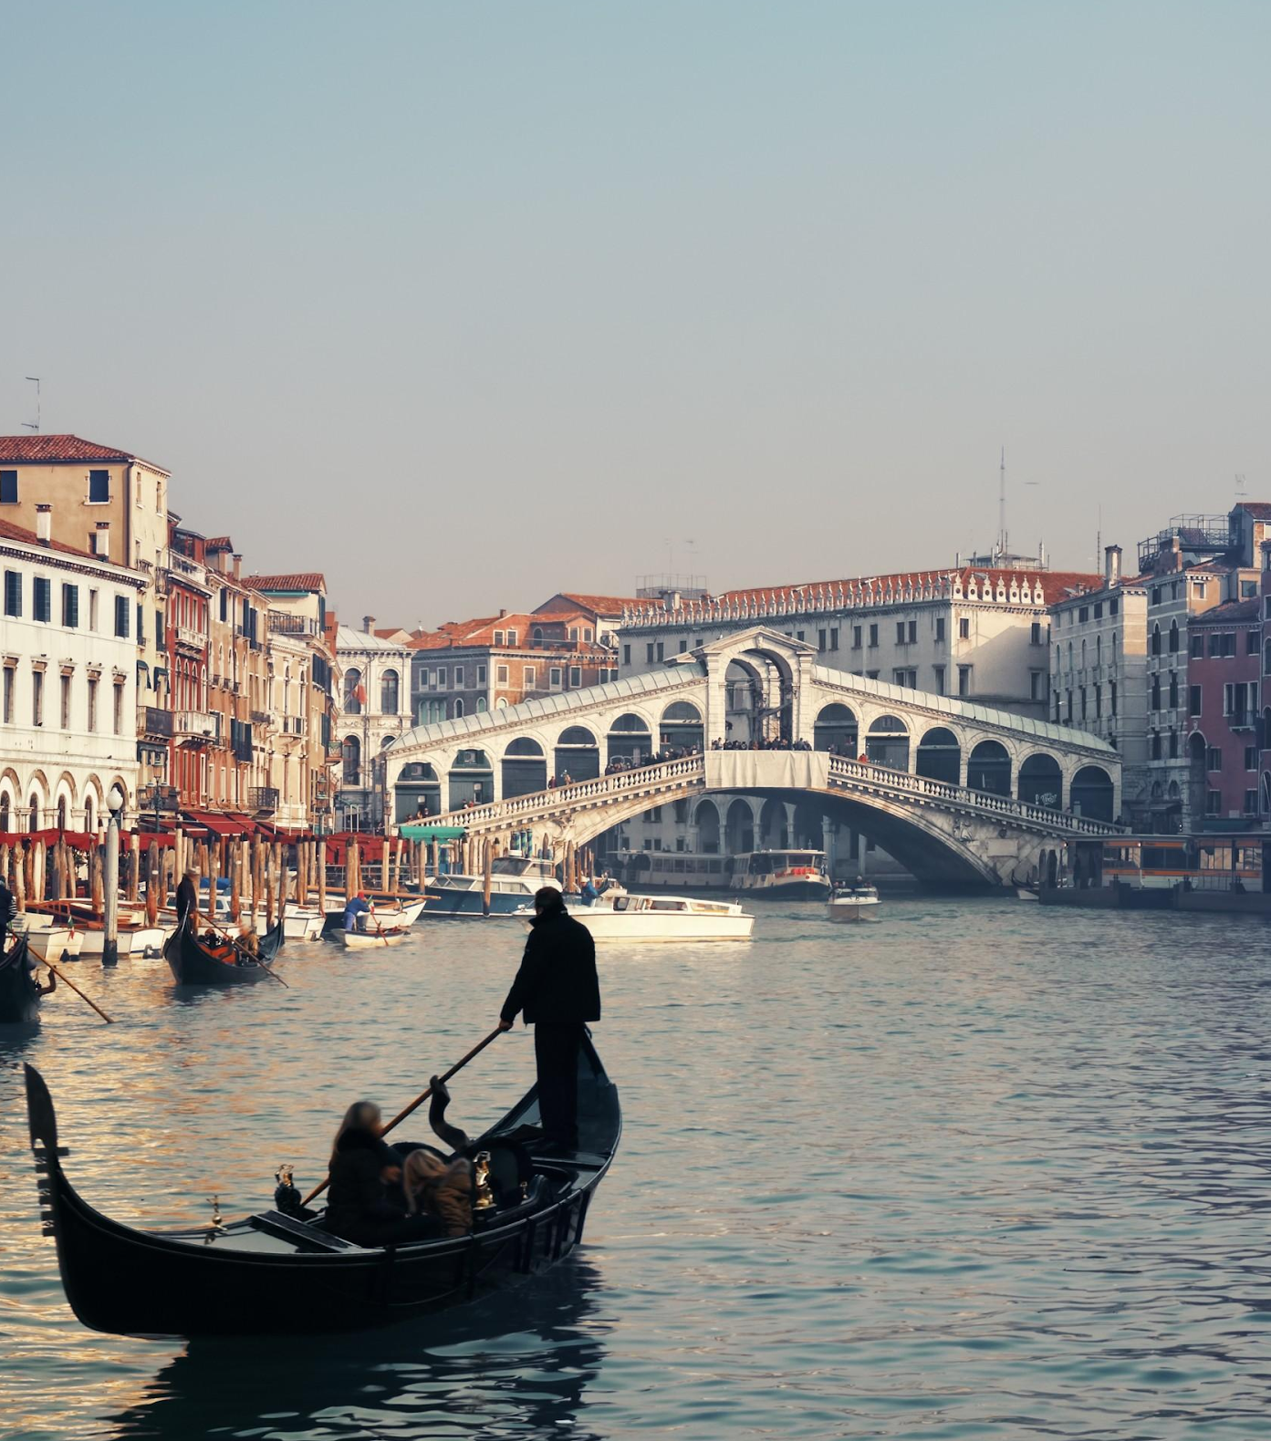
Bologna is the lively and ancient capital of Emilia-Romagna, in Northern Italy. Its Piazza Maggiore is a large square surrounded by medieval and Renaissance structures such as the Fountain of Neptune and the Basilica of San Petronio.
Florence, the capital of Tuscany, is home to many masterpieces of Renaissance art and architecture. One of the most famous places is the Duomo, the cathedral with a dome of tiles designed by Brunelleschi and Giotto’s bell tower.
Venice, the capital of the Veneto region, lies on more than 100 small islands within a lagoon in the Adriatic Sea. In this city there are no streets but canals. On the central square, there are the Basilica of San Marco, enriched by Byzantine mosaics, and the bell tower of San Marco, from which you can admire the red roofs of the city.
Genoa is a port city and is the capital of the Liguria region. It is known for its important role in maritime trade. In the historic centre there is the Cathedral of San Lorenzo, in Romanesque style.

Slide 5
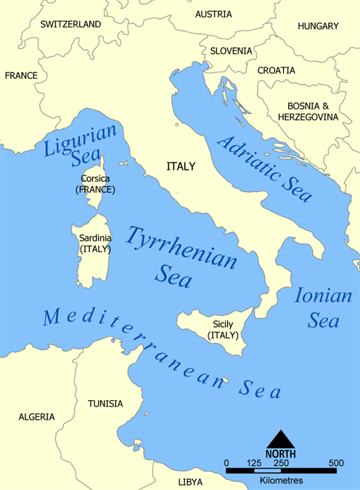
Seas
In Italy there are 4 seas that are arms of the Mediterranean Sea which washes other 20 countries in addition to Italy.
Along the North-East coast there is the Adriatic Sea. In the southeast, the Adriatic Sea connects to the Ionian Sea at the 72-kilometre (45 mi) wide Strait of Otranto. The countries with coasts on the Adriatic are Albania, Bosnia and Herzegovina, Croatia, Greece, Italy, Montenegro and Slovenia.
The Ligurian Sea is the portion of the Mediterranean that lies between the Italian Riviera and the islands of Elba and Corsica.
The Tyrrhenian Sea is part of the Mediterranean Sea, located off of the western coast of Italy.
By Emma Segantini and Vittoria Toselli

Slide 6
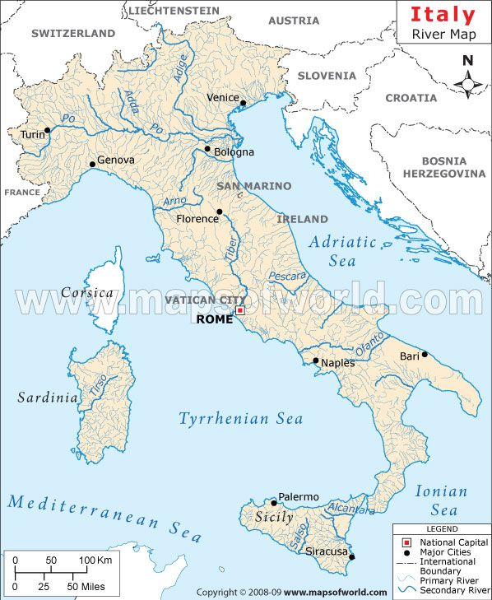
Rivers
Italian rivers are generally shorter than those of other European regions because Italy is partly a peninsula along which the Apennine chain rises, dividing the waters into two opposite sides.
On the other hand, they are numerous (about 1 200 [1]) and give rise, compared to other European countries, to a large number of sea mouths: this is due to the relative abundance of rains enjoyed by Italy in general, to the pres of the alpine chain rich in snowfields and glaciers in the northern part of the country, in the presence of the Apennines in the center-south and the coastal extension of Italy.
Their importance (range, length, etc.) naturally also depends on the characteristics of the soil, that is, more precisely, on its steepness and its greater or lesser permeability.
The longest Italian river is the Po, which flows for 652 km along the Po Valley, while the shortest is the Aril, a tributary of Lake Garda in the province of Verona, which has a length of 175 m.
By Ludovica Sfarra and Sebastian Vascautan

Slide 7
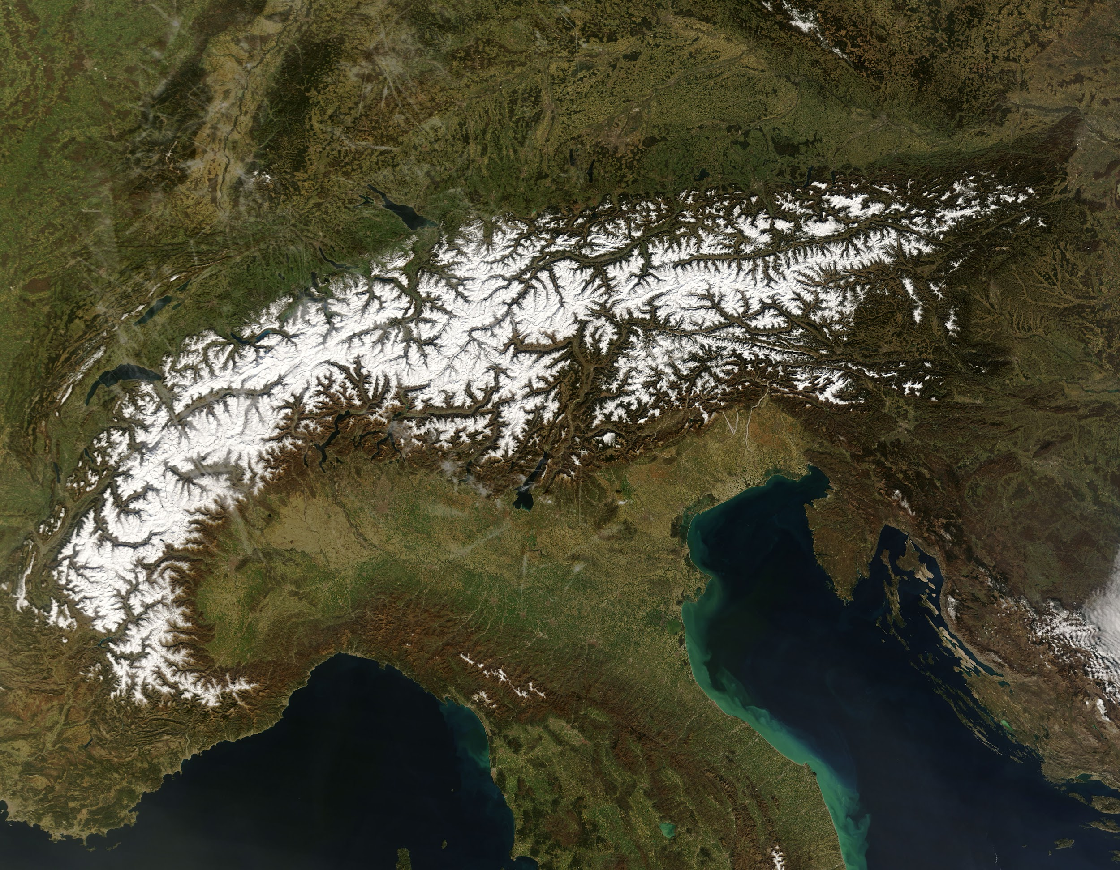
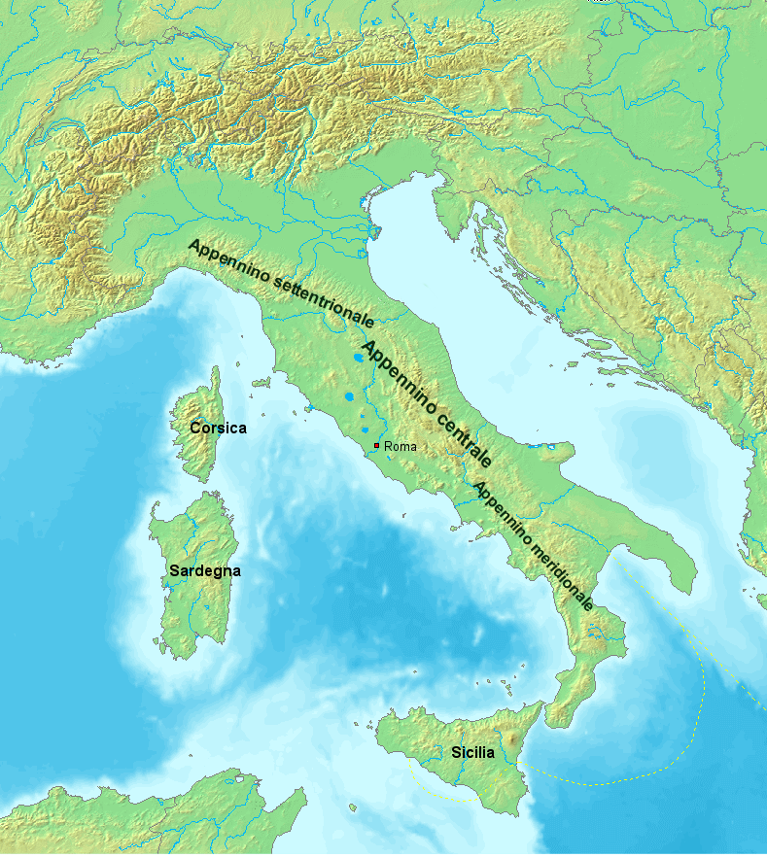
The mountains of Italy
Italy doesn’t only have cities, it also has beautiful sights too. There are two main ranges:
The Alps and the Apennines. The Alps:
They develop in the north part of Italy
and they form the border between Italy
and the other European states.
They are higher than the Apennines
and they can reach 4800 meters.
The Apennines: Instead of the Alps,
they develop along Italy.
They start from Liguria and end up in Sicily. They are less high than the Alps
and they can reach 2900 meters.
By Matteo Stucci and Claudio Tubi

Slide 8
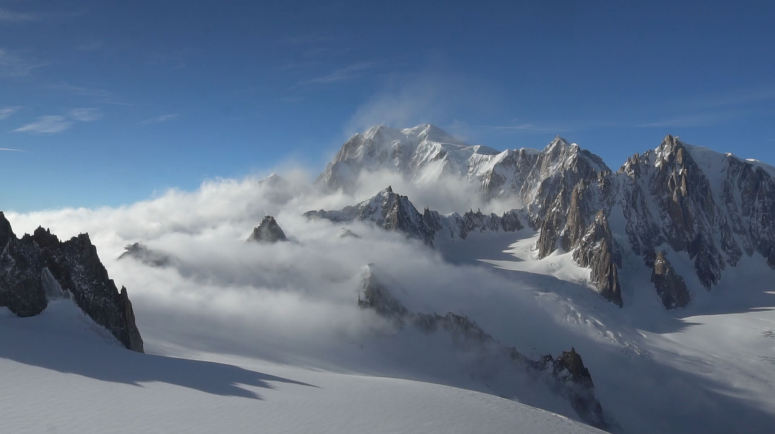
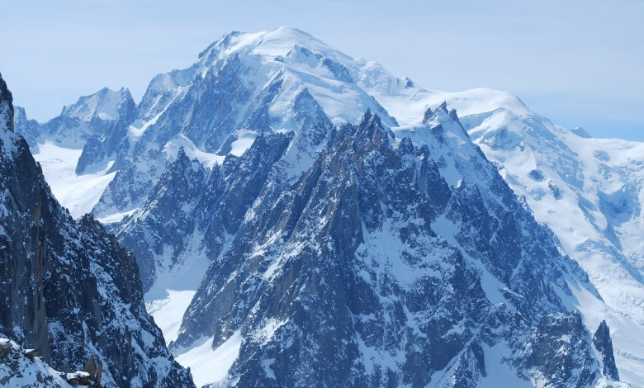
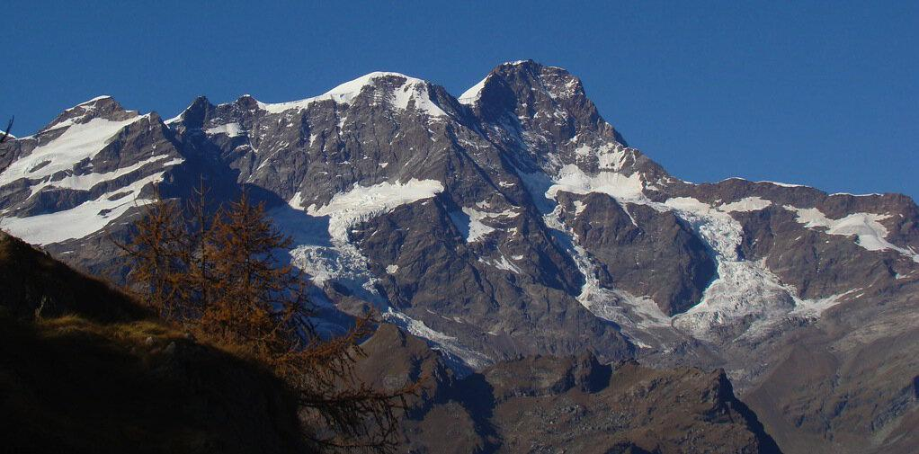
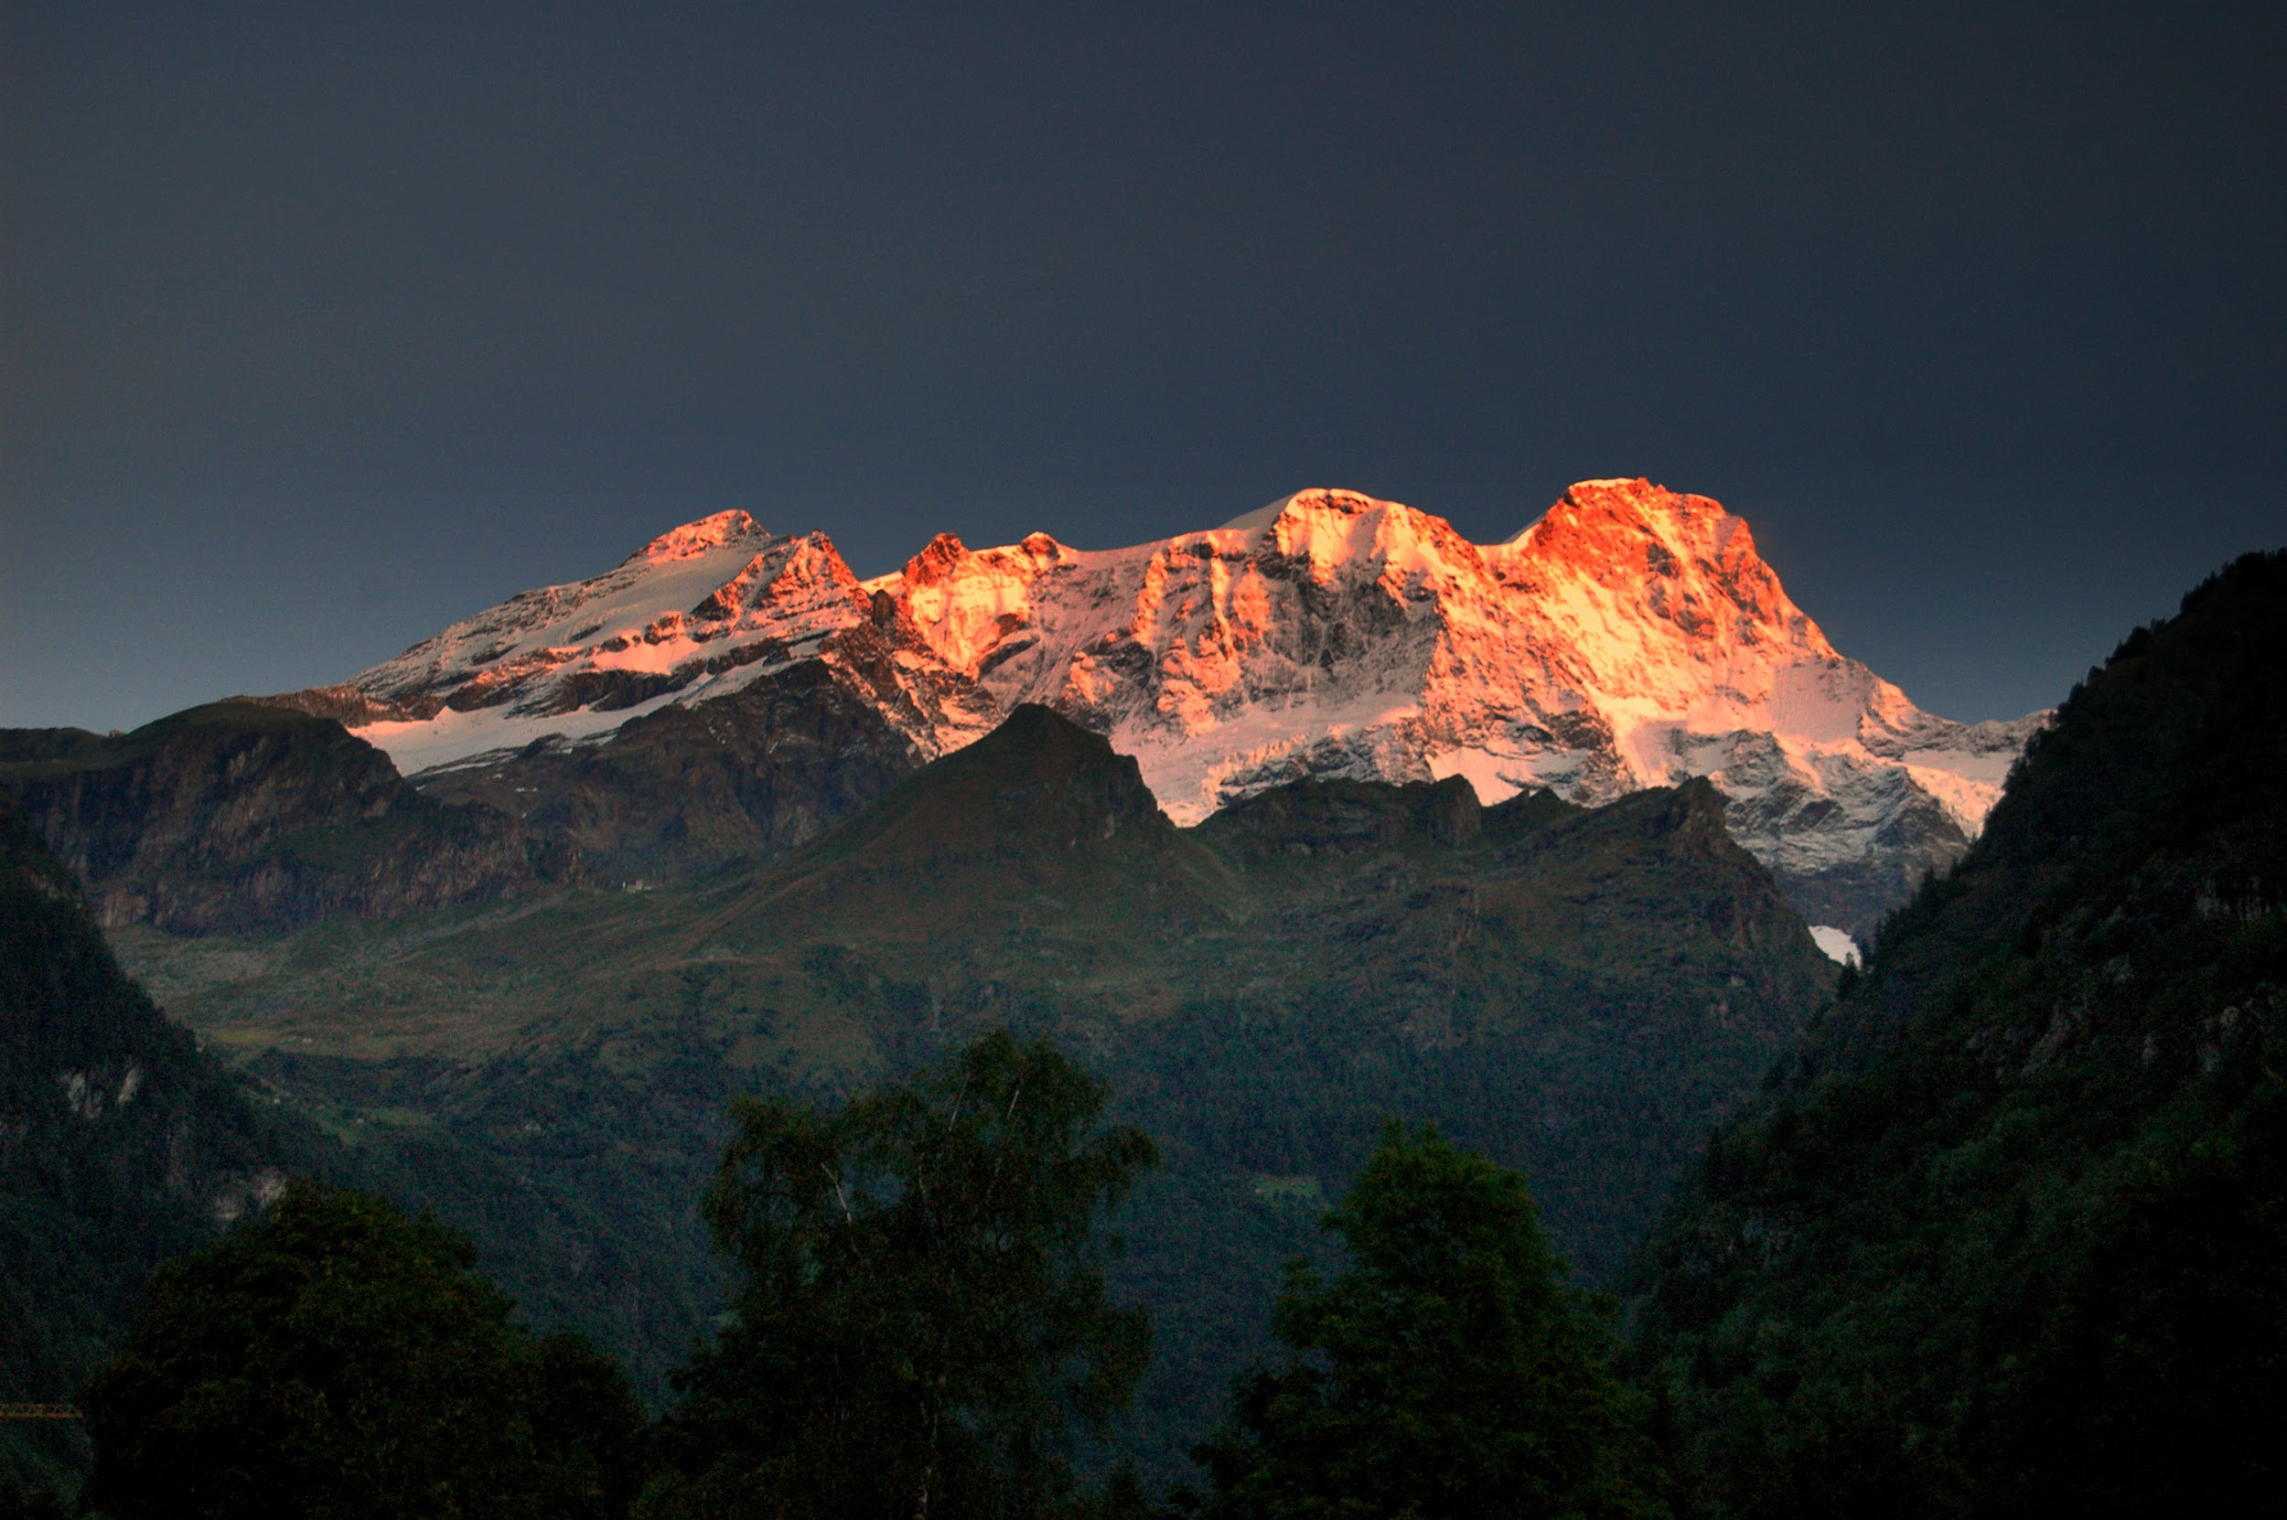
The most important mountains
There are three important mountains in italy. Mont Blanc in France and Italy is the highest mountain in the Alps, with its 4,808.72 meters of altitude it is in the sector of the north-western Alps.
The second mountain is the Pink Mountain, which is the largest mountain in the Alps, the second highest after Mont Blanc, the highest mountain in Switzerland and Piedmont and always belongs to the north-western Alps sector.
Another important mountain is the Cervino, 4,478 meters high and located in the Western Alps along the border between Italy and Switzerland to the west of Pink Mountain. it is also characterized by a pyramid shape.

Slide 9
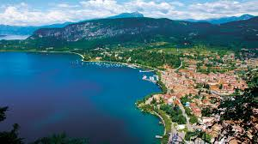
LAKES
In Italy there are a lot of different types of lakes, for example: glacial lakes ( Garda lake, Maggiore lake,Como lake,), volcanic lakes ( Bolsena lake, Bracciano lake), artificial lakes ( Occhito lake, Agnel lake) and coastal lakes (Lesina lake, Sabaudia lake).
Garda lake is the largest Italian lake, it has a surface of ​​370 square km and it streches trough three different regions: Lombardy, Veneto, Trentino-Alto Adige. It’s maximum depth is of 346 meters.It is glacial and its main tributary is the Sarca river.

Slide 10
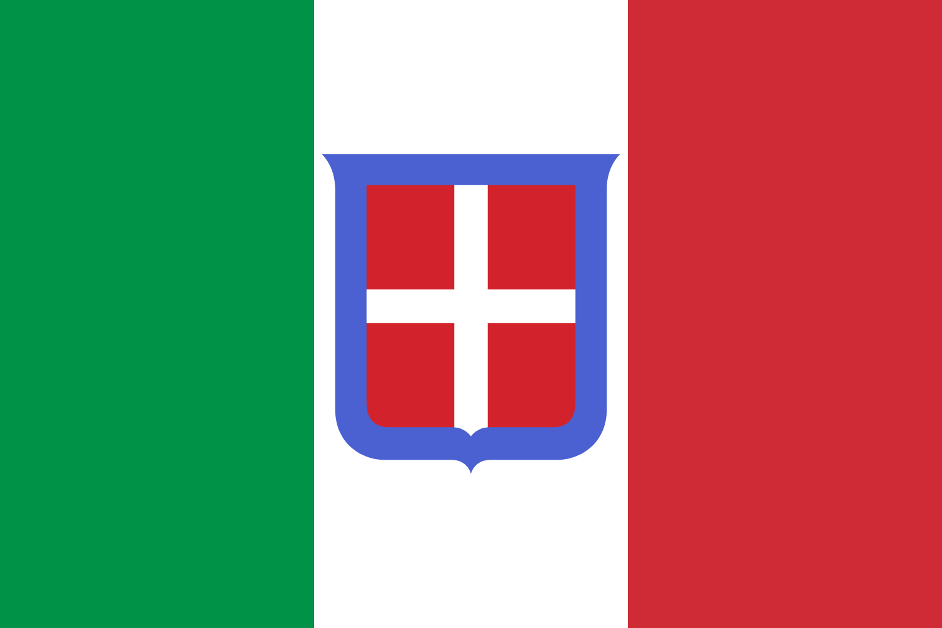
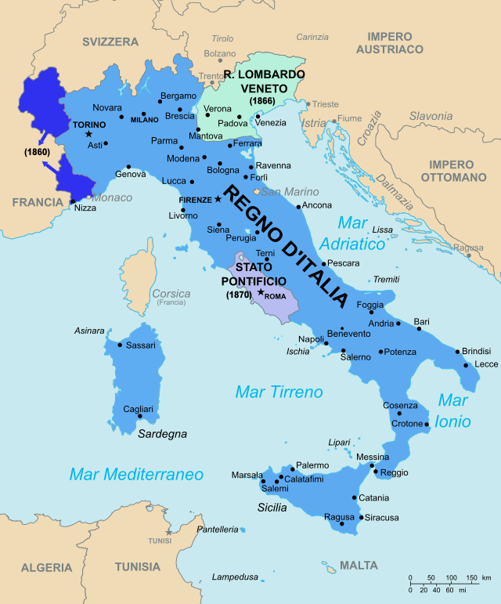
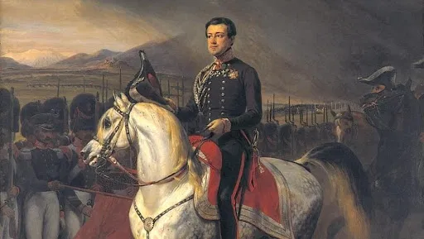
THE ITALIAN HISTORY
The Kingdom of Italy was the Italian state proclaimed on March 17, 1861 during the Risorgimento, following the Second War of Independence.
From 1861 to 1946 it was a constitutional monarchy based on the Albertine Statute, granted in 1848 by Carlo Alberto of Savoy to his subjects of the Kingdom of Sardinia, before abdicating the following year.
In 1946 Italy became a Republic and in the same year it was endowed with a Constituent Assembly.
Following a referendum held on 2 and 3 June, which sanctioned the birth of the Italian Republic, which on 1 January 1948 adopted a new Constitution.

Slide 11
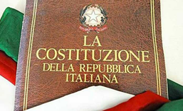
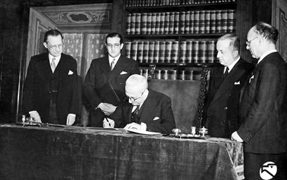
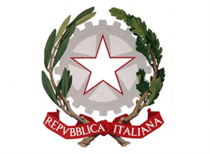
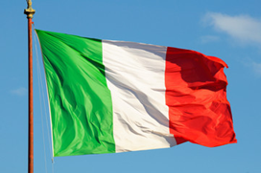
The birth of the Republic and the Italian Constitution
The Italian Republic was born on 2 June 1946. Italian citizens had to decide the form of government: whether to maintain the monarchy or to give birth to the Republic, through an institutional referendum.
This date is important for Italian history because, for the first time, women also participated in the vote, the principle of universal suffrage was implemented.
Two years later, on 1 January 1948, the Italian Constitution came into force. The Constitution is the fundamental Italian law, which indicates the ideals and objectives of our state. It consists of 139 articles.
The first 12 articles express the fundamental principles of the Constitution. The first part lists the rights and duties of citizens and the second part describes the legal system of the Republic.
The symbols of the Italian Republic are:
the emblem, characterized by three elements: the star, the toothed wheel, the olive and oak branches - symbol of: peace, work and strength.
The National Anthem: “Canto Nazionale” was written by poet Goffredo Mameli.
Another symbol of the Italian Republic is the tricolor flag: green, white and red.

