Slide 1
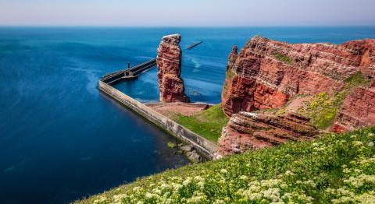
Heligoland
Some information and Sights
BY TIM AND MATHIS

Slide 2
Some information
also called Deät lun
Heligoland is a northsea Island
The Main Island broke 1721 in two parts ( now only the smaller one exist and it‘s 4,2km
Heligoland have 1306 Residents (2017)
Since 1890 it‘s German
Heligoland is a Part of Schleswig–Holstein

Slide 3
Sights
The „Lange Anna“ (it‘s 47 m high, the Stone weight 25 Tons and consists Buntsandstein)
Halunder Jet (Katamaran)
Lots of Gray seals (Kegelrobben)
Lots of lobsters (Hummer)
Many lobsterhouses where they Sell lobsters

Slide 4
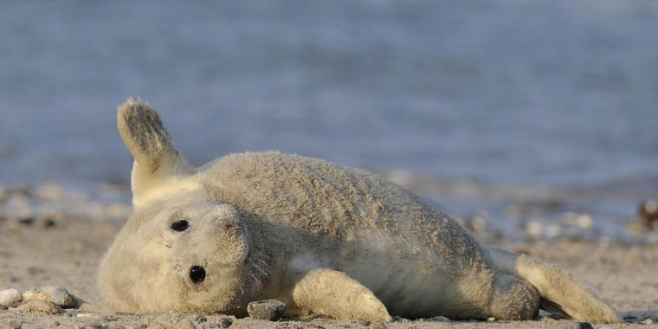
🥳the end🥳

