Slide 1
NETIQUETTE
AND
E-MAILS

Slide 2
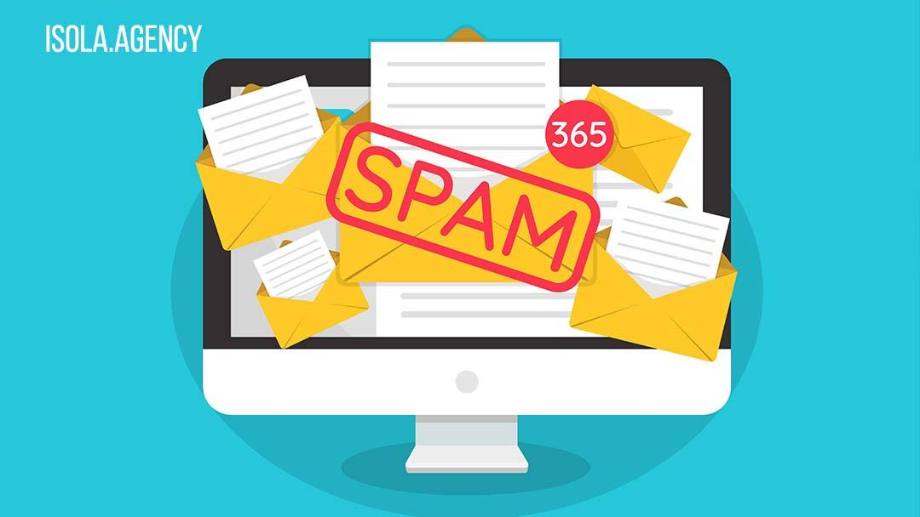
Netiquette
The netiquette is our online behavior. It is important to respect a code online!
- When you are writing an e-mail you need to make a clear and concise message.
- Before sending e-mail you have to check the text, the grammar, and the accuracy.
- It is important to send messages only to people who really need them, to avoid spam.

Slide 3
Tips for using E-mails correctly
- It is important to avoid useless e-mails to spare time.
Urgent e- mails Mark them priority.
- Choose who you want to send e-mails to.

Slide 4
Be careful!
In conclusion…
Remember to send emails only to people who really need them.
Every time you write an email check the text and correct the mistakes.
Bibliography: Philippa Bowen et al., “Business Plan - Companion book”, Dea Scuola
Sitography: https://dictionary.cambridge.org/dictionary/english/netiquette

Slide 5
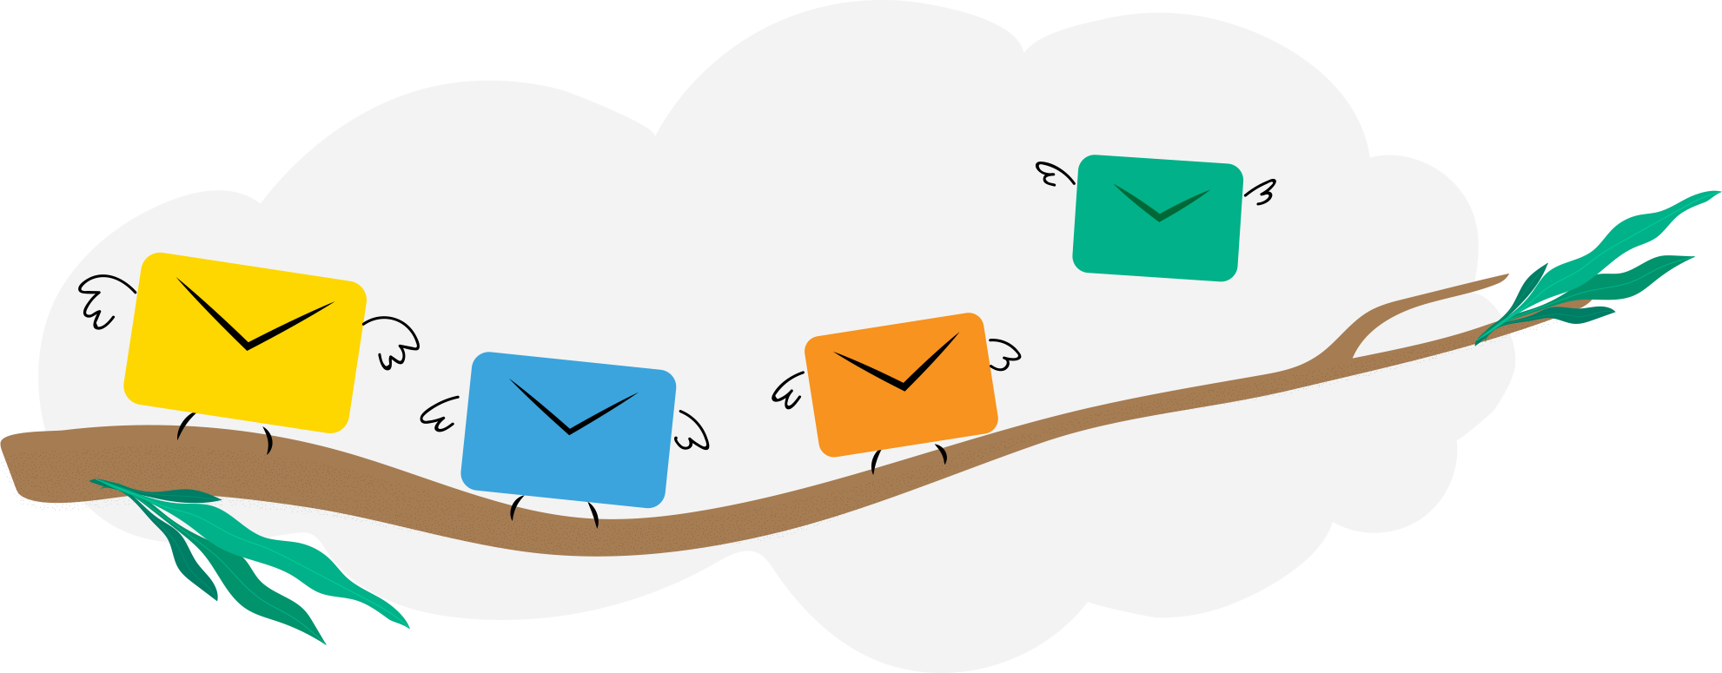
THANK YOU VERY MUCH FOR WATCHING OUR POWERPOINT
Presentation by The Green Team: Nicola Deleonardis, Diego Favretti, Filippo Ferrozzi, Edoardo Ionita and Ivano Festa.

