Slide 1
The Green Team,L.Ariosto.
Facilitator: Giulia Fedozzi
Diego Favretti,Deleonardis Nicola,Dalle Rive Vanessa,Mariasole Fantin,Carlotta Ghedini, Ionita Edoardo,Festa Ivano,Marco Gallucci ,Diego dalla Muta, Mariavittoria Dobori, Filippo Ferrozzi.

Slide 2
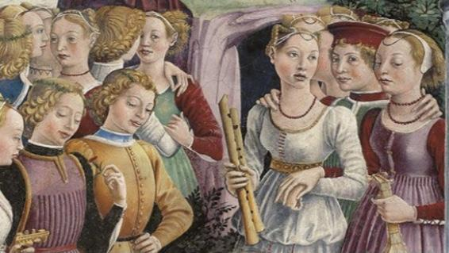
Story,origins and name of the city.
Life in the Middle Ages.
The Este Family-a dominant and important family. The Duchess Lucrezia Borgia and Alfonso.
Ercole II and the French princess Renata of France.

Slide 3
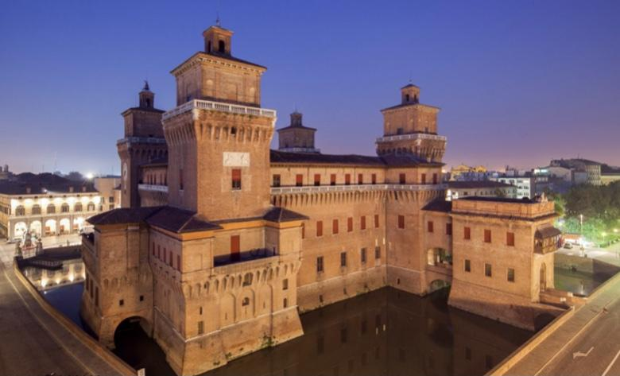
The Estense Castle.
The Estense Castle or Castle of San Michele, is the most representative monument of the city of Ferrara.
The first stone was symbolically laid on Septemper 29, St.Michael’s day.
The work was commissioned to the architect Bartolini da Novara.

Slide 4
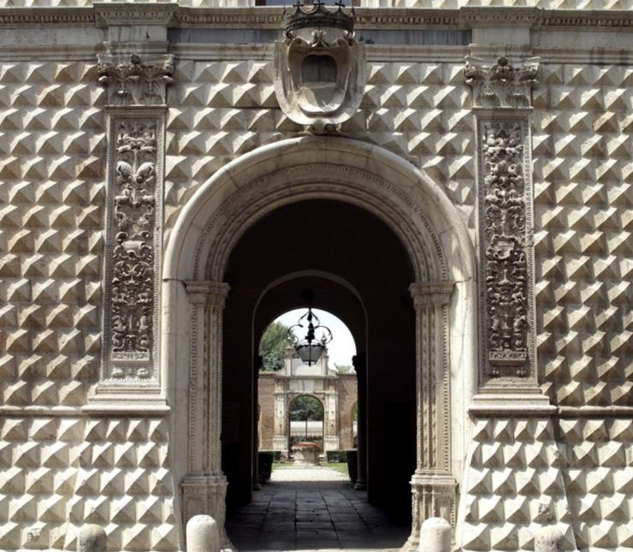
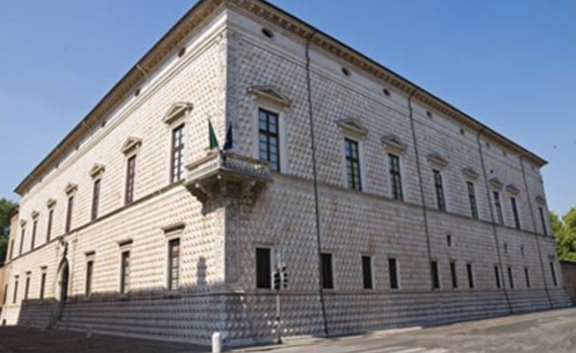
The Palace of Diamonds.
8,500 blocks of white and pink marble.
Designed by Biagio Rossetti.
The palace was built for Sigismondo d’Este brother of Duke Ercole I D’Este,starting from 1492 in the Quadrivio degli Angeli and constitutes the ideal center of the “Addizione Erculea”.
In 1944 a bombing demaged the building.
Now there are important temporary exhibitions.
This palace holds a legend of a important hidden diamond.

Slide 5
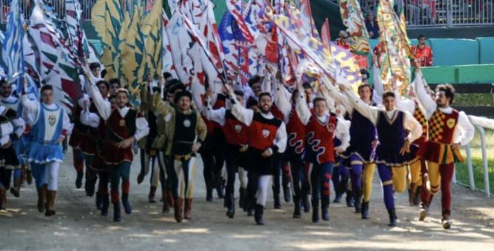
The Palio of Ferrara Ferrara’s Palio
The Palio is the oldest in the world and the first is held in 1259.
It was institutionalised in 1279.
It was held twice a year on April 23 and August 15, now only the last Sunday in May.
The winning jockey won a Palio (piece of fine fabric),second a porchetta and third a rooster.
Today there are four Palio that take place in Piazza Ariostea: the race of the putte, the race of putti,the donkey race and the horse race.
There are also flag-wavers and musicians competitions.
We ran along the Via Grande starting from the town of appoppa up to the current acqueduct,now we run in Piazza Ariostea.
All costumes are made with the style of the time.

Slide 6
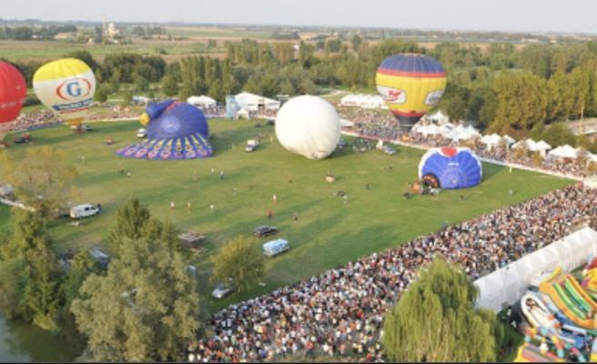
Ferrara Baloons festival
It’s the most important hot air balloon festival in Italy.
In 2012 it attracted 120,000 tourists.
The Festival takes place in an extended area of the Urban Park in September.

Slide 7
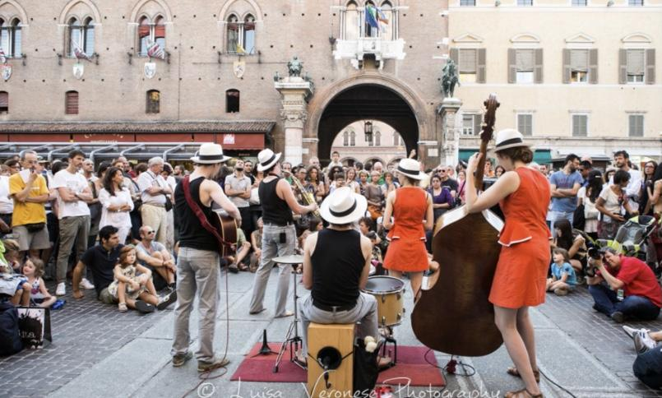
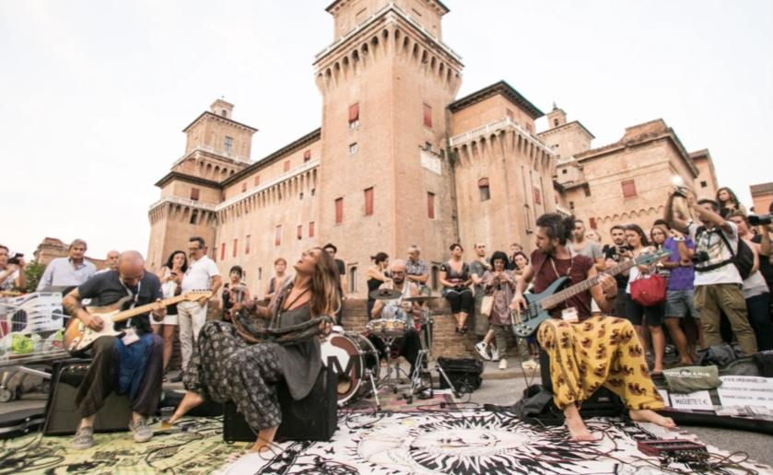
Ferrara Buskers Festival
This Festival is one of the major events dedicated to street music in the world.
It takes place at the end of August.
The busker is an artist who does not receive any cachet but his only gain is what the public gives in the hat.

Slide 8
Sitography.
www.ferraraterraeacqua.it
www.Wikipedia.it
www.turismo.it
www.homepalazzodeidiamanti.it
www.ilturista.it
www.paliodiferrara.it

