Slide 1
ONLINE SHOPPING
Blue team
Luigi Magri, Emma Mainardi, Federico Melandri,
Mohammadi Eman, Micai Nicolò, Scotto Ettore
IT ALLOWS PEOPLE TO BUY GOODS DIRECTLY OVER THE INTERNET USING A WEB BROWSER OR A MOBILE APP.

Slide 2
ONLINE SHOPPING
Amazon: how it all started
Amazon.com started in 1995
It became popular and successful in 10 years.
Now it has 150 million customers.

Slide 3
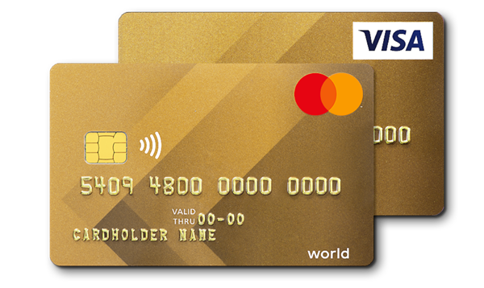
ONLINE SHOPPING
At the beginning people didn’t trust buying online:
They didn’t trust online payments
They couldn’t check the quality of the goods
But, when you buy something, you can check it.
If you don’t like it, you can return it!

Slide 4
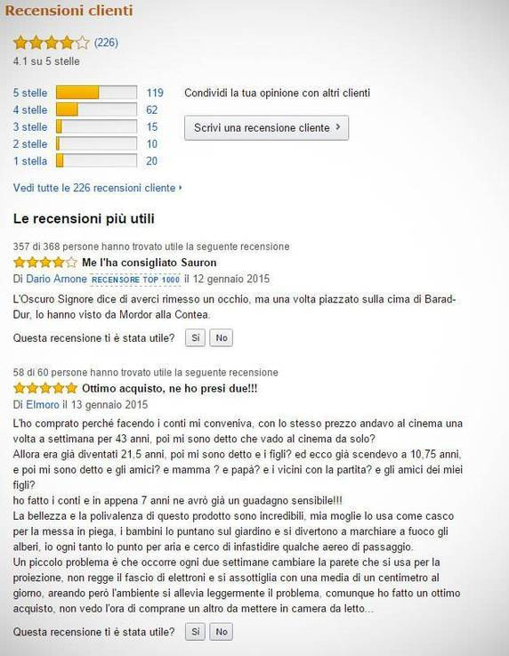
ONLINE SHOPPING
A world-wide business now
People check and trust online reviews.
Now companies appreciate the power of good reviews
Shopping online is a huge business now

Slide 5
Bibliography and sitography:
Philippa Bowen et al.,“Business Plan Companion Book”, Dea Scuola;
https://en.wikipedia.org/wiki/Online_shopping

