Slide 1
GERMANY
Se biutifullest kantry in se wörld

Slide 2
Structure
General information
Greatest sights
History

Slide 3
General information
GERMANY HAS:
AN AREA OF 357,386 KM
83,02 MIL. INHABITANTS
237 INHABITANTS PER KM
THE CAPITAL IS BERLIN ( WITH 3,664,826 RESIDENTS, IT IS ALSO THE BIGGEST CITY IN GERMANY)

Slide 4
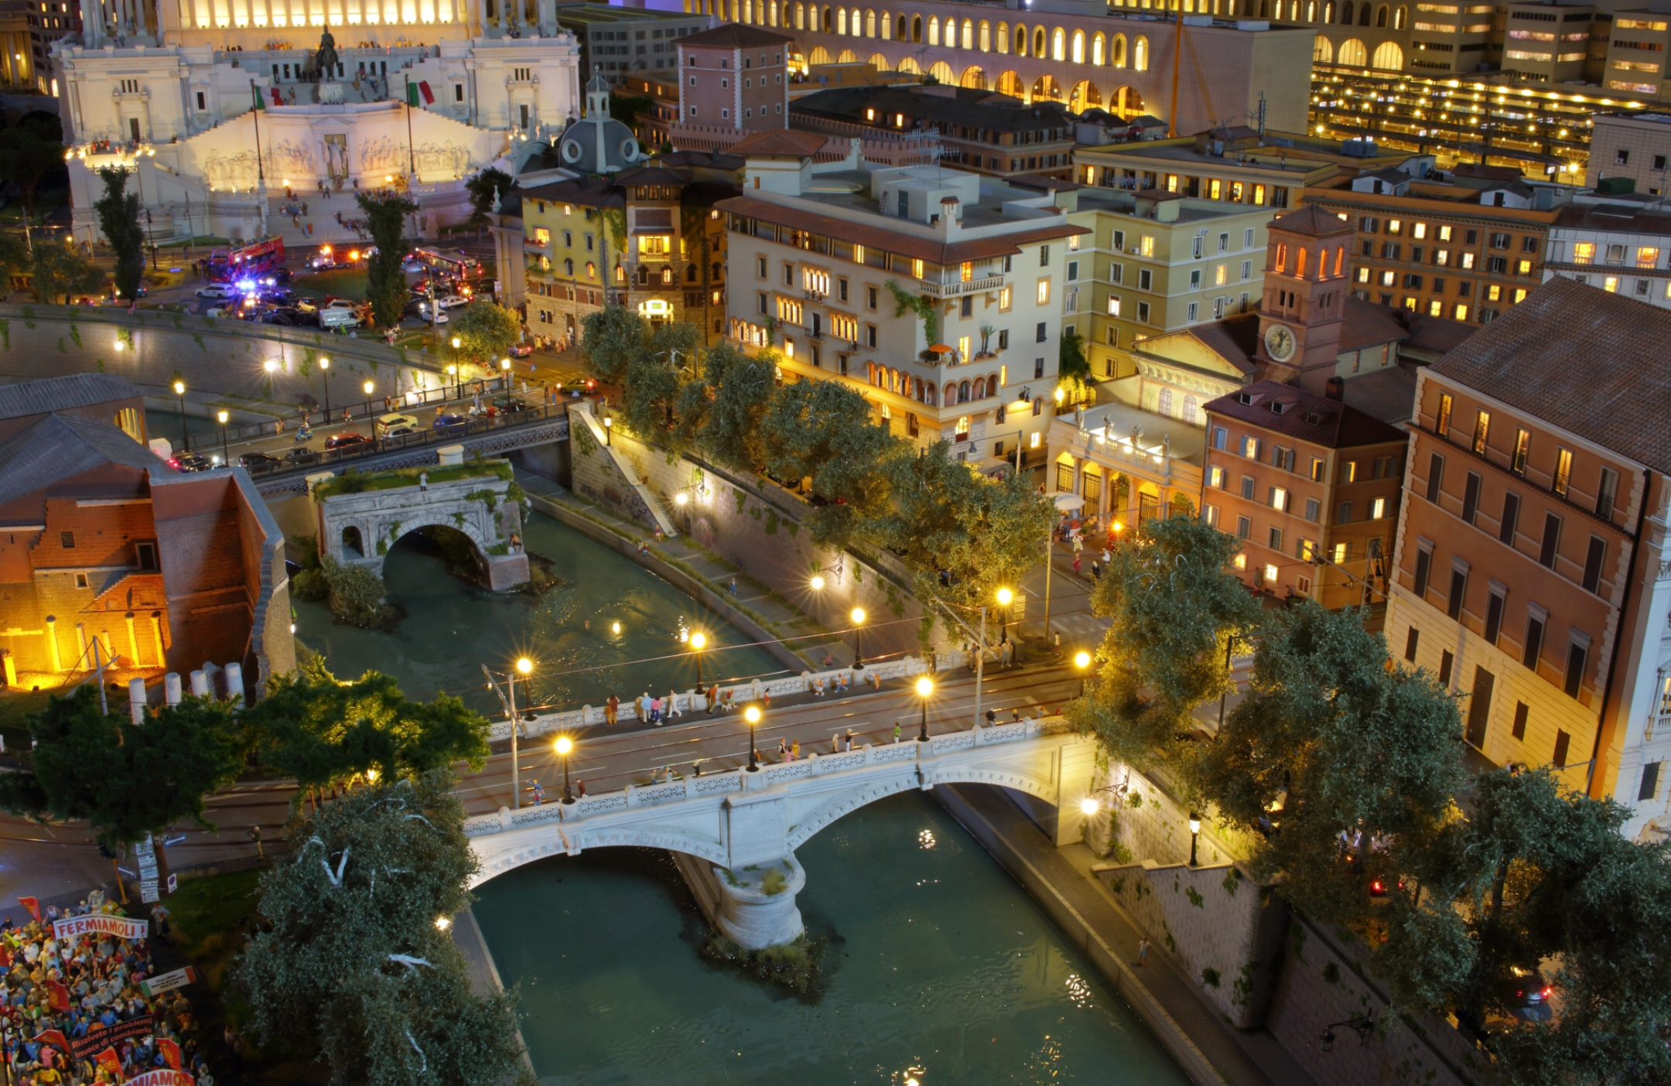
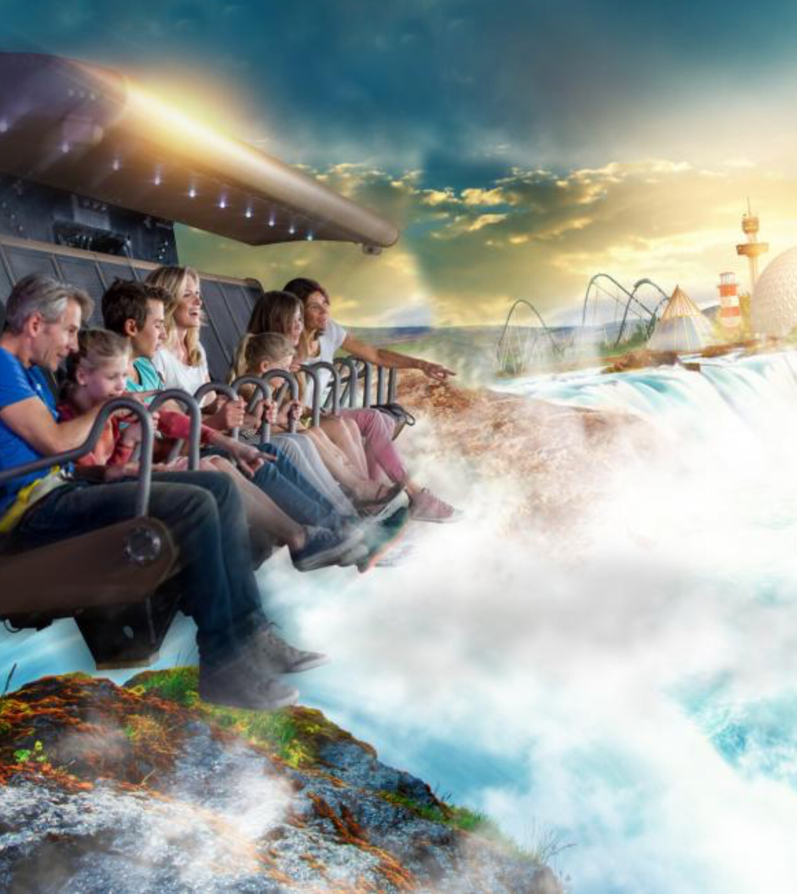
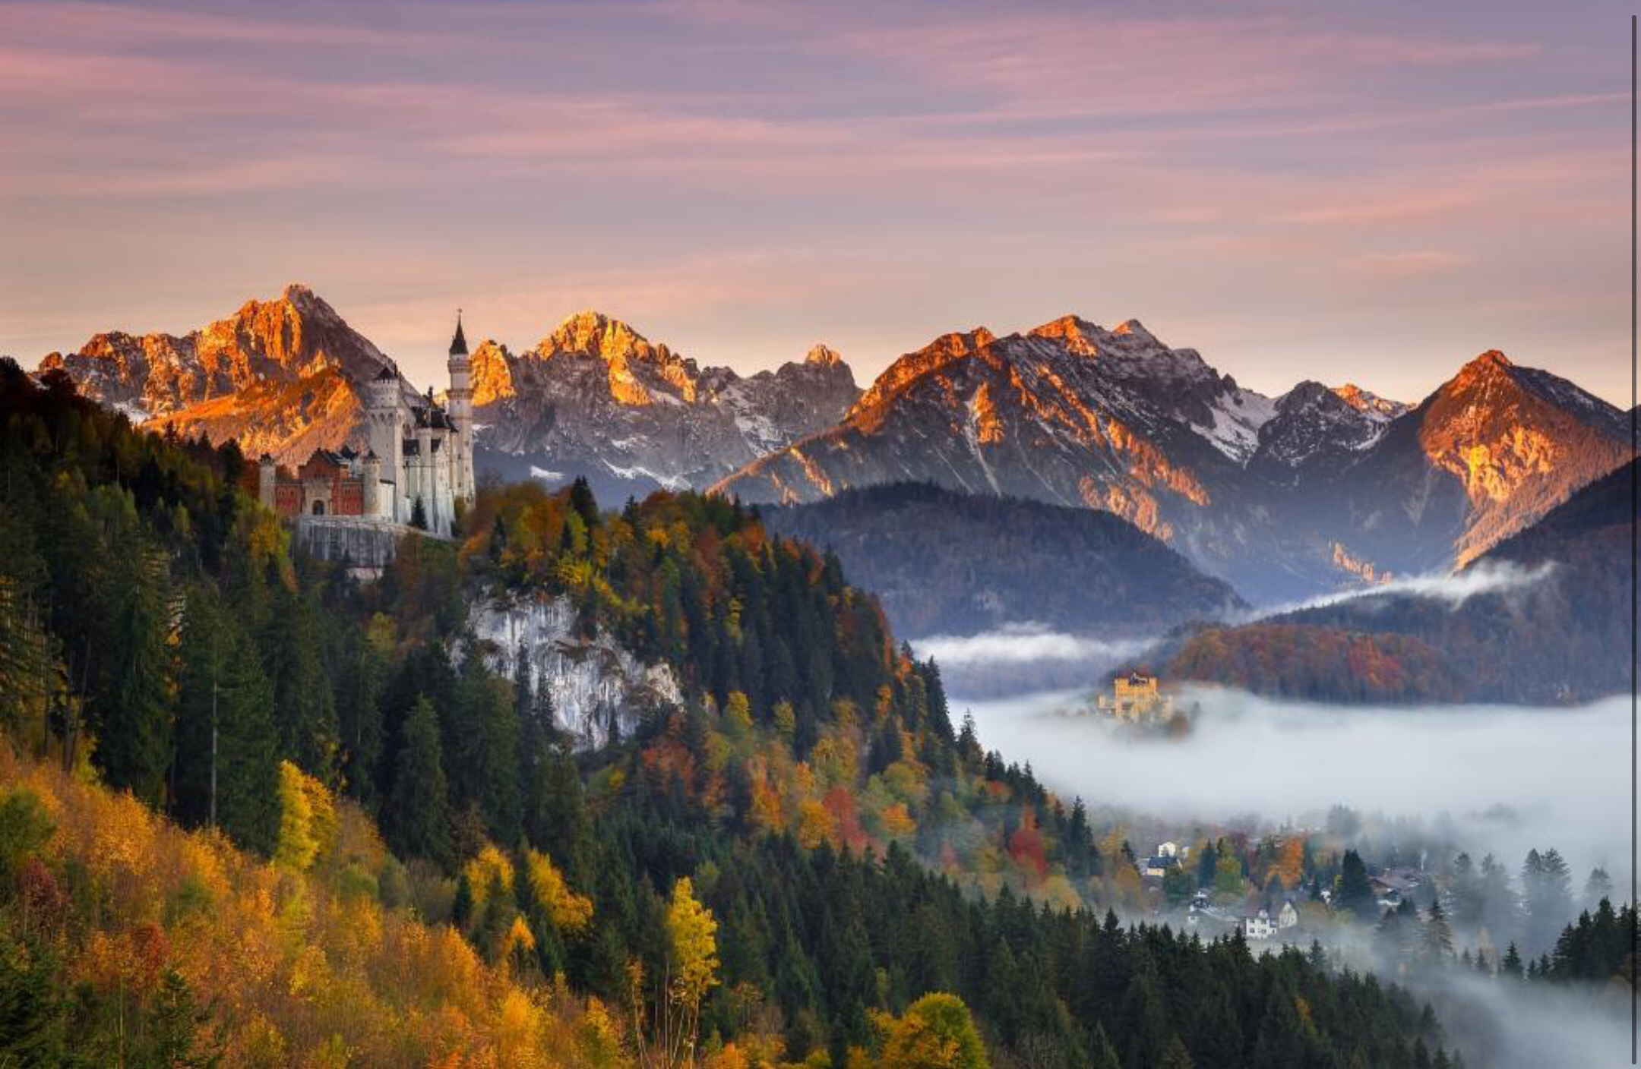
Greatest sights
1. THE MINIAUTUR WUNDERLAND HAMBURG
2. THE EUROPA-PARK
3. SCHLOSS NEUSCHWANSTEIN
4. INSEL MAINAU
5. ROTHENBURG OB DER DER TAUBER
6. DRESDEN
7.HEIDELBERG
8. PHANTASIALAND
9. TIERPARK HELLABRUNN
10. MOSELTAL

Slide 5
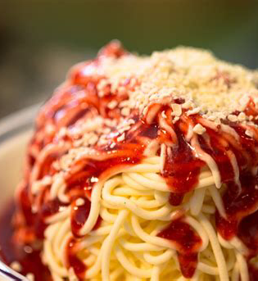
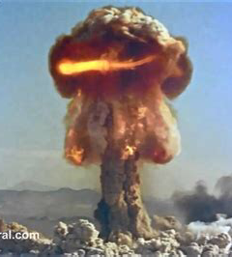
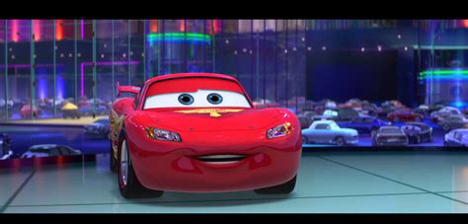
HISTORY
In Germanyˋs past, it was split into East Germany (GDR) and West Germany (FRG)
Germany started the two worldwars and lost both of them
We invented lots of things (see pics)

