Slide 1
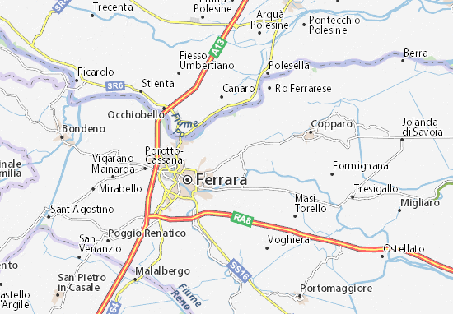
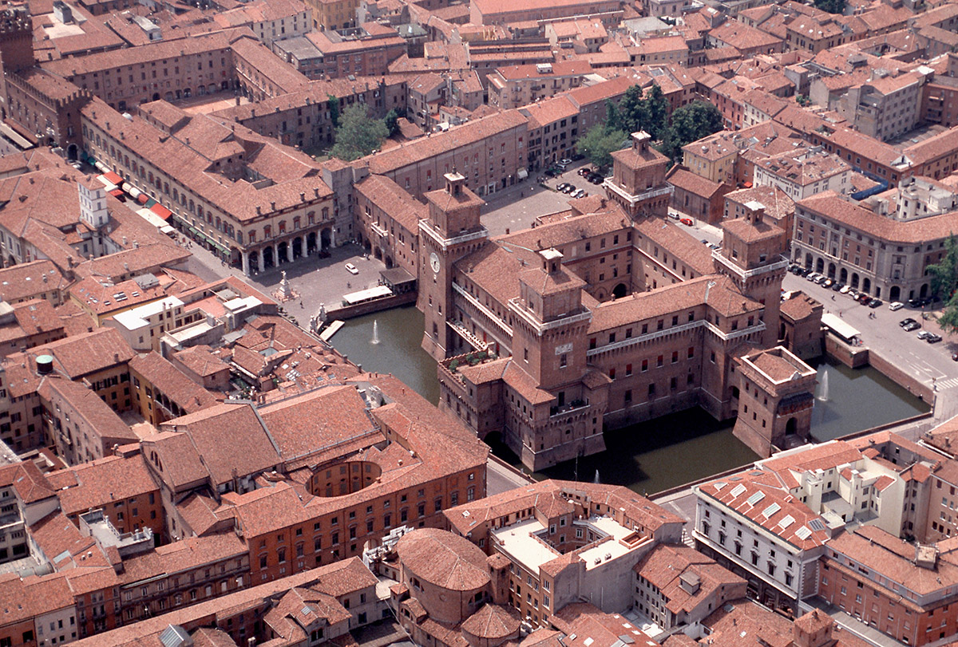
Ferrara’s geography
By: Luca Benazzi, Luca Borghetti, Vittoria Bernini, Francesco Bottura, Giacomo Vallieri, Lorenzo Andreoli, Giulia Aguiari, Giulia Consolini, Sara De Biaggi.

Slide 2
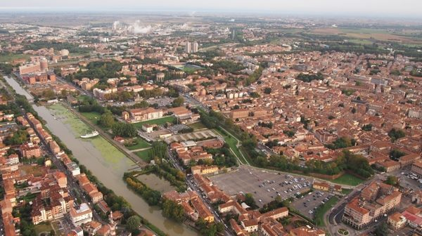
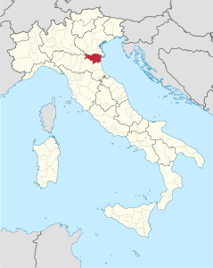
Location and territory of Ferrara
The province of Ferrara, located in northern Italy, extends itself from the Panaro river to the Adriatic Sea, limited to the north by the Po and to the south by the Reno. It is a wonderful territory full of plains and canals.

Slide 3
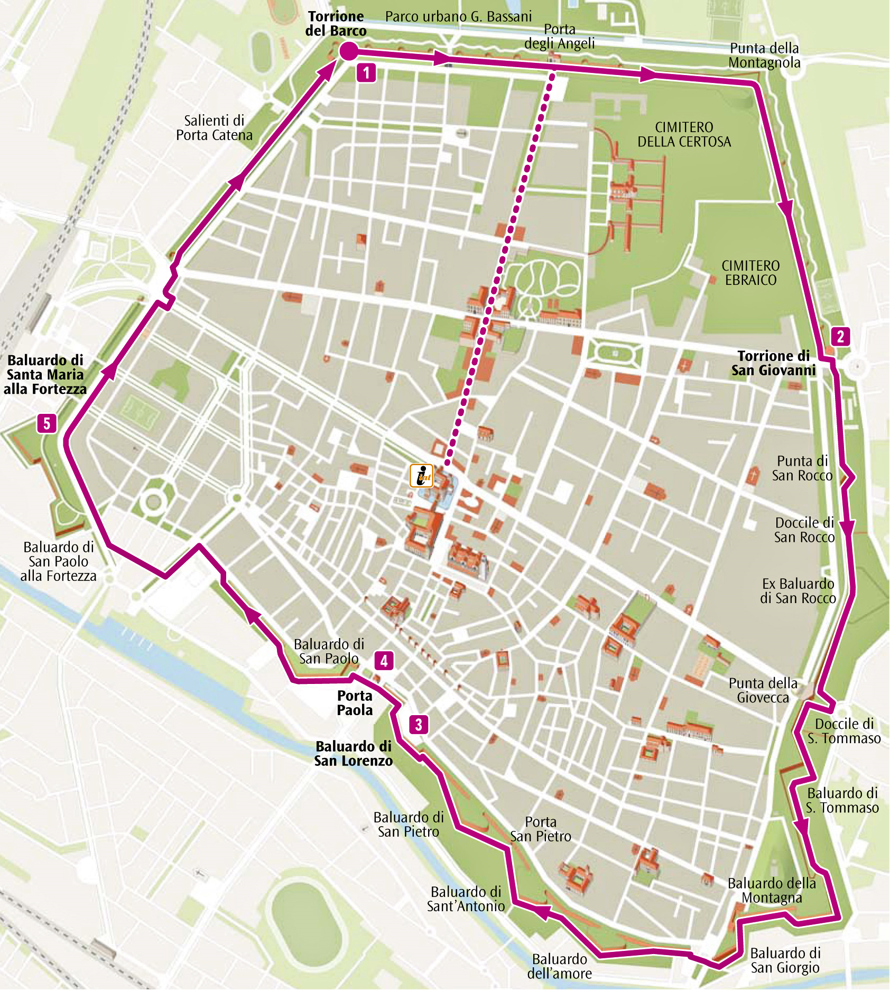
Plant of the city of Ferrara
The plant of Ferrara was inspired by the Roman model and foresees a road axis that started from the Estense Castle and reaches the Porta degli Angeli and another that connected the two main gates of the city, the Porta a Mare and the Porta a Po.
Important urban changes, especially after the Second World War, led to the growth of many neighborhoods outside the city walls. The city can be divided into two distinct parts across the border line by the road axis of corso della Giovecca and viale Cavour.
The province of Ferrara includes 21 municipalities and 344 840 residents.

Slide 4
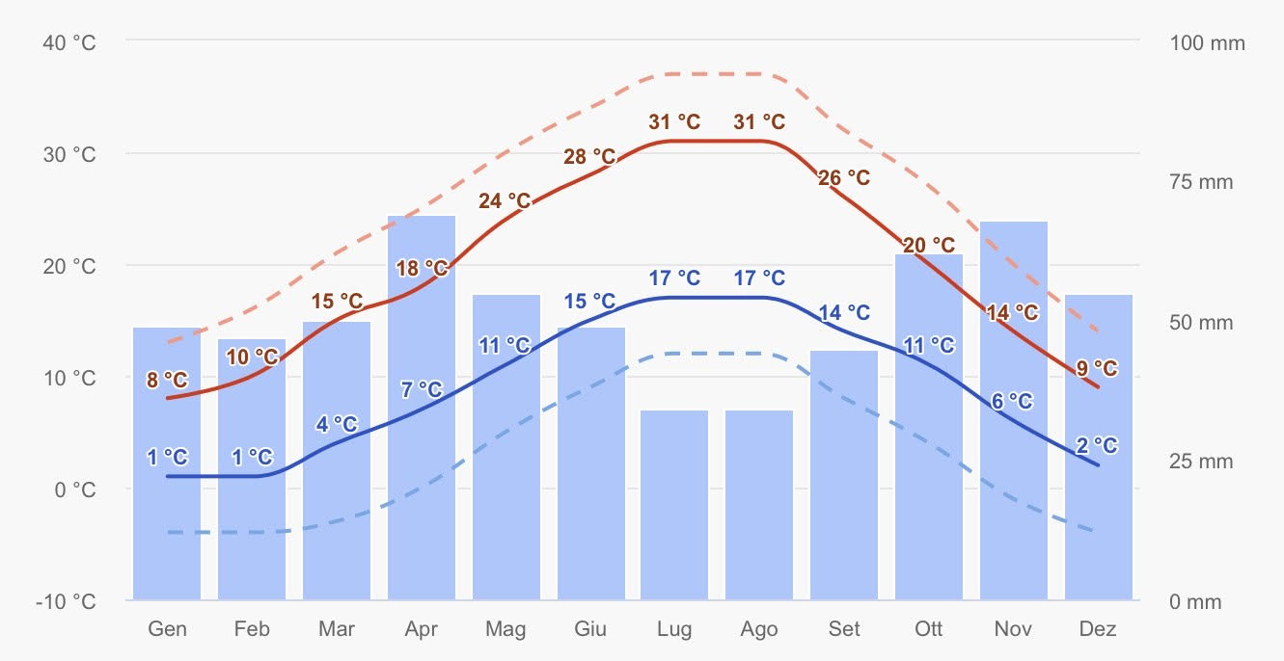
The climate of Ferrara
The solid red line shows the average maximum daily temperature for each month in Ferrara. Likewise, the solid blue line indicates the average minimum temperature. Warm days and cold nights (dashed red and blue lines) show the average of the hottest day and coldest night of each month for the past 30 years. Monthly rainfall above 150 mm indicates very humid months, below 30mm largely dry.

Slide 5
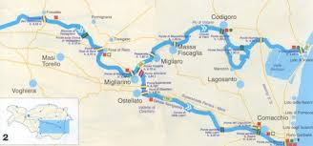
Hydrography of Ferrara
The Po is the most important river in the province of Ferrara, it is split into three different parts the Po of Volano, the Po of Goro and the Po of Primaro.

Slide 6
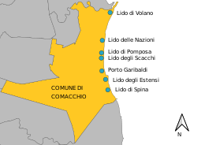
Shores of Comacchio
The more important shores of Ferrara are Garibaldi, Volano, Nazioni, Pomposa, Estensi, Spina and Scacchi. The shores of Comacchio are tourist locations, because there are a lot of beaches and campings

Slide 7
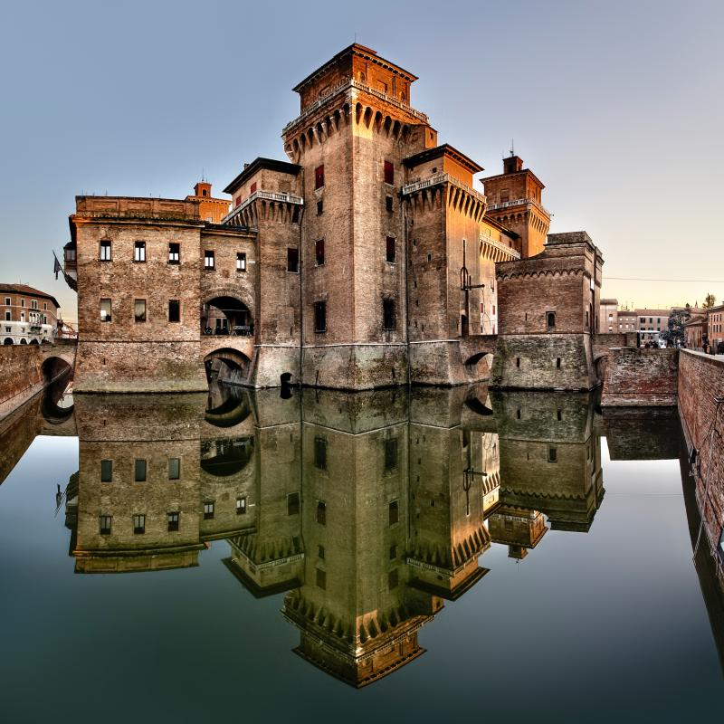
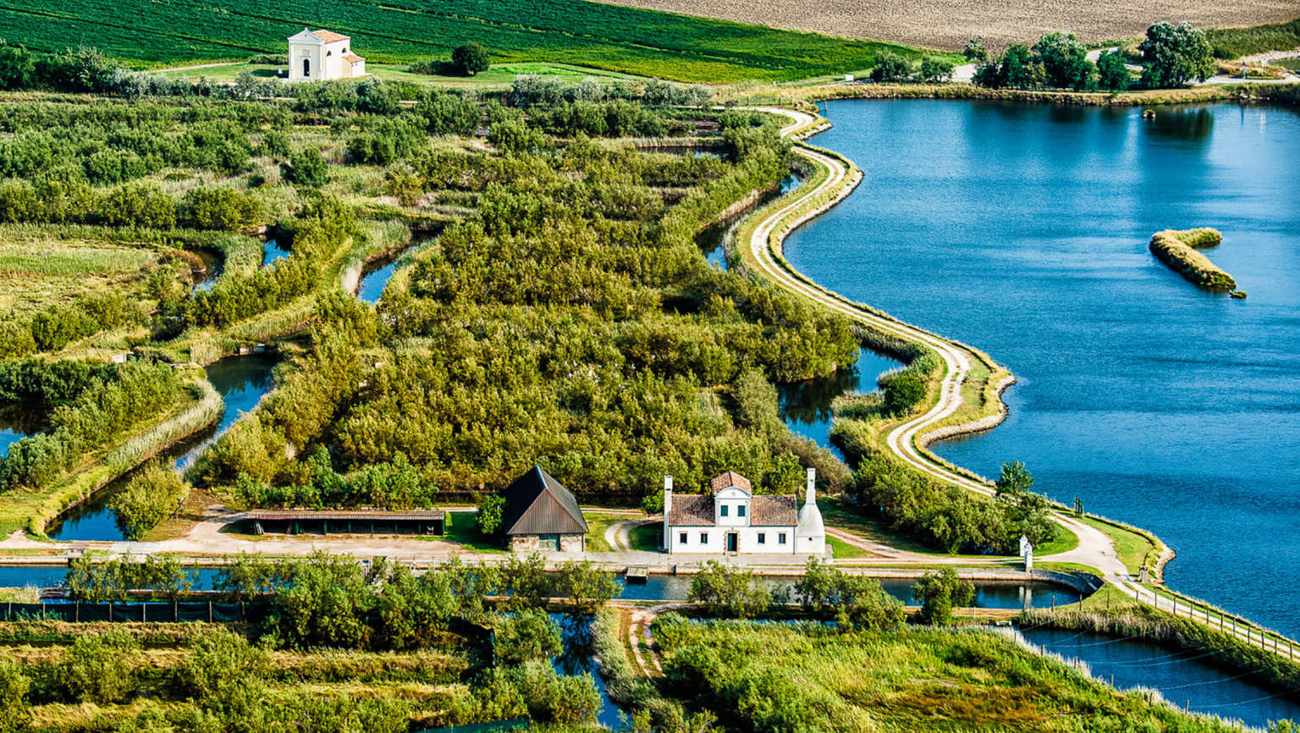
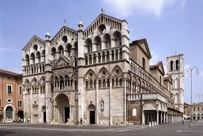
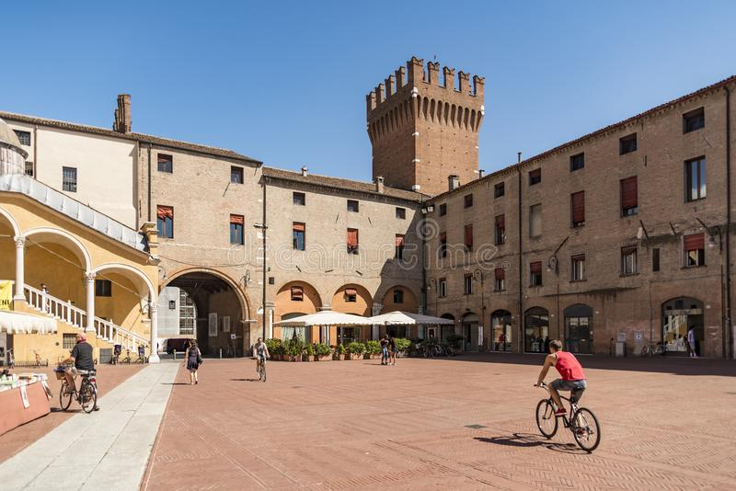
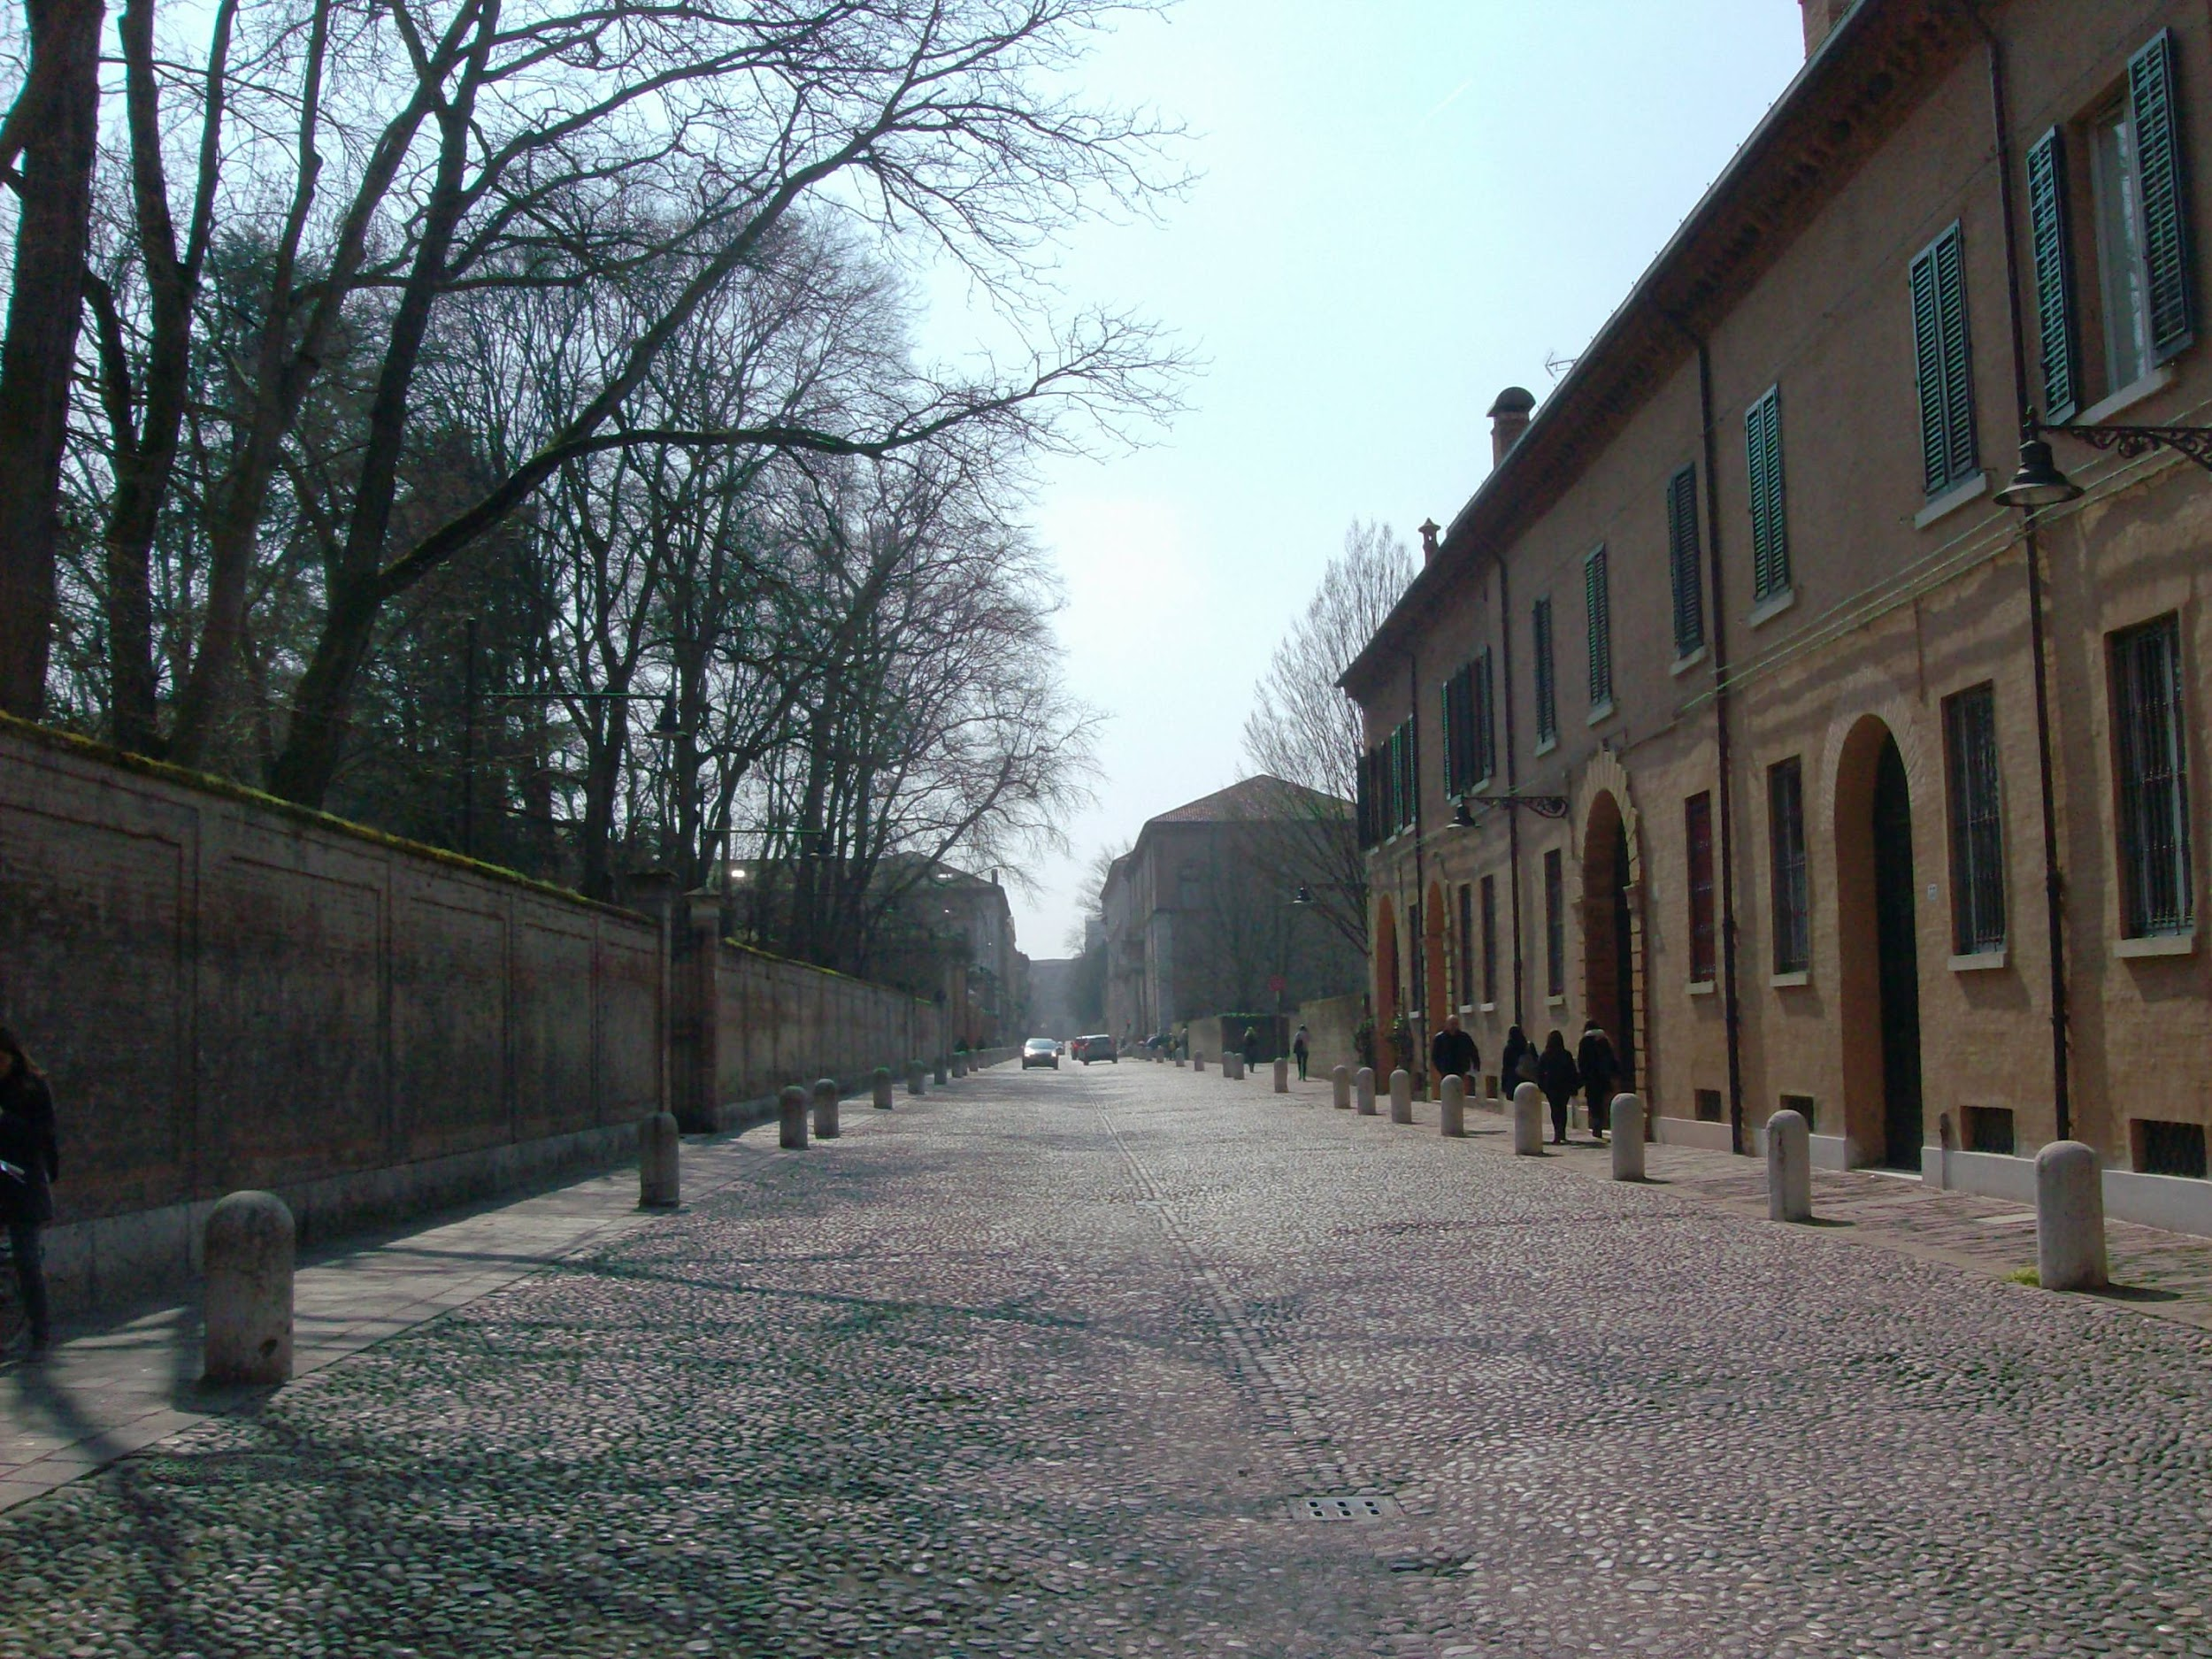
UNESCO
Ferrara is a UNESCO heritage city. The best places to visit considered UNESCO heritage are:
-the Estense castle;
-the Po delta;
-the Cathedral of San Giorgio;
-the Municipal Buildings;
-Schifanoia Palace;
-Corso Ercole d’Este.
Estense castle
the Po delta
Cathedral of San Giorgio
Municipal building
Corso Ercole d’Este
Schifanoia Palace

Slide 8
Sitography
https://it.wikipedia.org/wiki/Castello_Estense
http://www.unesco.it/it/RiserveBiosfera/Detail/95
https://it.wikipedia.org/wiki/Cattedrale_di_San_Giorgio_(Ferrara)
https://www.ferraraterraeacqua.it/it/ferrara/scopri-il-territorio/arte-e-cultura/ville-dimore-teatri-storici/palazzo-municipale
https://www.ferraraterraeacqua.it/en/ferrara/discover-the-area/art-and-culture/villas-historical-residences-and-theatres/palazzo-schifanoia
https://www.ferraraterraeacqua.it/it/ferrara/scopri-il-territorio/arte-e-cultura/piazze-logge-vie-storiche/corso-ercole-i-deste
Clima Ferrara - meteobluewww.meteoblue.com › tempo › ferrara_italia_3177090

