Slide 1
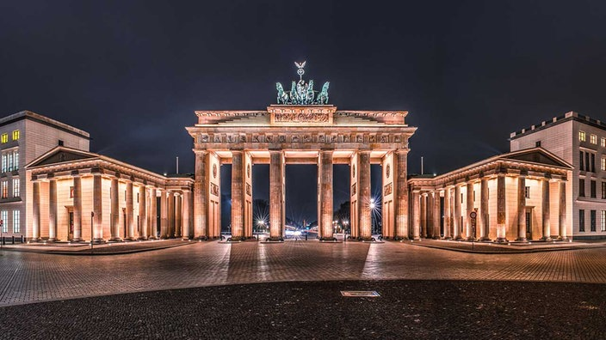
Germany

Slide 2
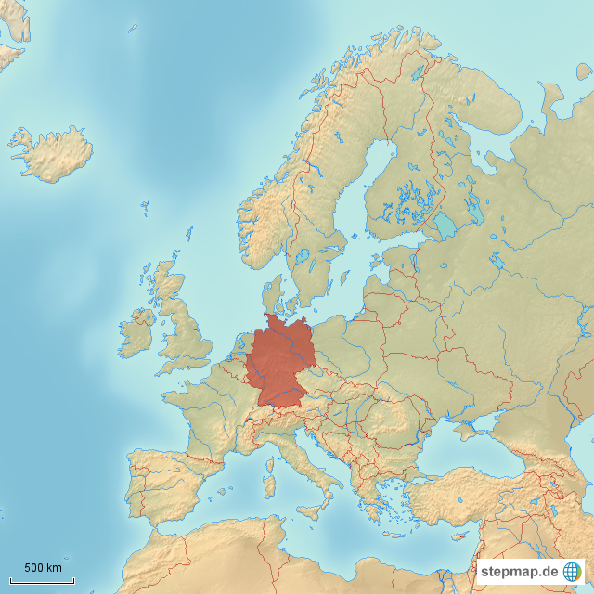
Germany in Europe

Slide 3
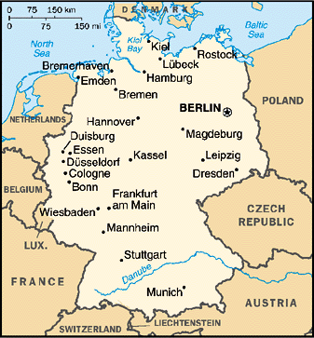

Slide 4
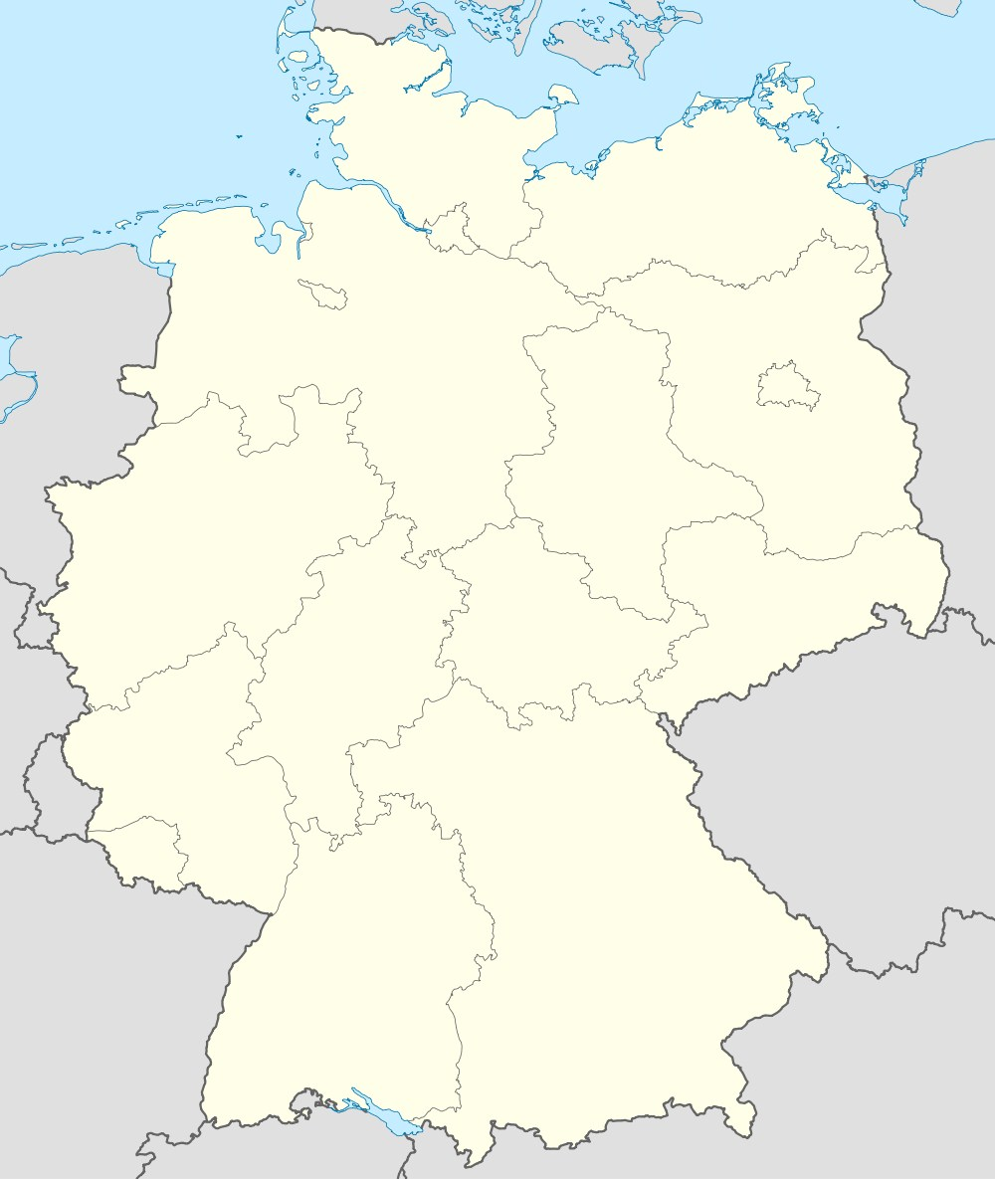
The 16 federal states

Slide 5
Bavaria

Slide 6
Bavaria
Baden-Wurttemberg

Slide 7
Saarland
Bavaria
Baden-Wurttemberg

Slide 8
Rheinland-Pfalz
Saarland
Bavaria
Baden-Wurttemberg

Slide 9
Hess
Rheinland-Pfalz
Saarland
Bavaria
Baden-Wurttemberg

Slide 10
Thuringia
Hess
Rheinland-Pfalz
Saarland
Bavaria
Baden-Wurttemberg

Slide 11
Saxony
Thuringia
Hess
Rheinland-Pfalz
Saarland
Bavaria
Baden-Wurttemberg

Slide 12
Saxony-
Anhalt
Saxony
Thuringia
Hess
Rheinland-Pfalz
Saarland
Bavaria
Baden-Wurttemberg

Slide 13
Saxony-
Anhalt
North Rhine-
Westphalia
Saxony
Thuringia
Hess
Rheinland-Pfalz
Saarland
Bavaria
Baden-Wurttemberg

Slide 14
Lower Saxony
Saxony-
Anhalt
North Rhine-
Westphalia
Saxony
Thuringia
Hess
Rheinland-Pfalz
Saarland
Bavaria
Baden-Wurttemberg

Slide 15
Lower Saxony
Saxony-
Anhalt
Brandenburg
North Rhine-
Westphalia
Saxony
Thuringia
Hess
Rheinland-Pfalz
Saarland
Bavaria
Baden-Wurttemberg

Slide 16
Lower Saxony
Berlin
Saxony-
Anhalt
Brandenburg
North Rhine-
Westphalia
Saxony
Thuringia
Hess
Rheinland-Pfalz
Saarland
Bavaria
Baden-Wurttemberg

Slide 17
Bremen
Lower Saxony
Berlin
Saxony-
Anhalt
Brandenburg
North Rhine-
Westphalia
Saxony
Thuringia
Hess
Rheinland-Pfalz
Saarland
Bavaria
Baden-Wurttemberg

Slide 18
Mecklenburg-
Vorpommern
Bremen
Lower Saxony
Berlin
Saxony-
Anhalt
Brandenburg
North Rhine-
Westphalia
Saxony
Thuringia
Hess
Rheinland-Pfalz
Saarland
Bavaria
Baden-Wurttemberg

Slide 19
Mecklenburg-
Vorpommern
Bremen
Hamburg
Lower Saxony
Berlin
Saxony-
Anhalt
Brandenburg
North Rhine-
Westphalia
Saxony
Thuringia
Hess
Rheinland-Pfalz
Saarland
Bavaria
Baden-Wurttemberg

Slide 20
Schleswig-Holstein
Mecklenburg-
Vorpommern
Bremen
Hamburg
Lower Saxony
Berlin
Saxony-
Anhalt
Brandenburg
North Rhine-
Westphalia
Saxony
Thuringia
Hess
Rheinland-Pfalz
Saarland
Bavaria
Baden-Wurttemberg

Slide 21
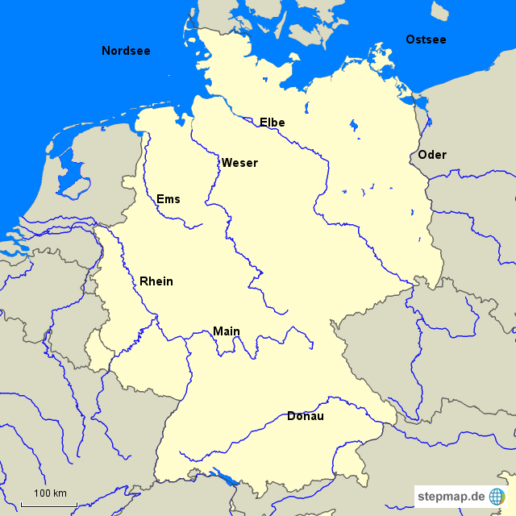

Slide 22
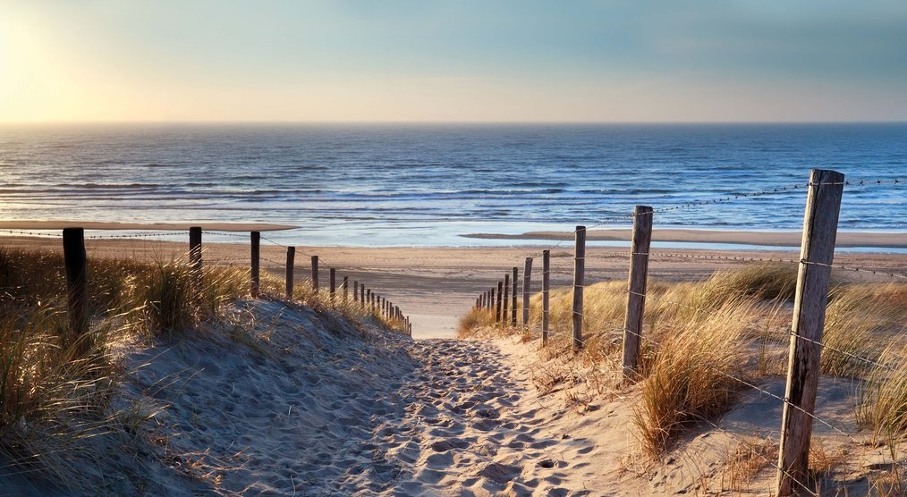
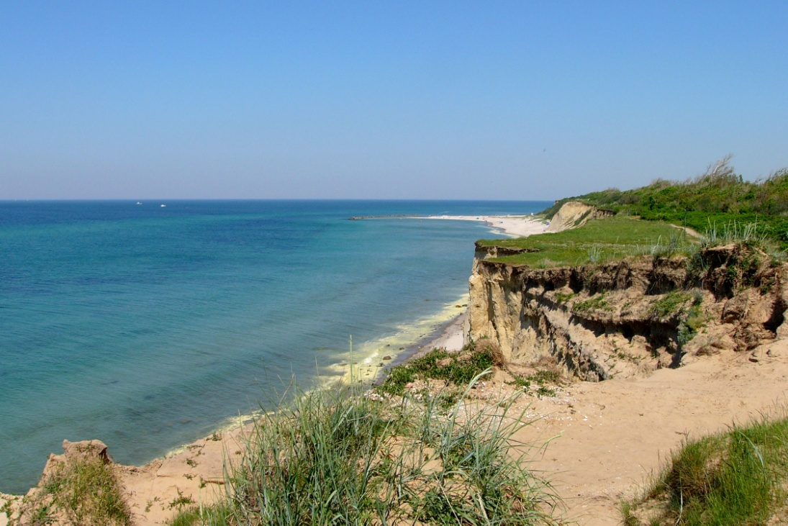
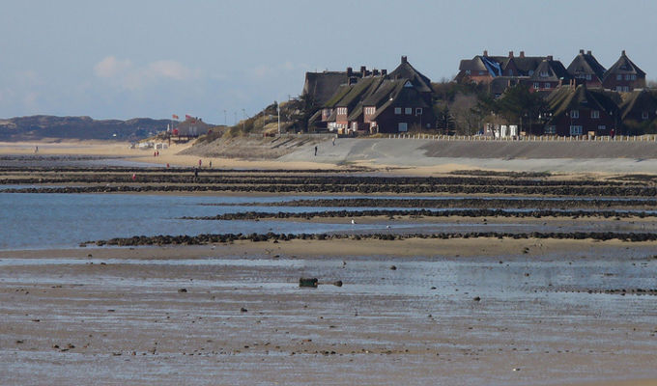
North Sea
Mud flat
Baltic Sea

Slide 23
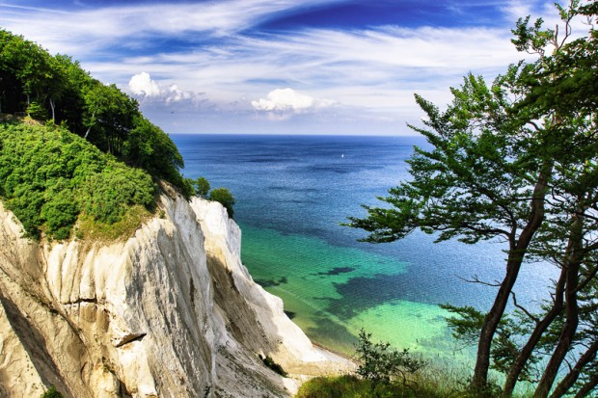
Chalk cliffs at Rügen

Slide 24
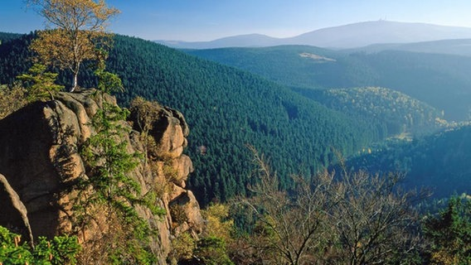
Harz

Slide 25
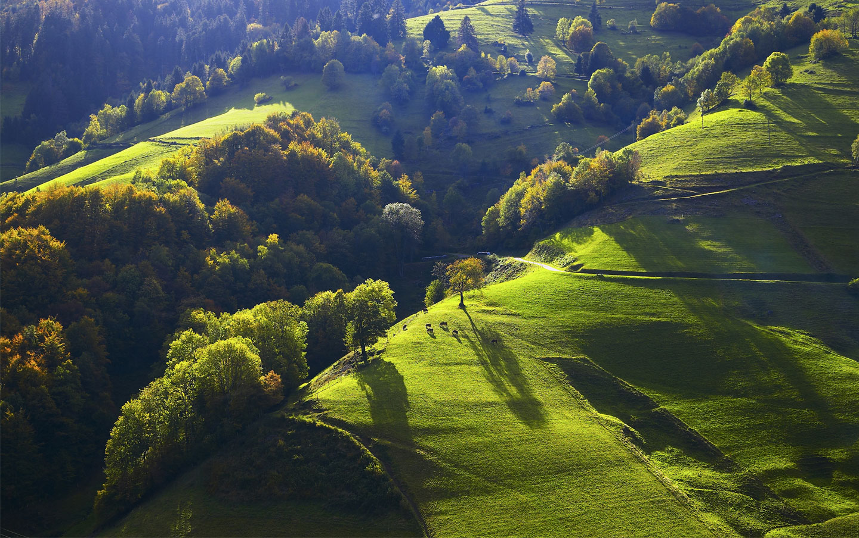
Black forest

Slide 26
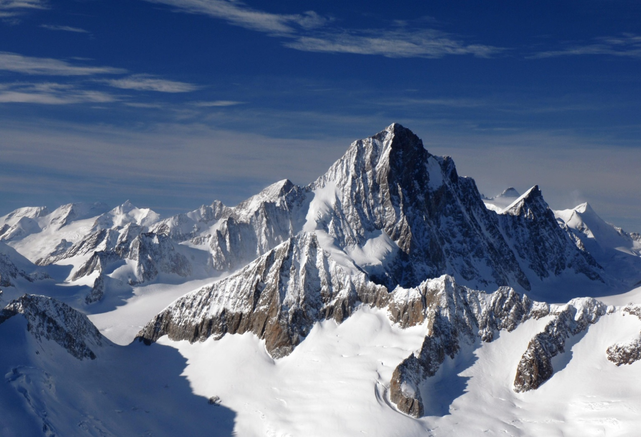
Alps

Slide 27
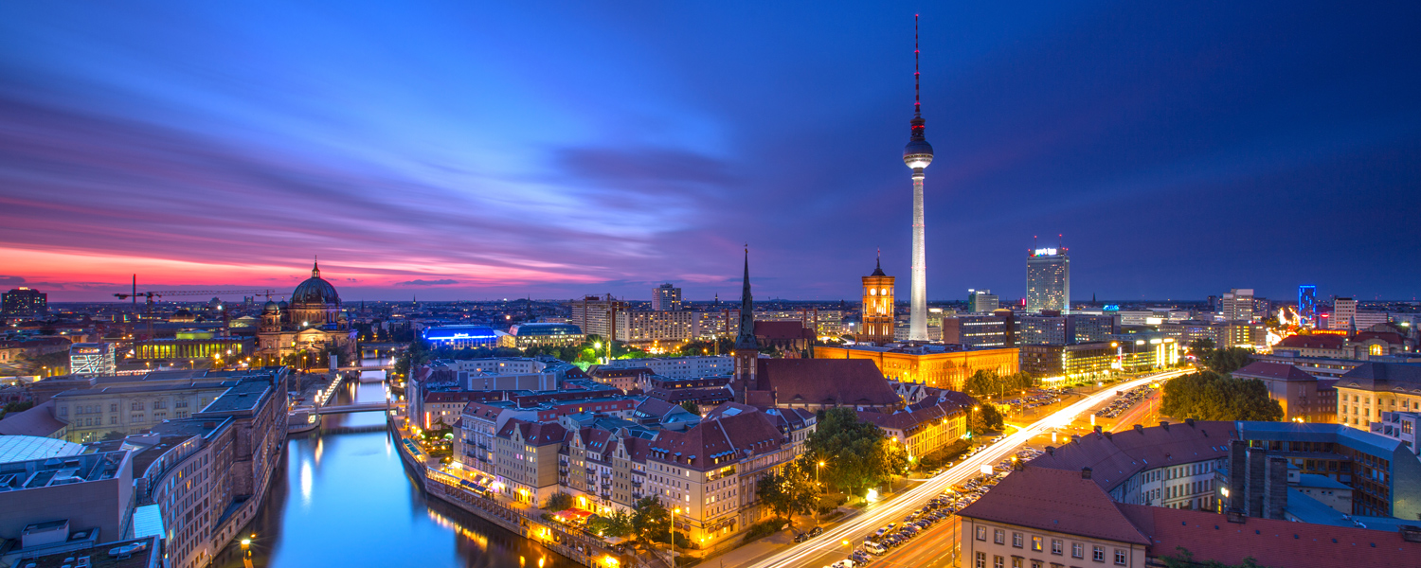
Berlin-the capital of Germany

Slide 28
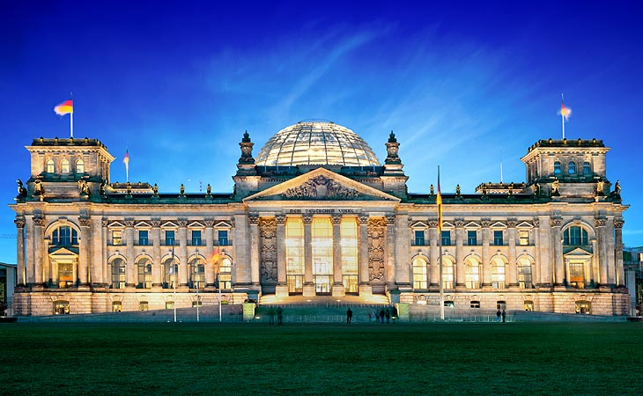
Parliament building

Slide 29
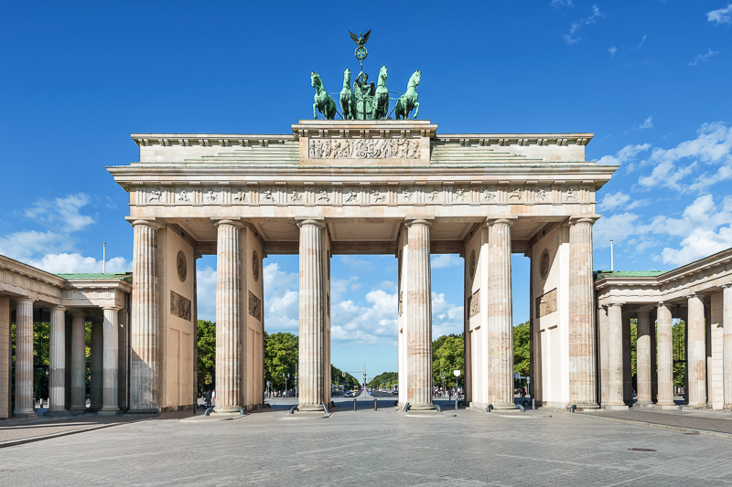
Brandenburg Gate

Slide 30
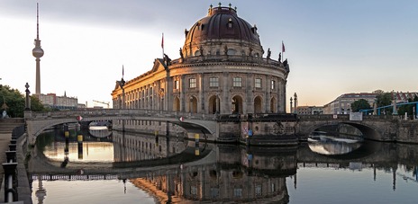
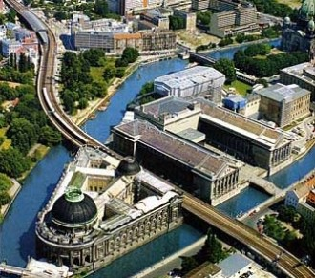
Museums island

Slide 31
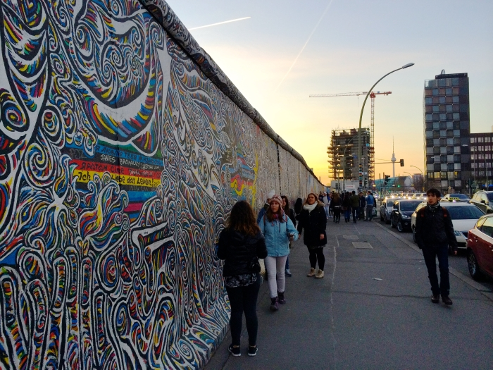
Berlin Wall

Slide 32
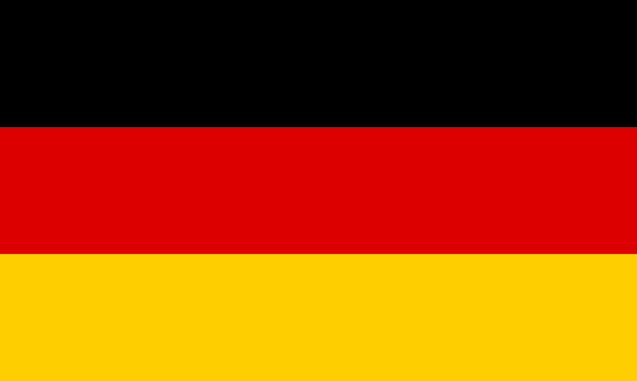
The German flagg

Slide 33
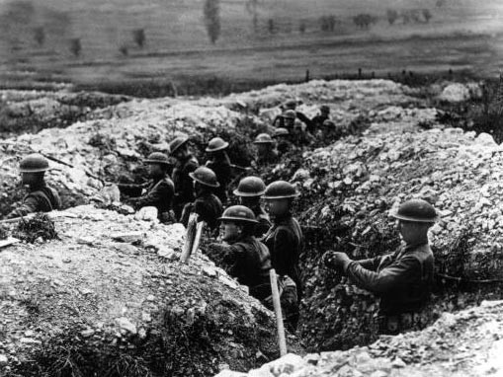
First world war

Slide 34
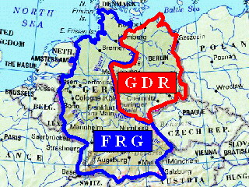
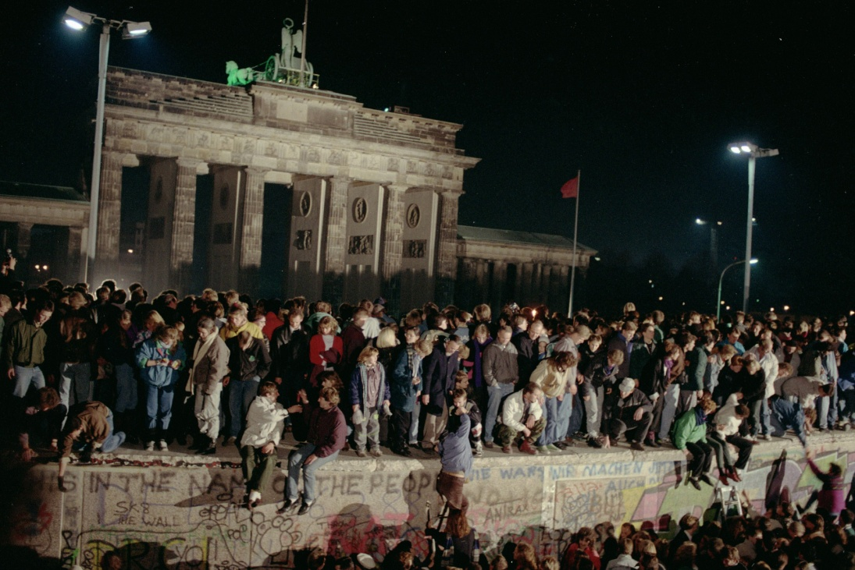

Slide 35
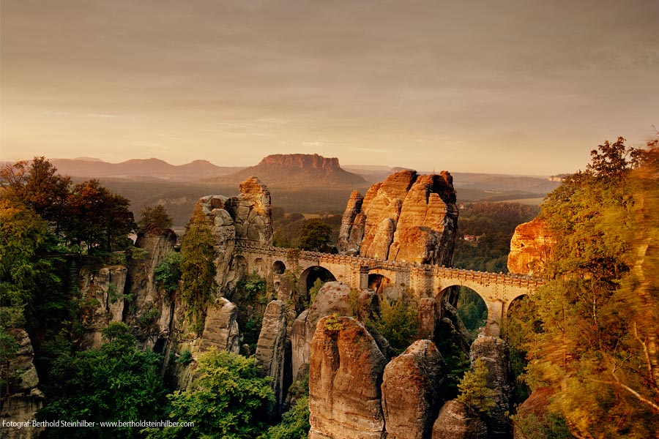
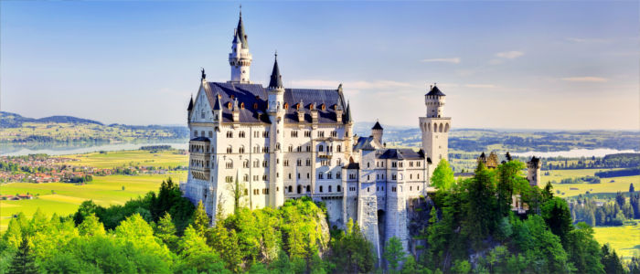
German sights
Bastei with bridge
Neuschwanstein Castle

Slide 36
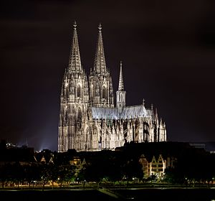
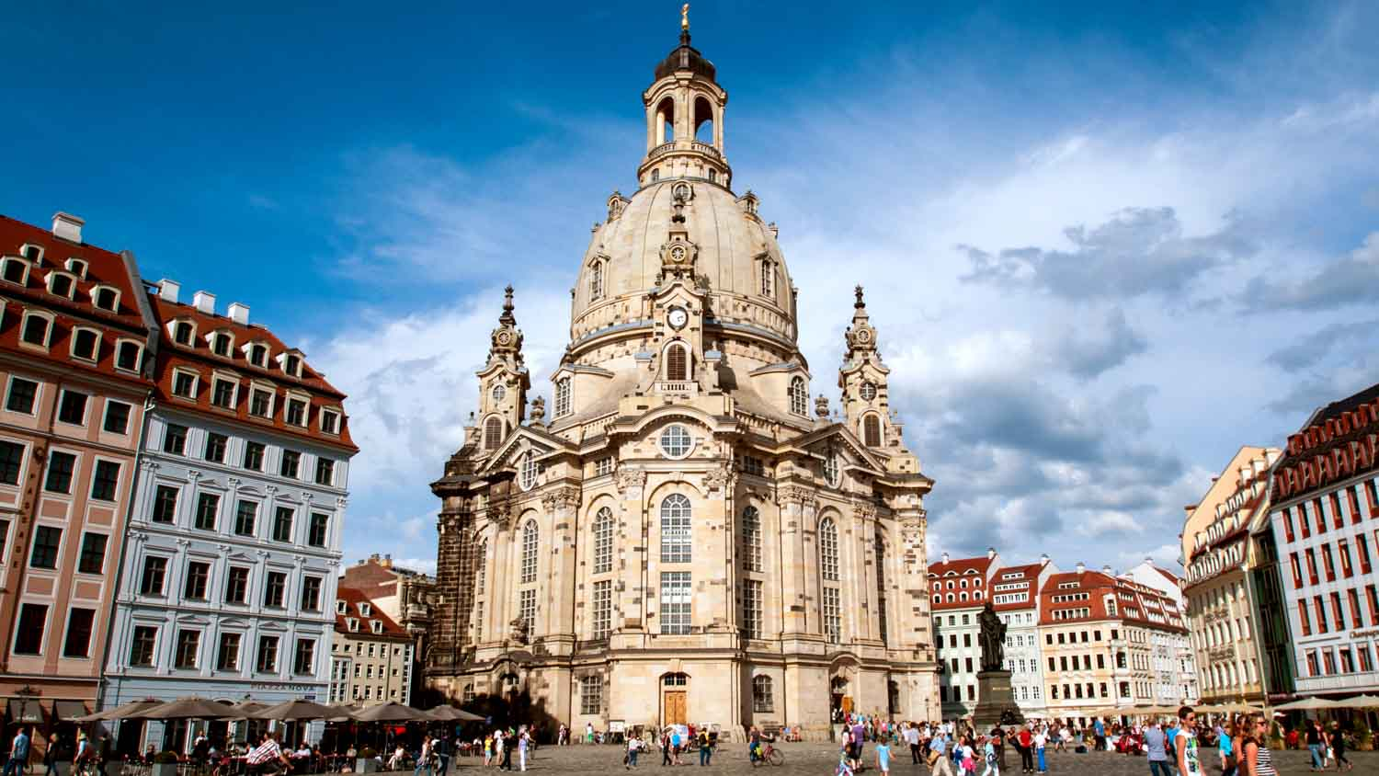
Cologne Cathedral
Dresden Women`s Church

Slide 37
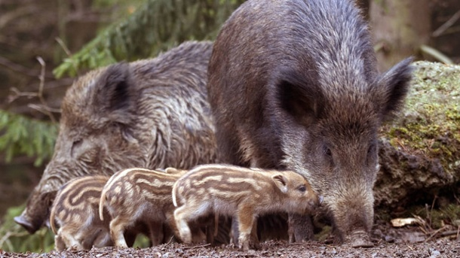
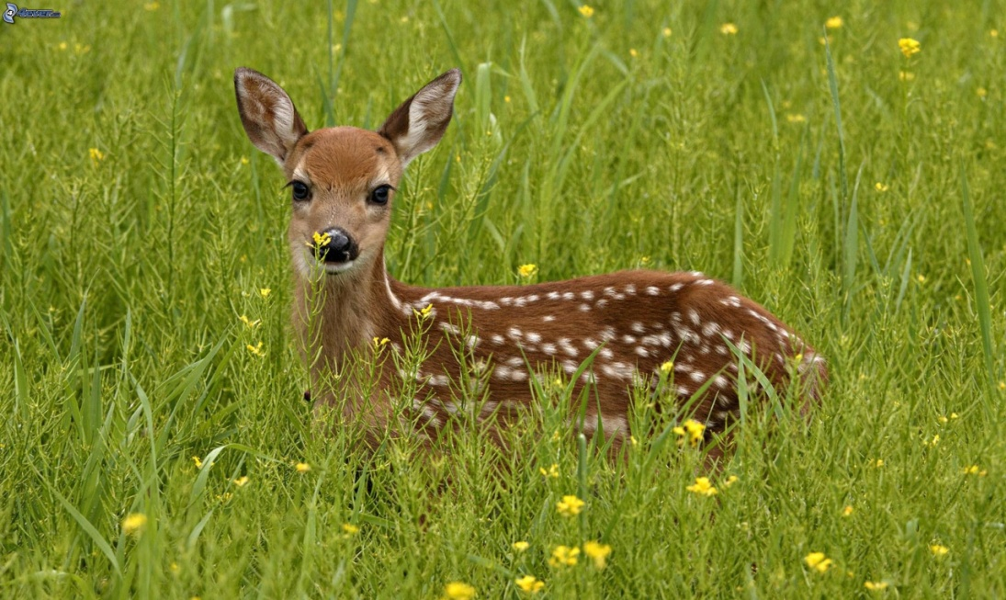
Typical German animals
Wild boar
deer

Slide 38
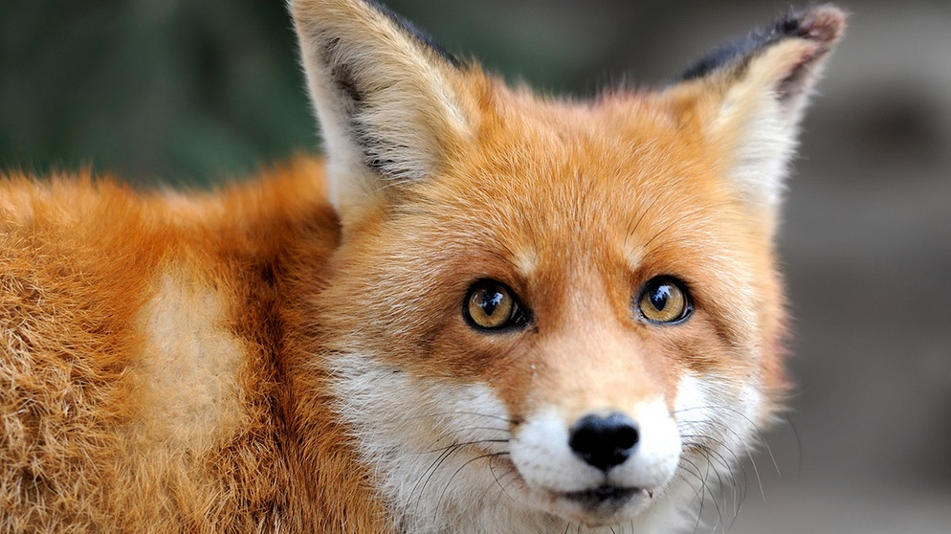
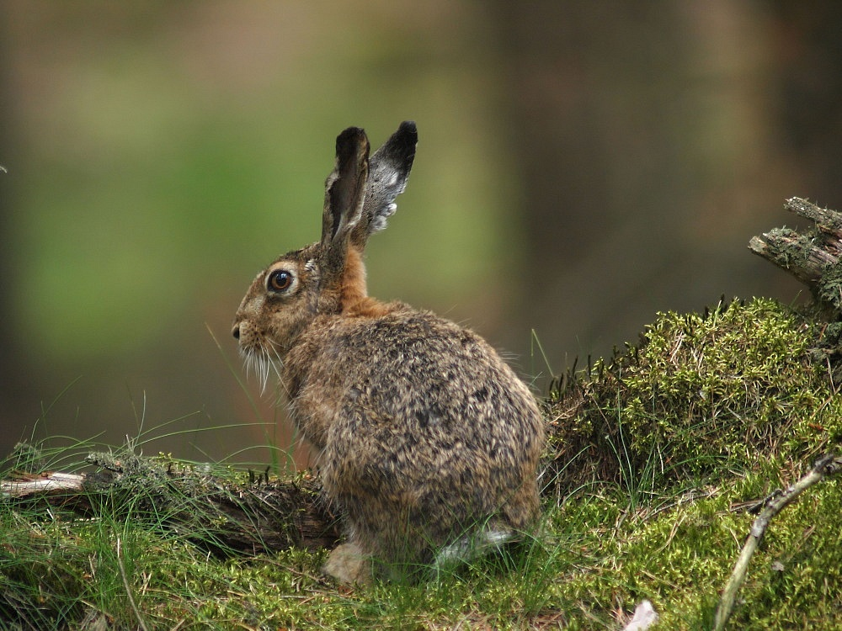
fox
Forest hare

Slide 39
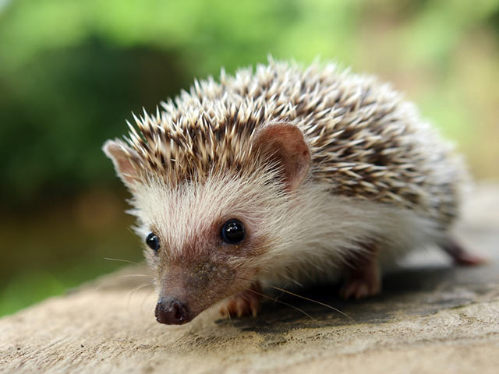
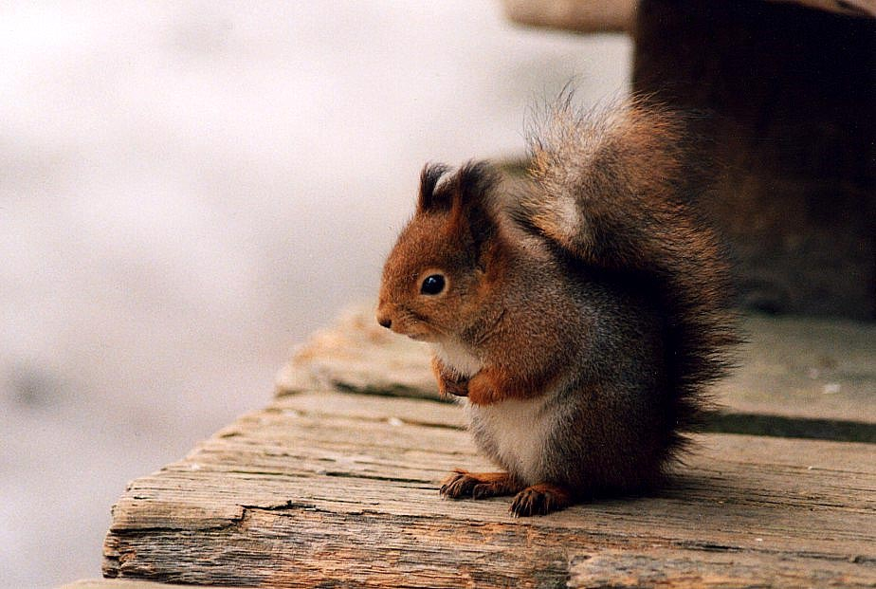
hedgedog
squirrel

Slide 40
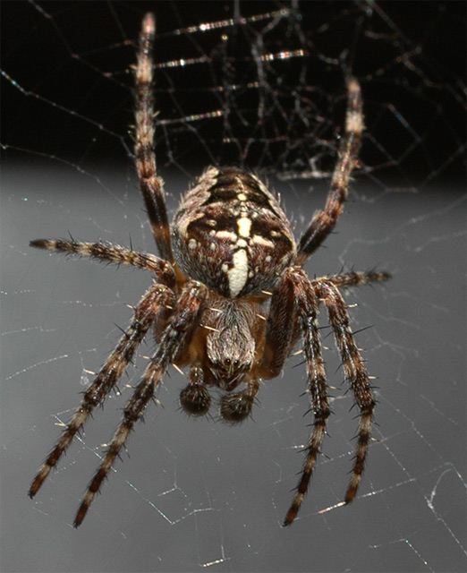
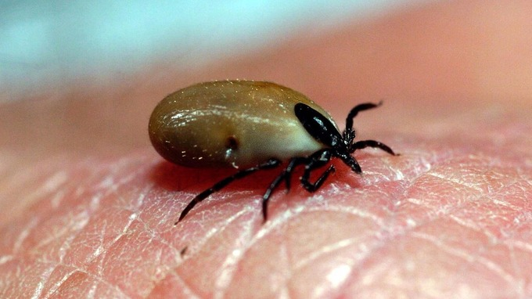
Asp viper
tick
Cross spider

Slide 41
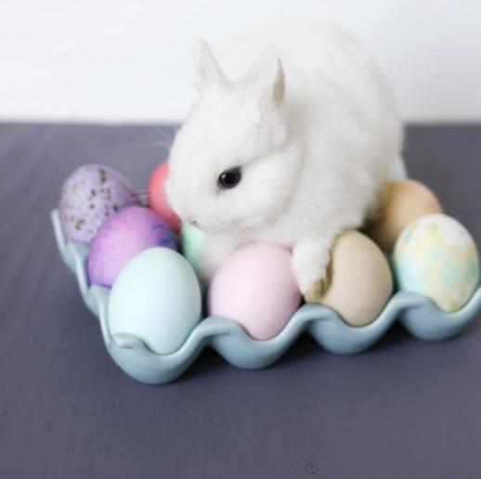
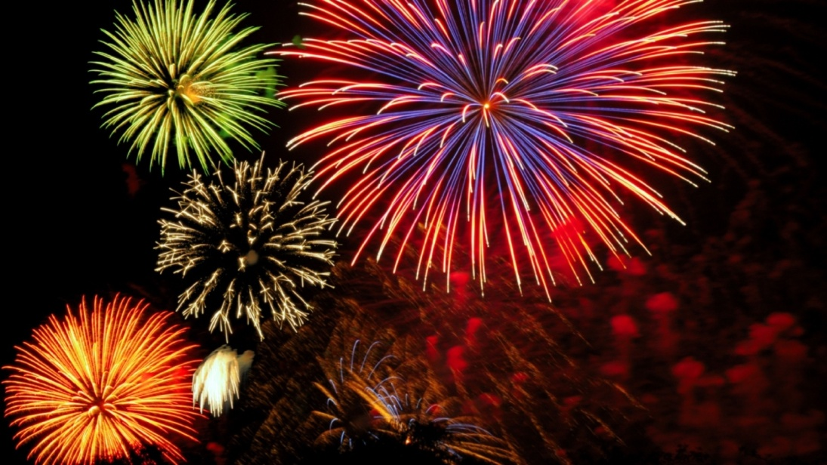
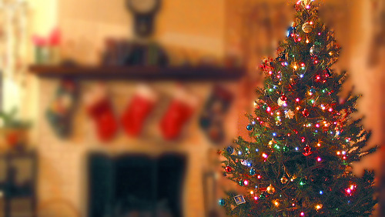
manners

Slide 42
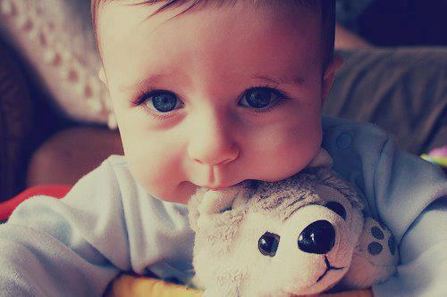
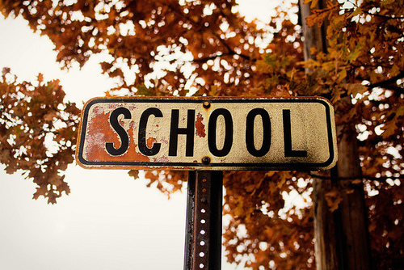
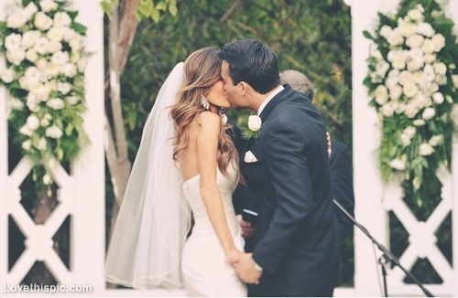
Live Sections

Slide 43
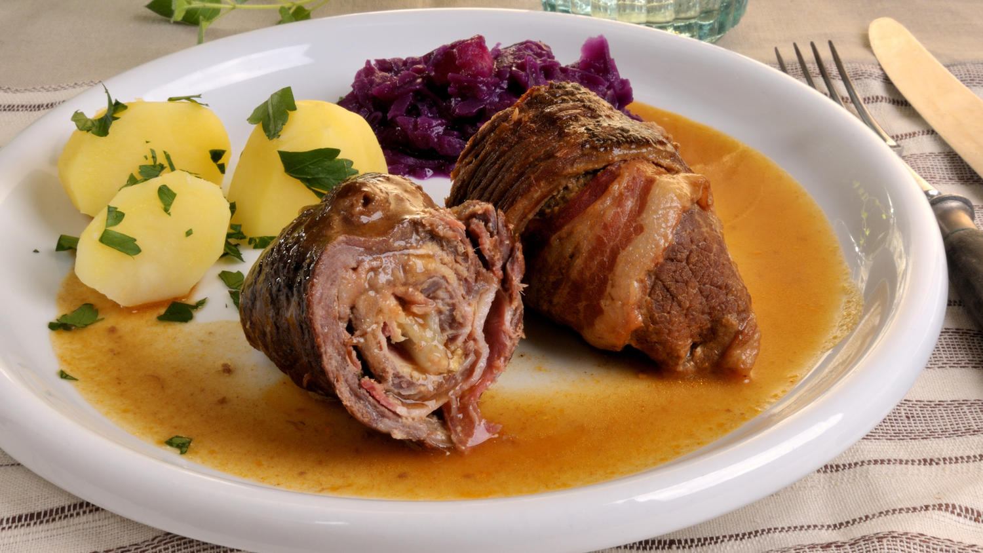
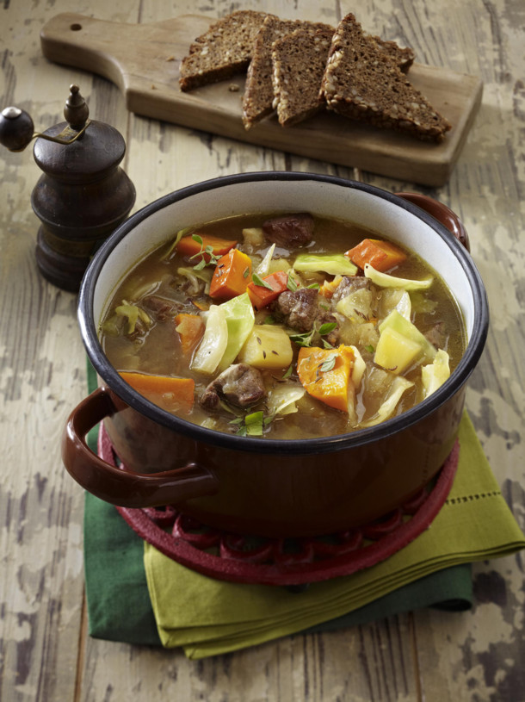
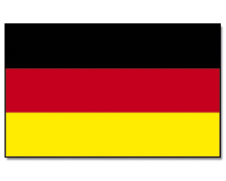

Slide 44
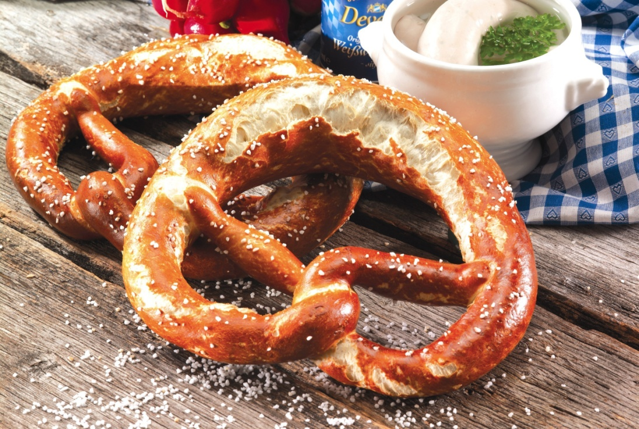
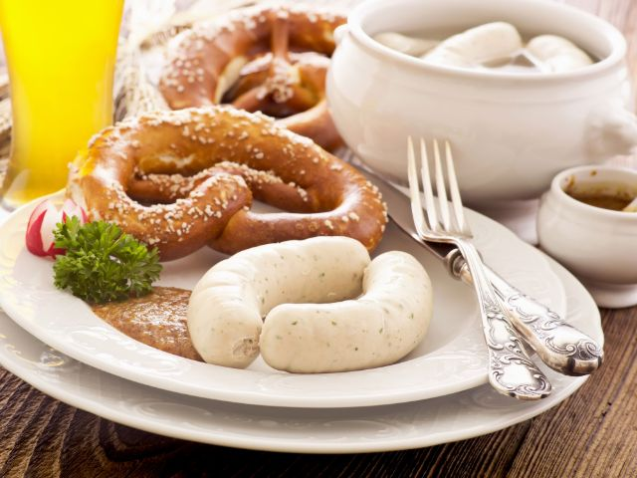

Slide 45
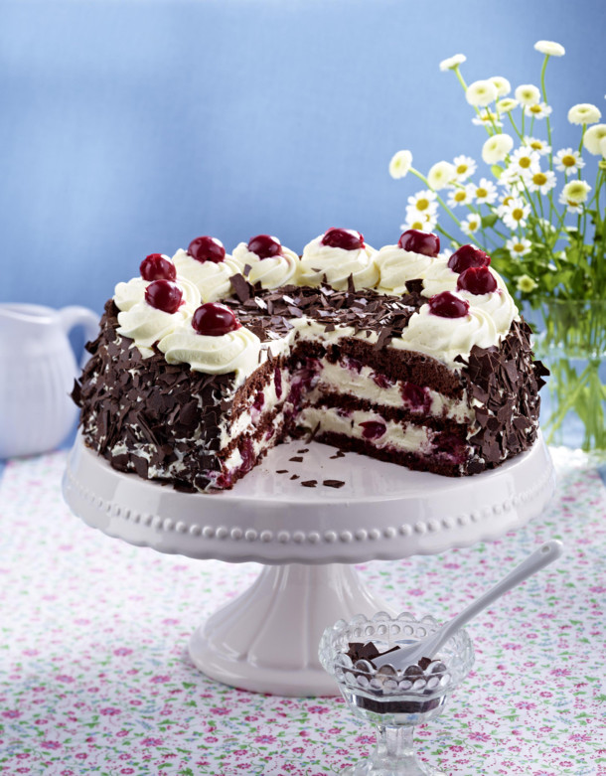
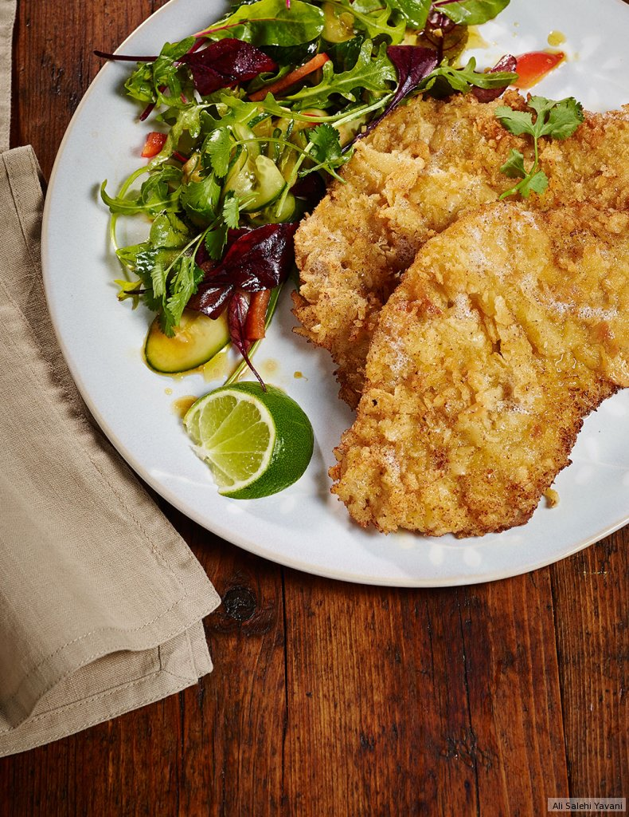
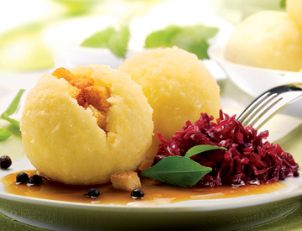

Slide 46
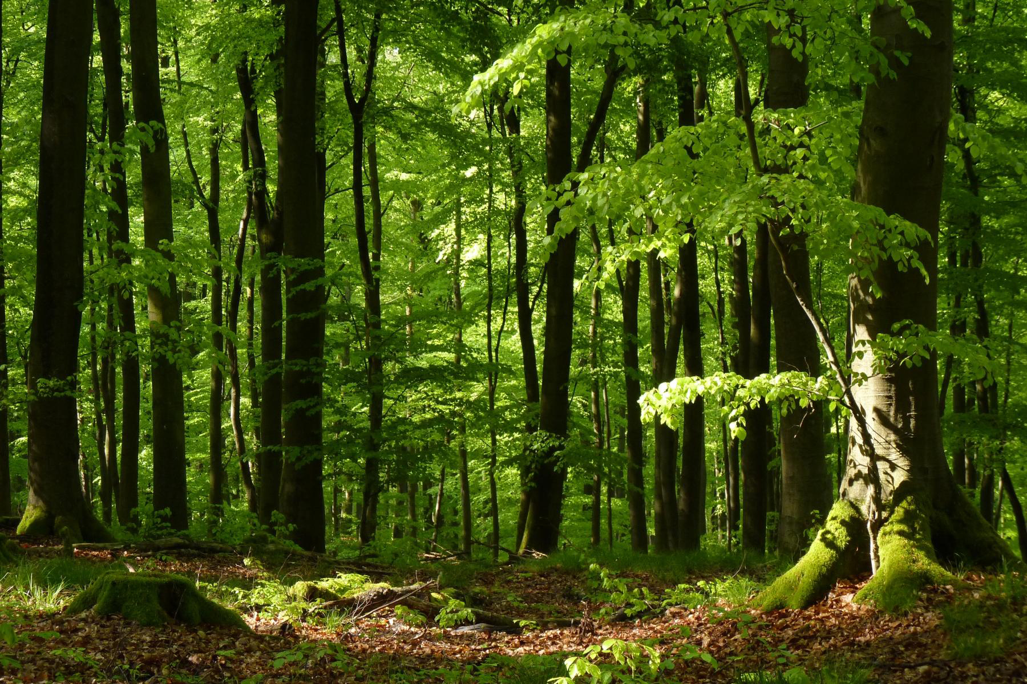

Slide 47
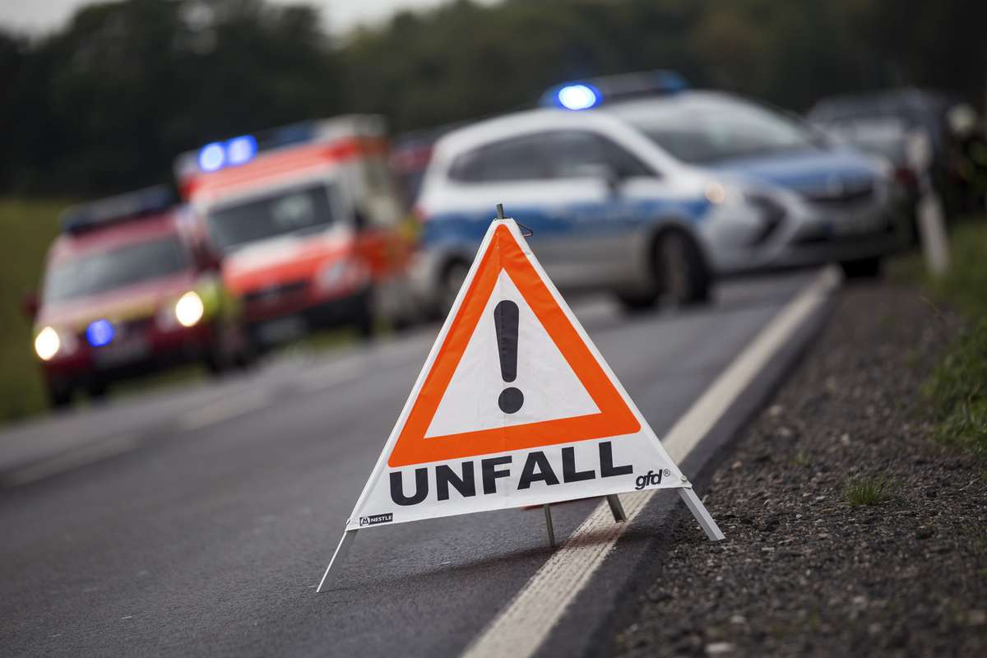

Slide 54
https://www.google.de/search?q=Deutschland&source=lnms&tbm=isch&
sa=X&ved=0ahUKEwiMop
qzgc_TAhWKUlAKHaCxCZwQ_AUICCgD&biw=1024&bih=674#tbm=isch
https://www.google.de/search?q=Deutschland&source=ln
ms&tbm=isch&sa=X&ved=0ahUKEwiMopqzgc_TAhWKUlAKH
https://www.google.de/search?q=Deutschland&source=lnms&tbm=isch&sa=X
&ved=0ahUKEwiMopqzgc_TAhWKUlA
https://www.google.de/search?q=wildschwein&source=
lnms&tbm=isch&sa=X&ved=0ahUKEwj4wqez-tbTAhVGI1A
http://www.paradisi.de/Freizeit_und_Erholung/Kultur/Braucht
um/Artikel/90

