Slide 1
AHMET FAİK EDİS ANATOLIAN HIGH SCHOOL FOR GIRLS

Slide 2
Ahmet Faik Edis Anatolian high School For Girls is located in the Black Sea Region of Turkey.
There are over 500 hundred students and 30 teachers at school.
School gives education only to female students.

Slide 3
Vision:
To be a high school contributing to the participation of the Turkish woman in social,cultural and economic fields.

Slide 4
Mission:
Raising students who can think scientific,being dependent on national and moral values;open to the change and developments.Intelectual and talented people are aimed.

Slide 5
There are seventeen classes a library,teachers’room,science lab,a canteen,a conferance hall at our school.The school aims to provide students with university education by preparing them academically.
Students take classes Maths,Physics,Chemistry,Biology,Philosophy,English,German,History,Geography,Turkish Language and Literature,and Religion Sciences.

Slide 6
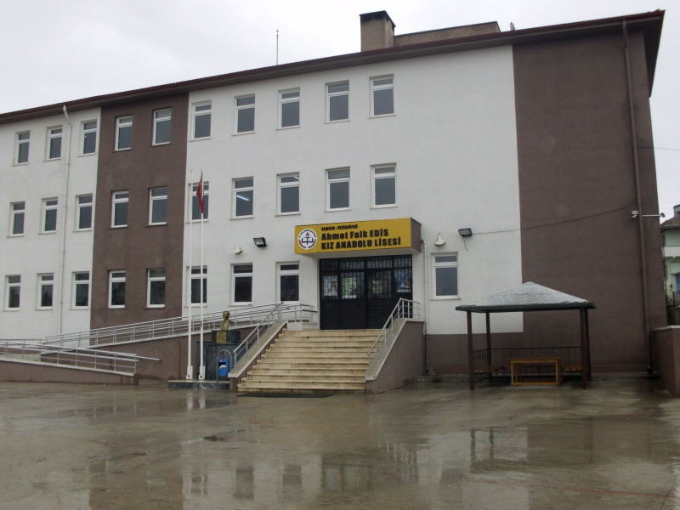
School webpage is https://vezirkopruafekal.meb.k12.tr/tema/index.php

