Slide 1
This is where we live

Slide 2
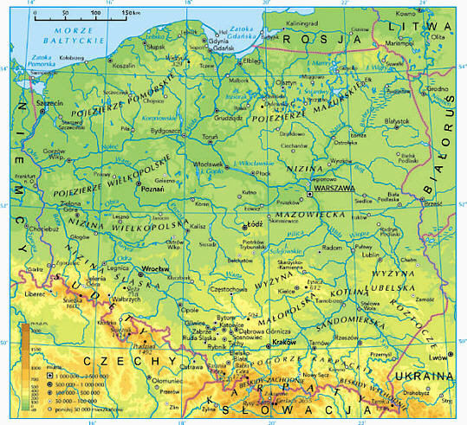
POLAND

Slide 3
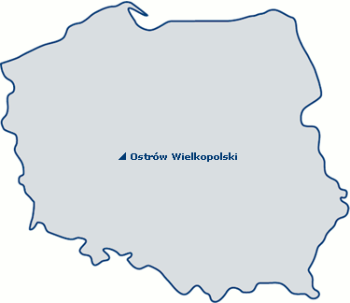
Our city on the map of Poland

Slide 4
Coat of arms of our city

Slide 5
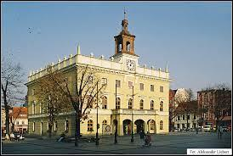
The Town Hall

Slide 6
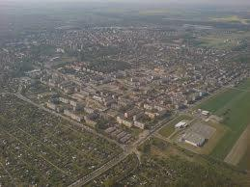
From a bird’s eye view

Slide 7
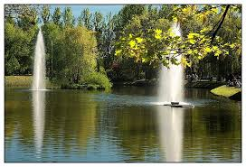
The park

Slide 8
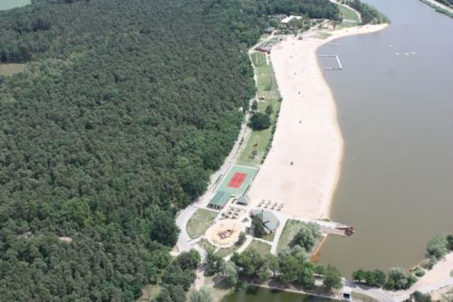
The lake

Slide 9
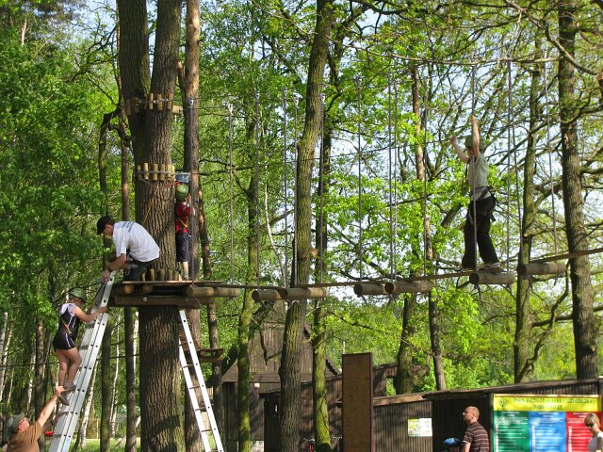
Ropes course

Slide 10
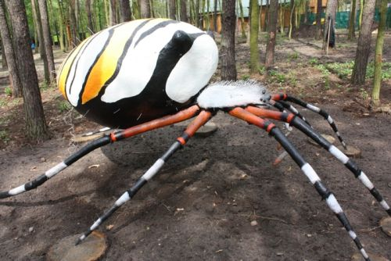
Models of insects in the park

Slide 11
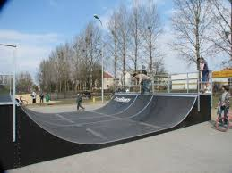
Place for skateboarding

Slide 12
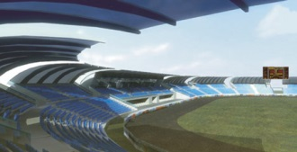
Speedway stadium

Slide 13
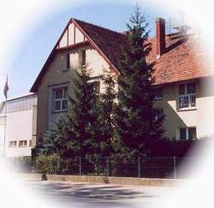
Our school

