Slide 1
Easter Traditions
Escola Tecnos
Terrassa (Barcelona)
March 2015

Slide 2
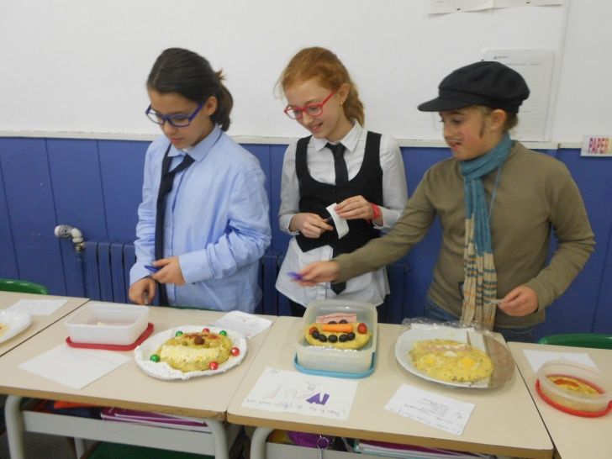
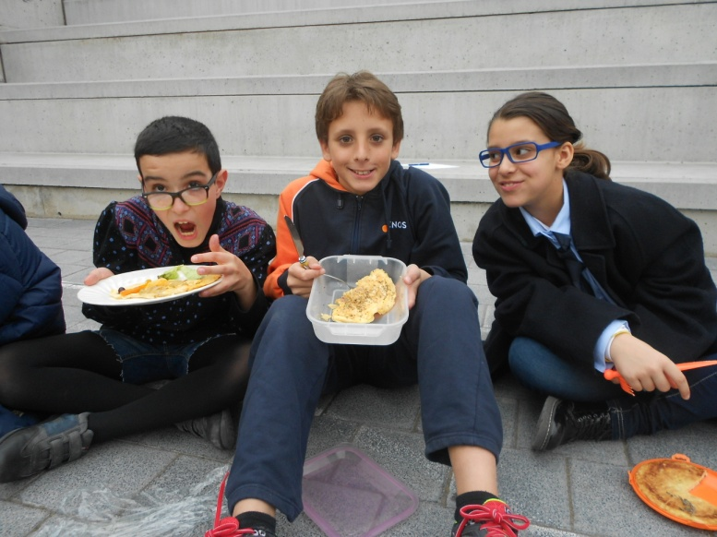
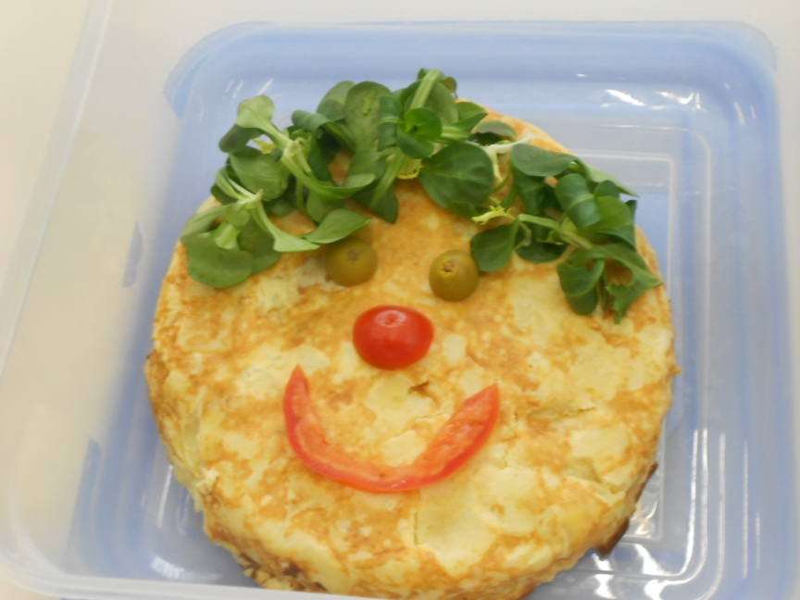
MARDI GRAS
We eat omelette. Year 5 students have an omelette competition.

Slide 3
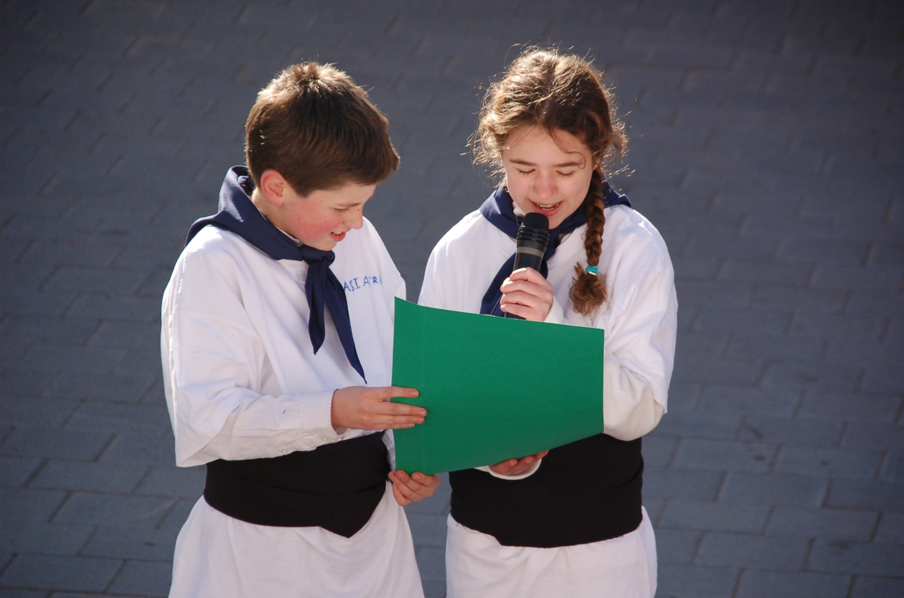
Two students read the Queen of Carnival’s announcement.
On the next day …

Slide 4
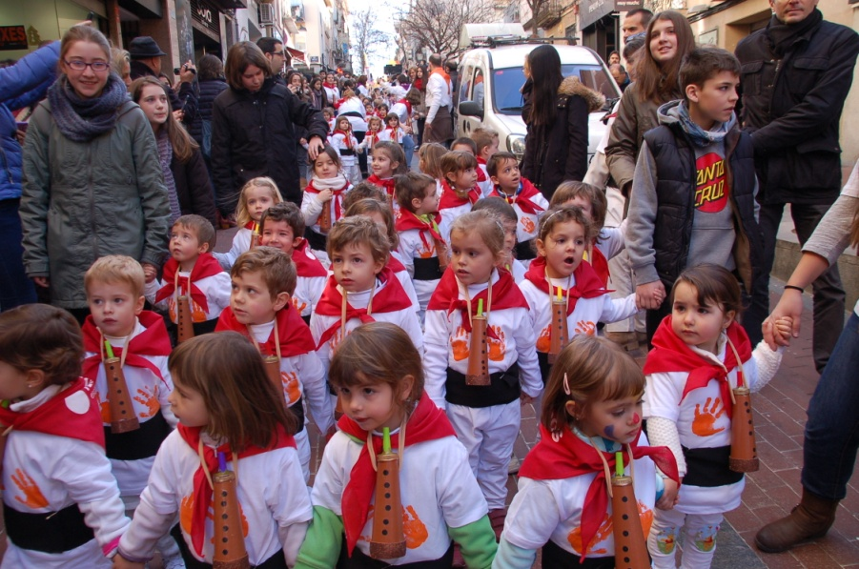
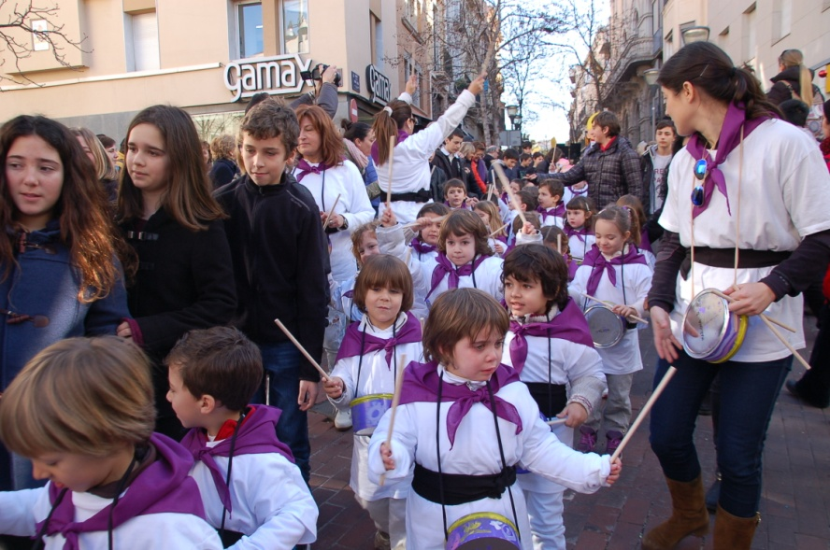
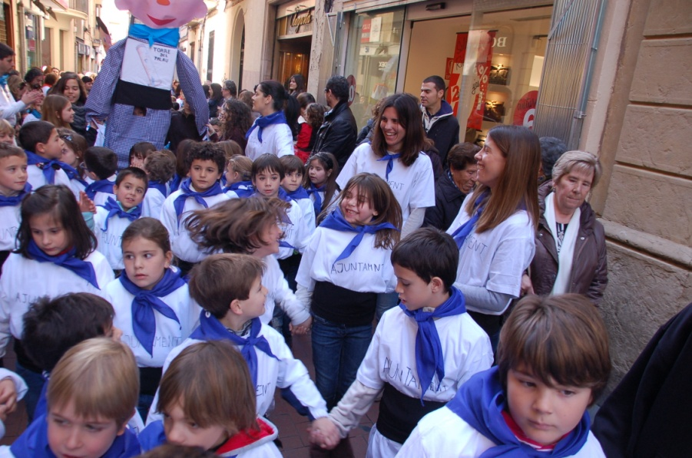
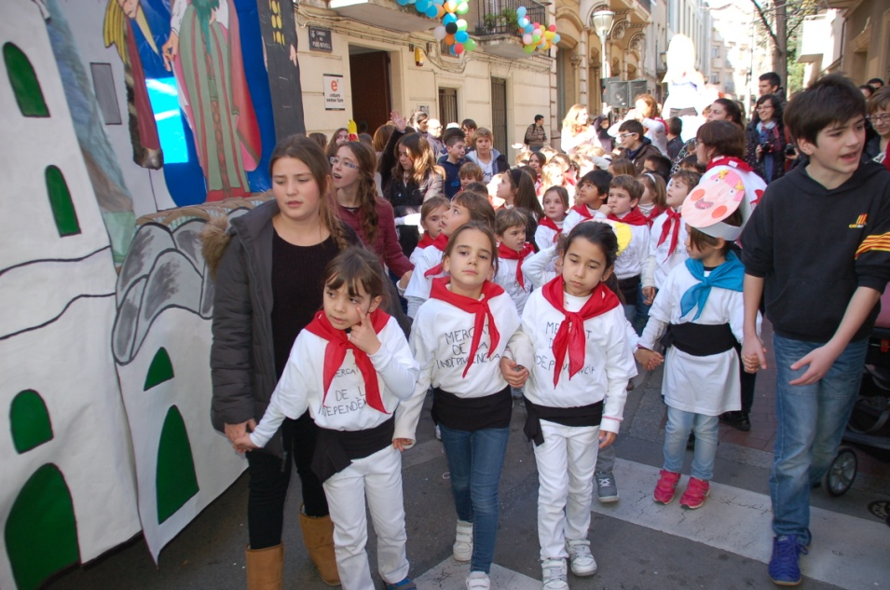
Our Carnival Parade

Slide 5
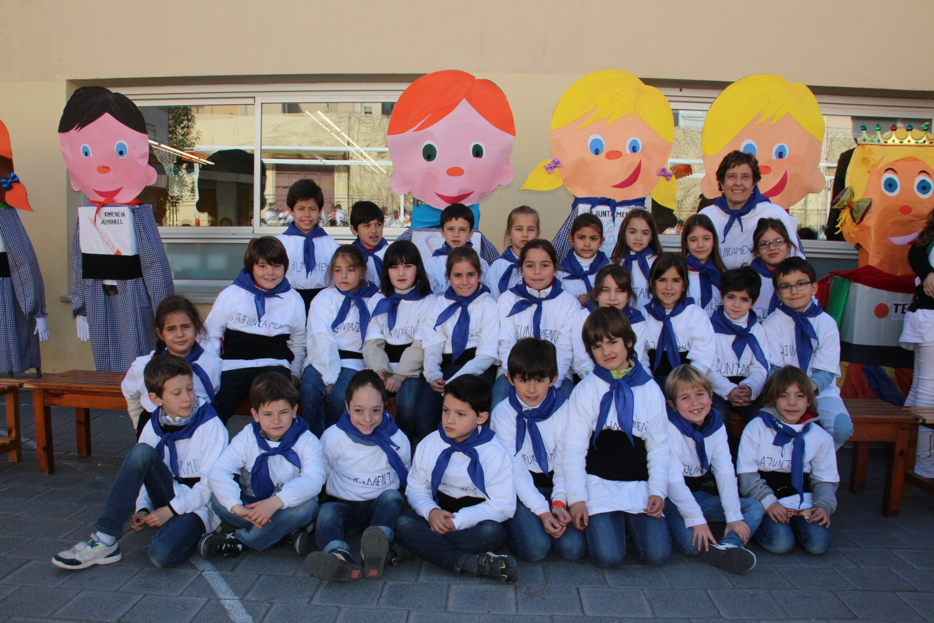
This is Group 2A on Carnival day.

Slide 6
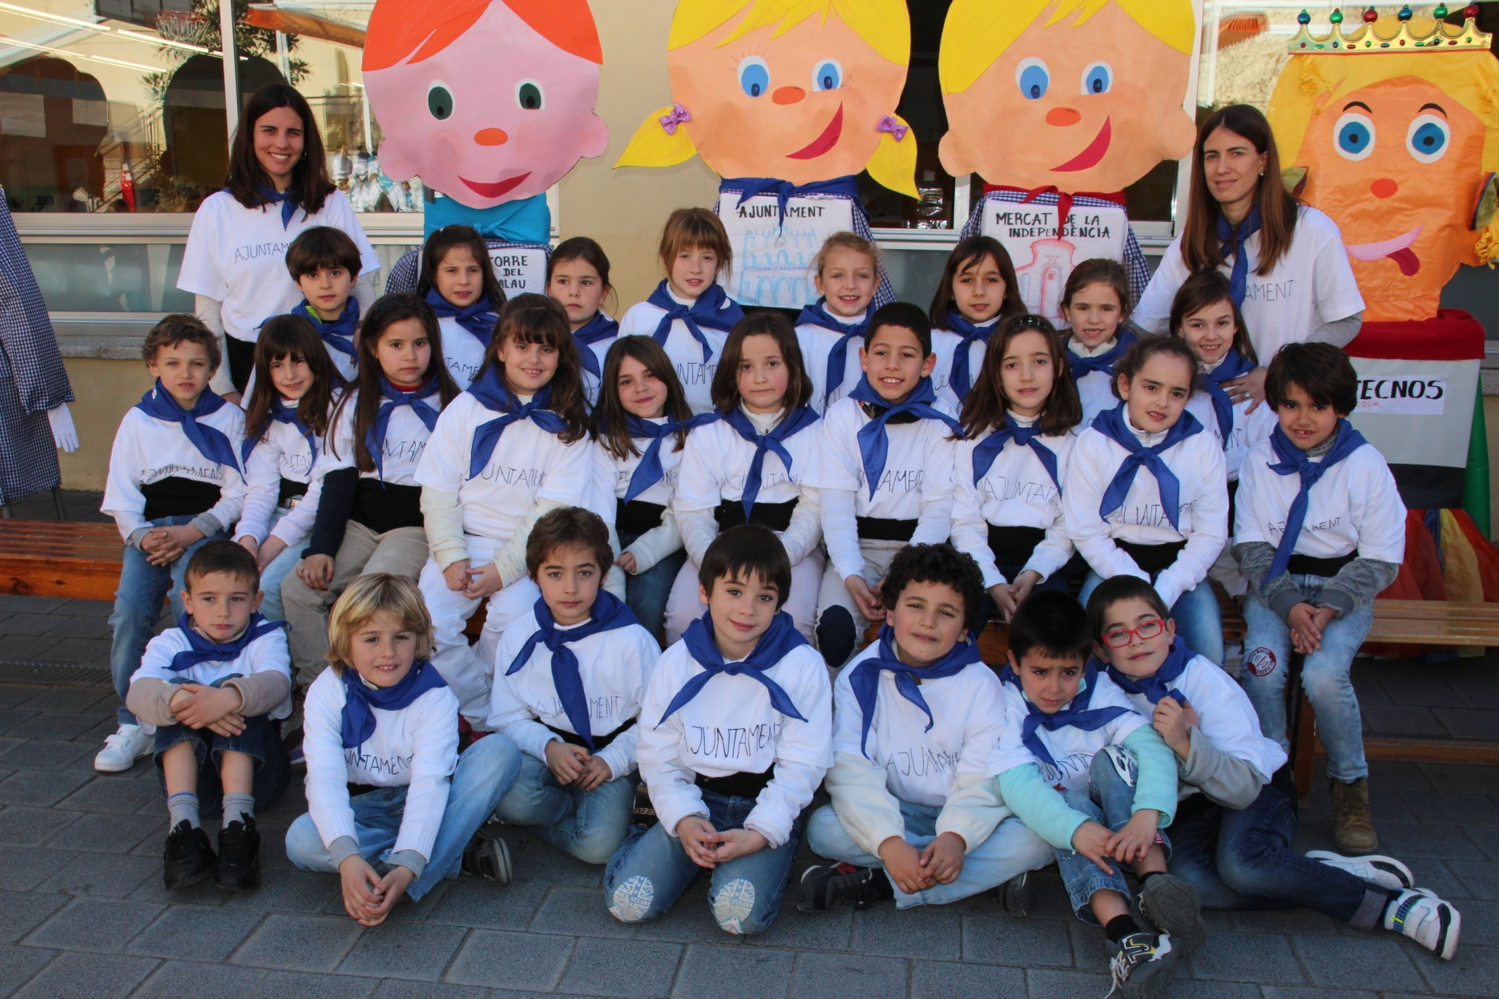
This is Group 2B on Carnival day.

Slide 7
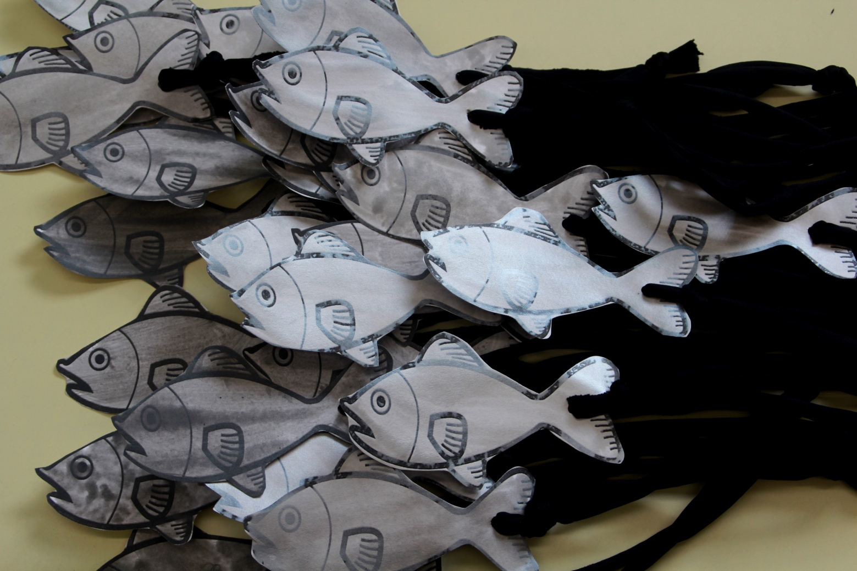
Ash Wednesday
Sardines are buried.

Slide 8
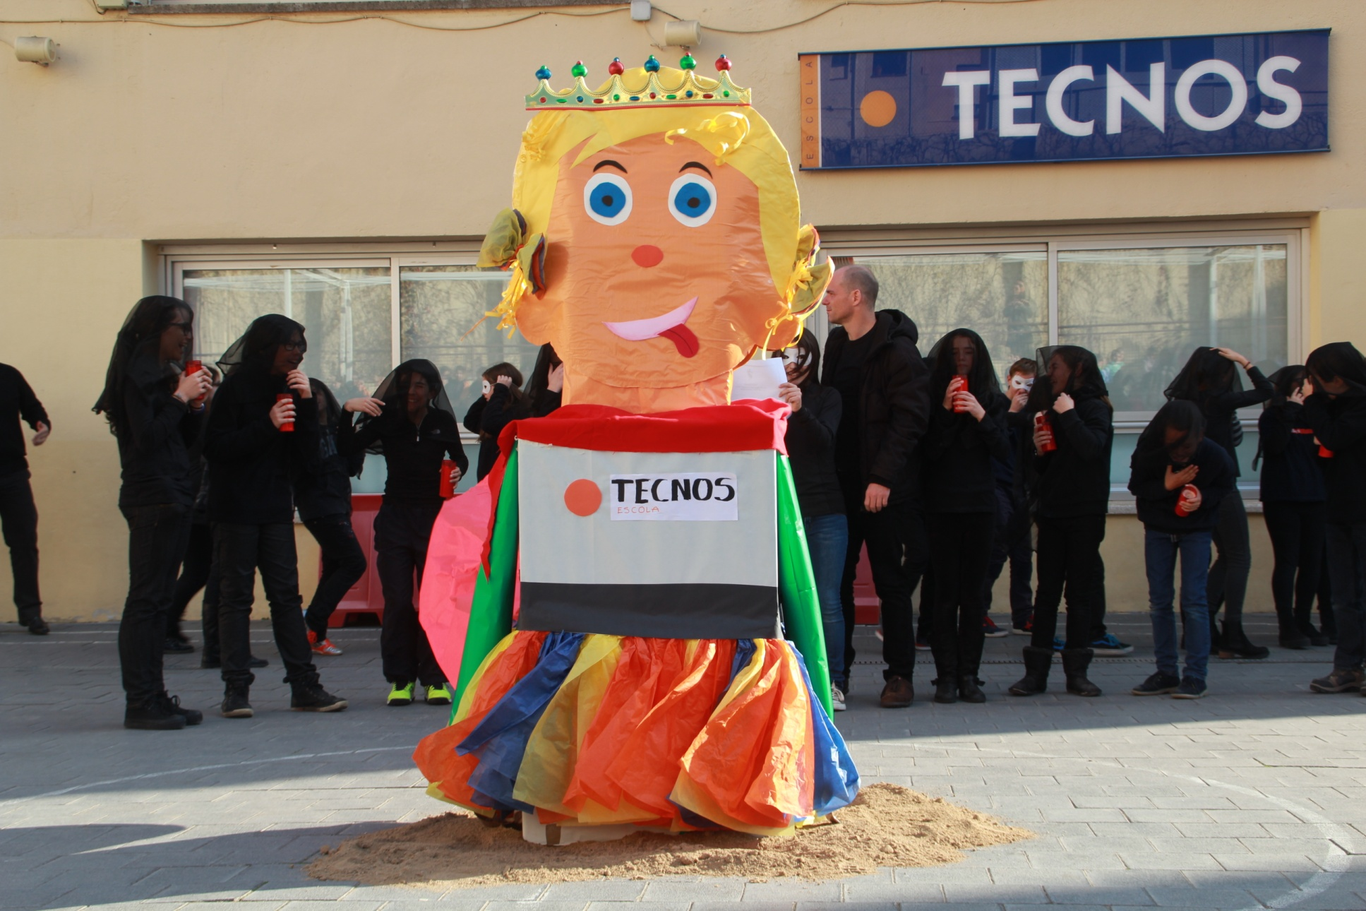
This is the Queen of Carnival.

Slide 9
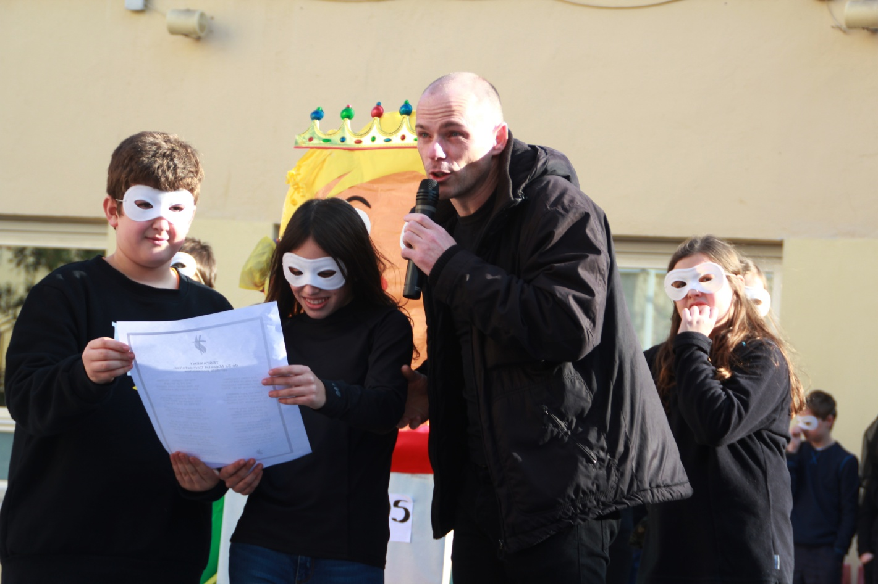
Ash Wednesday
Two students read the Queen of Carnival’s will.

Slide 10
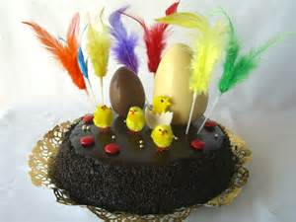
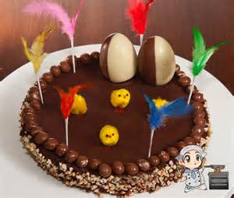
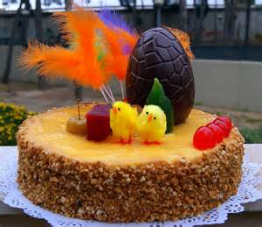
Easter Monday
We eat a cake called “Mona” (Monkey)

