Slide 1
Preparations for Easter

Slide 2
Ash Wednesday

Slide 3
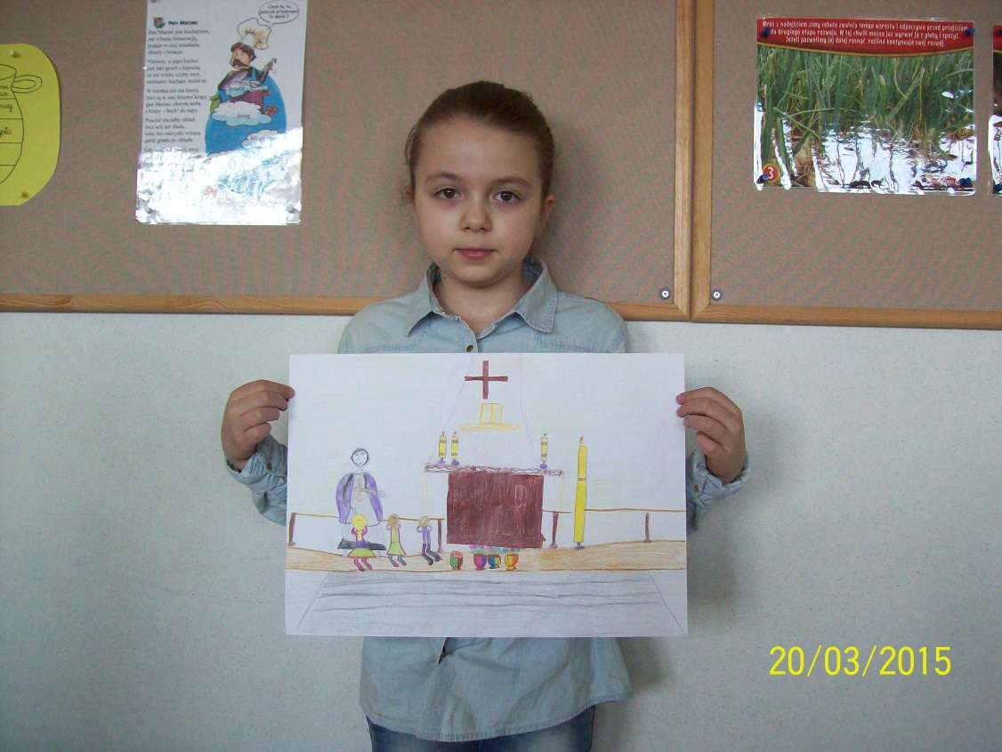

Slide 4
The Way of the Cross

Slide 5
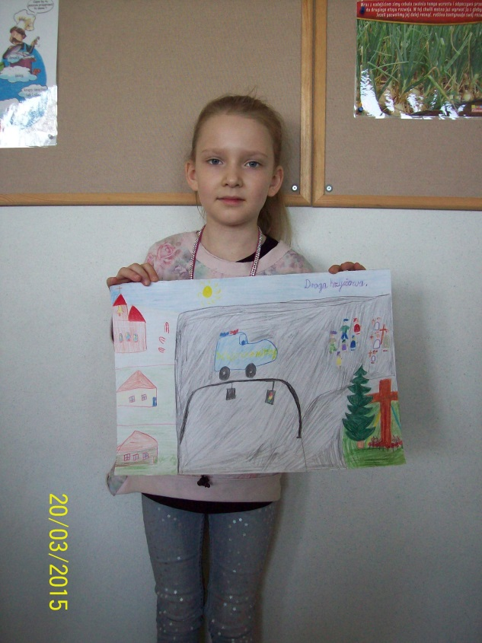

Slide 6
Lenten Retreat

Slide 7
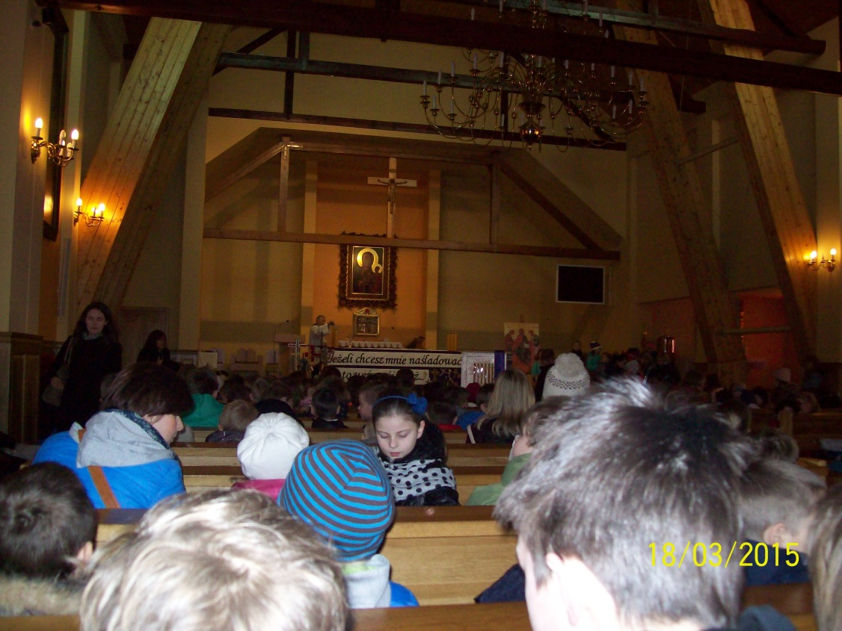

Slide 8
Palm Sunday

Slide 9
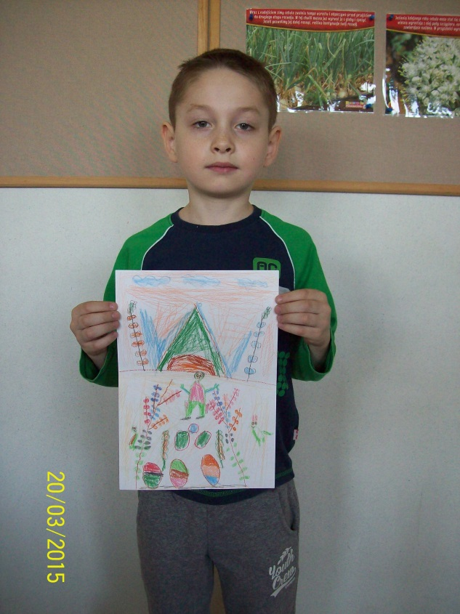

Slide 10
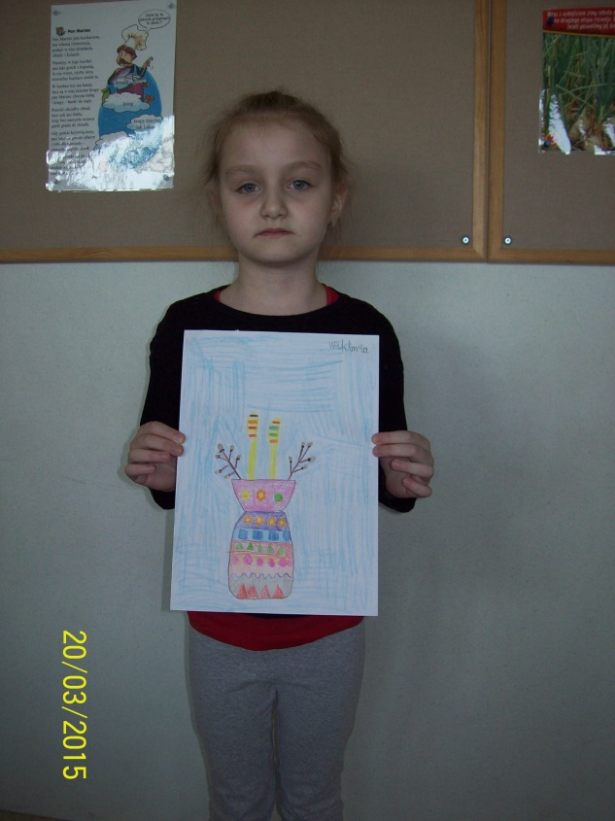

Slide 11
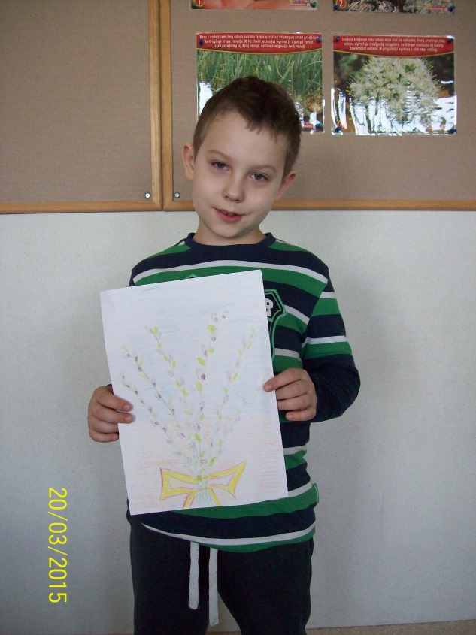

Slide 12
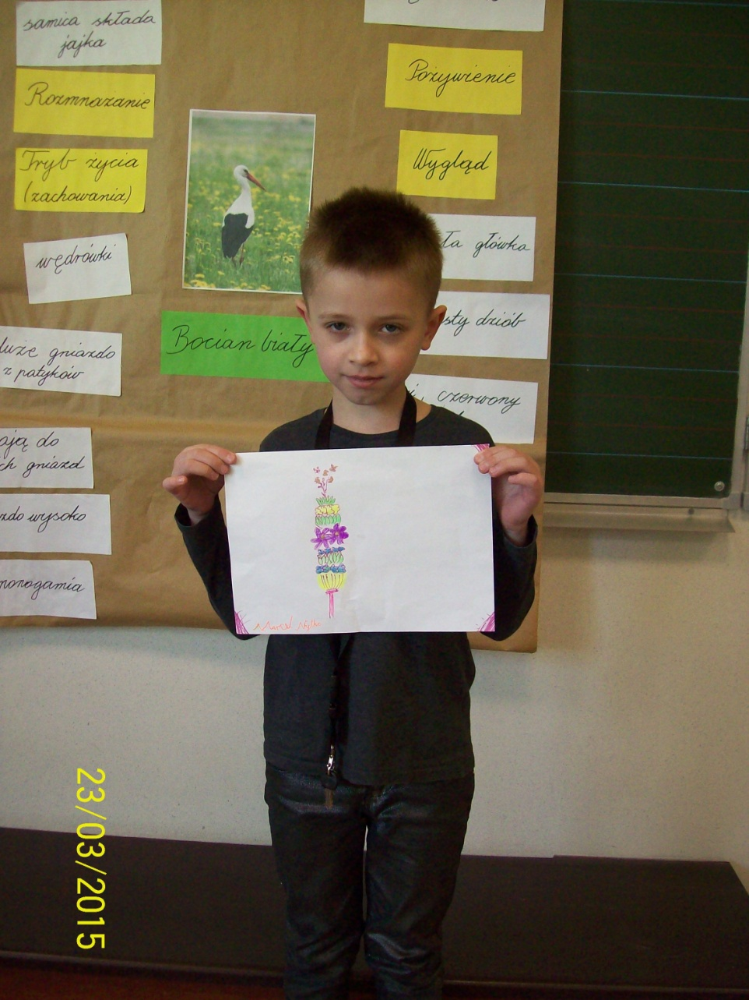

Slide 13
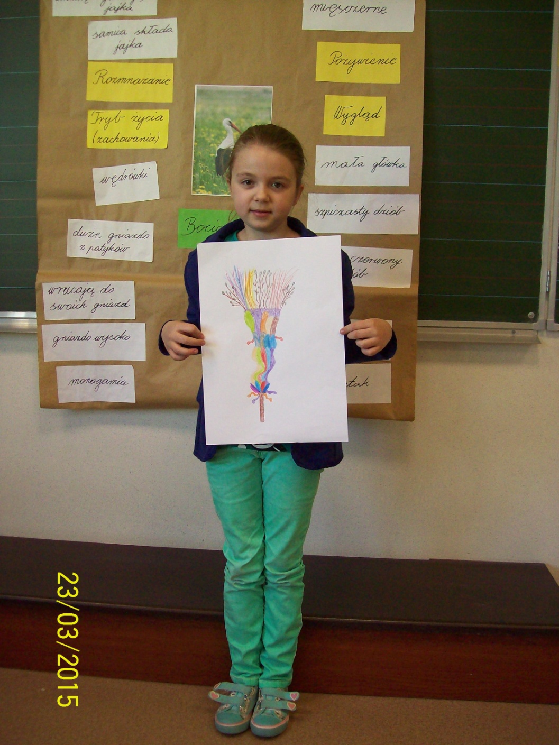

Slide 14
Blessing of food in Great Saturday

Slide 15
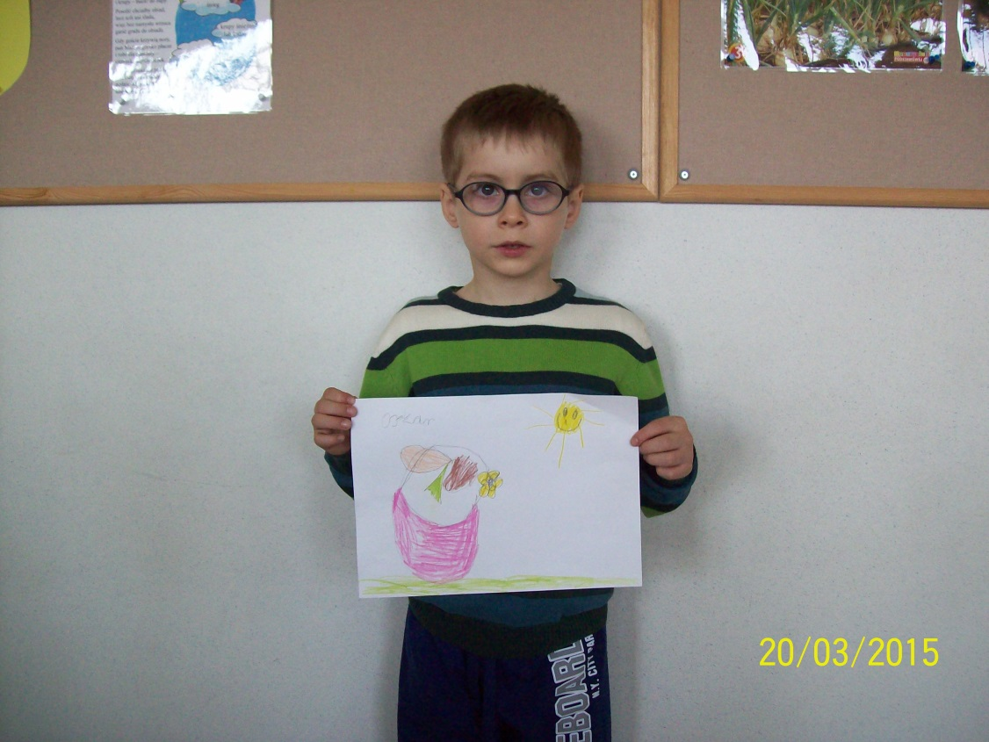

Slide 16
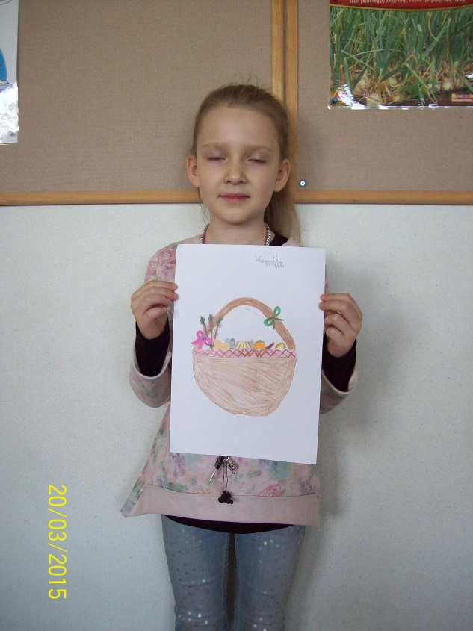

Slide 17
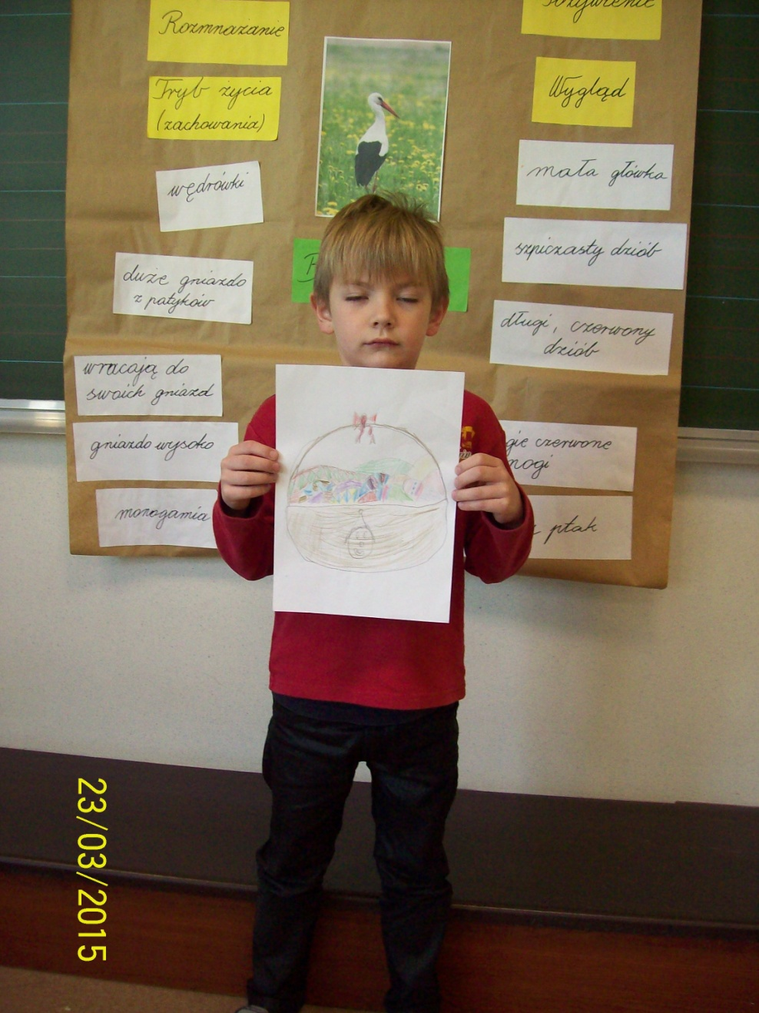

Slide 18
