Slide 1
Our school

Slide 2
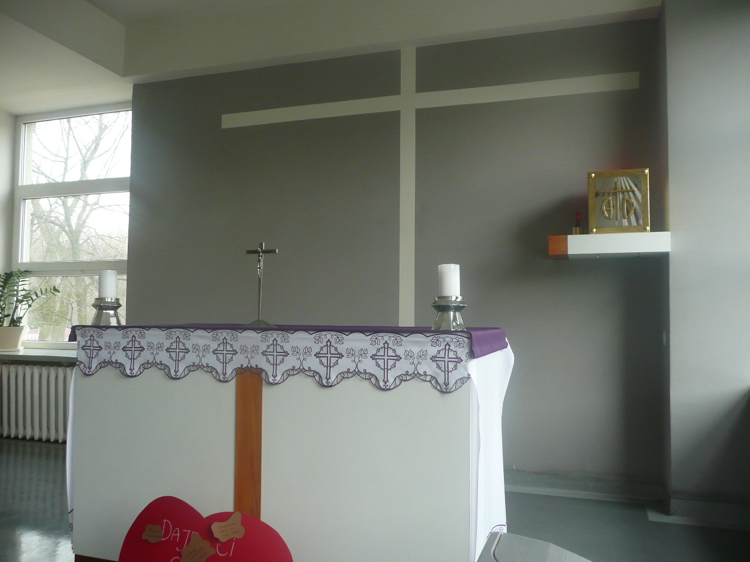
This is our chapel. We pray here and have a holy mass.

Slide 3
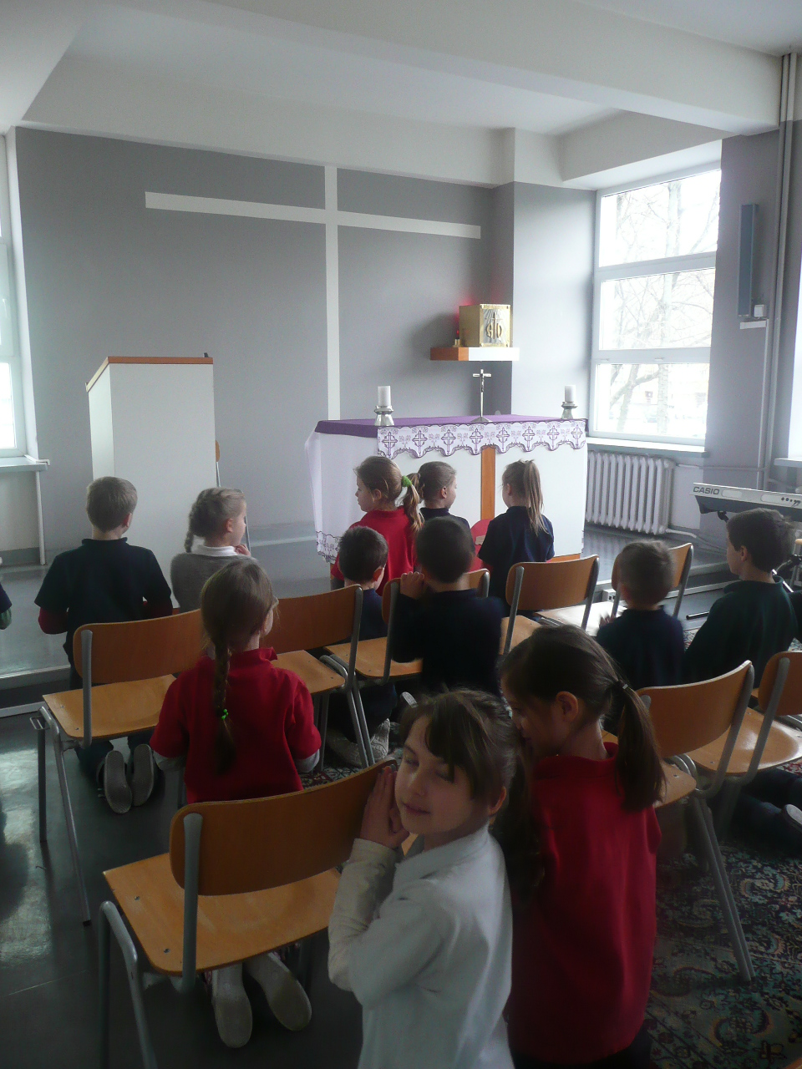
In our school chapel we talk to God.

Slide 4
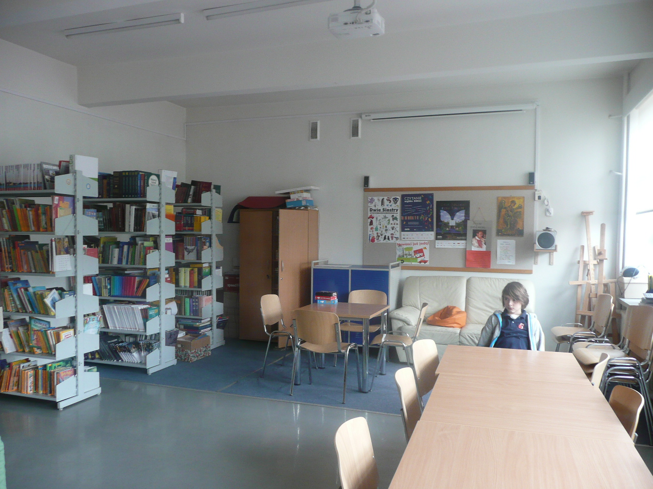
This is our library .We read and borrow books here. We must be quiet here.

Slide 5
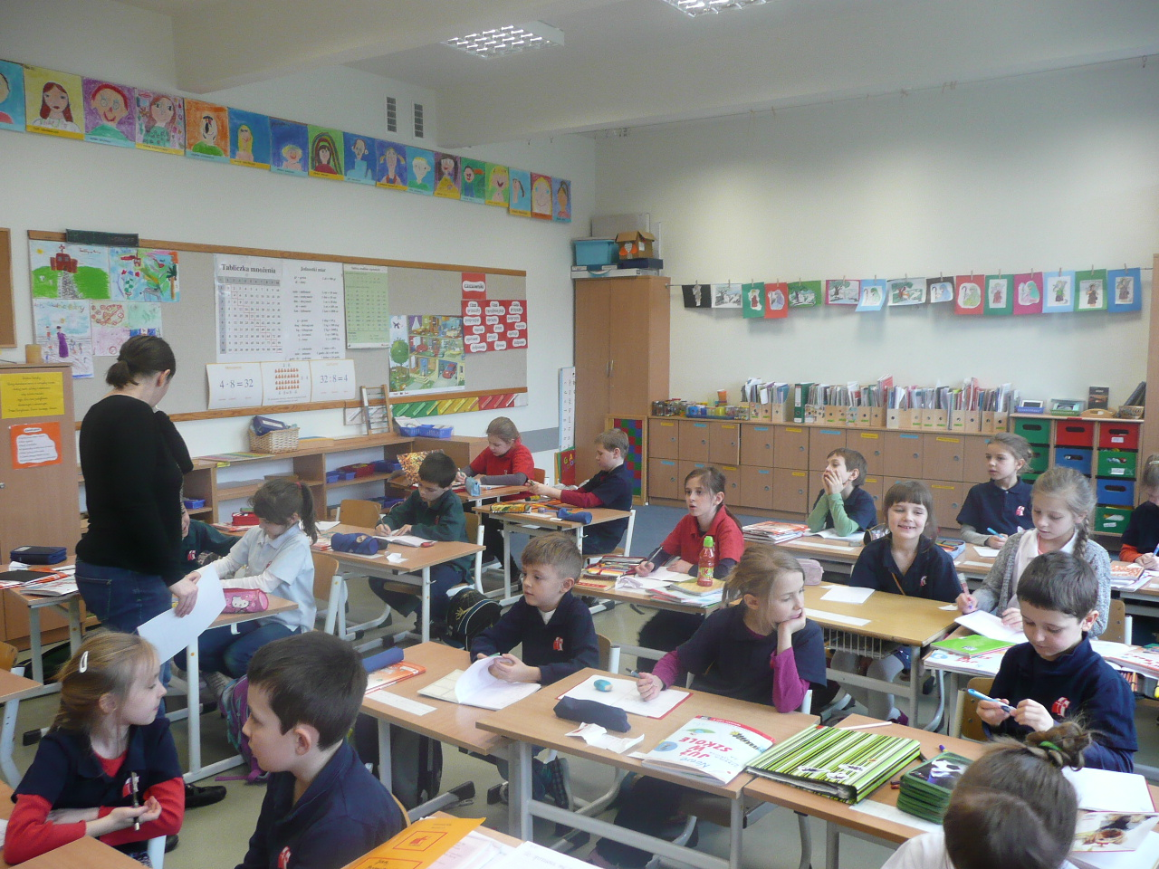
This is our classroom. We learn and play here. It is very colourful.

Slide 6
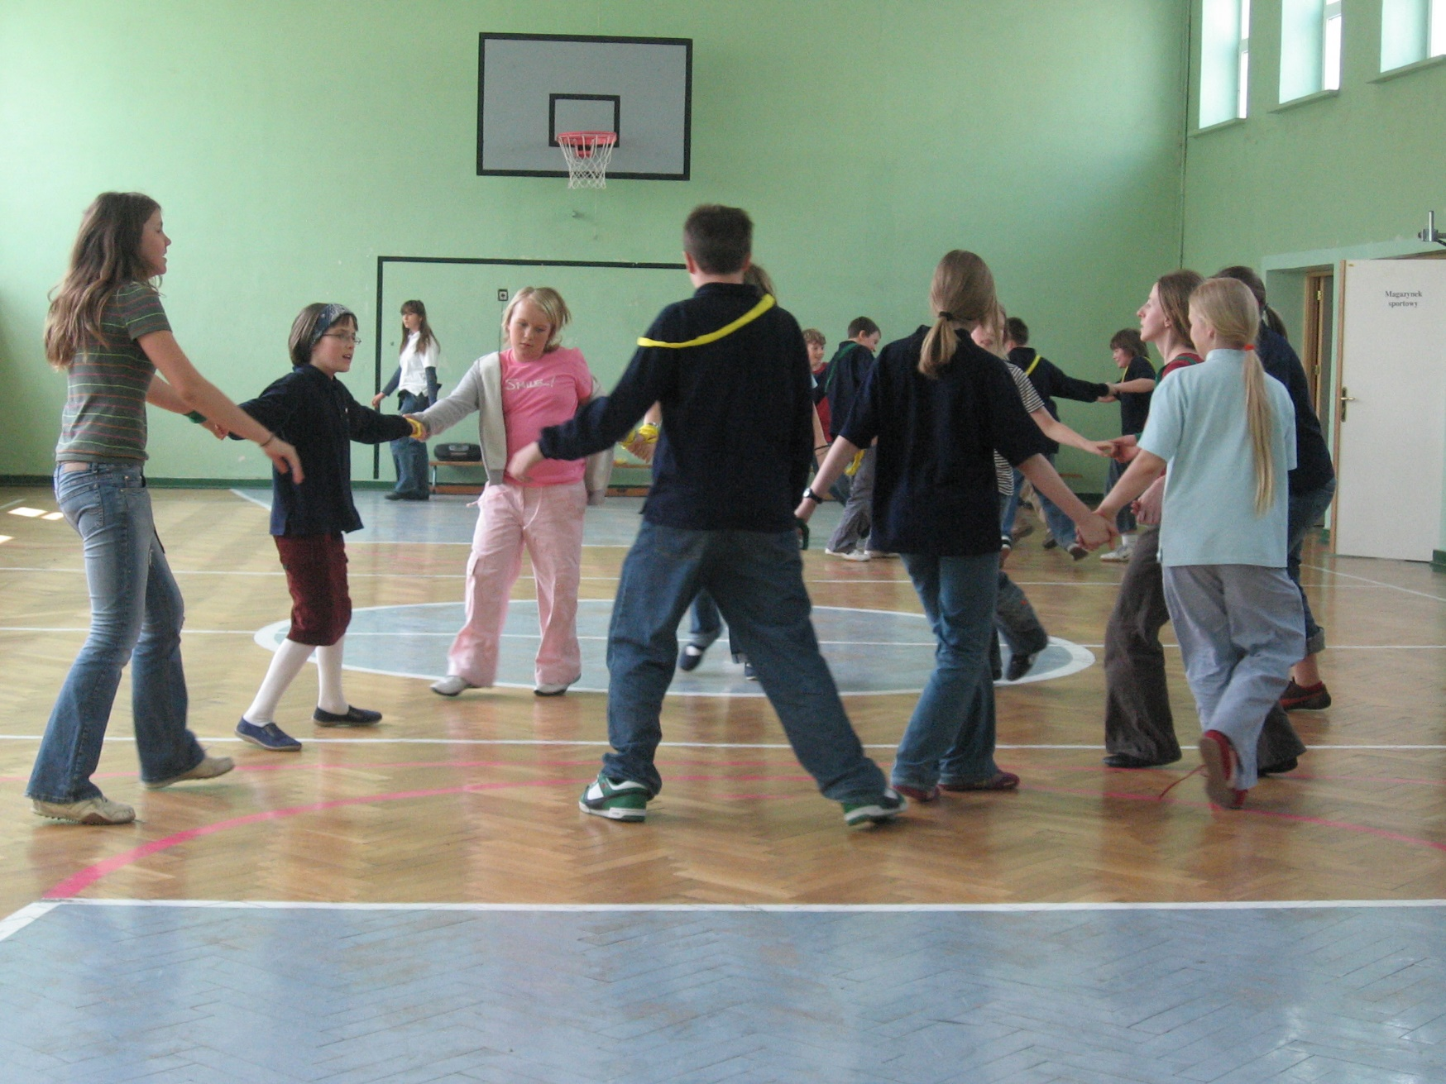
This is our gym. We exercise here and play different sports.

Slide 7
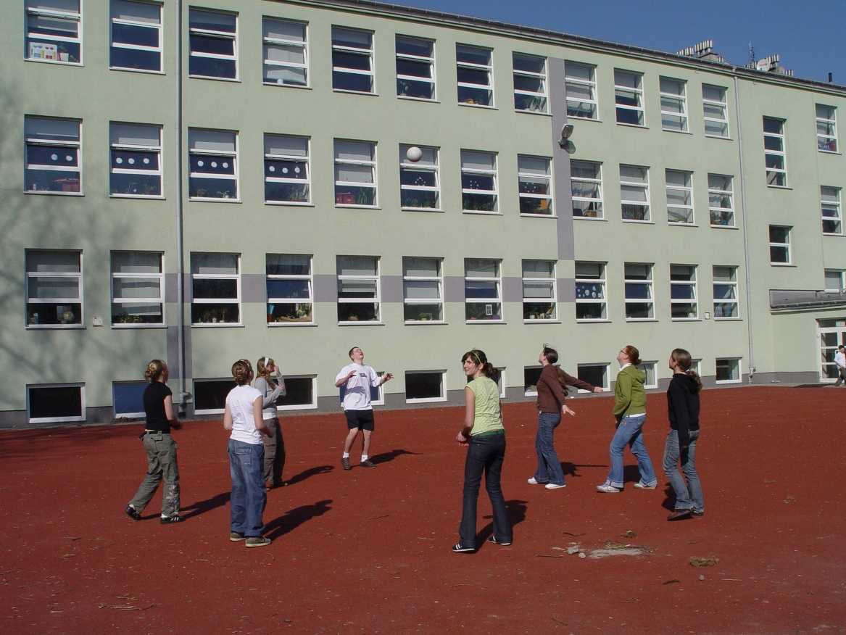
This is our playground. We play football and games here.

