Slide 1
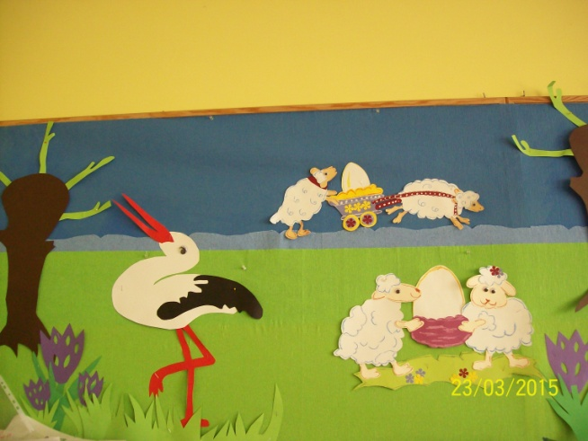
Easter traditions in poland

Slide 2
Easter breakfast
During Easter breakfast we eat food which was blessed the day before in church.

Slide 4
Easter Monday – pouring water
On the second day of Easter there is a Polish tradition of pouring water on our family members and friends.

Slide 7
Easter bunny
Easter bunny comes to Polish children and brings sweets such as chocolate eggs to baskets or nests hidden in a garden.

Slide 9
Easter decorations
Easter eggs and bunnies made by pupils from our class.

Slide 14
Easter bunny at school
Easter bunny also comes to children at school and brings sweets to baskets.

Slide 16
Easter wishes
We wish You Happy Easter: a lot of joy, health and happiness.
class 1b Ostrów Wlkp, Poland

