Slide 1
Aviation history
Amanda Logina
6.c klase

Slide 2
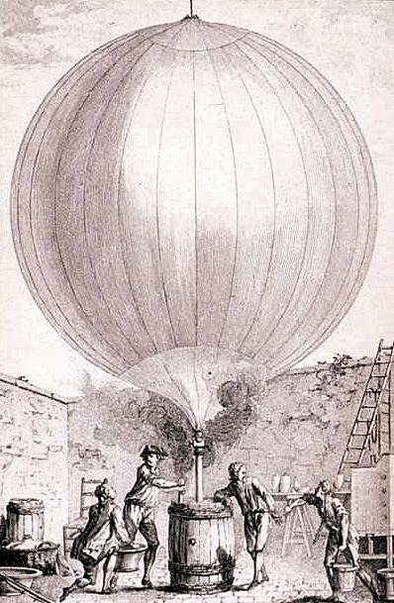
Aviation history
The history of aviation began with the first flight on November 21st, 1783 using a hot air balloon designed by the Montgolfier brothers. The practicality of balloons
was limited because they
could only travel downwind.

Slide 3
Aviation history
But the most accepted date is December 17th, 1903. The Wright brothers were the first to fly in a powered and controlled aircraft.

Slide 4
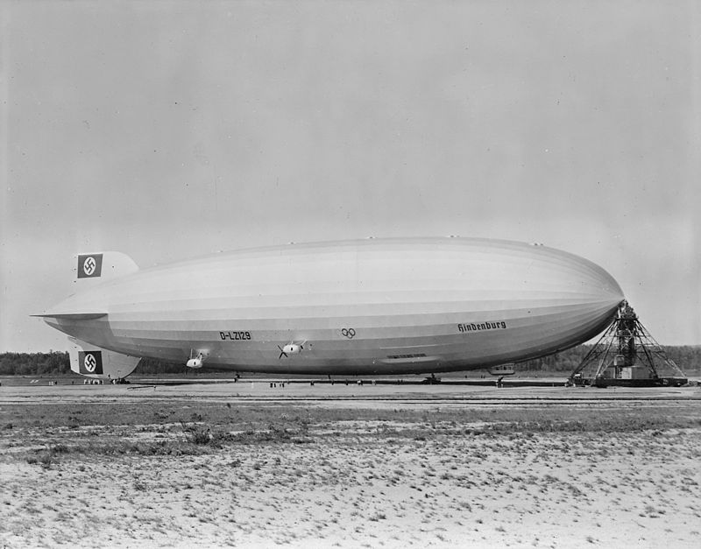
Aviation history
Jean-Pierre Blanchard flew the first human-powered dirigible.
Dirigible is easier to control, it has streamlined shape. It was filled with gas.

Slide 5
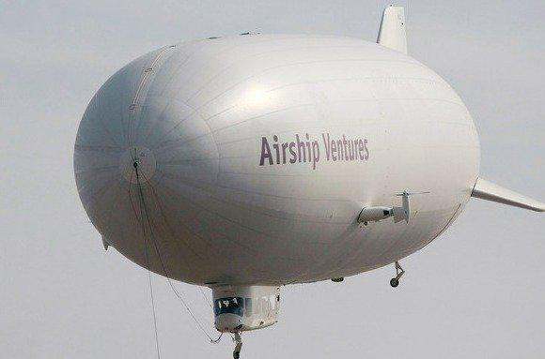
Aviation history
The best known aircraft of this type were manufactured by the German Zeppelin company.
The most successful Zeppelin was the Graf Zeppelin. It flew over one million miles, including an around-the-world flight in August 1929.

Slide 6
Dirigible '' Graf Zeppelin ' in September of 1930 flew over Riga . At the time this was the largest dirigible in the world.

Slide 7
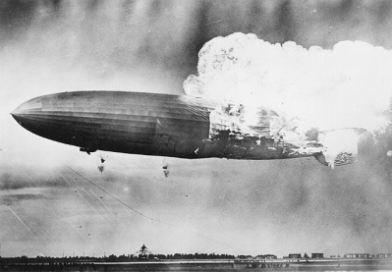
Aviation history
1931 Friedrichshafen , aircraft factory began of 200 000 cubic meters of building large- Zeppelin . The aircraft was ready in the spring of 1936 and was named the LZ -129 Hindenburg .
The "Golden Age" of the airships ended on May 6th, 1937, when the Hindenburg caught fire, killing 36 people.

Slide 8
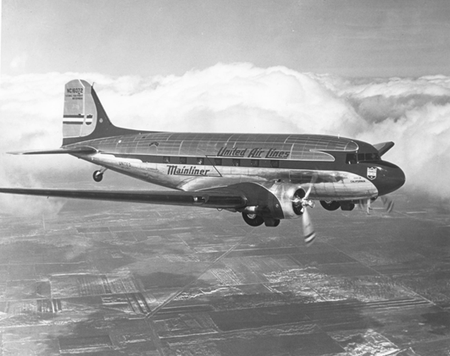
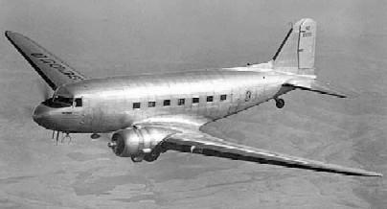
Aviation history
During the 1920s and 1930s great progress was made in the field of aviation. One of the most successful designs of this period was the Douglas DC-3 .

Slide 9
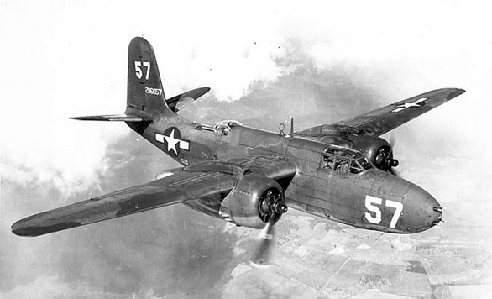
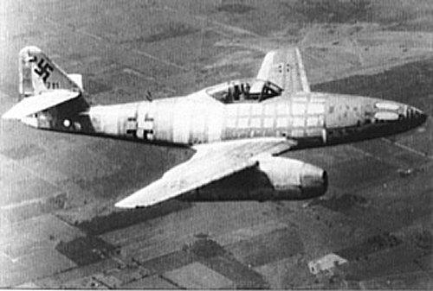
Aviation history
The war brought many innovations to aviation, including the first jet aircraft and the first liquid-fueled rockets.

Slide 10
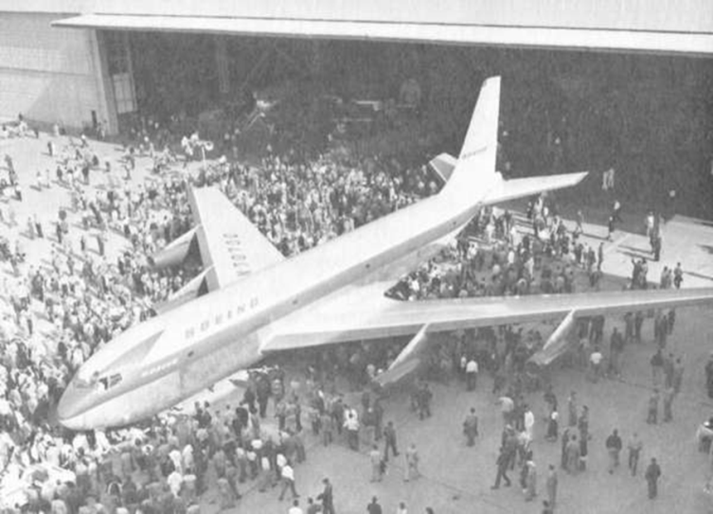
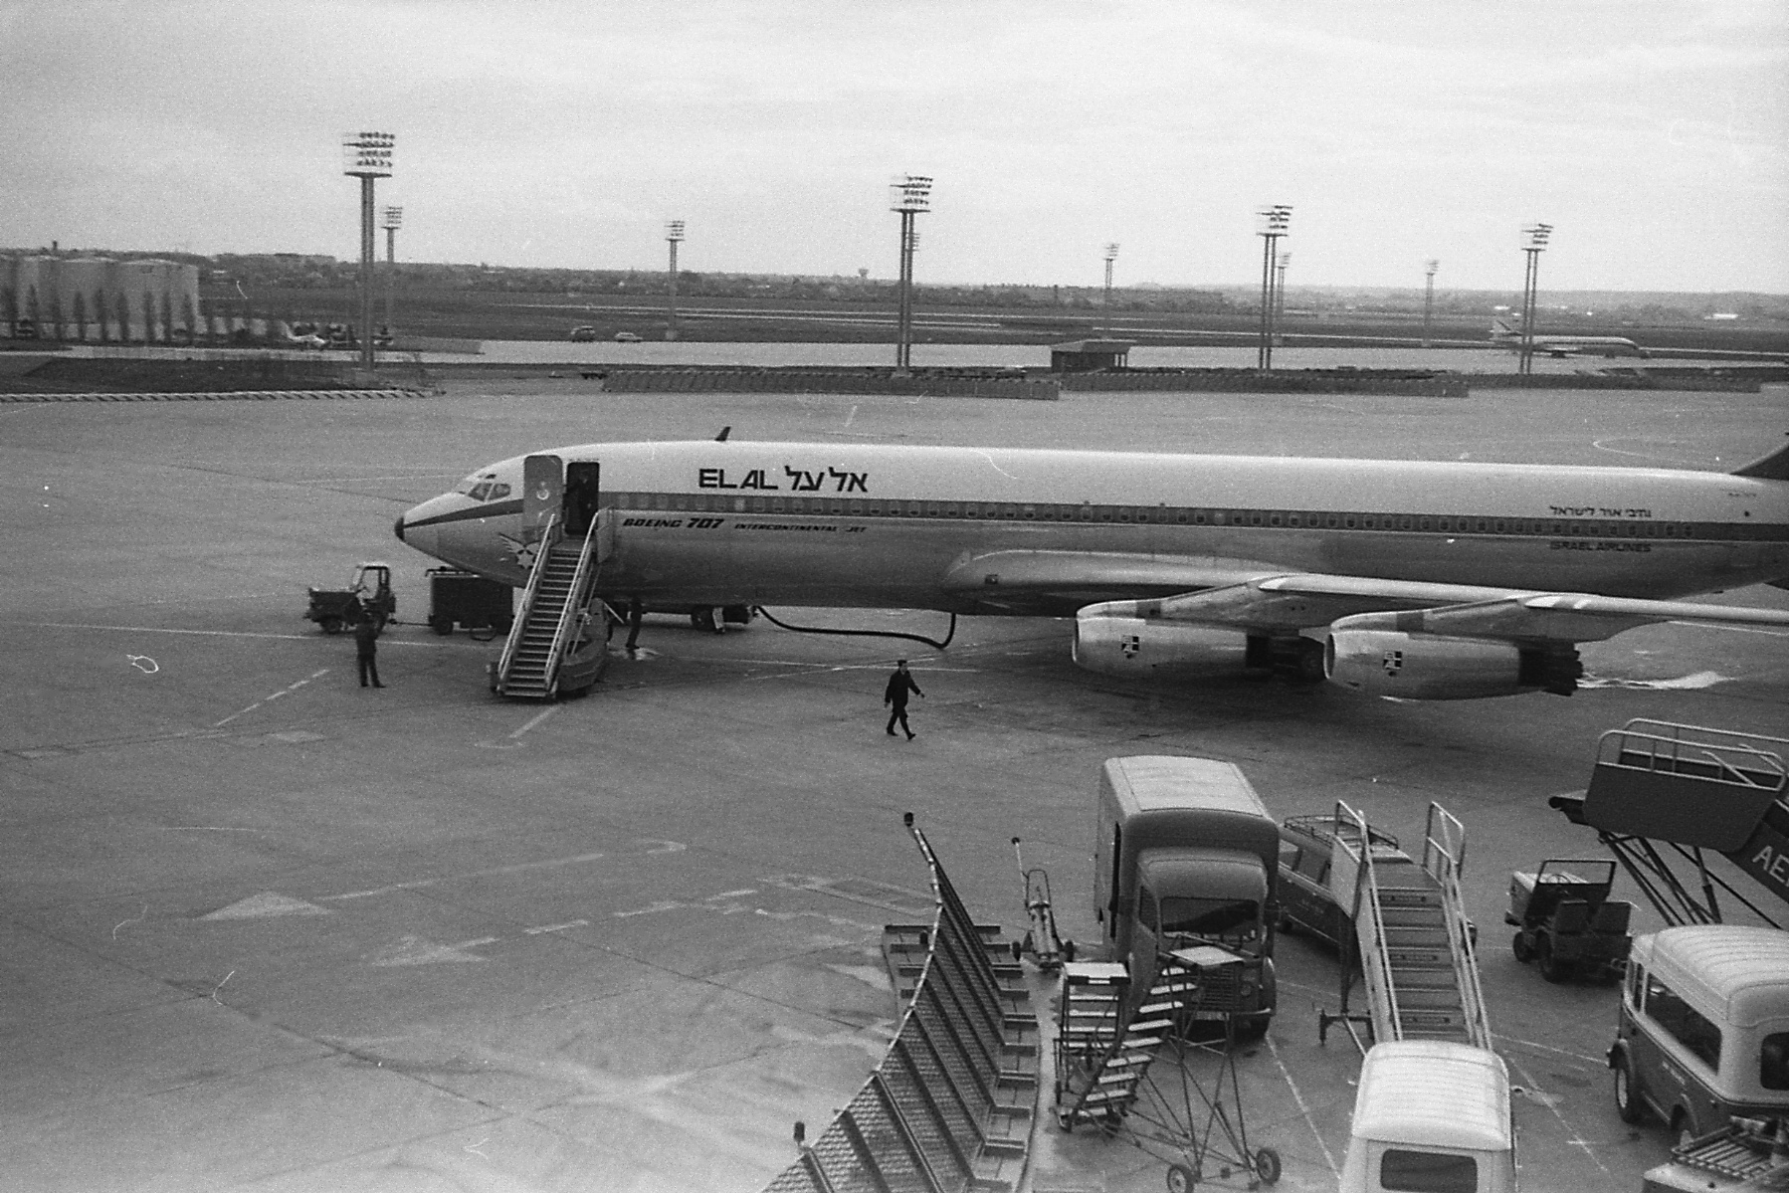
Aviation history
By the 1950s, the development of civil jets grew, beginning with the de Havilland Comet, though the first widely used passenger jet was the Boeing 707.

Slide 11
Aviation history
On June 21, 2004, Space Ship One became the first privately funded aircraft to make a spaceflight, opening the possibility of an aviation market capable of leaving the Earth's atmosphere.
Meanwhile, flying prototypes of aircraft powered by alternative fuels, such as electricity, and even solar energy, are becoming more common.

Slide 12
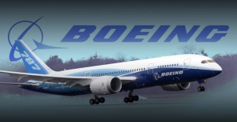
Main manufacturers
Airbus, based in Europe
Boeing, based in the United States
Bombardier, based in Canada
Embraer, based in Brazil
United Aircraft Corporation, based in Russia
Boeing, Airbus, Ilyushin and Tupolev concentrate on wide-body and narrow-body jet airliners, while Bombardier, Embraer and Sukhoi concentrate on regional airliners.

Slide 13
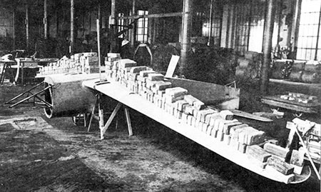
Aviation history in Latvia
In 1935 Kārlis Irbītis on manufacture VEF proposed to start Ikara type of airplane production, but many did not support this idea , because it was considered that the Latvian aircraft manufacture is not possible, they can only be imported. But VEF director T. Vītols and sales department manager Johansson agreed to begin production of the airplane .

Slide 14
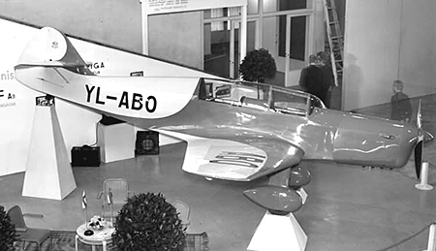
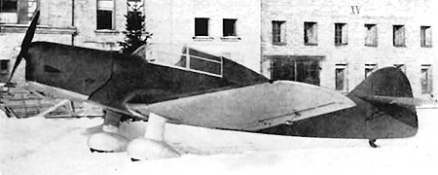
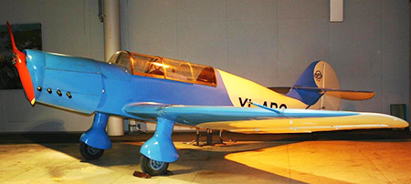
Aviation history in Latvia

Slide 15
Thanks for attention.

