Slide 1
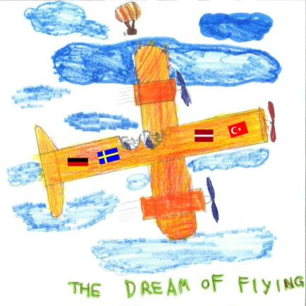
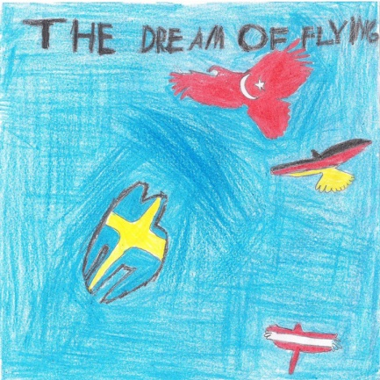
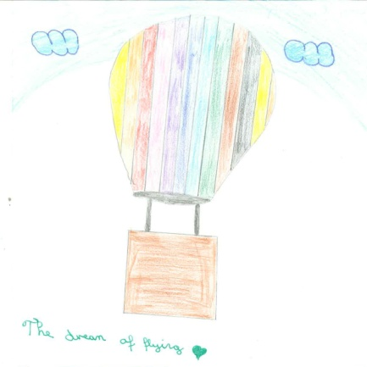
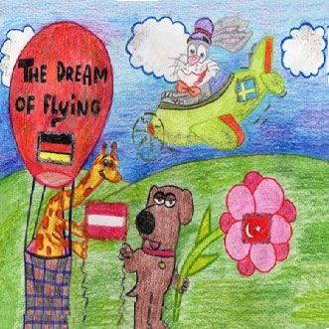
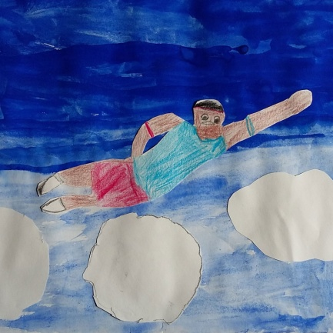
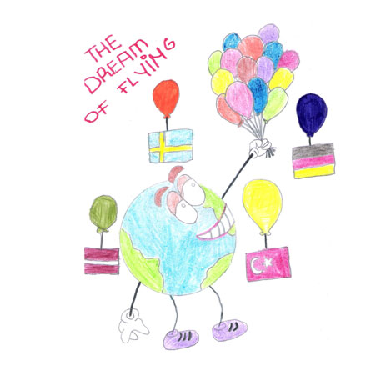
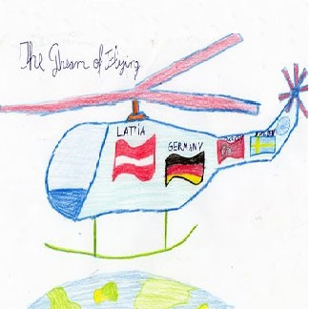
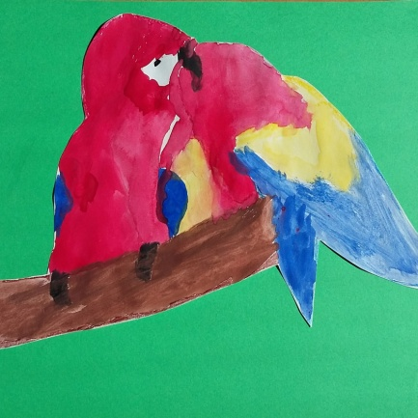
Results of
Final round
Logo competition
22nd Mai 2015

Slide 2
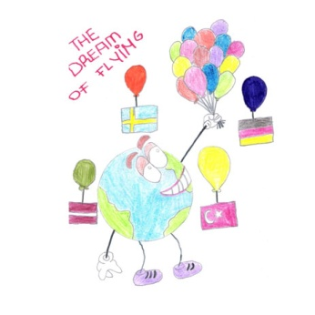
And the winner is ….
CONGRATULATIONS TO ALL OF YOU
Linnea from Sweden with 6 points
Linnea / Sweden
Davids / Latvia + Kerim / Turkey
Amir / Germany
Two logos won the 3rd place
Davids and Kerim with 4 points each.
2nd place for Amir with 5 points

