Slide 1

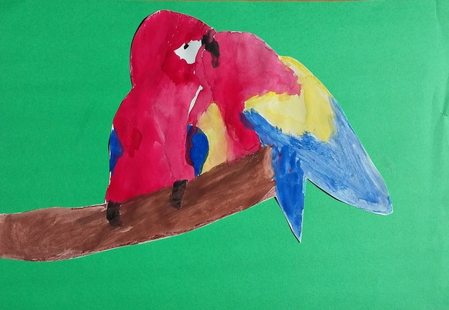
Experiment with seed expansion models
eTwinning project „The Dream of flying”
Balvi primary school
Class 6.c

Slide 2
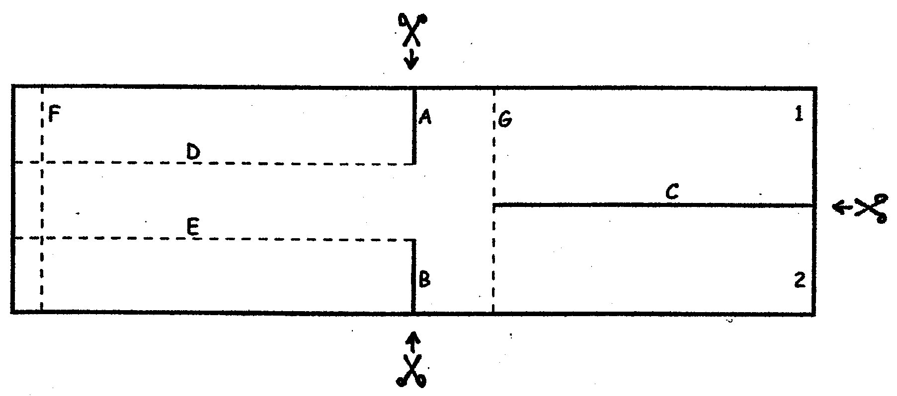
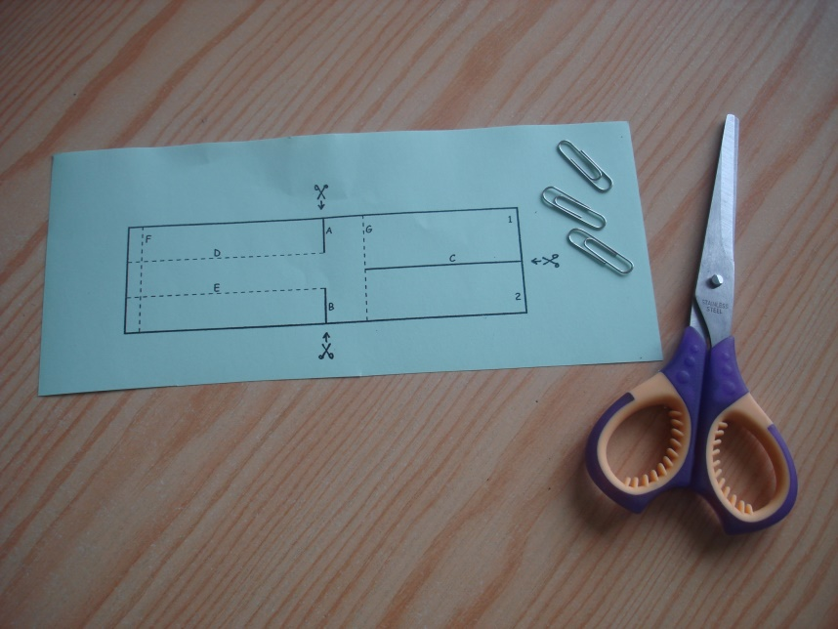
You need:
The pattern, scissors, paper clips.

Slide 3
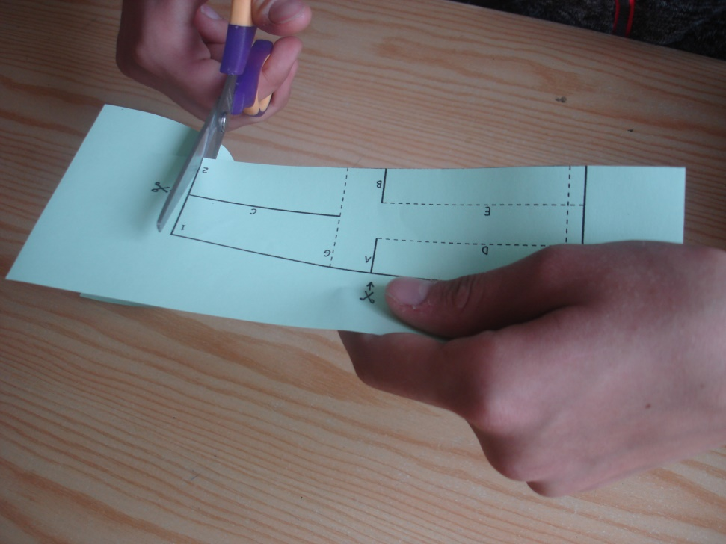
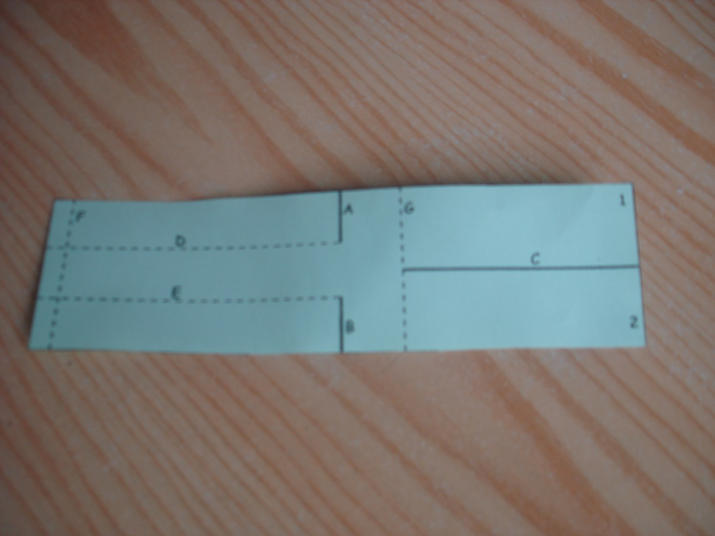
Cut the given pattern!

Slide 4
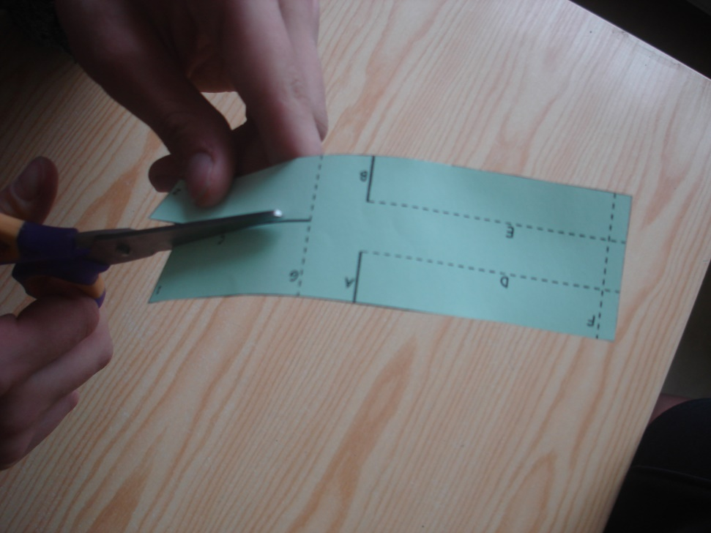
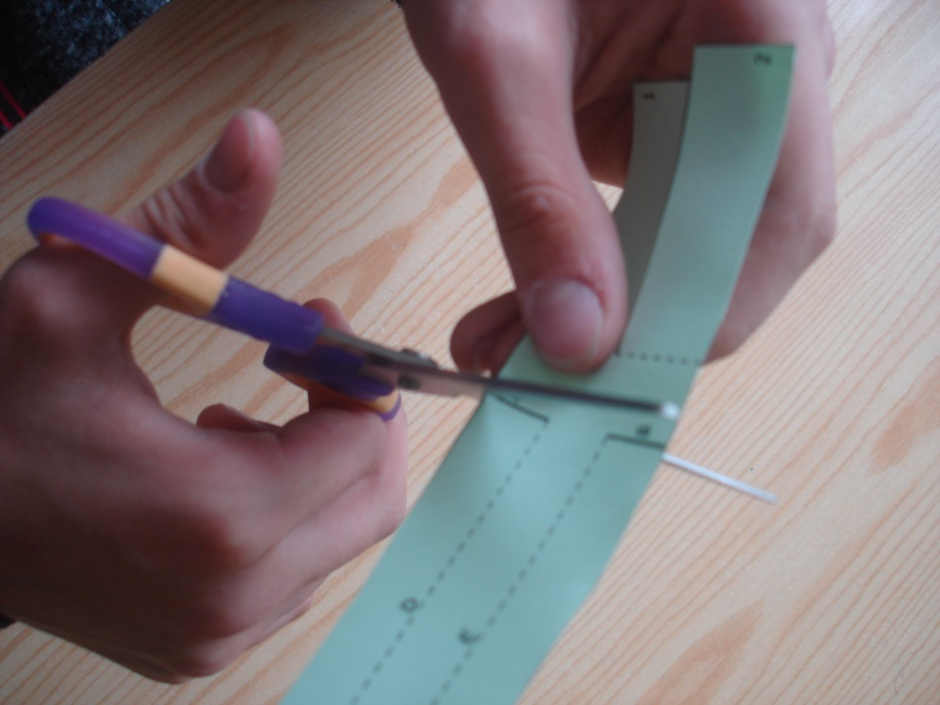
Make the cuts through the A, B and C lines!

Slide 5
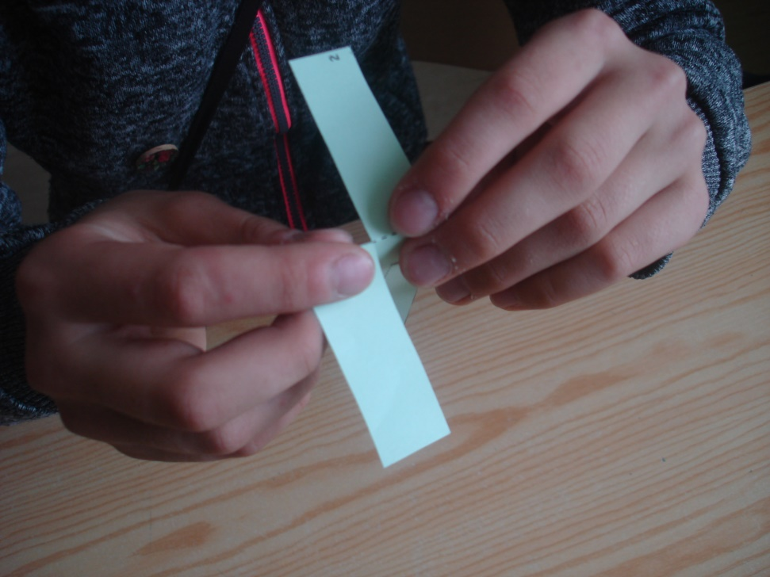
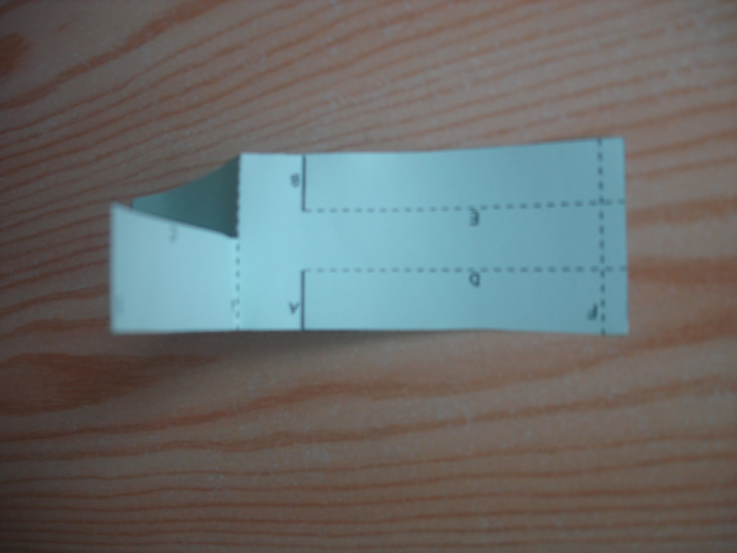
Unbend the parts 1 and 2 sheets by G line on both sides!

Slide 6
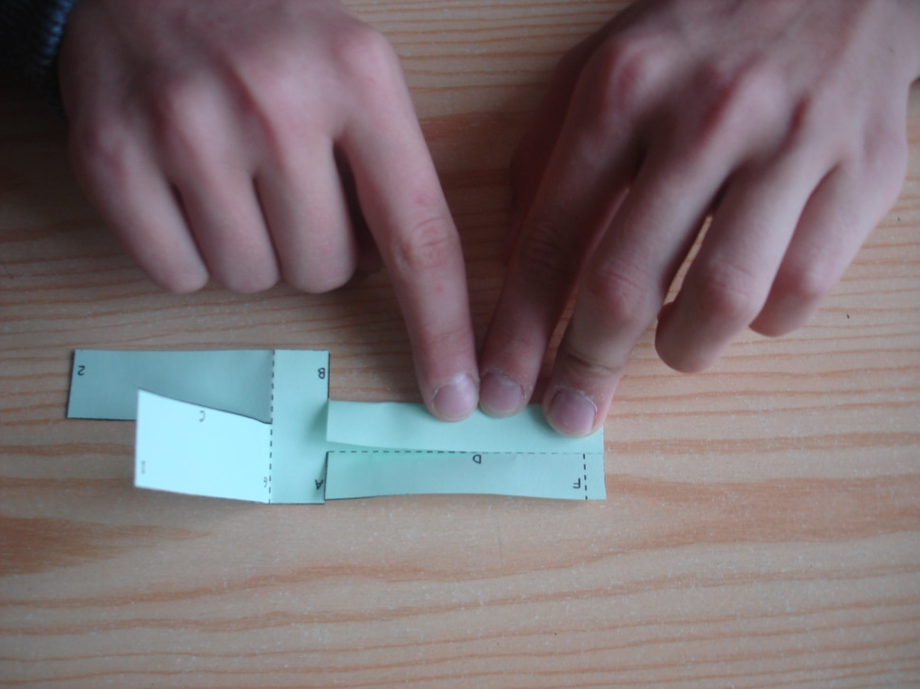
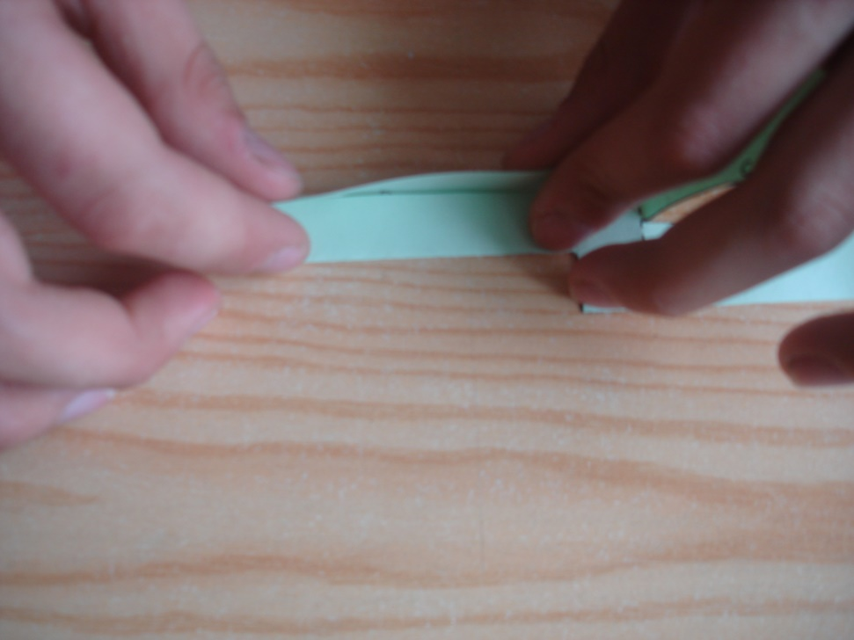
Fold along the D line!
Then fold up the E line!

Slide 7
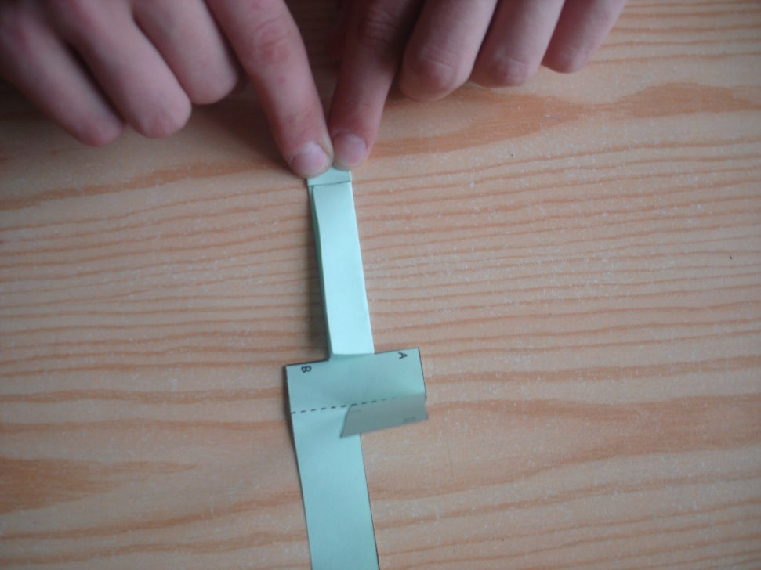
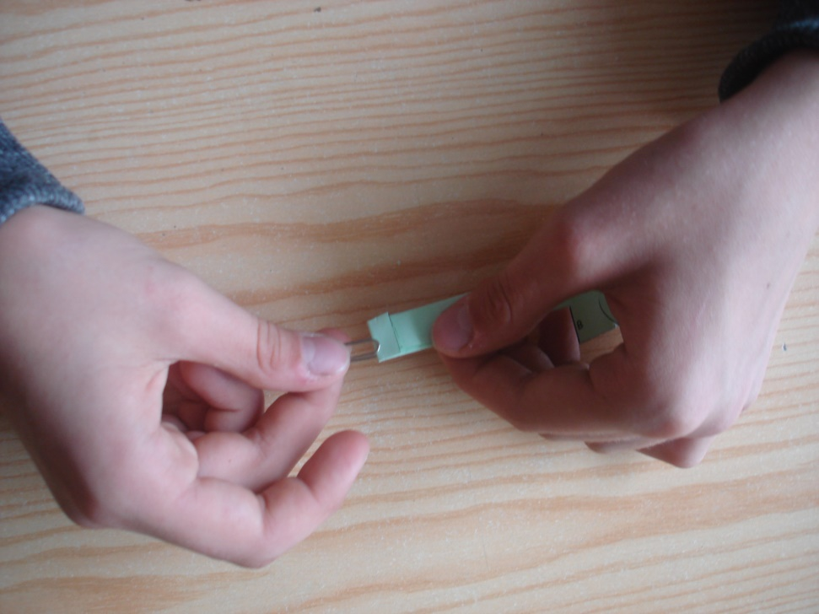
Fold up the F line!
Fix the folding with paper clip!

Slide 8
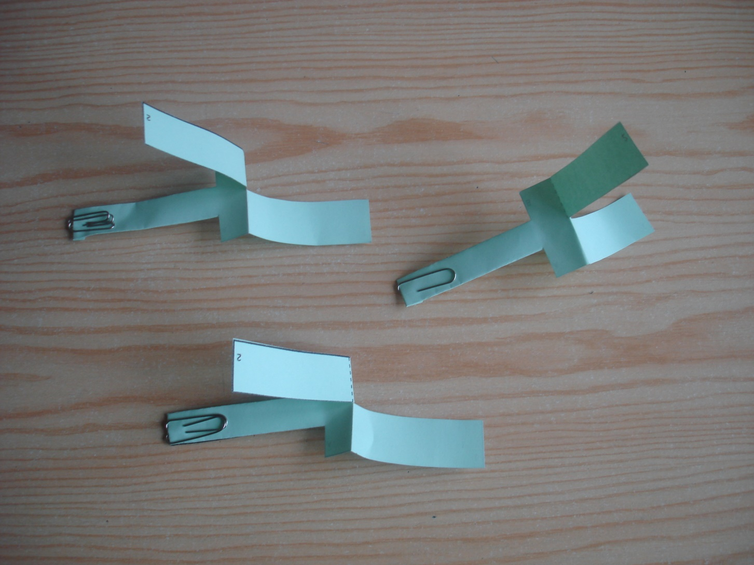
Make two more models!
Fix them with 2 and 3 clips!

Slide 9
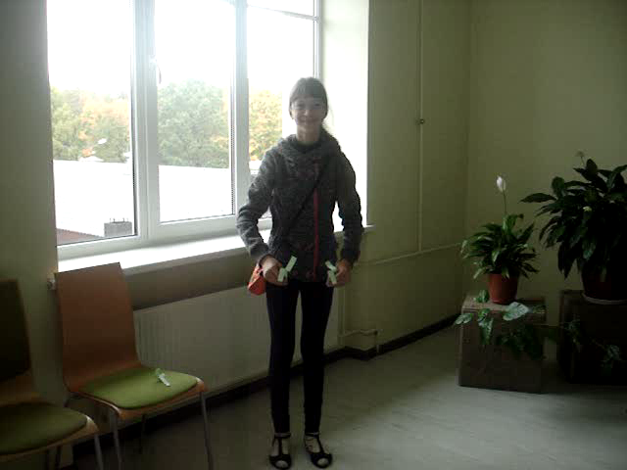
Throw the models in the air and watch the flight! Click on picture!

Slide 10
Repeat the experiment and think!
Which model does more quickly reach the ground?
How do the number of clips affects the flights?
The less clips, the longer flight.
The more clips, the model is getting heavier and faster is falling to the ground.

Slide 11
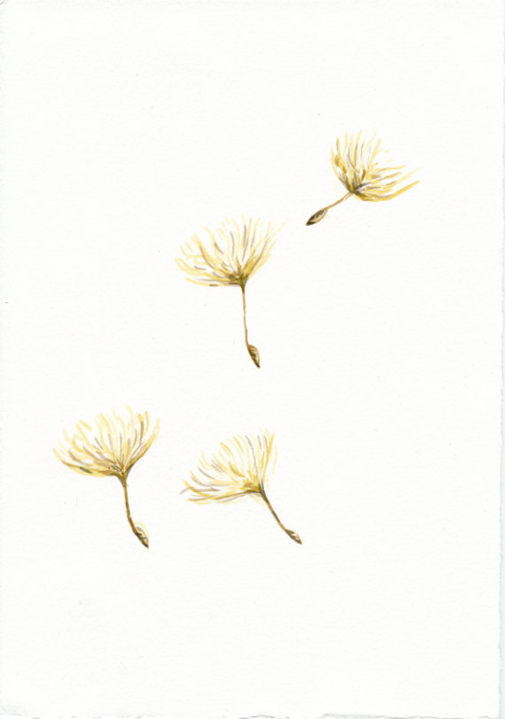
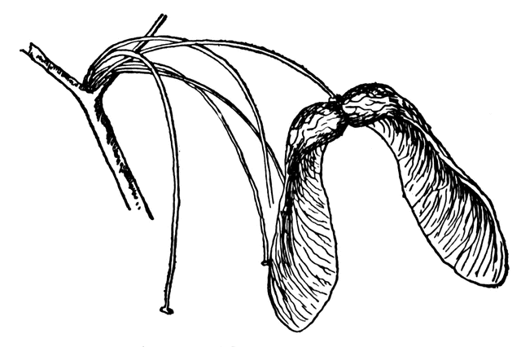
Similarities in the nature
Maple seed moves like this model and spuns in the air like a helicopter.
Dandelion fluff moves as a balloon, where the wind blows, there it flies.
http://etc.usf.edu/clipart/3400/3461/sugar-maple-seeds_1.htm
https://www.etsy.com/listing/106208285/dandelion-fluff-flying-dandelion

Slide 12
Enjoy!

