Slide 11
Brussels 2

Slide 12
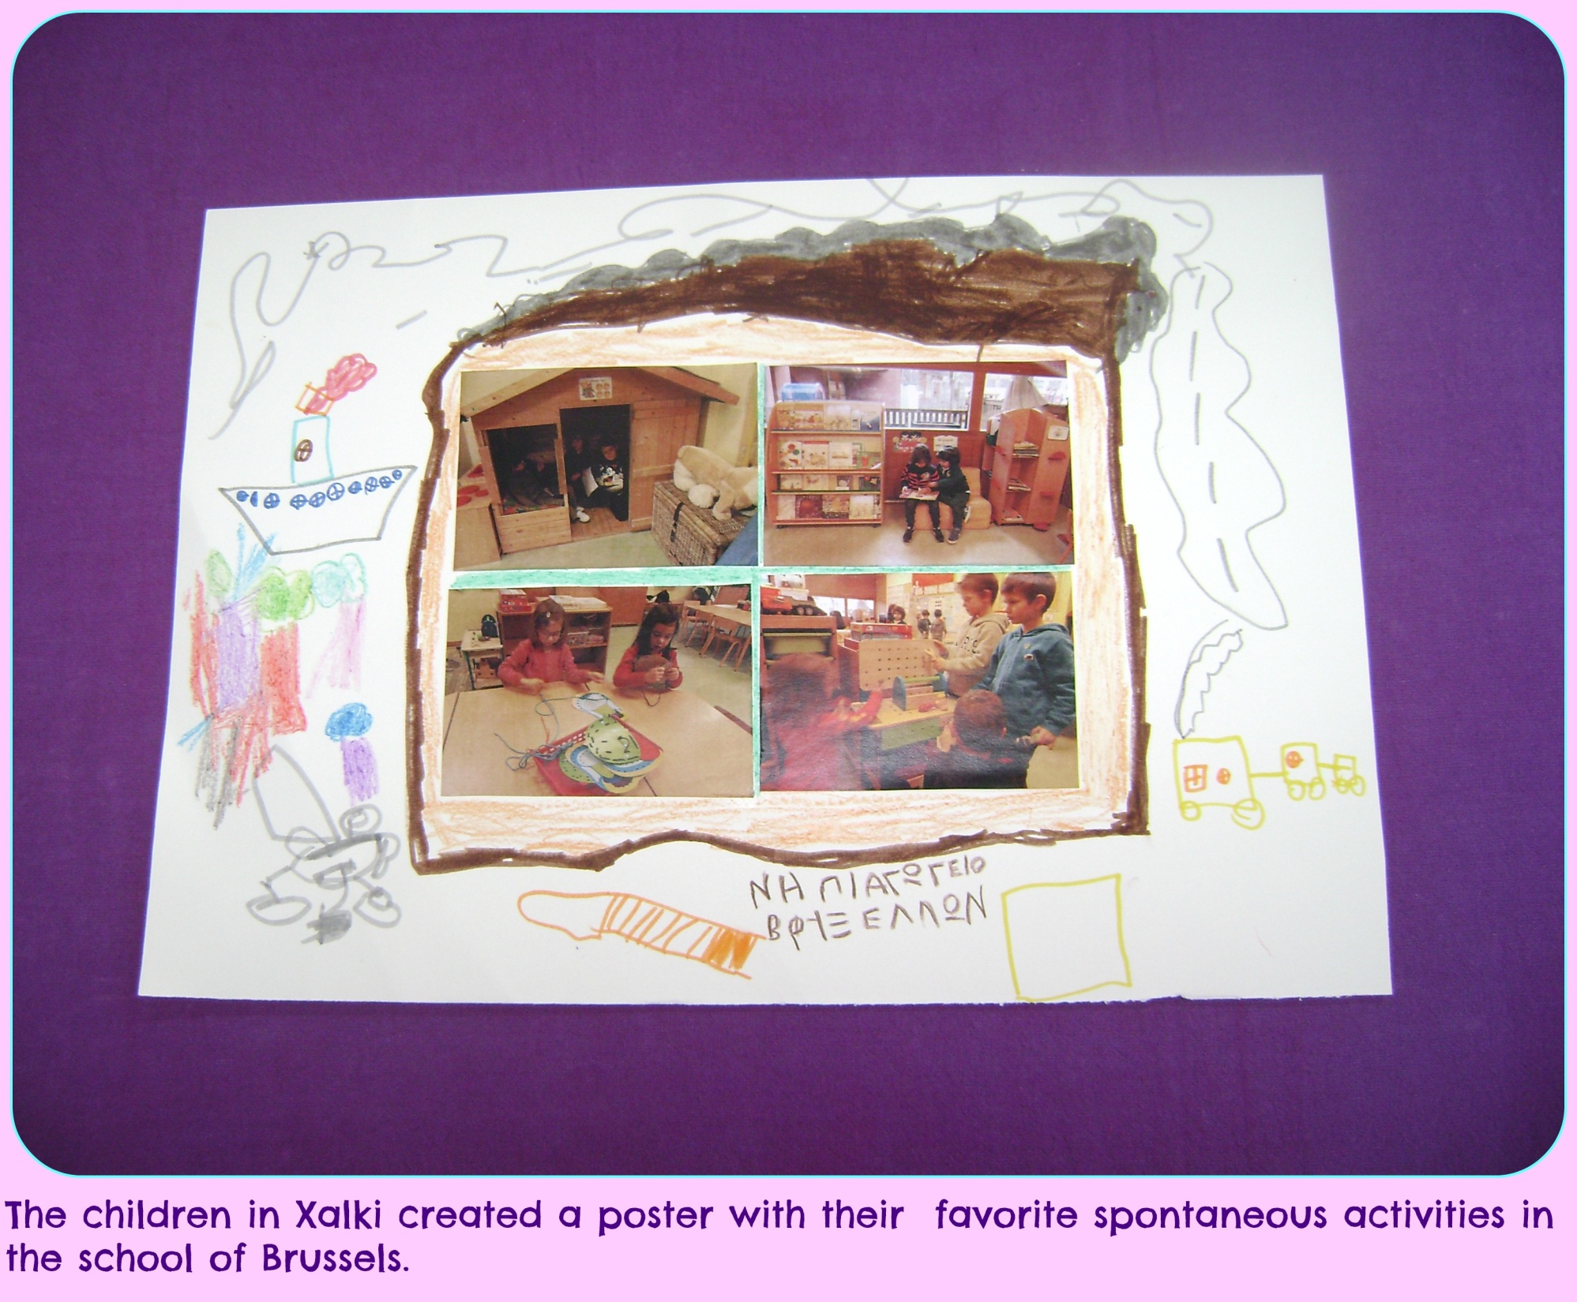
Brussels 3

Slide 13
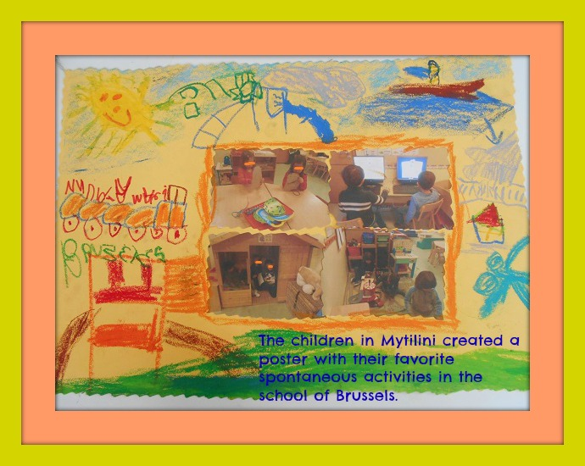
Brussels 4

Slide 16
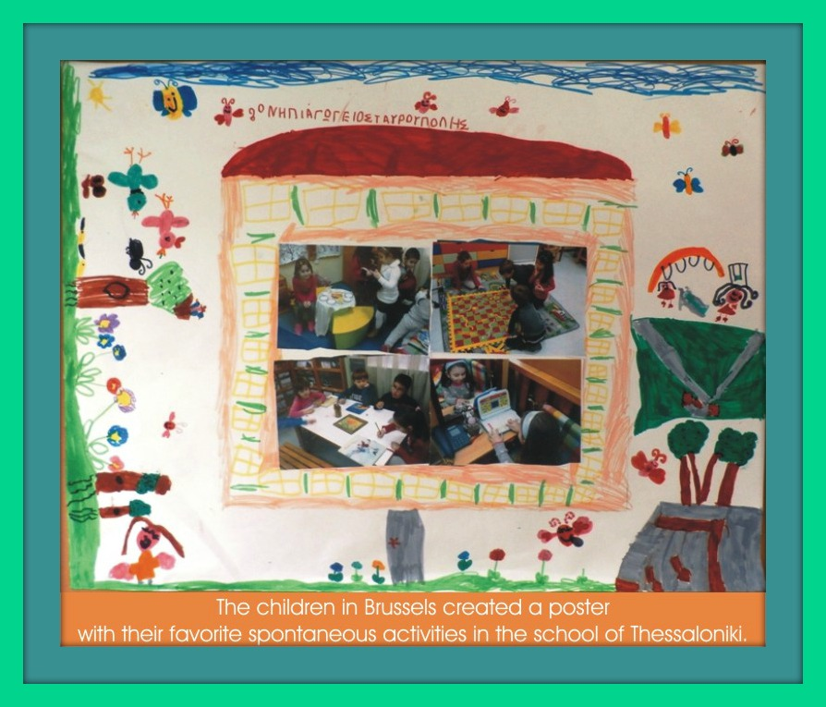
Thessaloniki 2

Slide 17
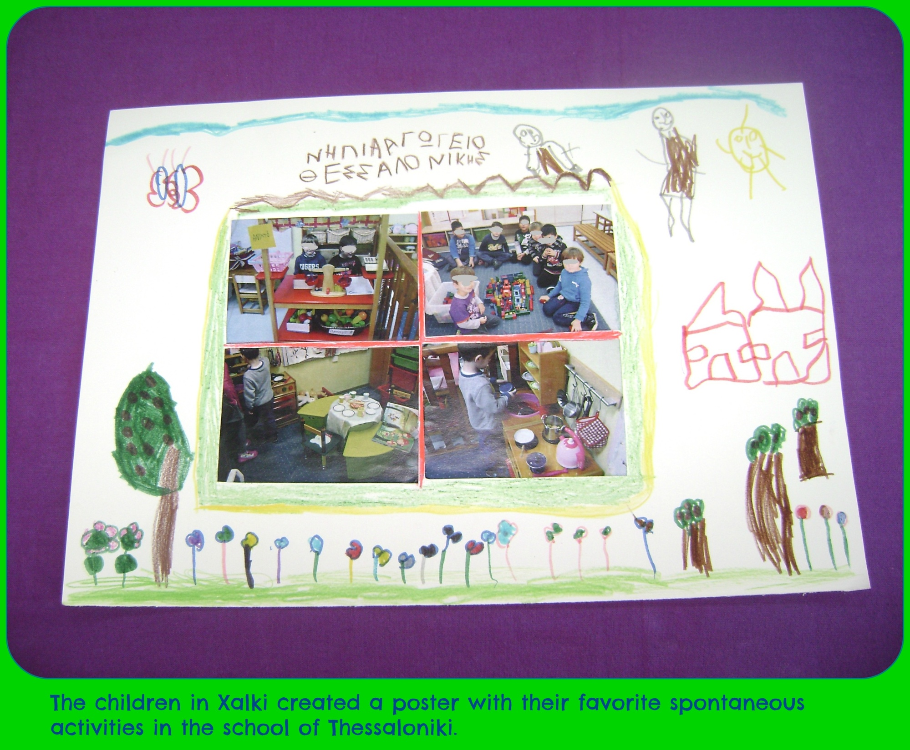
Thessaloniki 3

Slide 18
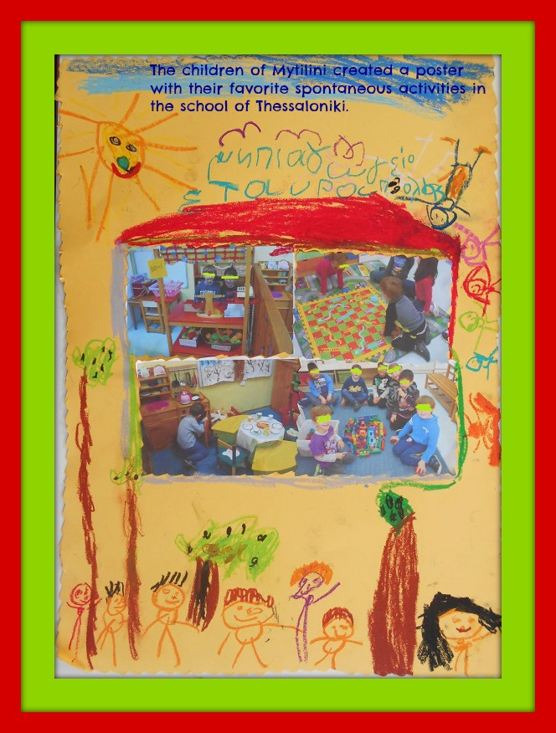
Thessaloniki 4

Slide 20
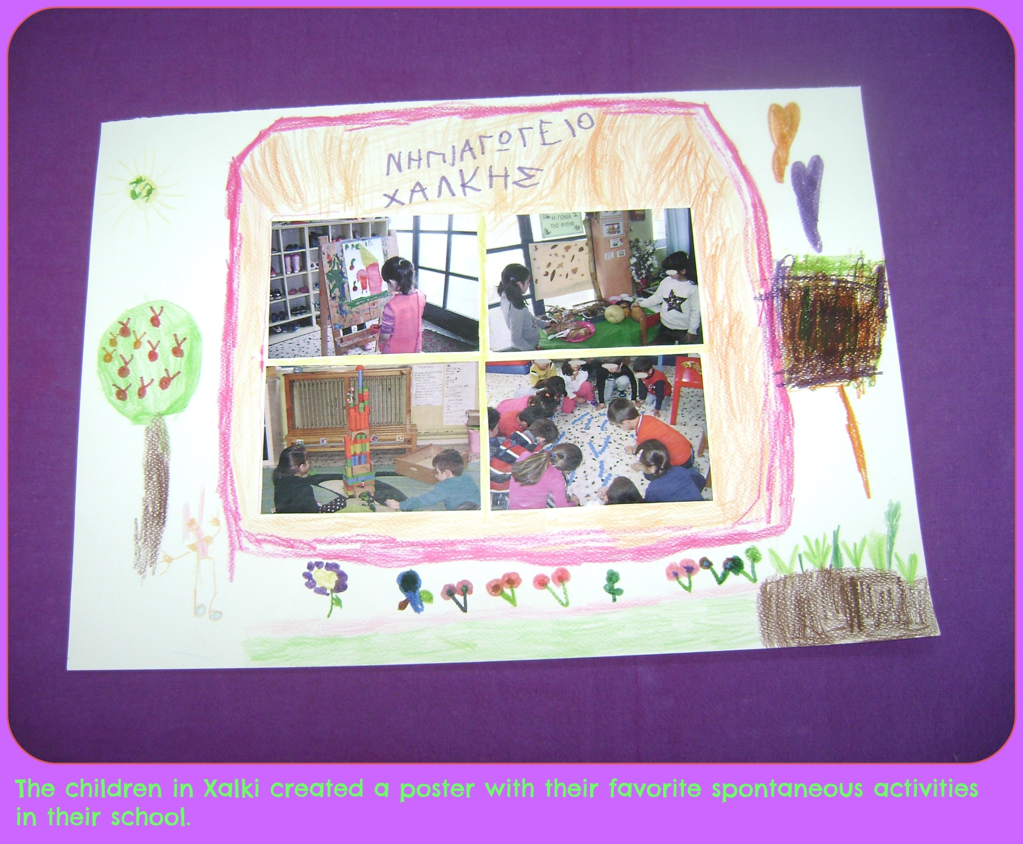

Slide 21
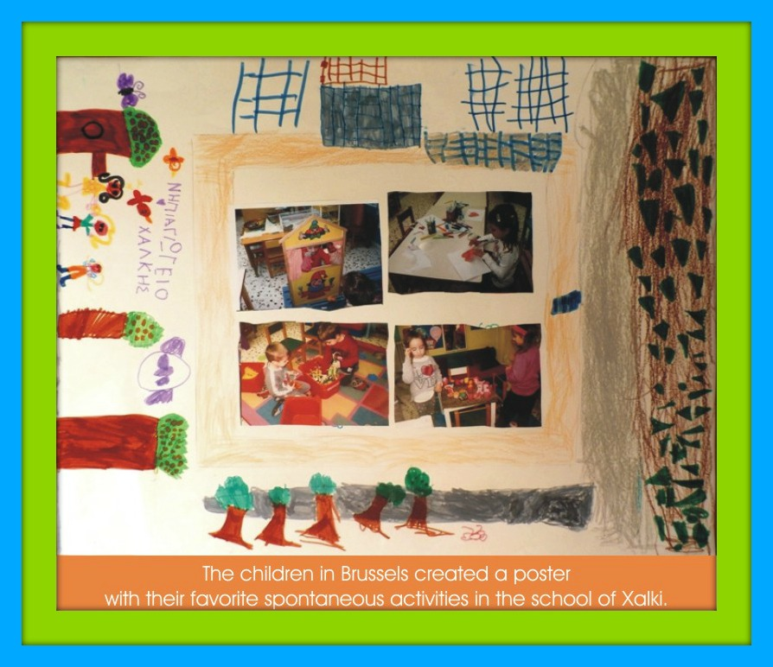
Xalki 2

Slide 22
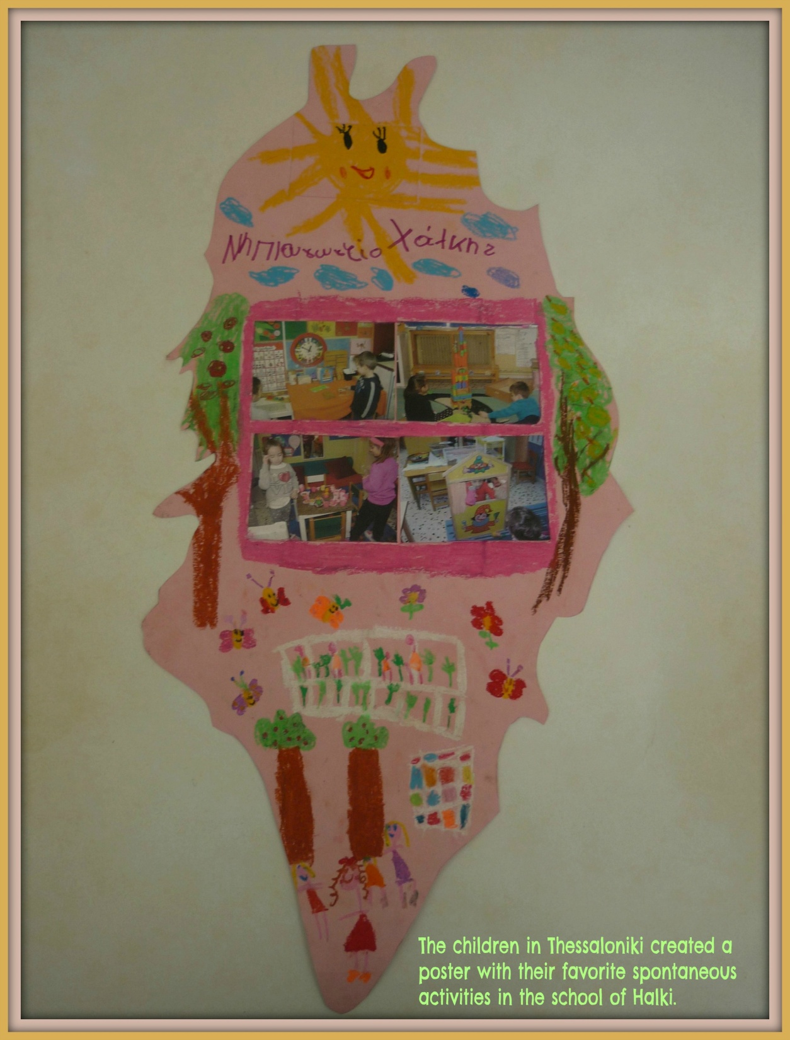
Xalki 3

Slide 23
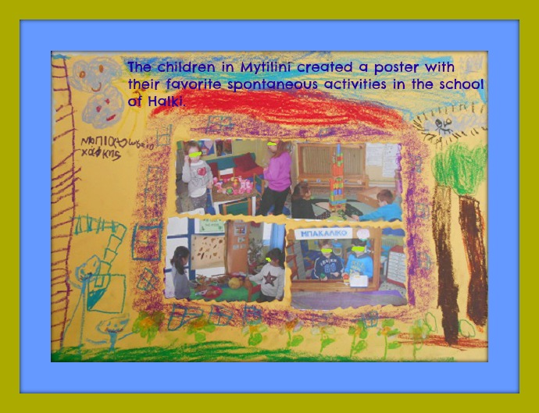
Xalki 4

Slide 25
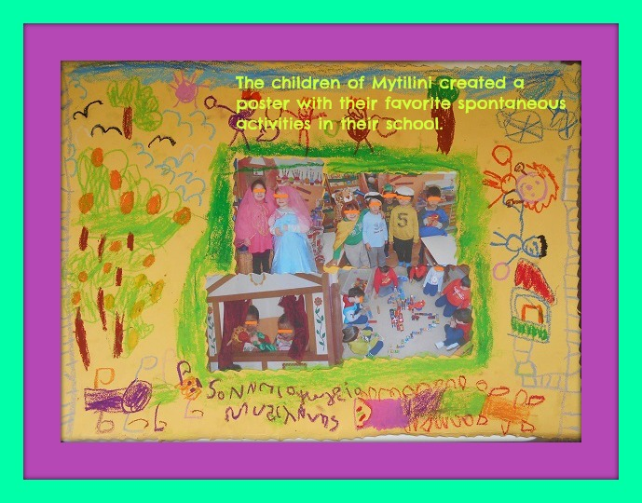

Slide 26
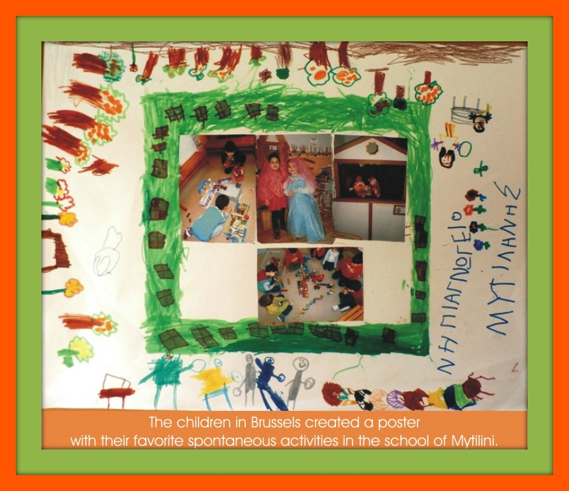
Mytilini 2

Slide 27
Mytilini 3

Slide 28
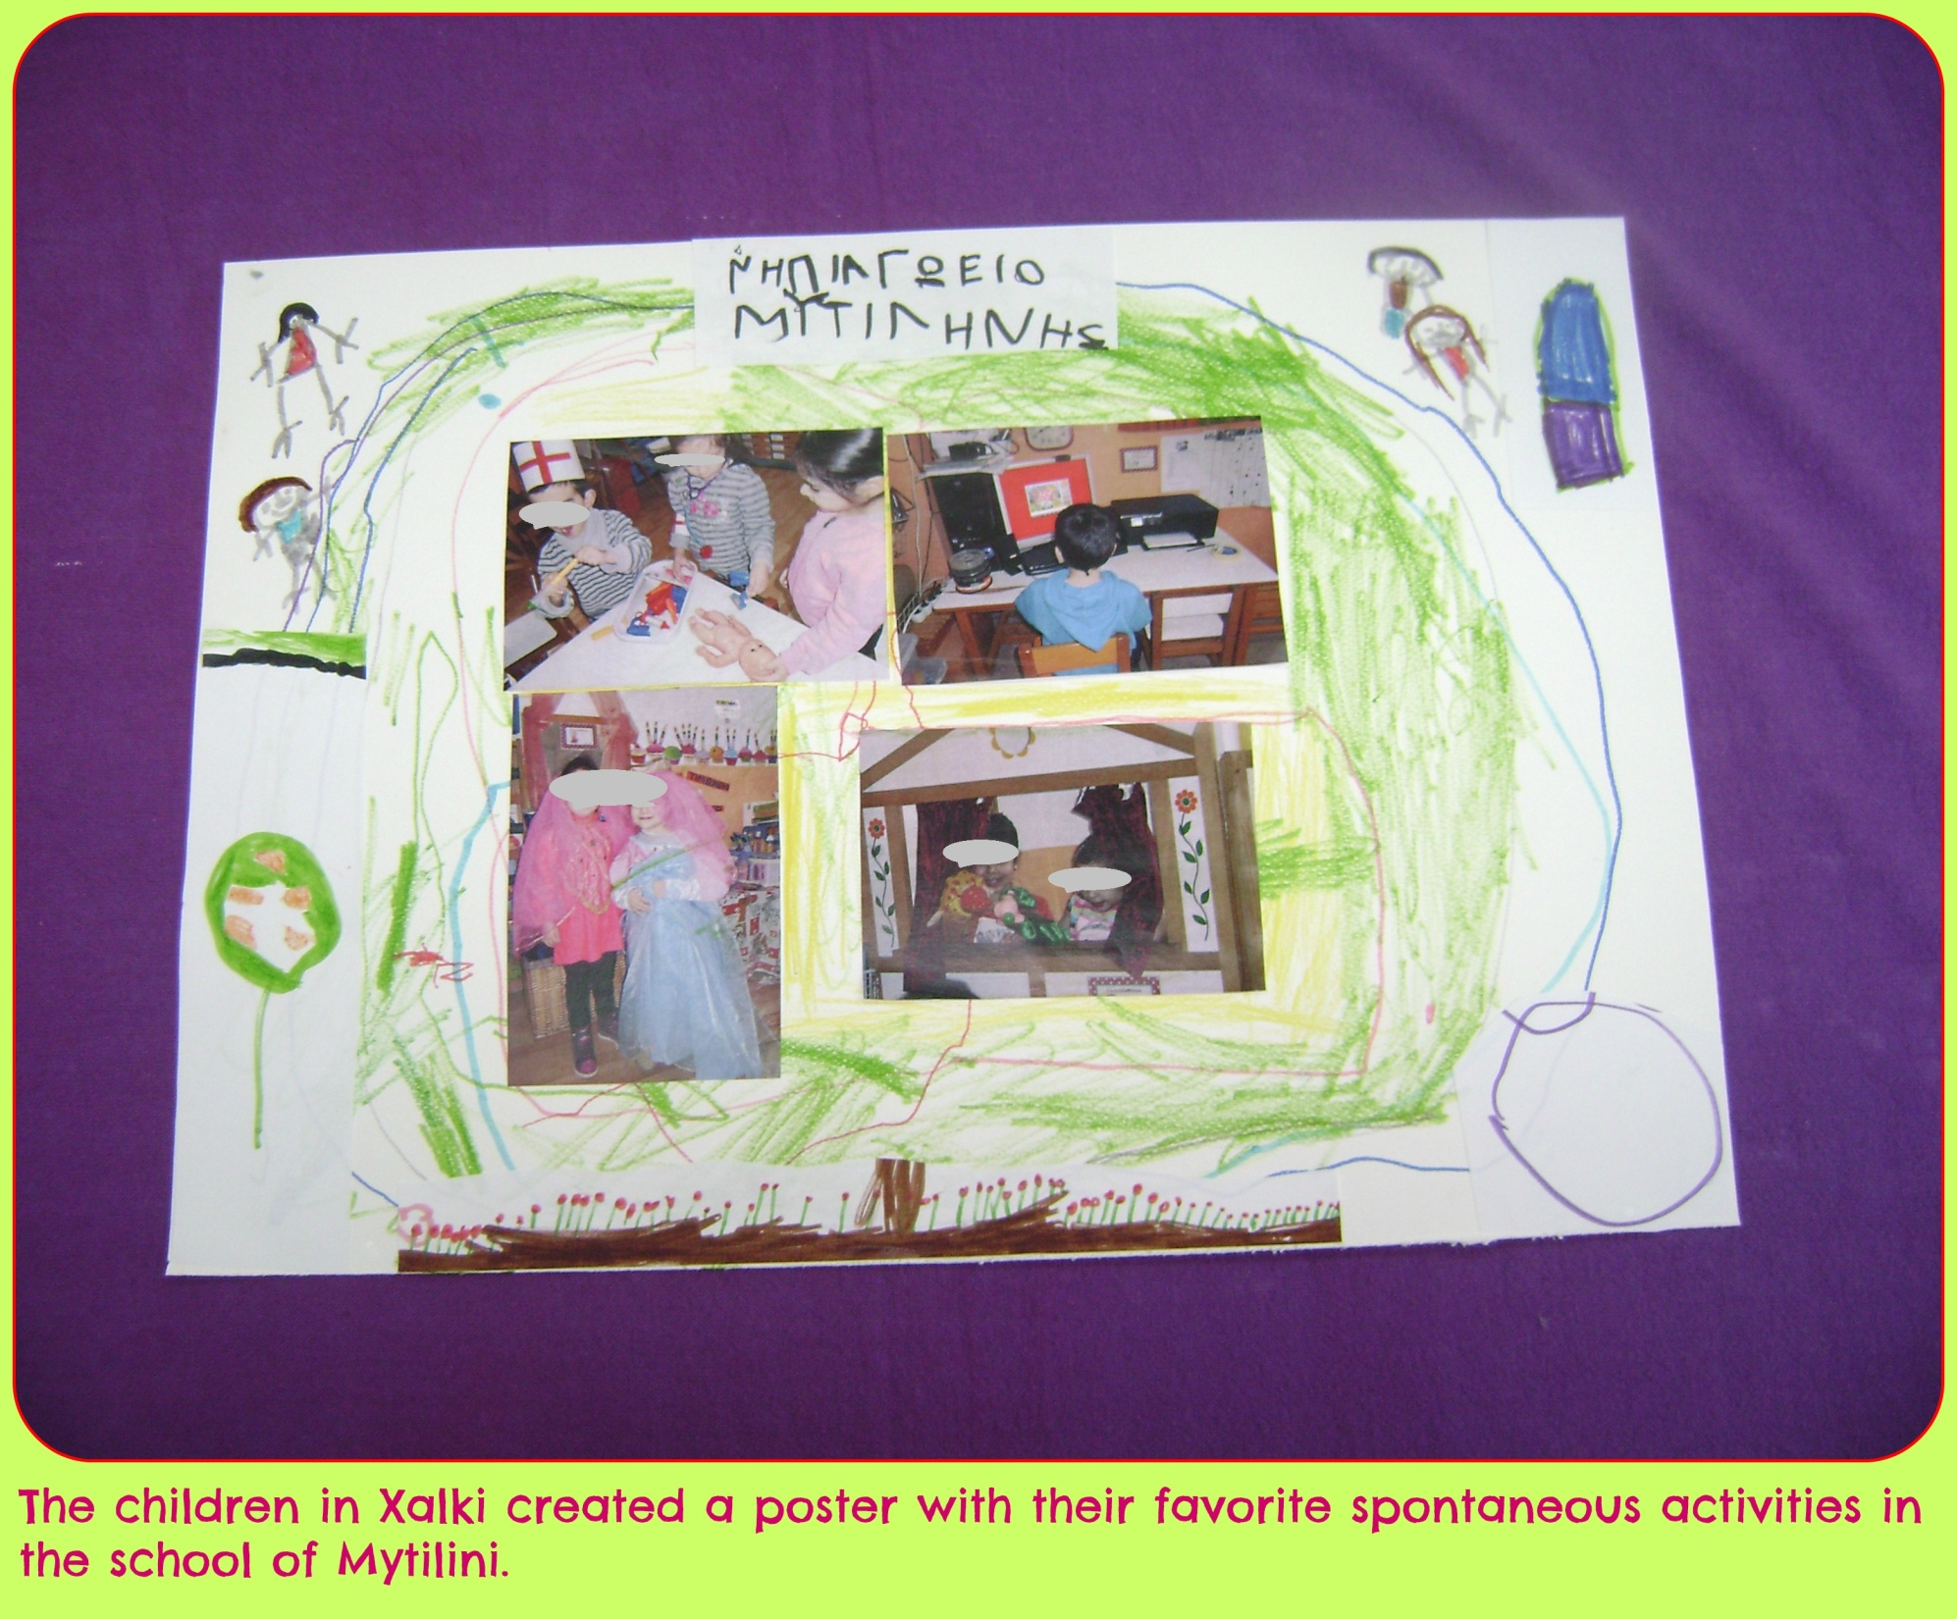
Mytilini 4

