Slide 1
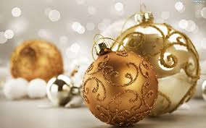
Welcome
This is a presentation of Polish Christmas traditions

Slide 2
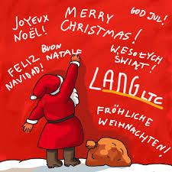
Christmas in Poland
Christmas - Christian tradition - the feast commemorating the birth of Jesus Christ. It is a permanent liturgical ceremony on December 25 . Christmas is preceded by a three-week waiting period (exactly four Sundays) , called Advent .

Slide 3
First star
It is a symbol of the Star of Bethlehem , whose appearance was accompanied by the birth of Jesus. Thanks to the shepherds , the Magi could reach the place of birth of the Savior. Today we expect the first star , which appears on Christmas Eve sky. It was only when she can shine , according to tradition , sit down to the table and divide the wafer .

Slide 4
Twelve dishes
At Christmas in Poland prepares to twelve dishes
borscht dumplings with cabbage and mushrooms carp ears mushroom soup boiled wheat with poppy seeds and honey served on Christmas Eve dumplings with poppyseed gingerbread poppy-seed cake vegetable salad track cheesecake

Slide 5
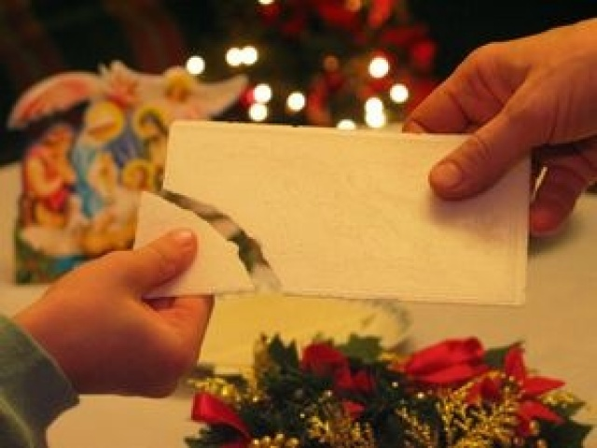
Breaking the wafer
Its name comes from the Latin word oblatum and means the same as the offering . This is nothing more than a thin piece of baked wheat flour and water. On it appear the images associated with Christmas. Sharing of bread has its roots in pagan traditions . With time, it passed permanently into Christian traditions , and today we share the wafer before Christmas Eve , we make a wish . Wish we make ourselves while sharing the wafer must be sincere , forgive yourself then all the blame to sit down to dinner at peace and pure hearts .

Slide 6
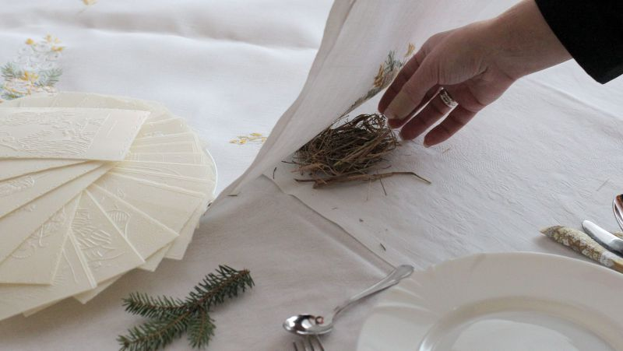
Hay Christmas Eve
We put them under a white cloth on the table where we eat Christmas Eve dinner. Of course symbolizes the place in which Jesus was born - the nativity scene and hay, which lay at birth.

Slide 7
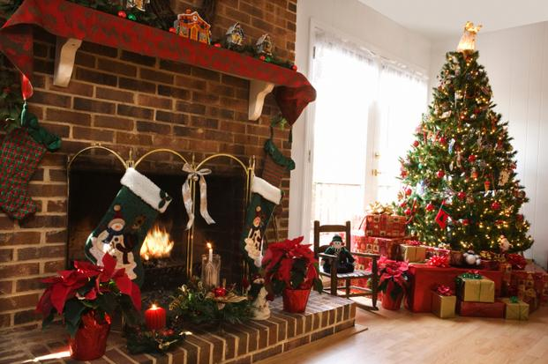
Christmas tree
She dresses usually on Christmas Eve or December 23 . Once they were adorned with bundles of hay or branches. Over time, the habit of bringing home and dress in various decorations of pine trees , moved from Germany to other Christian countries. Christmas decorations should be associated with the symbolism of Christmas, and at the top hangs a Christmas ornament in the shape of a star of Bethlehem. Once hung apples , which probably symbolized the biblical parable of Adam and Eve , the apple today replace glass baubles. Green tree is a symbol of life and the birth of the Savior. Christmas tree lights should illuminate for the first time after the appearance of the first star .

Slide 8
Christmas carol
We begin to sing them at the Christmas table. These are songs that tell the story of the Nativity of the Lord. Their name comes from the Latin - Calendae , which meant the first day of the month . The first " carols " were sung by the Romans in the framework of the solemn celebration of the first of January , after the custom of singing the songs took the Christians to worship the birth of Jesus . The oldest Polish carol is "healthy or king angelic " and comes with approx. 1420 years .

Slide 9
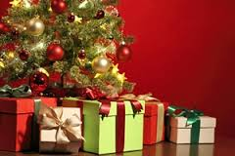
Gifts
He nicest , for many, the custom of Christmas . Today, they mostly associate Christmas. Originally this custom was associated only with a person of St . Nicholas , now , for Luther assume that these are gifts for the baby Jesus .

Slide 10
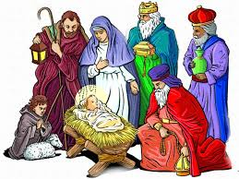
Stable
In it , Jesus was born . It is also a symbol of ourselves. We're as stable , which is not always clear where the good is intertwined with evil. But it is to the stable , and therefore to us , ordinary people, comes to Jesus , illuminates our life and gives us hope , love and faith. God is born in us !

Slide 11
The End
Thanks for watching
See you soon
Dawid Łysiak and Oskar Palus

