Slide 1
DigComp framework How can I apply it in my school
Maria Canter
Reunion, 2019

Slide 2
Why?
Digital society needs digitally-competent citizens

Slide 3
Our project objectives
to enhance ICT skills in students, based on European Digital Competence Framework
to improve teachers' design and teaching methodology and digital competences, by guiding the students in project’s learning activities

Slide 4
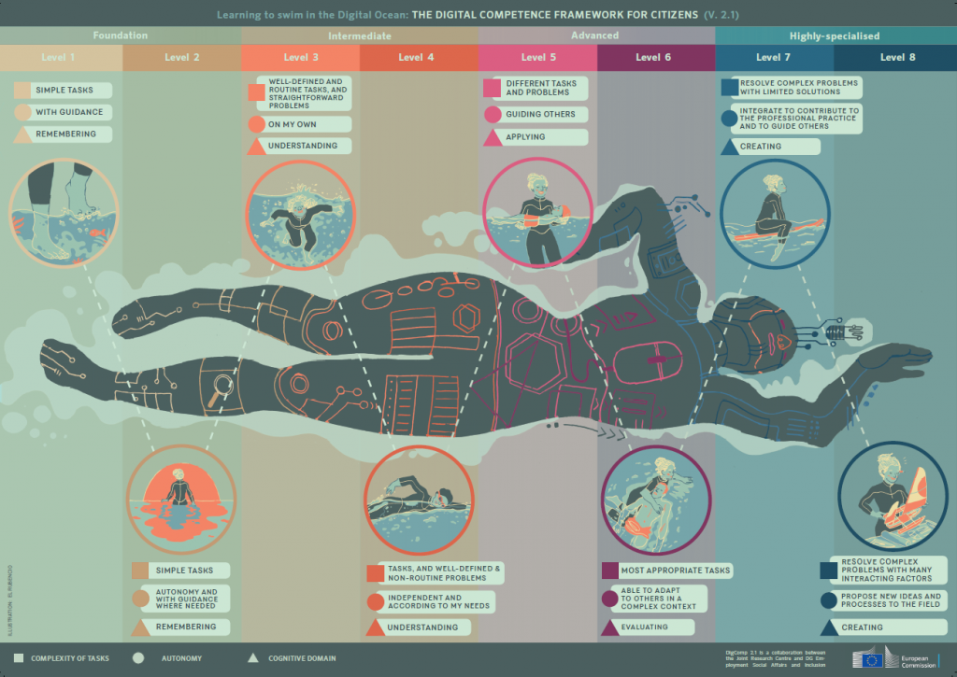
DigiComp Framework

Slide 5
DigComp 2.0
Identifies the key components of digital competence in 5 areas which can be summarised as below:
1) Information and data literacy
2) Communication and collaboration
3) Digital content creation
4) Safety
5) Problem solving

Slide 6
Our project
Area 1 Information and data literacy
1.3 Managing data, information and digital content
To organise, store and retrieve data, information and content in digital environments. To organise and process them in a structured environment.

Slide 7
Our project
Area 2 Communication and collaboration
2.1. Interacting through digital technologies
To interact through a variety of digital technologies and to understand appropriate digital communication means for a given context
2.2. Sharing information and content through digital technologies
To share data, information and digital content with others through appropriate digital technologies.
2.3. Collaborating through digital technologies
To use digital tools and technologies for collaborative processes, and for co-construction and co-creation of resources and knowledge.

Slide 8
Our project
Area 3 Digital content creation
3.1. Developing digital content
To create content in diﬀerent formats (e.g. data, text, multimedia), to edit and improve existing content, to express oneself through digital means.

Slide 9
G Suite
Managing data, information and digital content.
G Suite is a set of cloud computing, productivity and collaboration tools, software and products

Slide 10
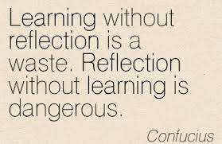
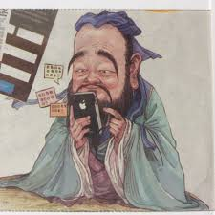
Reflection about what we learned

Slide 11
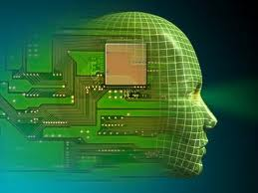
Thank you!
https://ec.europa.eu/jrc/en/digcomp/digital-competence-framework

