Slide 1
Digital Journalism
What, why and how to teach?

Slide 2
Why teach digital journalism? (https://niemanreports.org/articles/introduction-6/)
“a childhood lived as much online as off” has given students the necessary building blocks “to be journalists in a digital age.” Dianne Lynch
educate consumers of news to “differentiate between raw, unmediated information coursing through the Internet and independent, verified journalism.” Howard Schneider
“promote news literacy among children who spend increasing amounts of their time finding and sharing information online.” Kim Pearson

Slide 3
How to teach multimedia journalism? - an analysis of 30 syllabi (http://www.mulinblog.com/how-to-teach-multimedia-journalism-an-analysis-of-30-syllabi/)
Blog:. The two typical uses of a blog are (a) students blog about a topic of their choice, or (b) students post their assignments (audio, video, photo, etc).
Video: usually, this is not about vigorous television news production; it is more about shooting interviews, then editing the footage into a video story.
Audio: record sound and interview using digital audio recorder, and edit an audio piece using Audacity.
Audio slideshow: put together a slideshow of photos with narration and/or music, the common tool is Soundslides.
Social media: use of Twitter, Facebook, Youtube, Vimeo, Flickr, LinkedIn, blog, etc.
Photography: shooting photos and editing using Photoshop; some instructors include sessions on guidelines for taking good photos.
Data visualization: this includes infographics, interactive Google maps, timeline
Writing for the web: as text is a typical part of a multimedia story package.
Web design: use Dreamweaver to create web pages.
Flash: create a Flash-based multimedia project
Web analytics: Search Engine Optimization

Slide 4
7 Things You Should Know About Digital Journalism Courses (http://mediashift.org/2016/05/7-things-you-should-know-about-digital-journalism-courses/)
1
2
3
4
5
6
7
1. Focus On Storytelling
2. Aim For T-Shaped Graduates
3. Emphasize Digital Agility
4. Give Them Real-World Experience
5. Develop Strategic Thinking And Understanding Of Audience
6. Teach Teamwork
7. Assign Content Packages

Slide 5
10 Digital Skills That Can Make Students Instantly Employable (https://digitalmarketinginstitute.com/blog/12-07-17-10-digital-skills-that-can-make-students-instantly-employable)
Social Media
Search Engine Marketing
Analytics
Content Marketing
Email
Mobile
Strategy & Planning
Social Selling
Pay-Per-Click Marketing (PPC)
Video

Slide 6
Let’s see some examples
What can you actually do in class?

Slide 7
Explore how social media shapes world events
A case study
On March 15, 2013, the award-winning graphic novel, Persepolis by Marjane Satrapi, was pulled from library shelves and ordered removed from classrooms by the Chicago Public Schools. A student journalist found Satrapi’s literary agent, who immediately found the author. Satrapi, who now lives in Paris, responded – as did the American Library Association's Office of Intellectual Freedom and many outraged local, national and global citizens. In summary: Students used social media to put the word out about Chicago’s policy, and the book was returned to library shelves.
Ironically, the book was written partly in reaction to the censorship of artistic expression in Iran under the fundamentalist Islamic regime that took over power of the country after the 1979 Revolution.

Slide 8
Below are three levels of activity for students:
Flashlight: How can you verify that the above story is true? Can you find news reports or statements from the parties involved online? Do they verify the story or conflict with the story? How can a researcher resolve conflicts if sources say different things in a case study? Spotlight: Research a similar case of censorship that was overturned. Start by looking over the Global Journalist. Explore the role of social media in the case. Searchlight: The use of social media is exploding. Is censorship also increasing? How would a researcher look into that? Find two or three examples of groups that monitor Internet freedom. Do those measurements include social media?

Slide 9
Use digital tools to collect, publish and share content on the web
Paper.li - find and collect content that's aligned with your audience's interests. We use natural language processing, machine learning and social signals to analyse and extract the most relevant and engaging stories from social media and the web. Paper.li automatically finds content on any subject, or you can quickly and easily add your own content sources. Then prioritize them and add filters to best reflect the type of content you want.
Currents - a free tool that shows the attention of over 1 billion people each month and 850,000 viewed articles each day. It enables publishers to see which topics are performing the best in news sites around the world. It also shows the keywords that people are using to search the content and how those topics have performed historically.
TinEye - a useful tool in the context of vulnerability to fake news, especially around imagery and photos. TinEye is an image search engine that uses image identification technology rather than keywords, metadata or watermarks. When you submit an image on the Tineye website it will scour the web to find out when and where it was used first.

Slide 10
An example of how technology impacts journalism
Paper.li

Slide 11
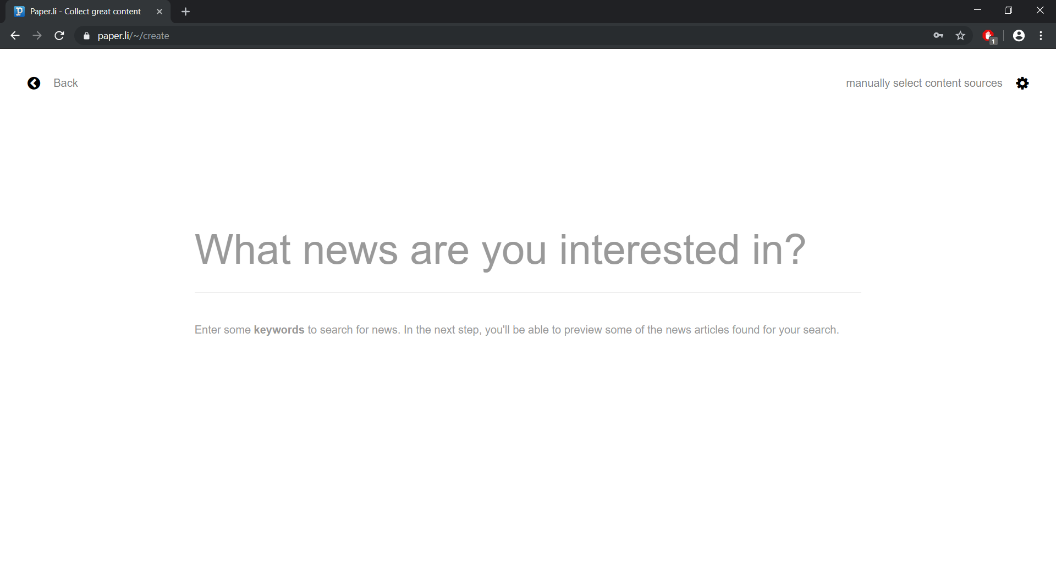
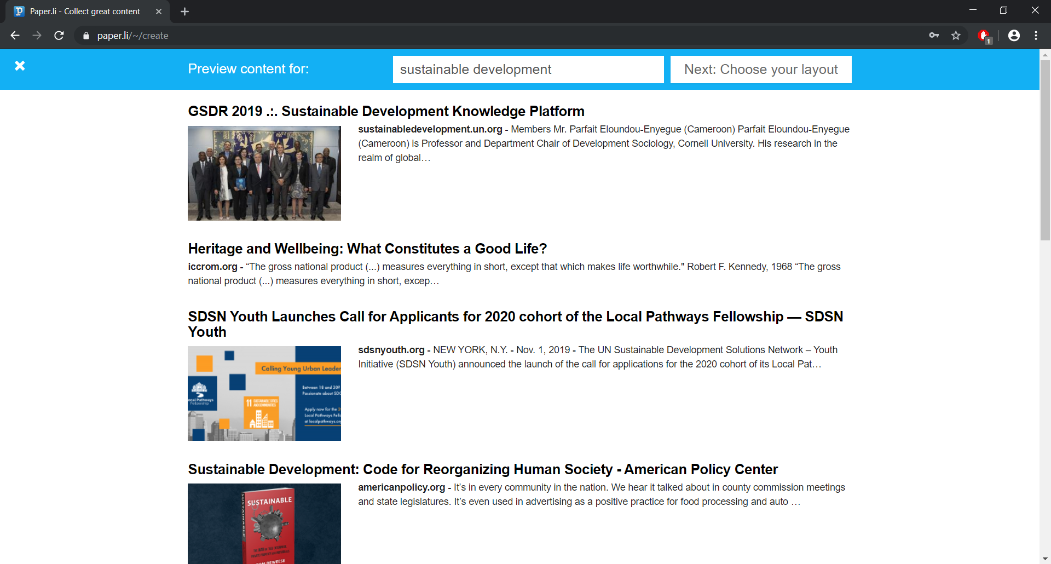
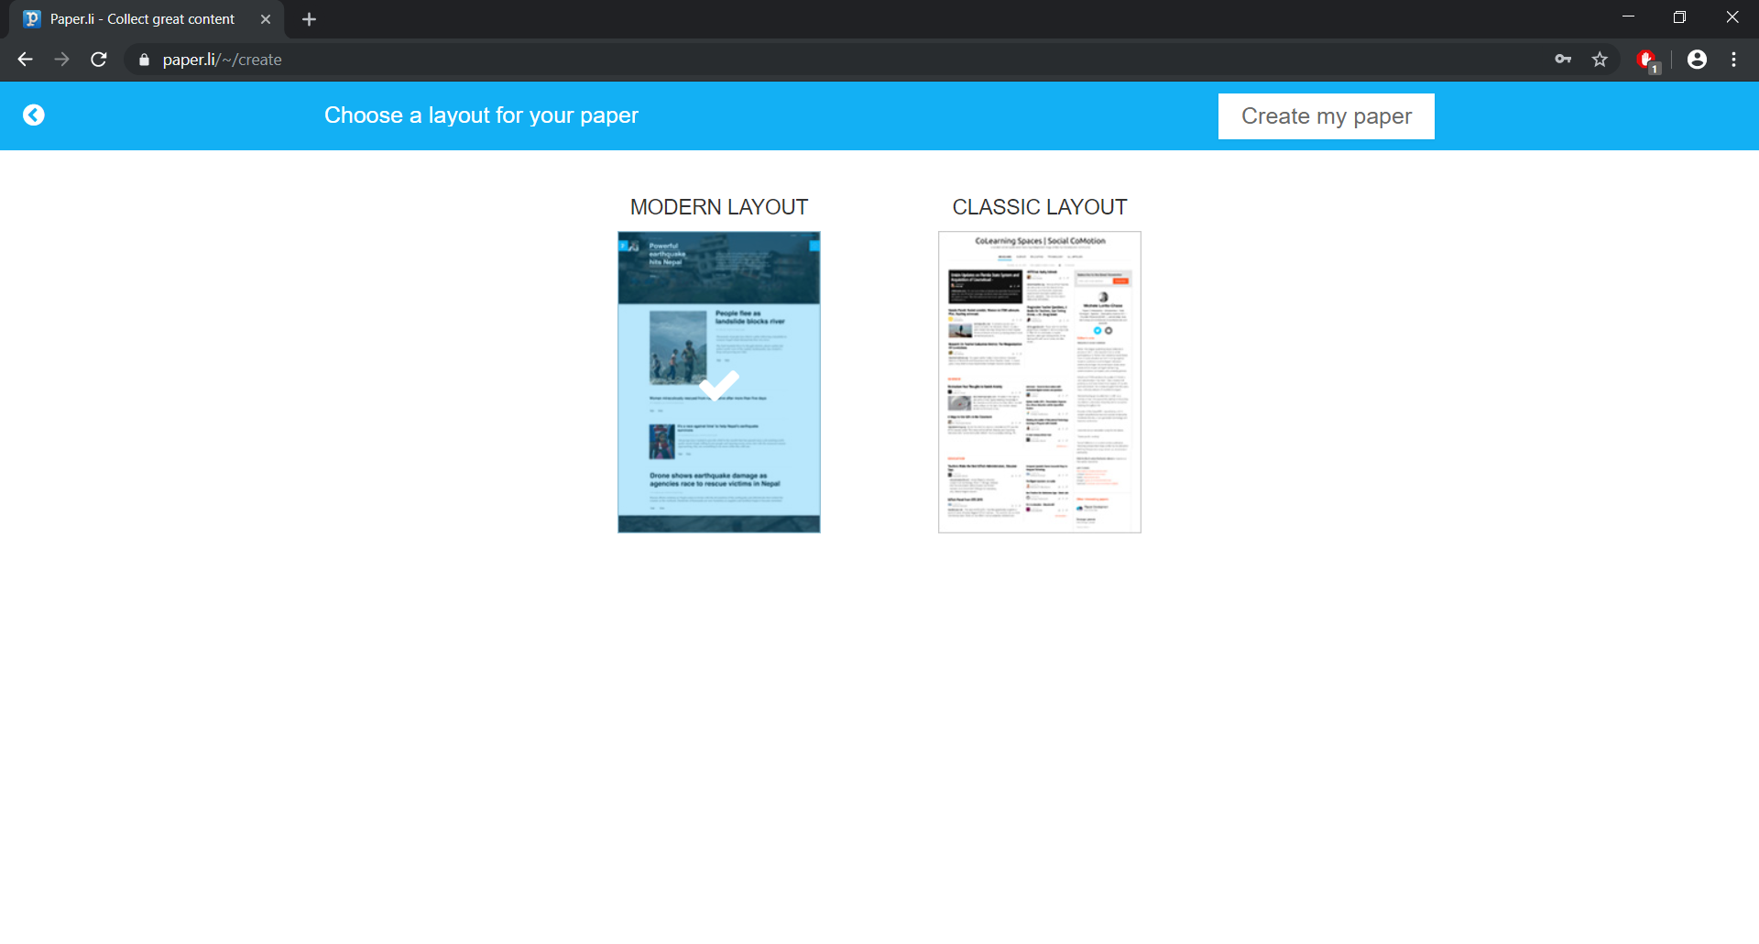
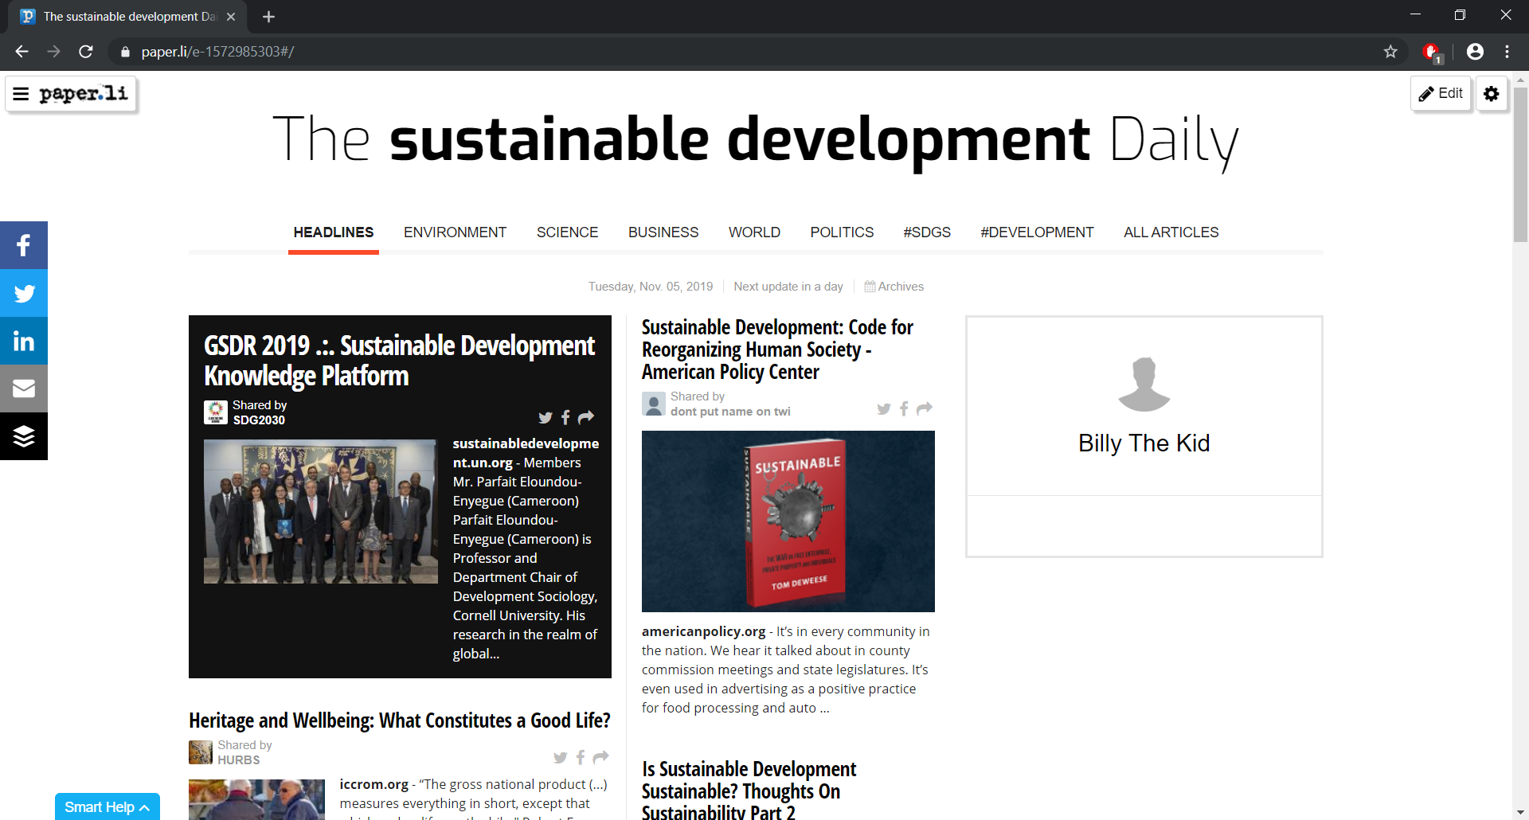
Start your newspaper
Choose topic of interest
The content of the paper is generated
Choose the layout of the paper
You’re done!

Slide 12
Games that challenge people to identify fake news

Slide 13
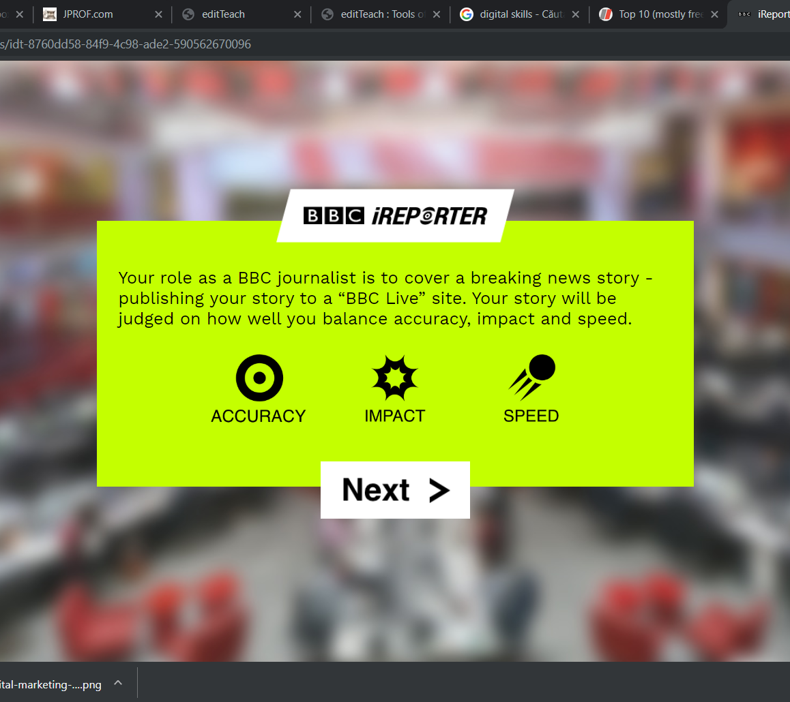
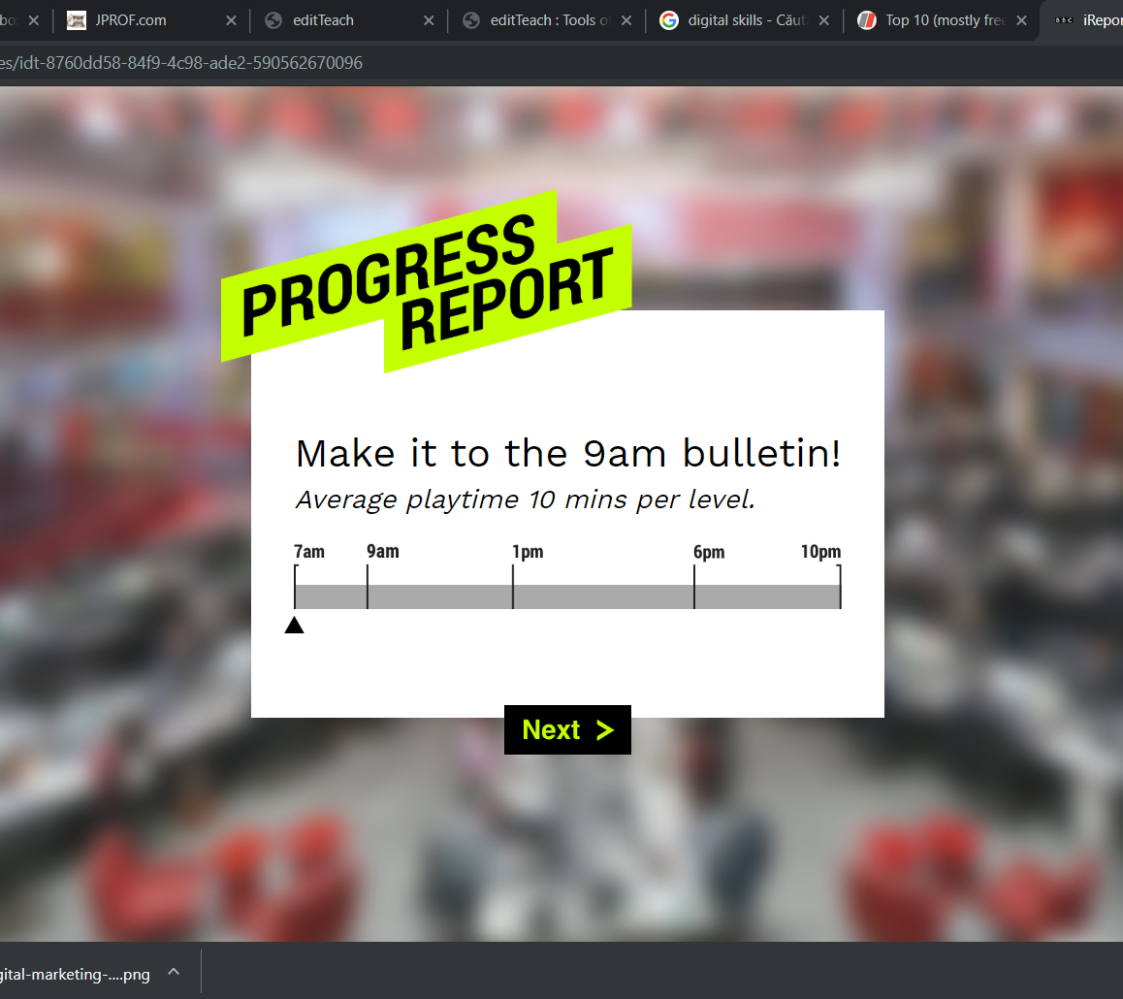
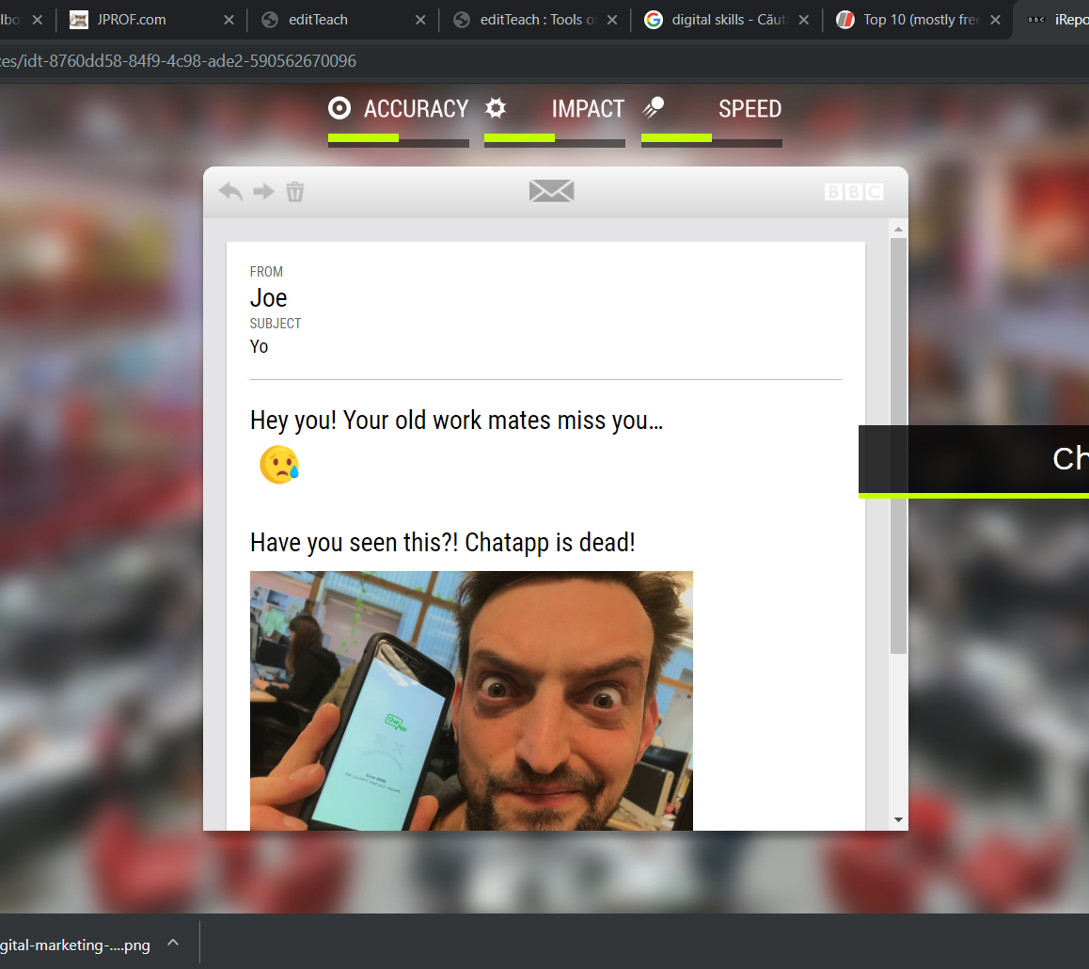
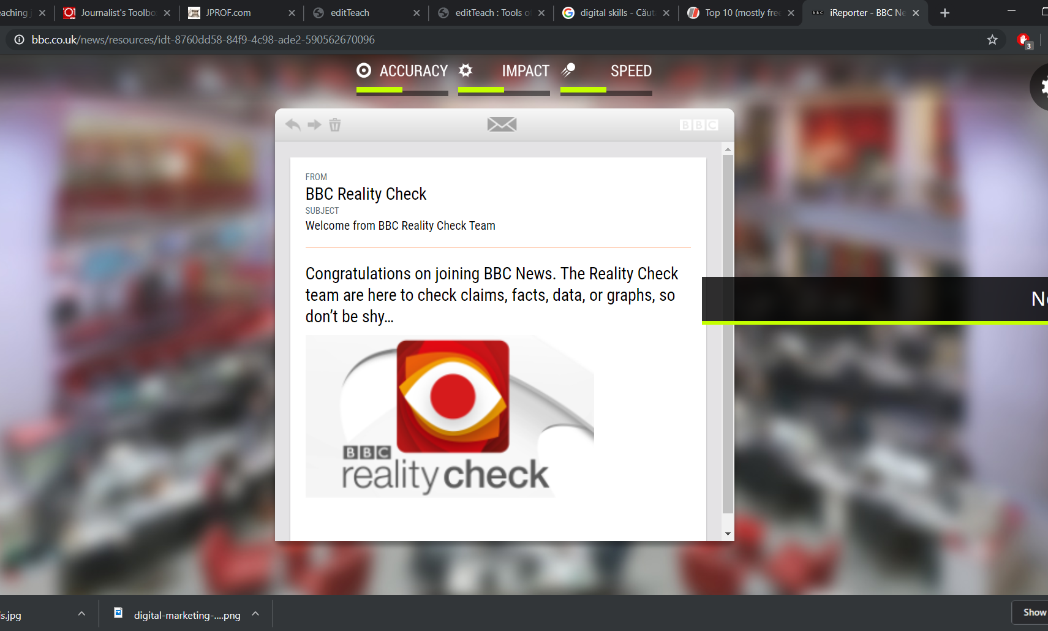
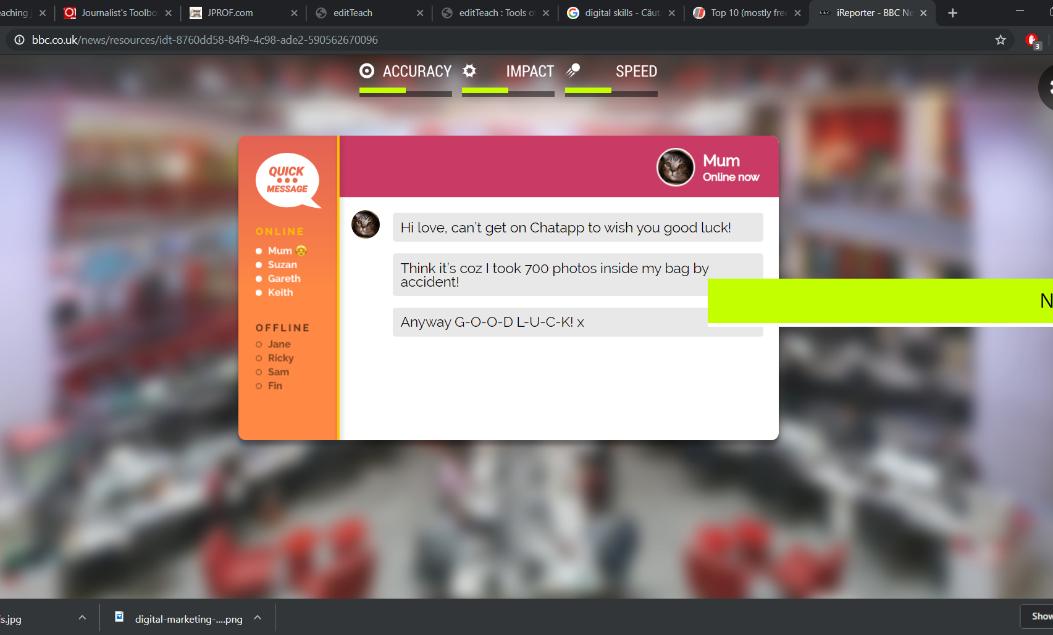
Screen-shots of the BBC Game
People are challenged to spot fake news
They are put in a scenario (the player is a journalist) and they have to check if a certain story is real or not

Slide 14
A part of the Ignorance Project of Gapminder.org

Slide 15
Journalist’s toolbox (1)
EditTeach.org Resources for journalism instructors at many levels: high school, college, newsroom, etc.
JPROF.com Resources for college journalism instructors.
JTeacher.com
Teaching Resources for Google News Initiative Tools Training videos, exercises, tipsheets and more.
Google Fusion Tables Primer Great resource for learning maps, charts, etc. from Doug Haddix at Kiplinger/Ohio State.
Verification Junkie This tool from Josh Stearns centralizes several social media verification tools in one place. Great for reporting and fact-checking on deadline.
Verification Handbook From Craig Silverman, this guide gives you tools to verify digital content for emergency coverage.
Dart Center: Resources for Educators Training Journalists Covering Sensitive Issues Resources from San Diego State professor Amy Schmitz Weiss on teaching students to cover topics such as suicide, homicides, sexual assaults and other traumatic news events.
The Slot: The Nine Commandments of Caption Writing
PBS MediaShift: Where to Get Journalism Grants Great list.

Slide 16
Rethinking Schools: Online Geography Test A good quiz to give young reporters.
Thsrs: The Shorter Thesaurus A great tool for headline writing. This thesaurus gives you synonyms the same length or shorter than the word you enter. This helps if you’re stuck on a headline and can’t think of a concise word to use on a tight headline count.
AP Style Exercises Online Developed by Ron Hartung, writing/editing coach at the Tallahassee Democrat.
Poynter: Editor’s Guide to Identifying Plagiarism
No Train, No Gain A great collection of handouts and contacts for newsroom training.
The Good, The Bad & The Ugly or Why It’s A Good Idea to Evaluate Web Resources From Susan E. Beck of the New Mexico State University Library.
ASNE: HighSchoolJournalism.org American Society of Newspaper Editors’ site has hundreds of stories and resources for high school journalists.
Television News Center A public nonprofit that trains TV journalists. Site offers tips, training, etc.
Pressnet: Journalists, Journalism and Mass Media in Internet Site editors say it’s for “journalists, mass media, students, teachers and professors of the journalism and the social communication.” Includes a world directory and specialized directory.

Slide 17
Journalist’s toolbox (2)
Pressnet: Journalists, Journalism and Mass Media in Internet Site editors say it’s for “journalists, mass media, students, teachers and professors of the journalism and the social communication.” Includes a world directory and specialized directory.
Plugged In: Using the Internet for High School and Professional Journalism Downloading this online publication from the Radio and Television News Directors Foundation will prove valuable to students and educators, station interns and journalists new to the profession.
Write Check Check grammar and plagiarism.
Reading List for Innovative Ideas on Journalism Education From the Online News Association.
Academic Earth Lectures and teaching resources galore for professors.
Photojournalism e-book: Breaking into Photojournalism Kenneth Wajda, an author and an award-winning photojournalist, wrote an e-book for students and other photographers interested in how to break into the business of photojournalism. He covers how to find and shoot spot news, the importance of professional ethics and respect, how to build a sports and people portfolio on the side, and how to approach news and photo editors with your photographs. A must-read for aspiring photojournalists.
Connect Online, LLC An online directory of writing education for journalism, poetry, screenwriting, etc.

