Slide 1
TWINSPACE
Anthony RIOU
Coşku AKER
TR Teacher
Multilateral Contact Seminar, İzmir, 18-20 April 2019

Slide 2
HOMEPAGE
The cover of the project
« Latest updates » of the project. « User » mode : comment/like - public ; « System » mode : new elements added to the TwinSpace – only members
Teacher Bulletin. Space for communication among teachers only.
Administrators / Founders can edit the settings of the TwinSpace (title, description, theme, profile picture)
Join the chat room and organise Live event
Multilateral Contact Seminar, İzmir, 18-20 April 2019

Slide 3
MEMBERS
Invite your pupils to join the project / TwinSpace.
Invite the guests (external members of the project like : parents, headmaster…).
Export the list of invited pupils (just ID – not passwords)
Attention! : to invite teachers in a project (eTwinning and non eTwinning) ➔ differences
Multilateral Contact Seminar, İzmir, 18-20 April 2019

Slide 4
PAGES
Pages allow you to promote and make the results of your projects visible online.
In the pages section users can create new pages by clicking on the button on the left bar.
Multilateral Contact Seminar, İzmir, 18-20 April 2019

Slide 5
Create a page
When a new page is created and named ,users can add different features.
Multilateral Contact Seminar, İzmir, 18-20 April 2019

Slide 6
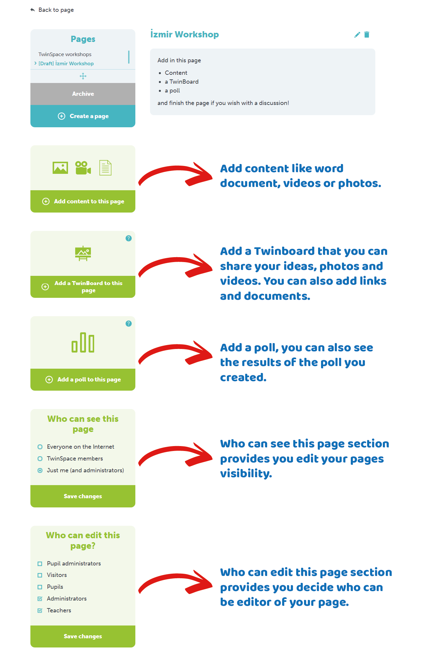
Pages may include:
Content
A TwinBoard
A poll
Multilateral Contact Seminar, İzmir, 18-20 April 2019

Slide 7
When you create or edit a page, you can select “who can edit this page?” and “who can see this page?”
Administrators can define who can carry out certain tasks and view what in the TwinSpace, via the tools in the left bar.
If the page is made public, the pop-up below appears.
Multilateral Contact Seminar, İzmir, 18-20 April 2019

Slide 8
Add Content
When a new page is created,users add different features.
Content section lets you embed pictures, videos, links, and iframes.
Pictures can be uploaded directly to the page.
Also you can see a text editor here.
Multilateral Contact Seminar, İzmir, 18-20 April 2019

Slide 9
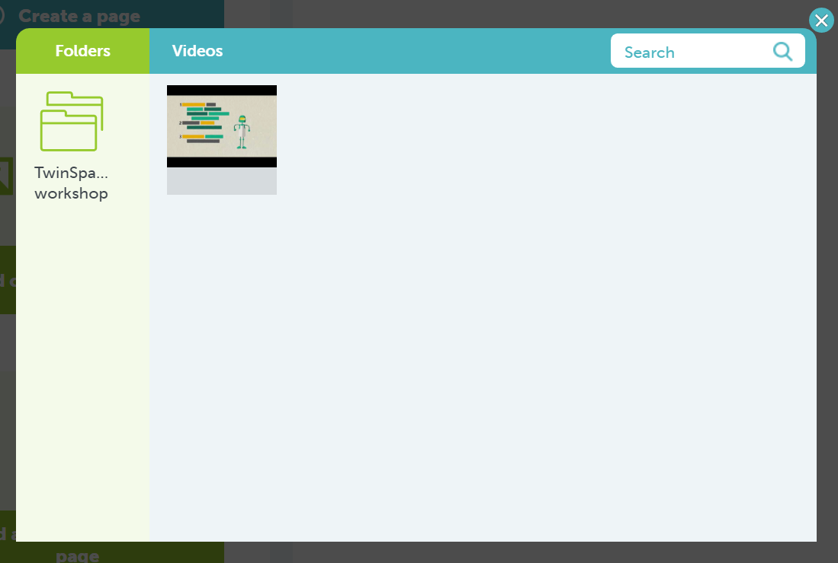
Add videos
Click on the icon Add video and insert the video URL you want to upload.
You choose videos from the below websites:
DailyMotion
Vimeo
YouTube
Multilateral Contact Seminar, İzmir, 18-20 April 2019

Slide 10
Add Images
You will see two main sections.
Albums/Folders and images/files, to add an image, either drag an image into the images section or click on the button to select from your desktop/device.
Multilateral Contact Seminar, İzmir, 18-20 April 2019

Slide 11
Add Documents
Multilateral Contact Seminar, İzmir, 18-20 April 2019

Slide 12
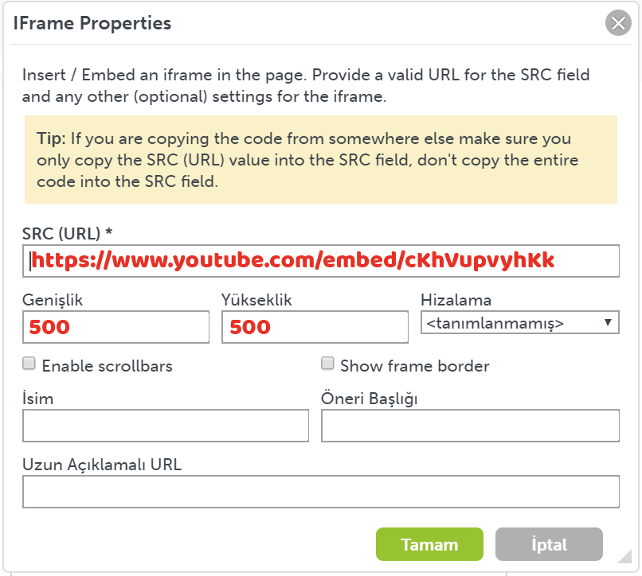
Iframe
When embedding an iframe (by clicking on the “globe” icon) users will be asked to insert the URL of the tool to embed.
When adding the URL, this is what you will see.
Multilateral Contact Seminar, İzmir, 18-20 April 2019

Slide 13
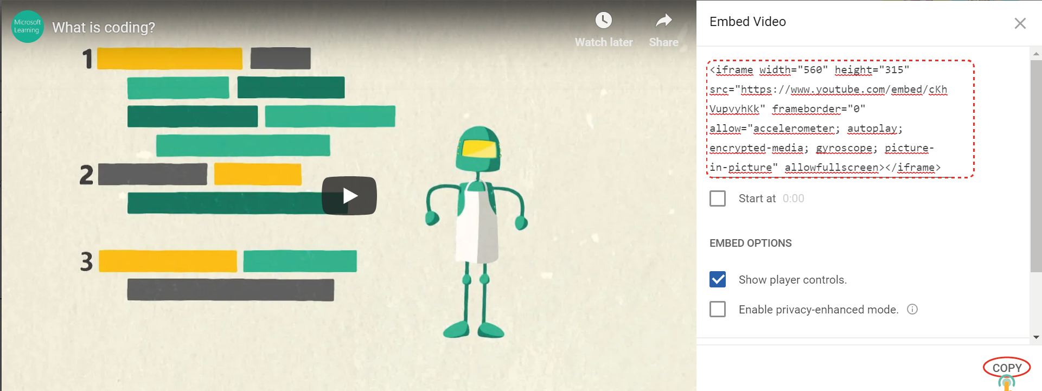
Multilateral Contact Seminar, İzmir, 18-20 April 2019

Slide 14
We don’t need the whole code, we need just SRC code.
Multilateral Contact Seminar, İzmir, 18-20 April 2019

Slide 15
Create a Twinboard
You can post items in the form of videos, pictures, text, files.
Multilateral Contact Seminar, İzmir, 18-20 April 2019

Slide 16
An interactive board where you can post text, images, or embed videos.
TwinBoard is a tool to append sticky notes
Multilateral Contact Seminar, İzmir, 18-20 April 2019

Slide 17
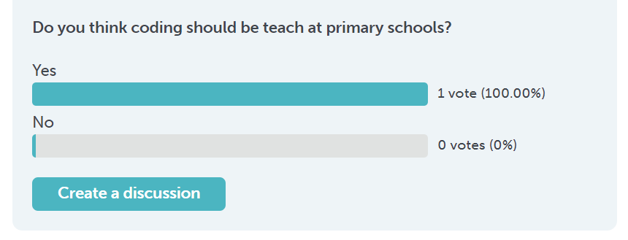
Create a poll
You can also add a poll to the page with customised questions and answers.
Multilateral Contact Seminar, İzmir, 18-20 April 2019

Slide 18
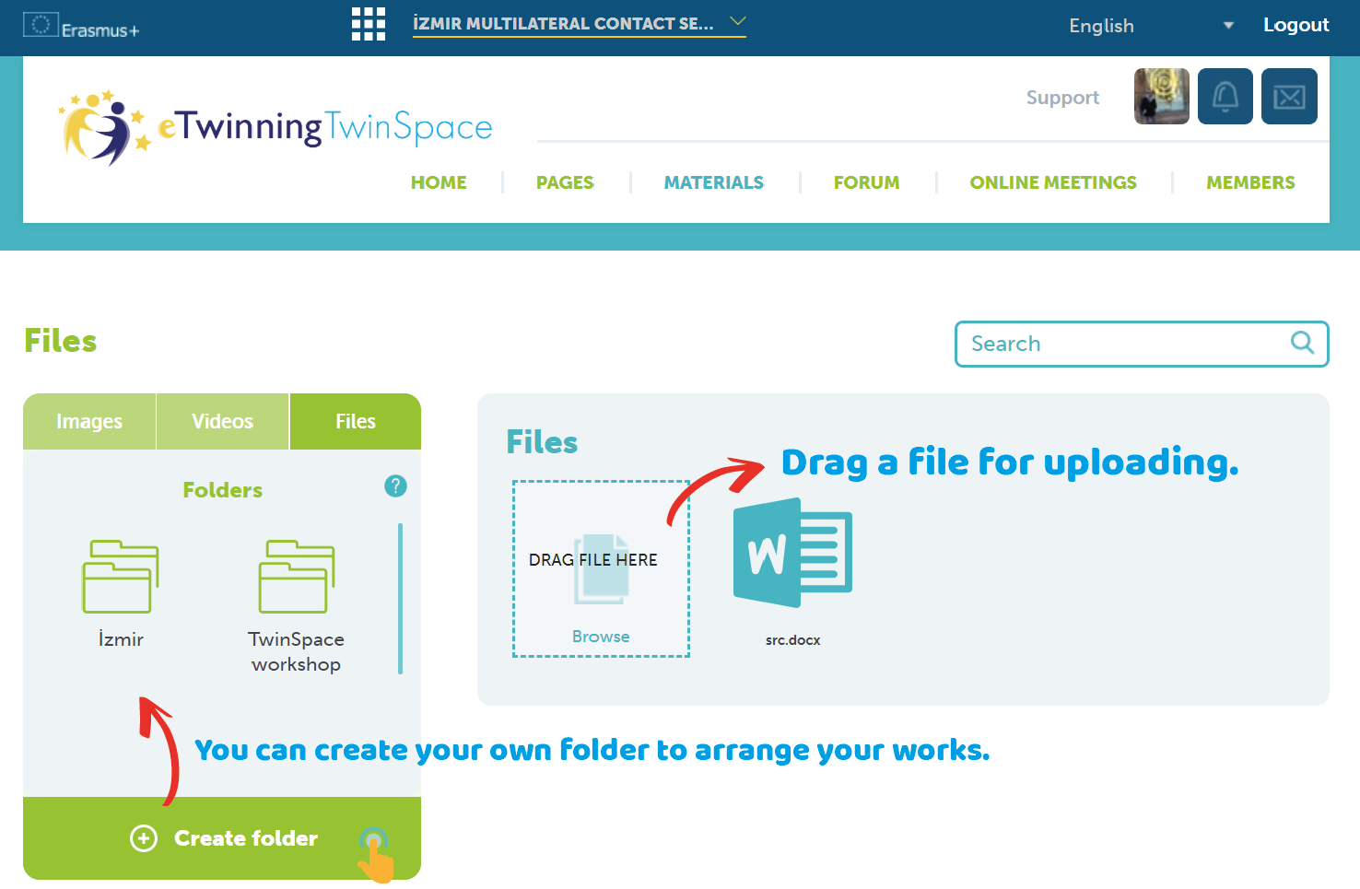
MATERIALS
In this part you can post images,videos and documents related to your projects.
Add an image,video or document ,either drag an image into the images section or click on the button to select from your desktop/device.
Multilateral Contact Seminar, İzmir, 18-20 April 2019

Slide 19
You can use albums to create a collection which you can later add to a page to form a gallery.
Folder is a place to store and organize your files.
Multilateral Contact Seminar, İzmir, 18-20 April 2019

Slide 20
FORUM
This section contains discussions and only teacher administrators can manage the forum section.
The moment you create a “discussion” you can also create threads. Everybody can reply to threads by clicking on the reply button.
Multilateral Contact Seminar, İzmir, 18-20 April 2019

Slide 21
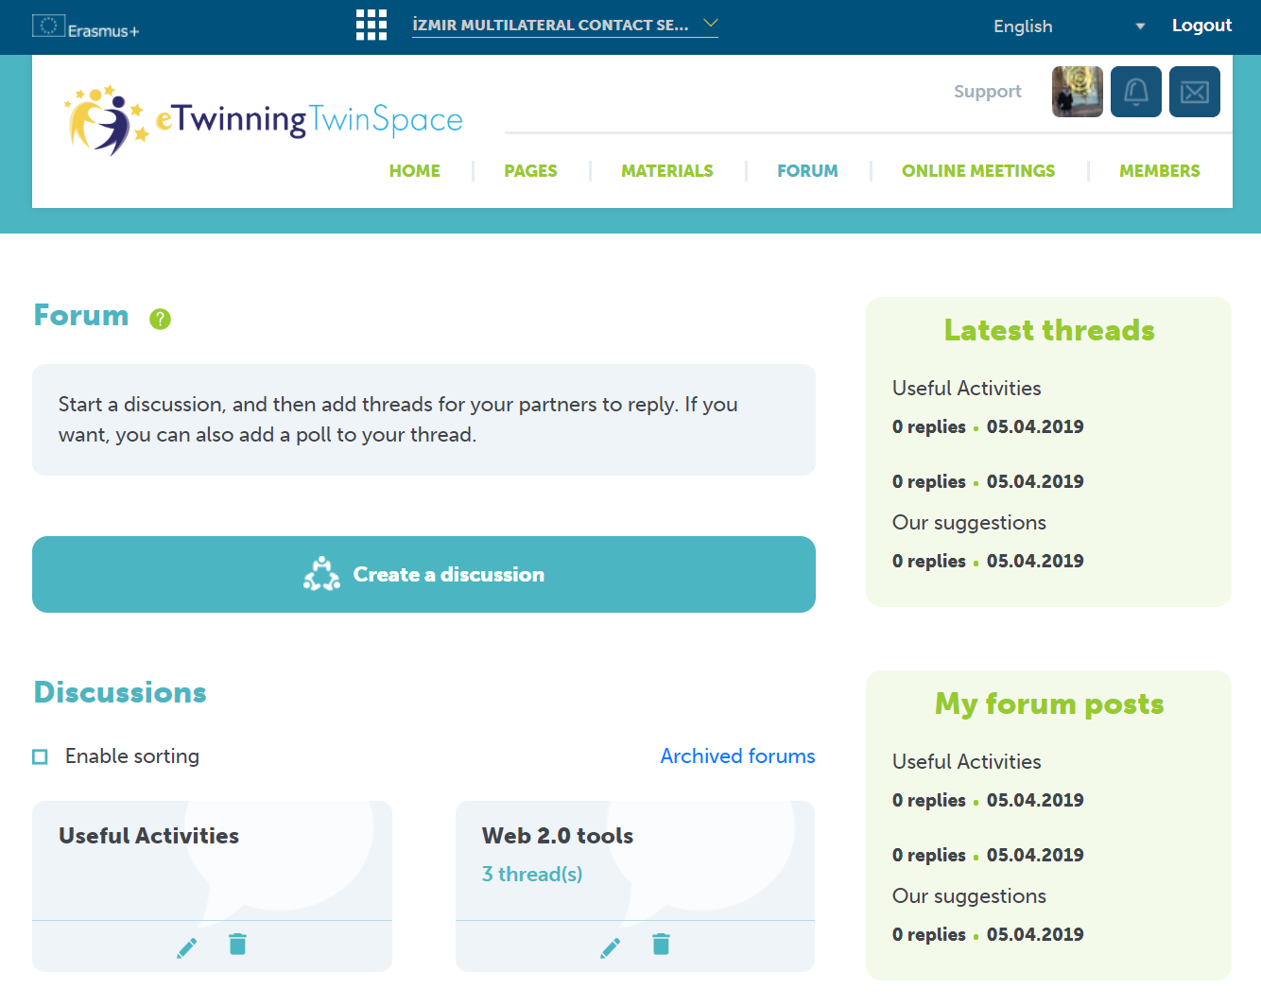
You can start a discussion with using the blue button ‘Create a Discussion’ and then add threads for your partners to reply.
Multilateral Contact Seminar, İzmir, 18-20 April 2019

Slide 22
If you want you can also add polls to your threads.
Multilateral Contact Seminar, İzmir, 18-20 April 2019

Slide 23
Enable Sorting
Elements in a page can be moved in the “edit” mode by clicking on “enable sorting”, and then dragging elements in the page.
Multilateral Contact Seminar, İzmir, 18-20 April 2019

Slide 24
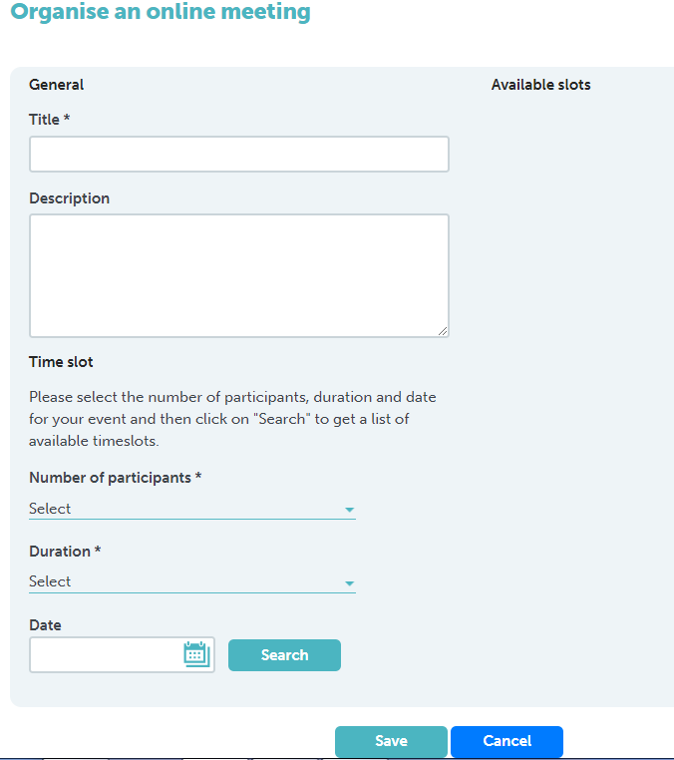
Synchronous communication : Virtual meeting
Multilateral Contact Seminar, İzmir, 18-20 April 2019

Slide 25
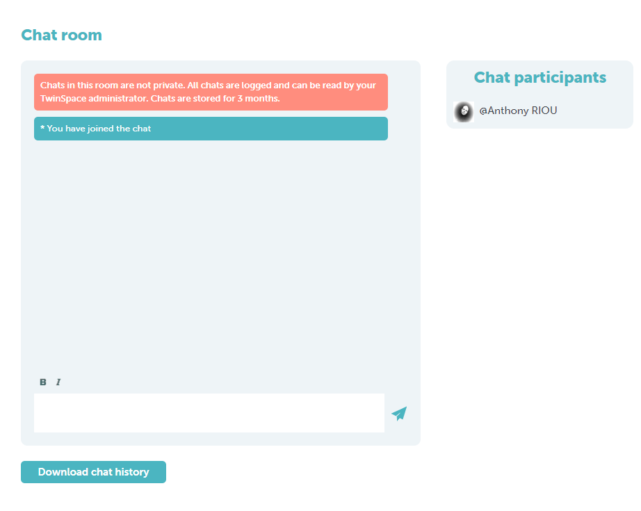
Synchronous communication : Chat room
Multilateral Contact Seminar, İzmir, 18-20 April 2019

Slide 26
Multilateral Contact Seminar, İzmir, 18-20 April 2019

Slide 27
eTwinning Türkiye
eTwinning Türkiye @tretwinning
tretwinning@gmail.com
etwinning.meb.gov.tr
Multilateral Contact Seminar, İzmir, 18-20 April 2019

