Slide 1
Activities with local municipality and cultural associations (spring 2019)

Slide 2
MEETING ON FOOD WITH ROTARY CLUB

Slide 5
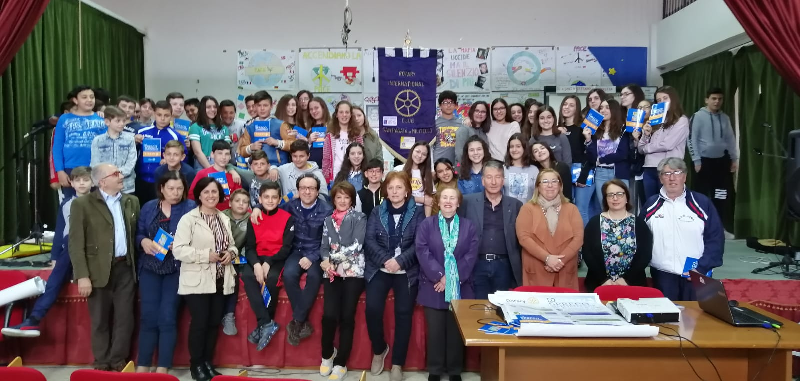

Slide 6
MEETING ON LEGALITY WITH CO.TU.LE.VI ASSOCIATION

Slide 7
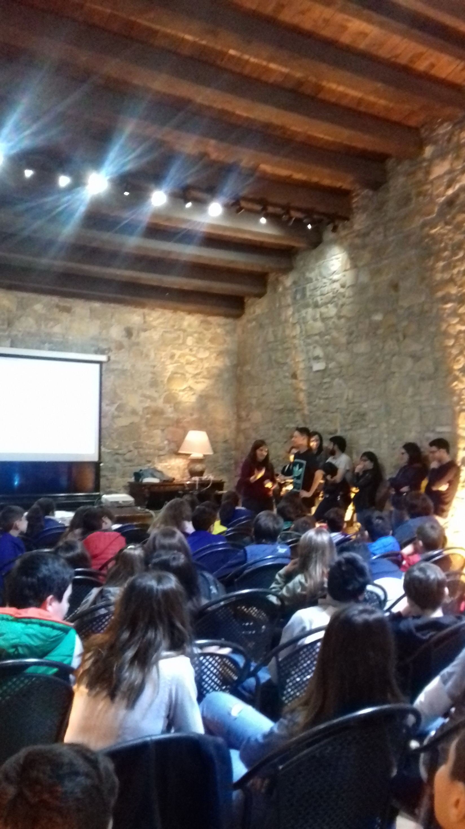

Slide 8
MEETING ON CERAMIC WITH CARAMIC MUSEUM AND MUNICIPALITY

Slide 11
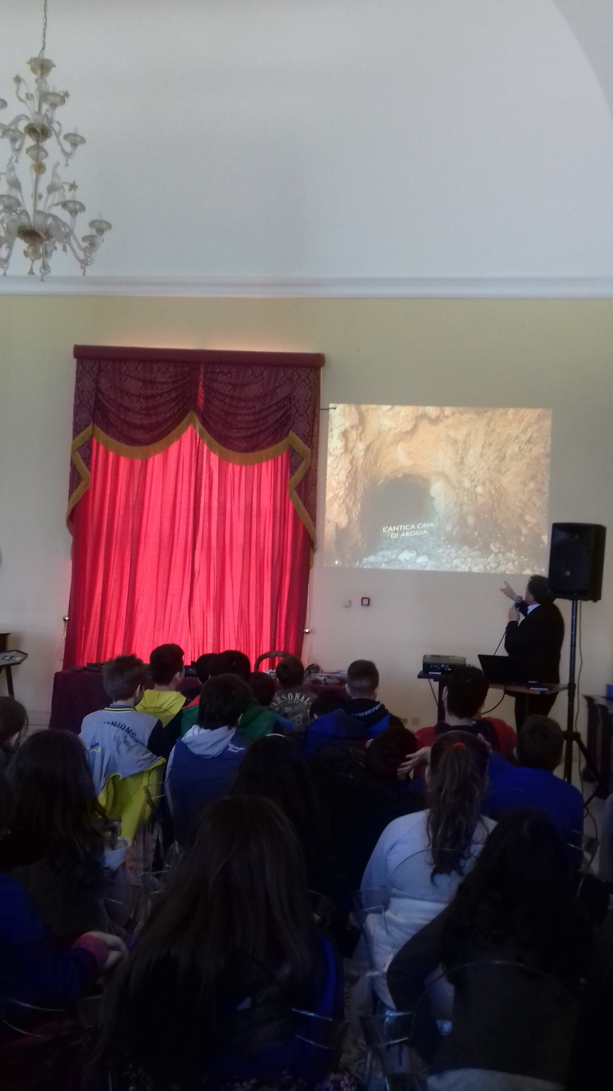

Slide 13
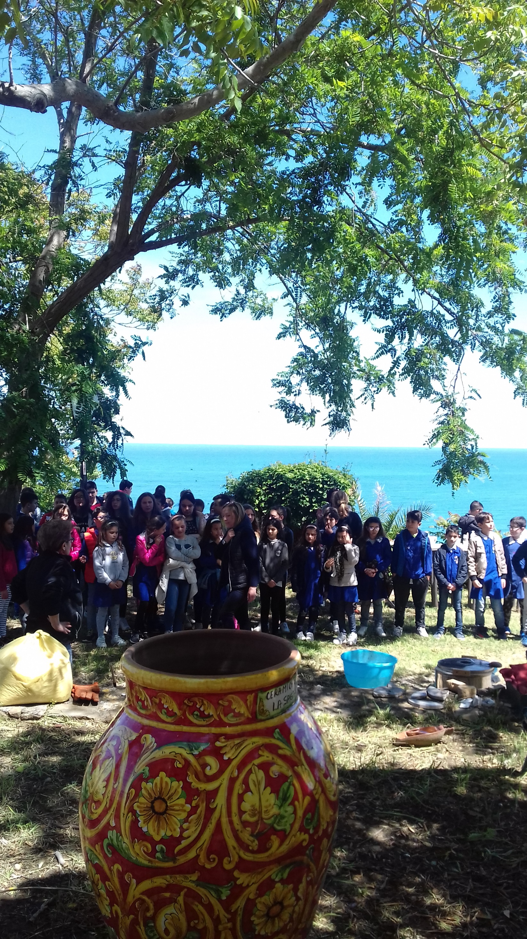

Slide 14
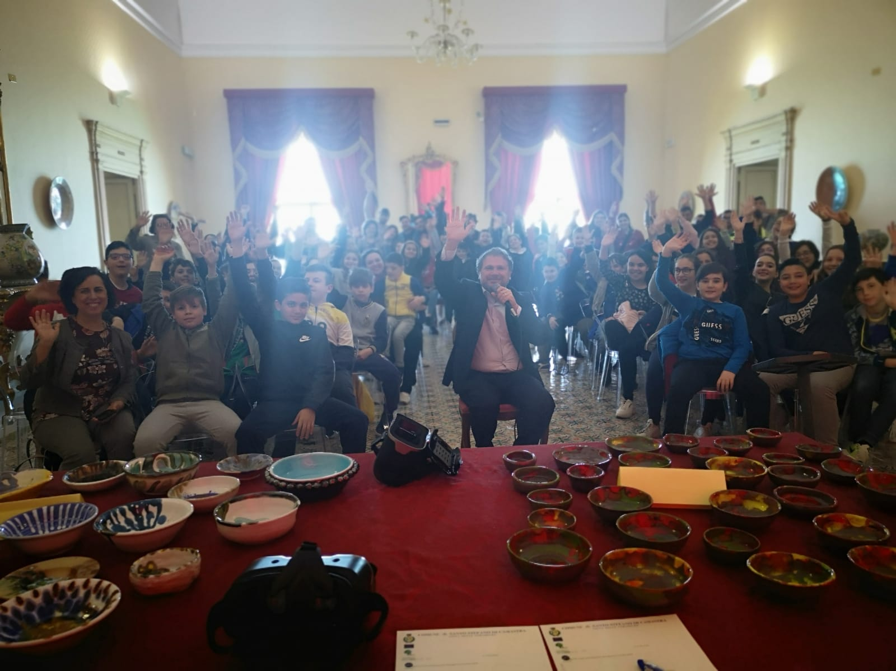

Slide 15
VISIT TO REGIONAL RAI TV STUDIOS WITH INTERVIEWS

Slide 16
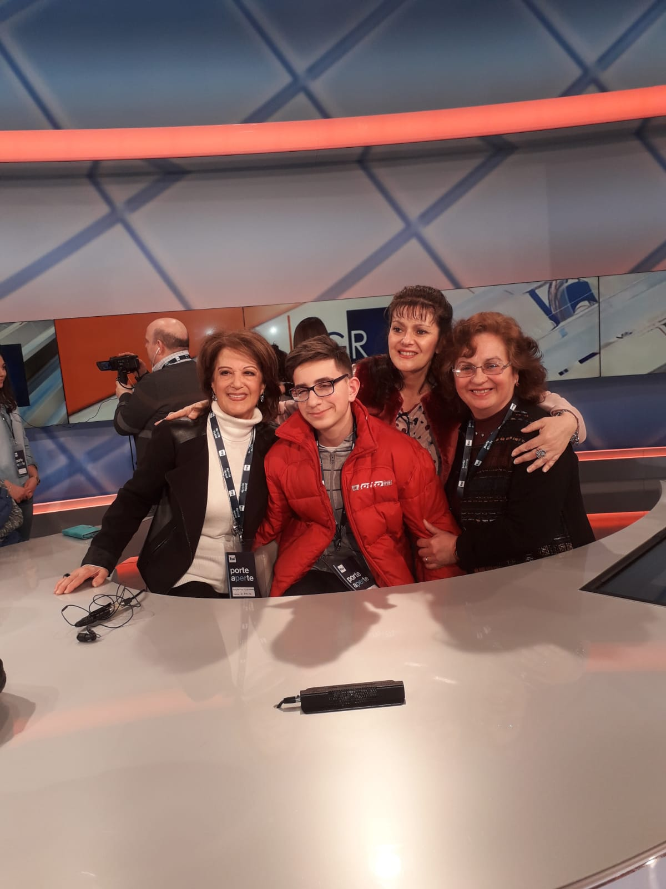

Slide 17
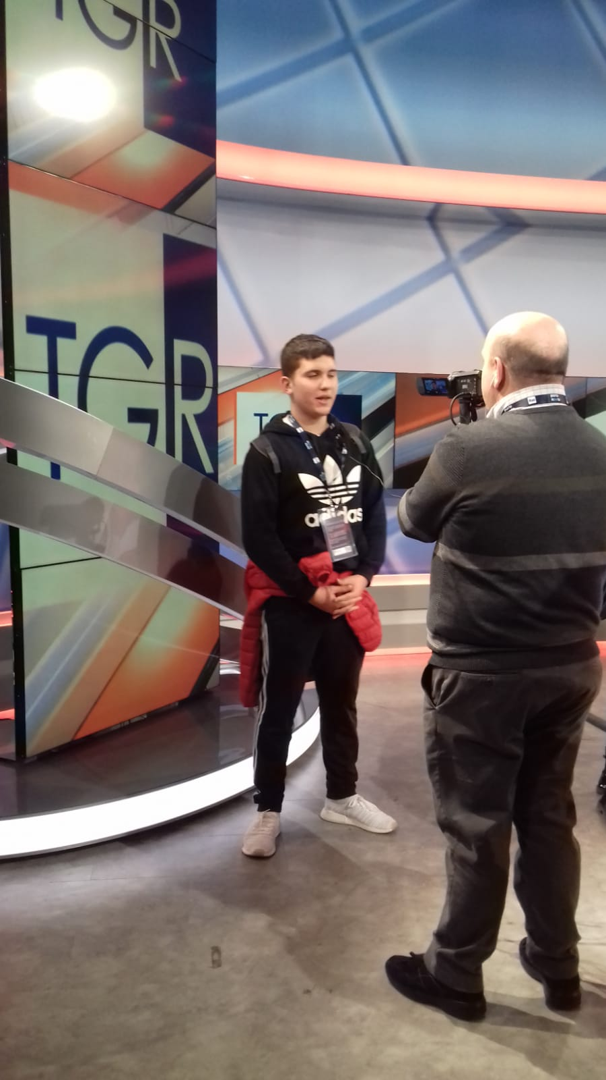

Slide 18
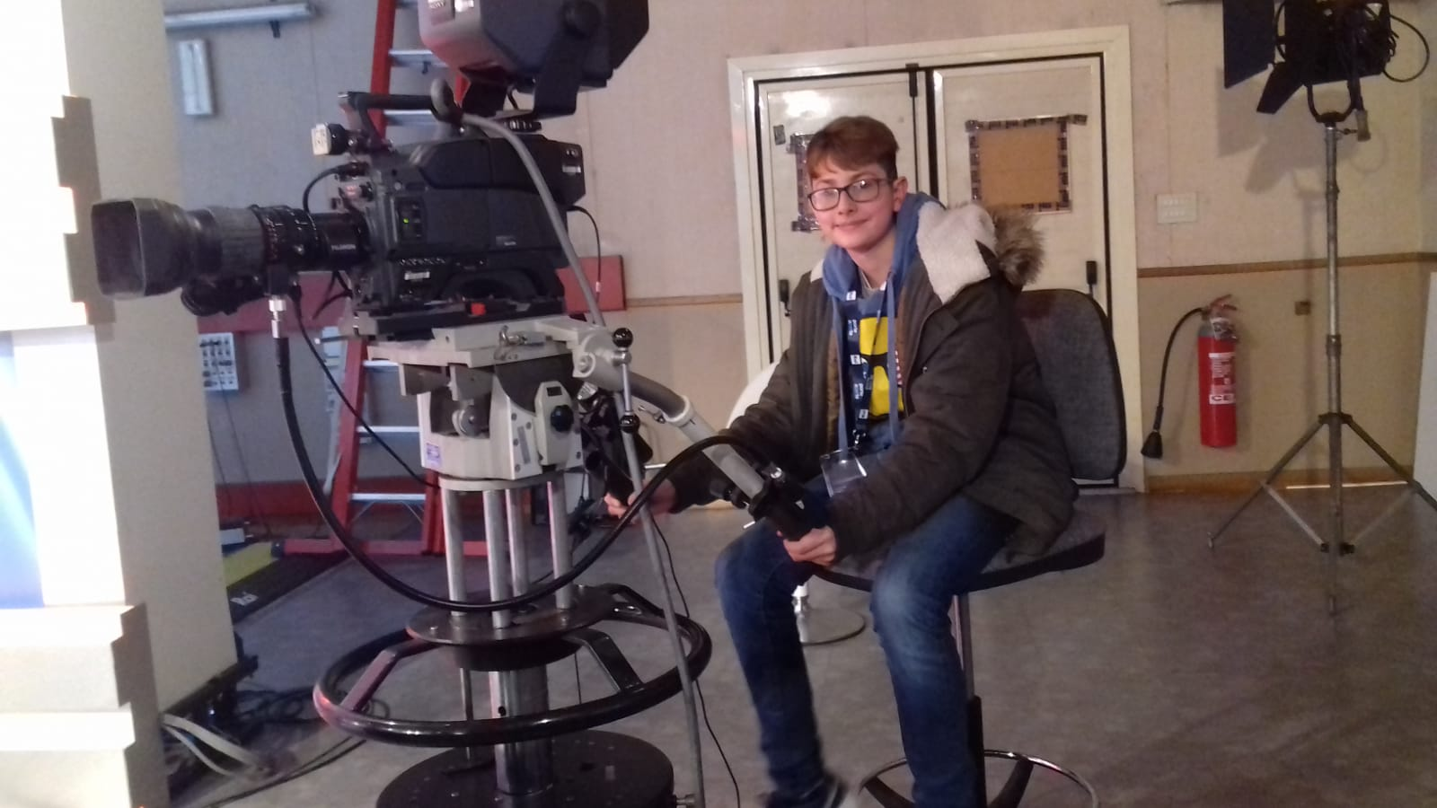

Slide 19
LOCAL NEWSPAPERS

Slide 21
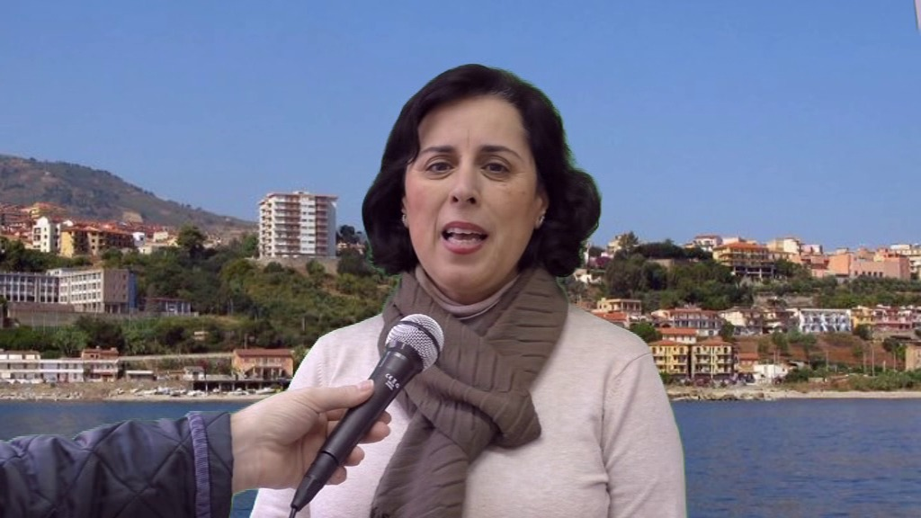

Slide 22
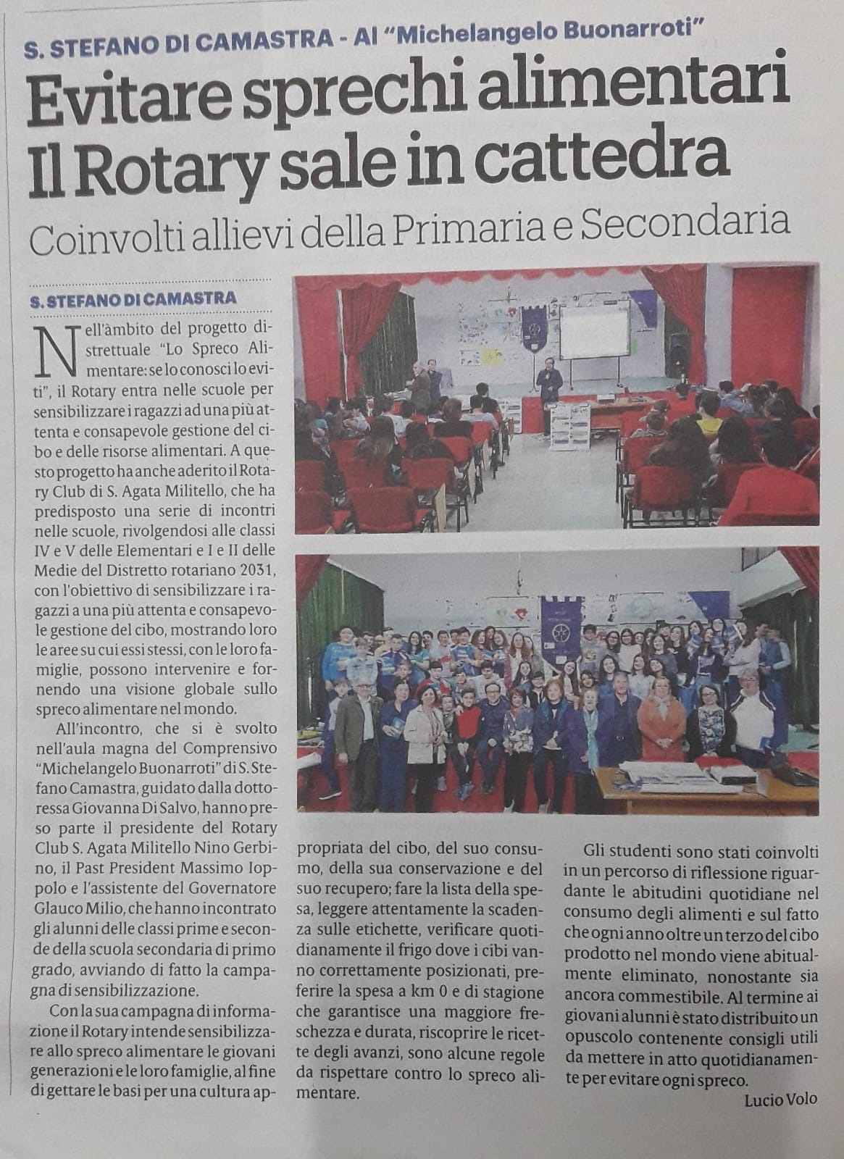

Slide 23
