Slide 1
Small towns… new challenges Gastronomy
Istituto Comprensivo
Santo Stefano di Camastra
Italy

Slide 2
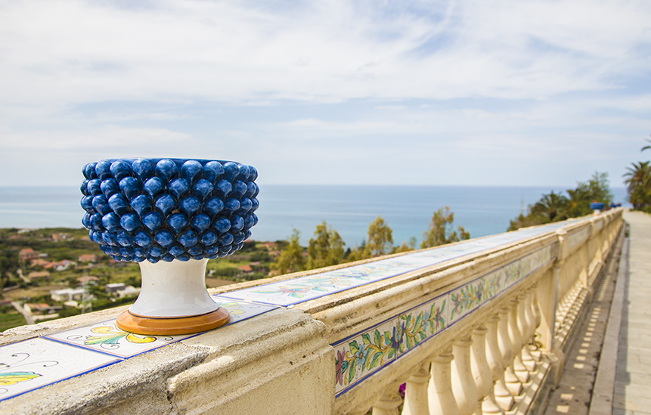
MENÙ
SicilEat
Restaurant
Starter
Panelle
1st Main Course
Pasta alla Norma
2nd Main Course
Sarde a Beccafico
Dessert
Cassata Siciliana

Slide 3
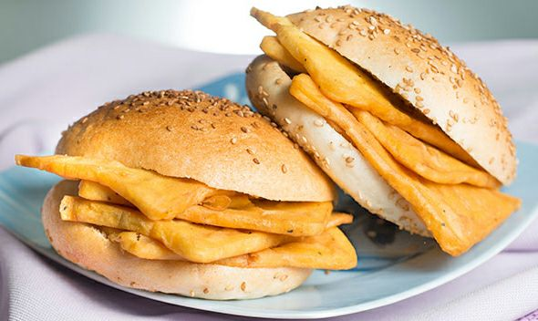
Starter: Panelle
INGREDIENTS:
Chickpea flour
Olive Oil
ELABORATION:
In a large saucepan, mix the chickpea flour and the water necessary to have a thick batter. Put the pan on the stove and, over low heat, stirring often with a wooden spatula, cook until the mixture has a thick and creamy consistency. Pour this polenta on a level and level it giving it a minimum thickness. Allow to cool and cut out the panelle in the preferred shapes (Lozenges, rectangles, etc.). In the frying pan, fry a large amount of oil and put the panelle: drain them golden on both sides on absorbent paper and serve hot.
CURIOSITY:
The "panelle" are not only used as a tasty appetizer but represent the characteristic snack of Sicily, you can also have it in the street (street food). You can eat with the classic Sicilian bread with sesame seeds, often combined with the potato croquettes with lemon and black pepper.

Slide 4
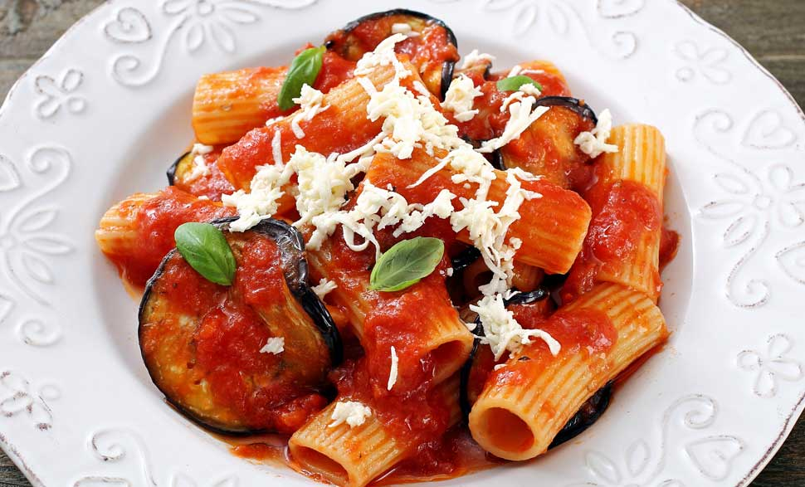
1° Main course: Pasta alla Norma
INGREDIENTS FOR 4 PEOPLE:
300 g penne
150 g aubergines
150 g salted ricotta cheese
50 g canned tomatoes
50 g onion
Olive oil
basil
1 garlic clove
salt and pepper
CURIOSITIES:
This famous Sicilian first course comes from Catania and its name was in honour of the composer Vincenzo Bellini who wrote the opera “NORMA” which opened the Bellini Theatre in 1890
ELABORATION:
Cut the aubergine into cubes and salt. Leave them to draw out excess of water. Add the oil in a frying pan and fry the onion and garlic.
Add the aubergines, tomato pulp, salt and pepper and cook for 15-20 minutes.
Meanwhile, cook the penne in salted boiling water and when cooked, toss the penne with the sauce.
Add the basil and grated salted ricotta or diced mozzarella.

Slide 5
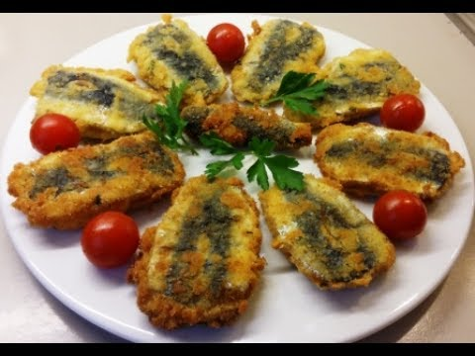
2° Main course: Sarde a Beccafico
INGREDIENTS FOR 4 PEOPLE:
1 kg sardines
breadcrumbs
2 garlic cloves
70 gr. of pine nuts
Parsley
ELABORATION:
Clean the sardines and remove the head the backbones. Open them as a book.
Chop finely the parsley and the garlic and place them in a bowl with the breadcrumb, the parmesan, egg and salt and pepper and mix well.
Place a sardine in the palm of your hand skin-side down and put a tablespoon of breadcrumb stuffing in the centre. Flatten it out across the sardine without going right to the edges. Place another sardine on top and press it lightly to the stuffing. Repeat with the remaining sardines and stuffing.
Place the flour in a bowl and season with a little salt and pepper. Lightly dust the stuffed sardines in flour. Heat some oil in a frying pan and fry the sardines for about 3 minutes on each side, until golden.

Slide 6
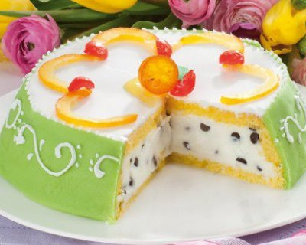
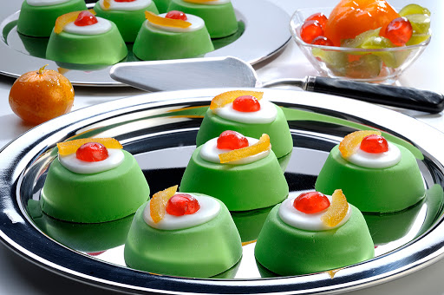
Dessert: Cassata siciliana
INGREDIENTS:
1 sponge cake
800 gr ricotta cheese
500g marzipan
300 gr sugar
1 vanillin sachet
100 gr chocolate drops
3 tablespoons Rum
100gr candied fruit
ELABORATION:
Take the sieved ricotta and mix well with the sugar, add the dark chocolate drops and 100 gr of diced candied fruit (pumpkin, cedar, orange) to the ricotta. Spread 250 g of marzipan and cut strips as high as the edges of the pan and 2-3 mm thick. Make the marzipan strips stick to the edges of the pan and then place, on the bottom of the pan 1 measure-sized sponge cake. Take another pan of sponge cake and make strips as high as the edges of the pan. Make the latter adhere to the strips of marzipan and sprinkle the sponge cake with 50 grams of sugar and with a 1/2 glass of rum melted on the fire. Then brush the base of the cassata. We then move on to fill the pan with the ricotta previously processed and close it with 1 disc of sponge cake brushed with sugar and rum. Put in the fridge to rest for 1 night. Toss the cake on a plate. Make the icing by adding 200 grams of icing sugar, 1 egg white and a few drops of lemon juice. Brush the surface with the icing and finally decorate with candied fruit to taste.
CASSATINE:
It is the typical cake of Palermo, but it represents the Sicilian cuisine all over the world. The Cassata is one of the typical cake of the Christmas festivity.

