Slide 1
Air pollution

Slide 2
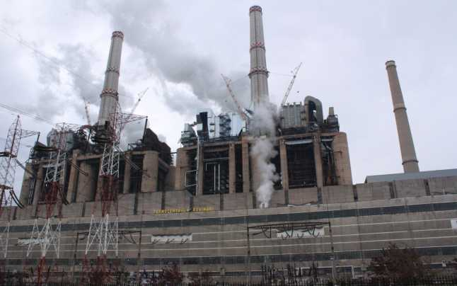
Air pollution is the presence of substances in the atmosphere that are harmful to the health of humans and other living beings, or cause damage to the climate or to materials.

Slide 3
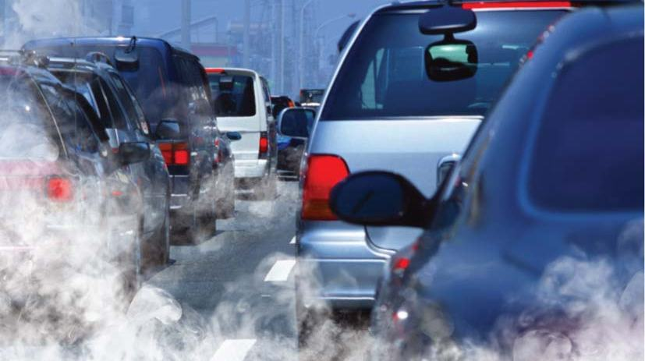
There are many different types of air pollutants, such as gases (including ammonia, carbon monoxide, sulfur dioxide, nitrous oxides, methane, carbon dioxide and chlorofluorocarbons), particles (both organic and inorganic), and biological molecules.

Slide 4
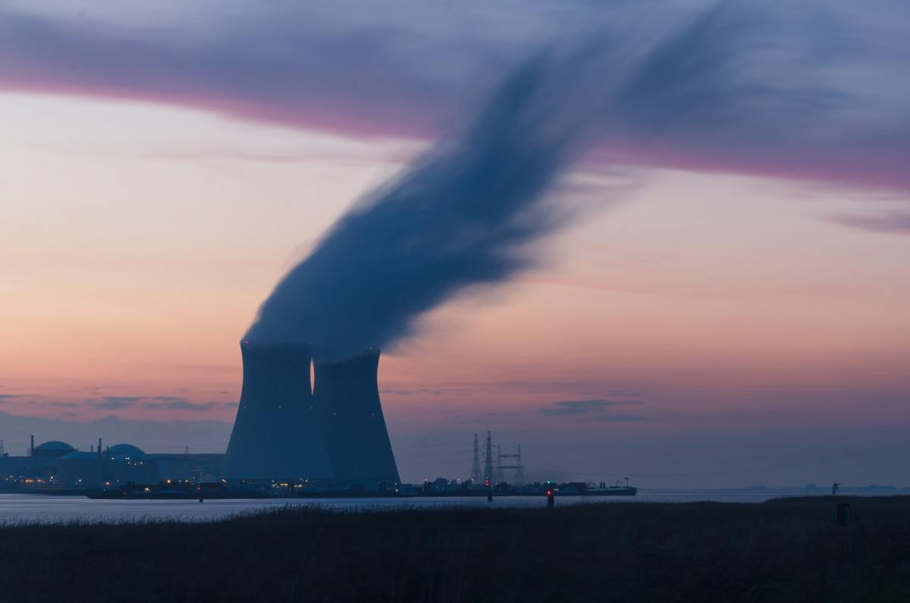

Slide 5
Air pollution is caused by solid and liquid particles and certain gases that are suspended in the air. These particles and gases can come from car and truck exhaust, factories, dust, pollen, mold spores, volcanoes and wildfires.
The solid and liquid particles suspended in our air are called aerosols. Air pollution happens when solid and liquid particles—called aerosols—and certain gases end up in our air. These particles and gases can be bad for the planet and for our health, so keeping track of them is important.

Slide 6
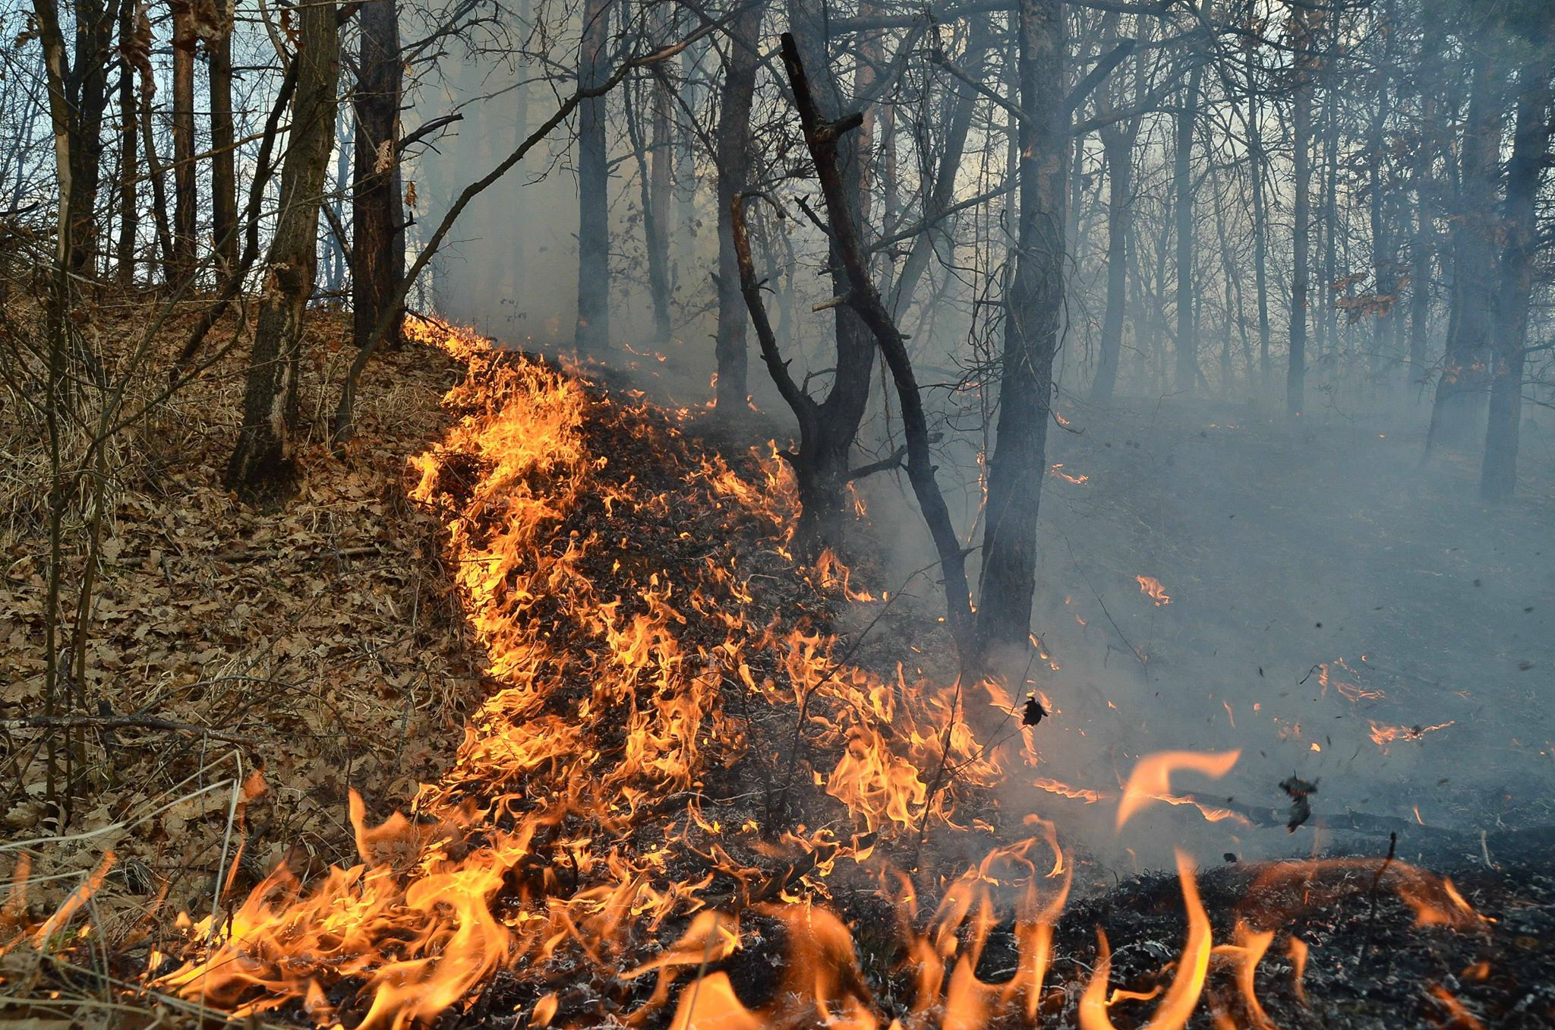

Slide 7
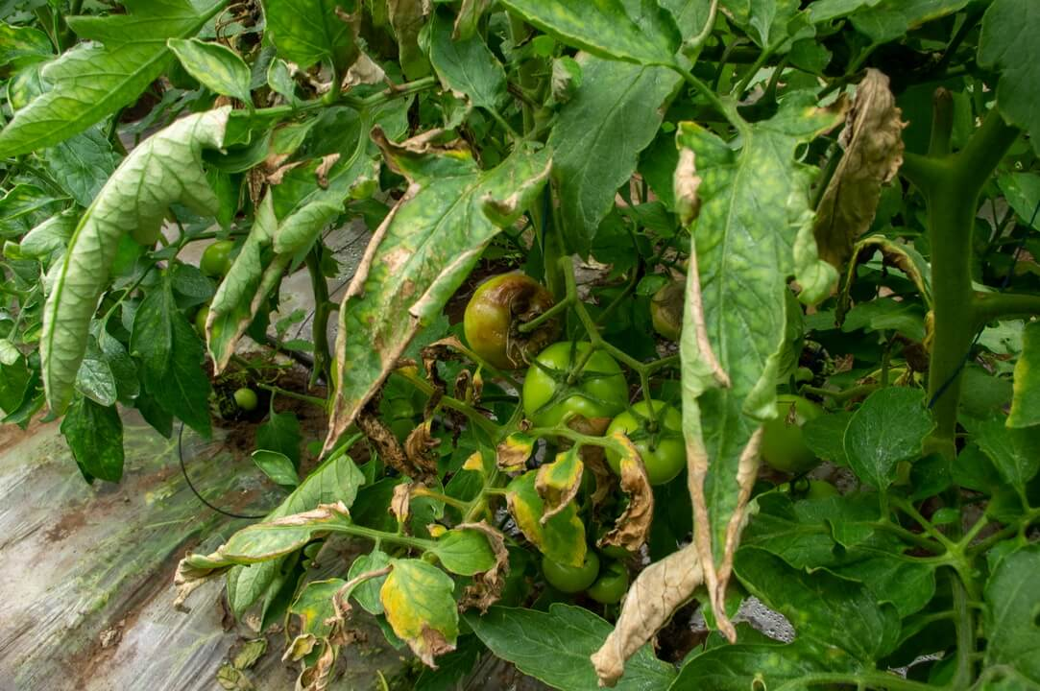
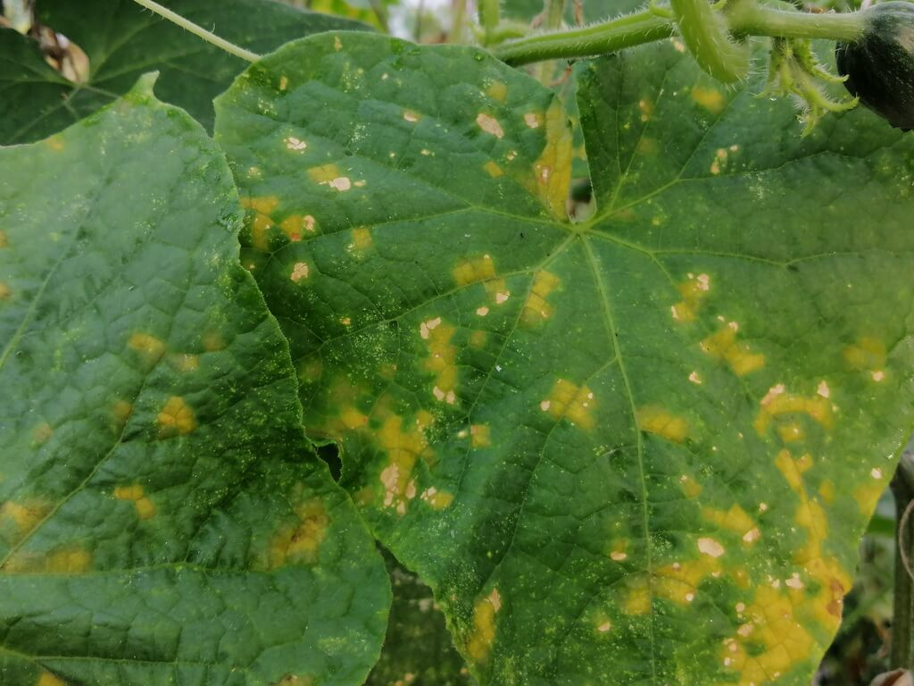
Air pollution may cause diseases, allergies and even death to humans; it may also cause harm to other living organisms such as animals and food crops, and may damage the natural environment (for example, climate change, ozone depletion or habitat degradation) or built environment (for example, acid rain). Both human activity and natural processes can generate air pollution.

