Slide 1
Pollutants inside and outside our area
Târgu Jiu

Slide 2
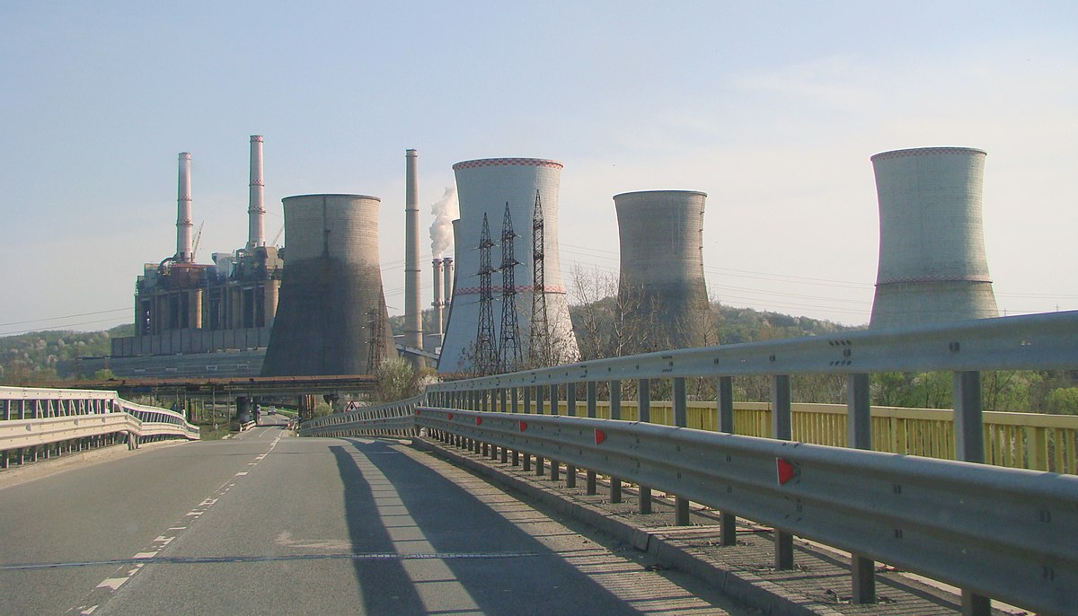
For many of us, it is maybe a surprise to learn that the air on an urban street with medium traffic could actually be cleaner.

Slide 3
Categories of pollutants Biodegradable pollutants: they are substances that descompose quickly in a natural process. Neodegradable pollutants: there are materials that do not descompose or descompose very slowly in the natural environment.

Slide 4
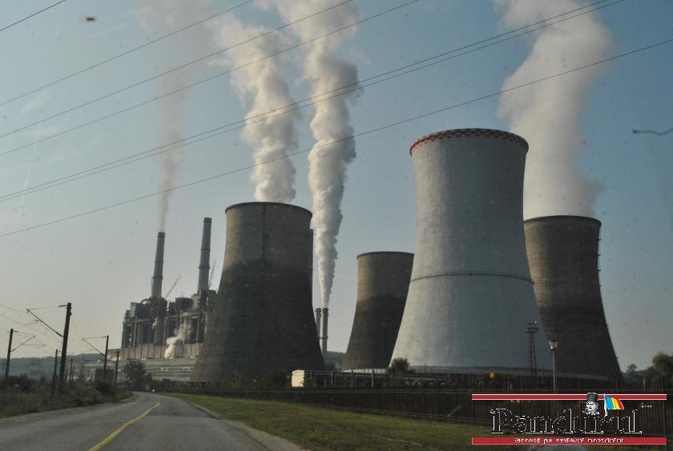
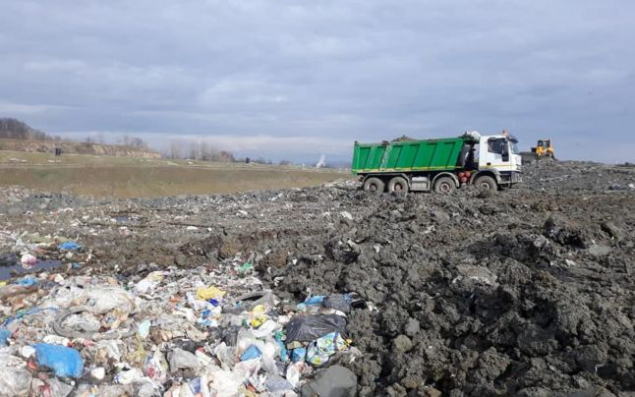

Slide 5
Pollution in Târgu-Jiu
Hundreds of tons of waste endanger the operation of the two hydroelectric plants in Gorj.
Piles of garbage are collected every day on the Jiu river, which risks blocking the turbines of the hydropower plants and even causing floods in Târgu-Jiu.

Slide 6
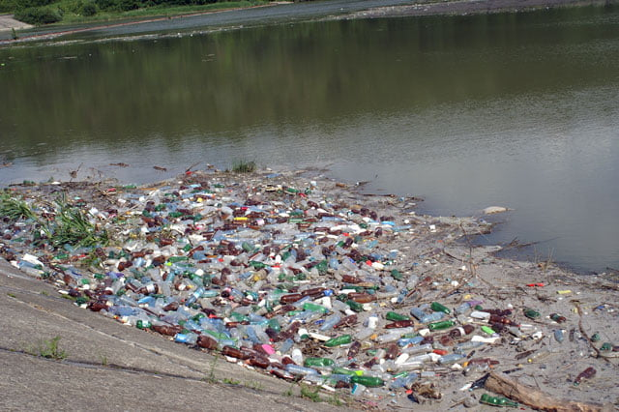

Slide 7
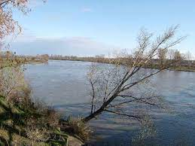
In 2012, the Jiu river was polluted with coal impurities so the fish had suffered.

