Slide 1
NİTROGEN
1.what is nitrogen?
2. What is nitrogen used for?
3. What are the benefits?

Slide 2
What is nitrogen?
First of all, it's a asal gas. It is odorless, colorless and not necessary for living, but it is important for growing plants and is one of the main additives of fertilizers.

Slide 3
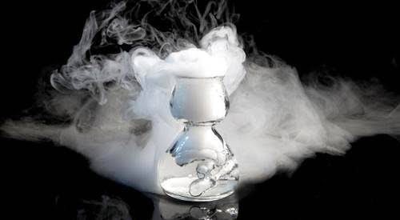

Slide 4
What is nitrogen used for?
Its use is far beyond gardening. Nitrogen is usually found in the form of liquids or gases (it is also possible to obtain solid nitrogen). Liquid nitrogen is used as a cooler; it has the capacity to quickly freeze the ability to freeze the ability to quickly freeze food and medical research, and is also used in reproductive technology.

Slide 5
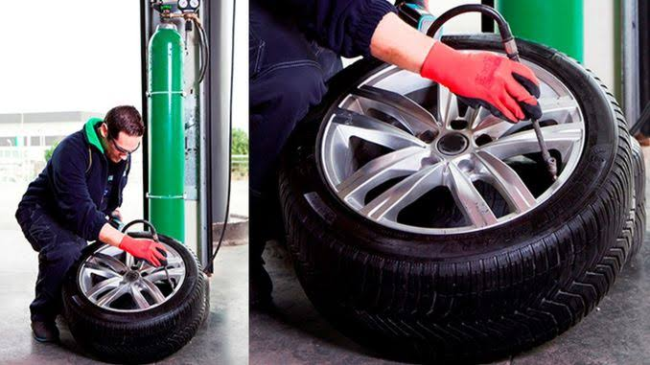
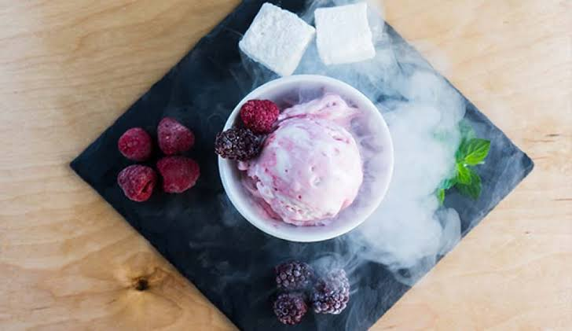

Slide 6
