Slide 1
Heavy Metals

Slide 2
What are heavy metals?
Heavy metal is the name given to the elements in the group consisting of elements with metallic properties, which have not been clearly defined. This group includes transition metals, some semi-metals, lanthanides and actinides.

Slide 3
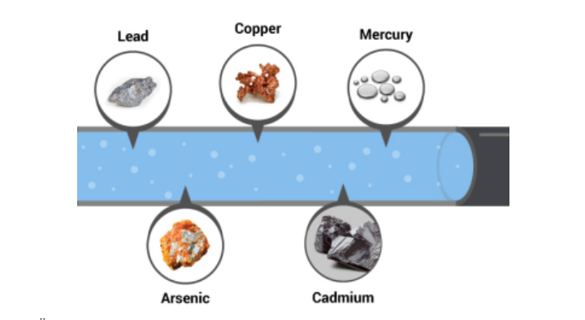
Heavy metals are naturally occurring compounds in the earth's crust. They cannot be destroyed or destroyed. Metals with densities higher than 5 g / cm3. Generally, all metals that are toxic and cause environmental pollution are called heavy metals. More than 60 metals, including lead, cadmium, chromium, iron, cobalt, copper, nickel, mercury and zinc, are included in this group.

Slide 4
Heavy metal poisoning
Heavy metal poisoning is the name given to the negative effects and diseases that occur in our body by copper, chloride, aluminum, mercury, lead, cadmium and arsenic.

Slide 5
Relations of heavy metals with living organisms
Living organisms need varying amounts of "heavy metals". People need iron, cobalt, copper, manganese, molybdenum, and zinc. Excessive levels can harm the organism. Other heavy metals such as mercury, plutonium, and lead, toxic metals have no known vital and beneficial effects on organisms, and their accumulation in the body over time causes very serious diseases.

