Slide 1
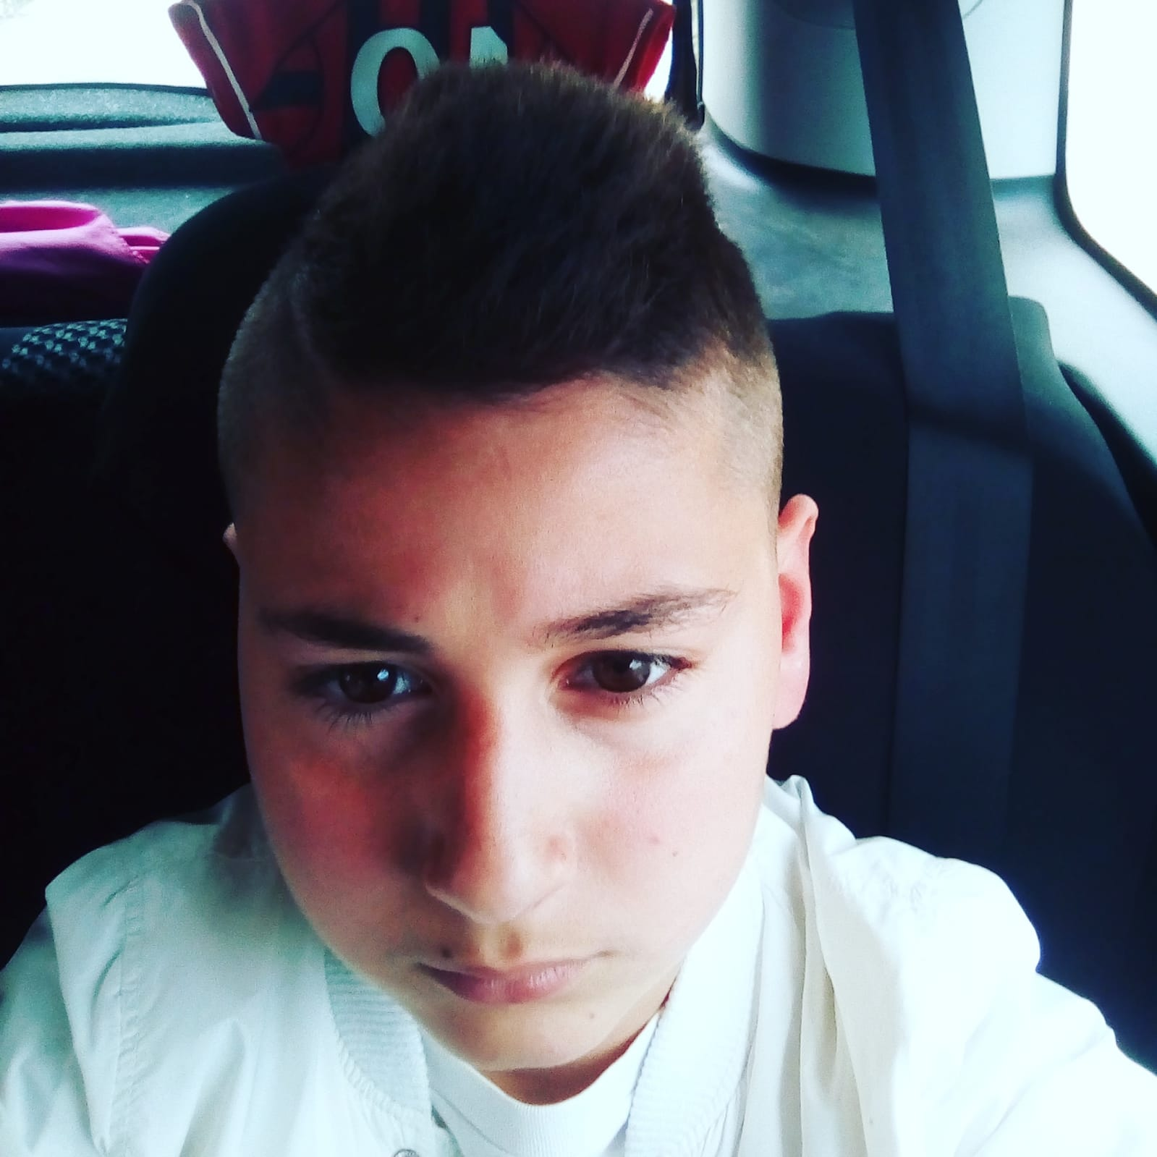
My name is Gabriele
Cambareri.I’m twelve
years old.I have
Brown hair and
Brown eyes.
I’m tall
and thin.

Slide 2
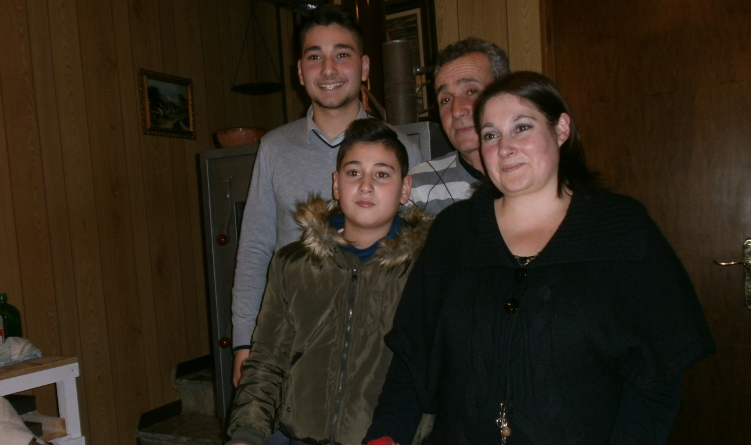
This is my family
My father’s name
Is Santo,my
Mother’s name is
Cinzia and my
Brother’s name is
Carmelo.

Slide 3
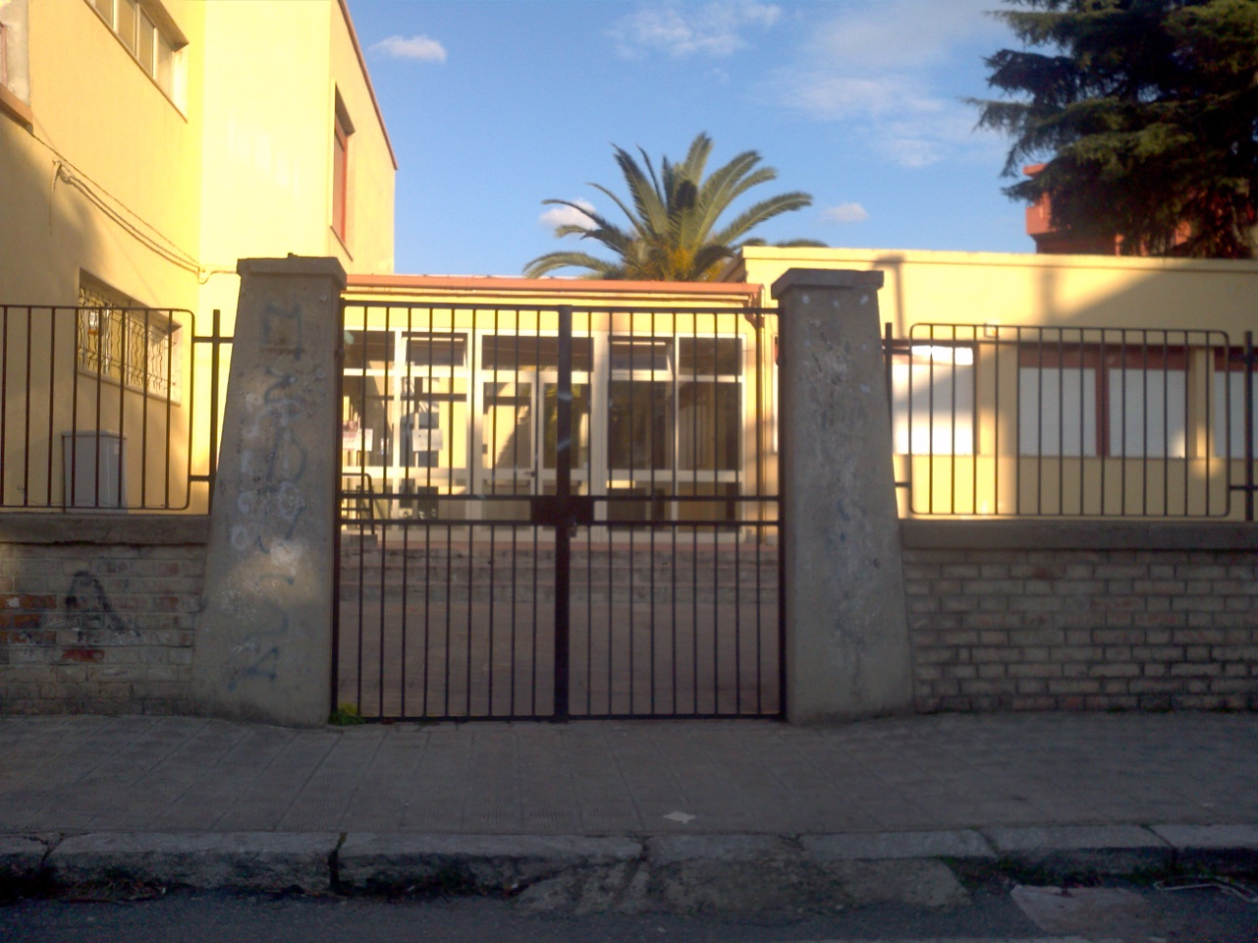
I go to school to Radice-Alighieri secondary junior school.

Slide 4
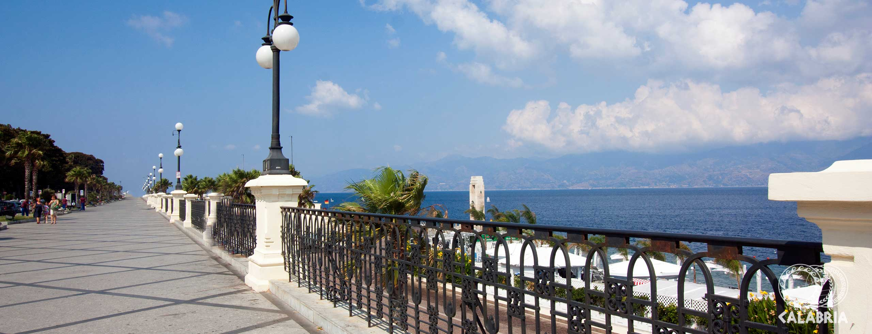
I’m from Italy. I live in
Reggio Calabria.

Slide 5
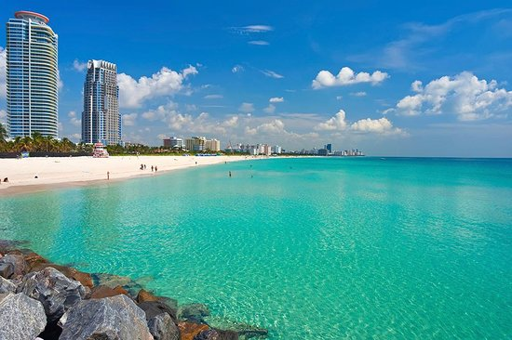
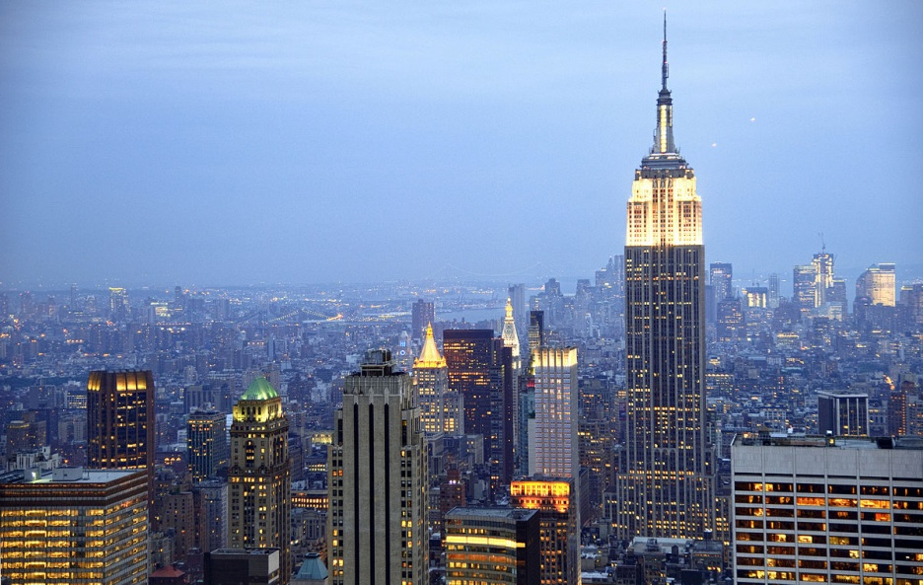
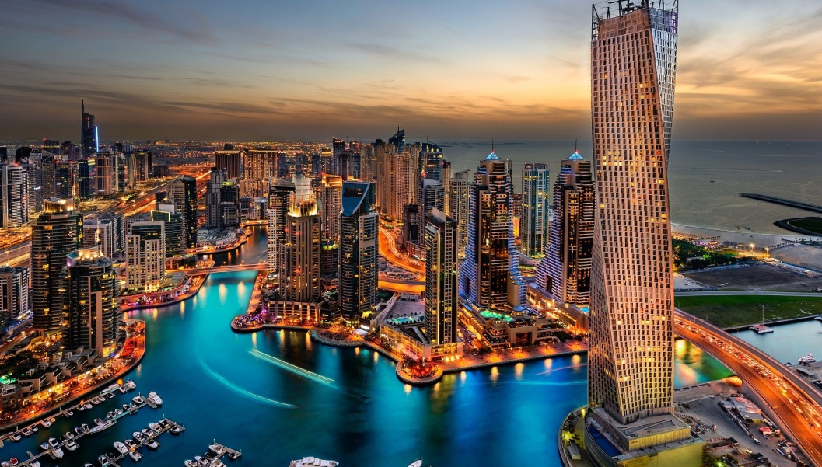
My favourite cities are
Miami beach,Manhattan
And Dubai.

Slide 6
My favourite colours
Are green,red and
Black.

Slide 7
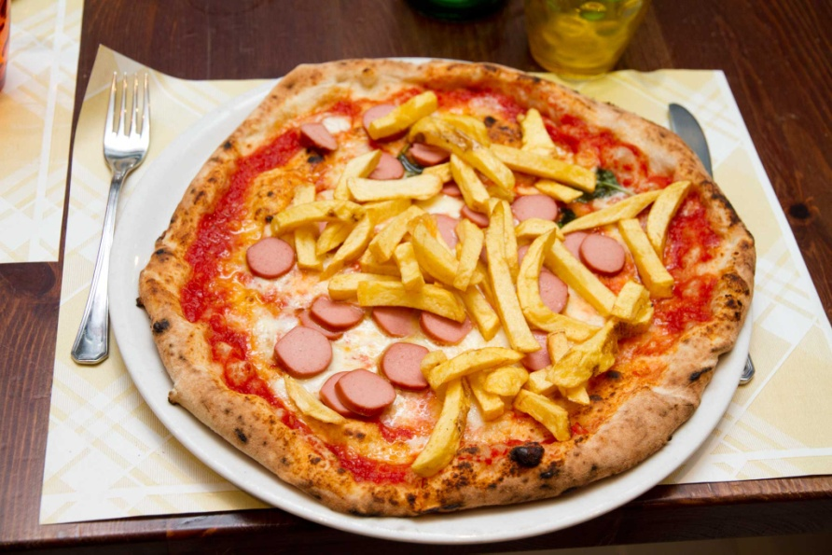
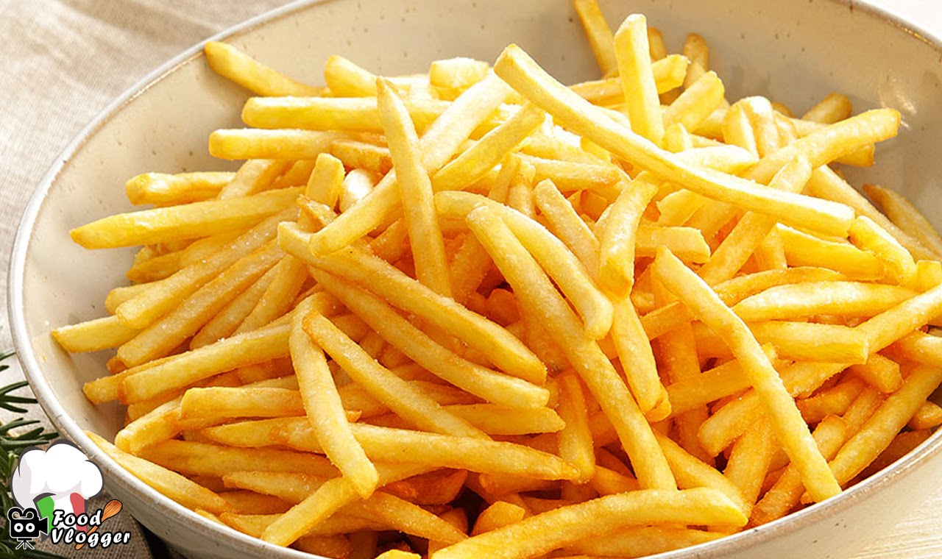
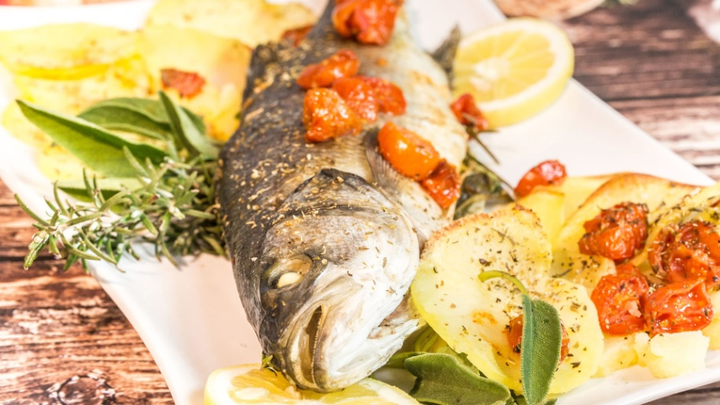
My favourite foods
Are pizza,fish and
chips

Slide 8
My favourite subjects
Are Spanish and
Physical Education.

Slide 9
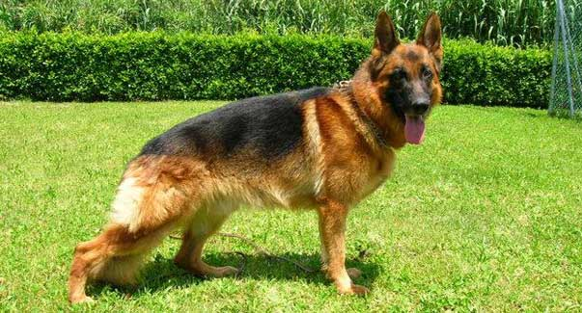
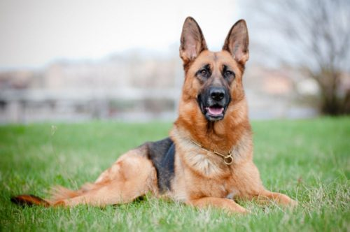
My favourite pet
Is dog.

Slide 10
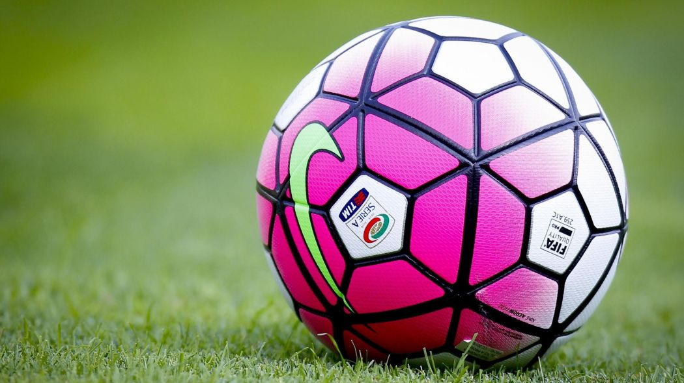
My favourite sport
is Football.

Slide 11
Nice to meet you
eTwinners!

