Slide 1
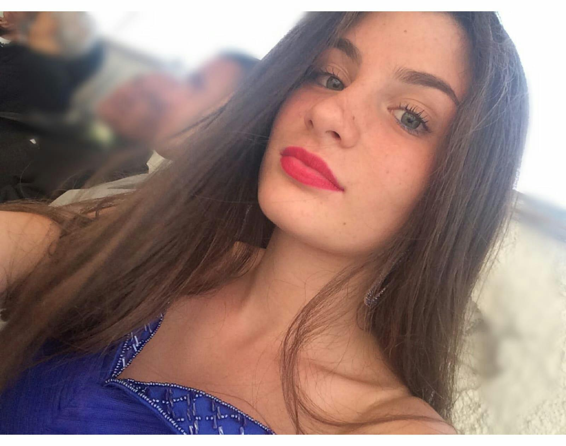
I introduce myself
My name is Aurora,I’m 13, I’m in eighth grade, I have green eyes and brown hair and I’m average height

Slide 2
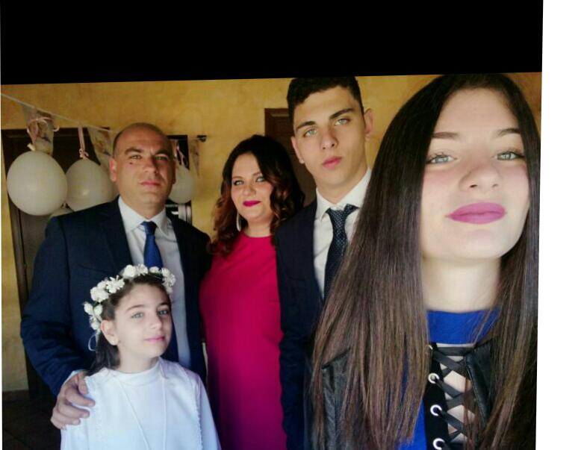
My family
my family is formed of 5 people :my mother, my father. my brother and my sister, we are a very close family

Slide 3
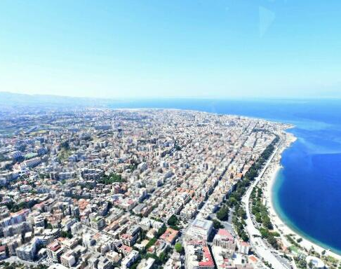
Reggio Calabria
I live in catona (RC)

Slide 4
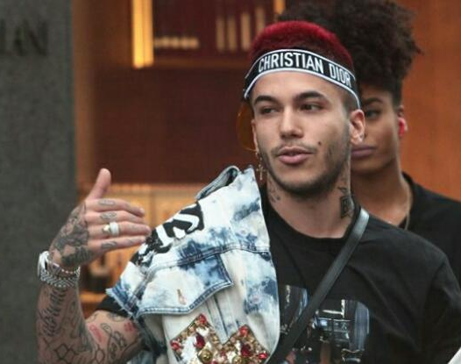
Music
I like listening to music a lot, my favorite rap singer is Sfera

Slide 5
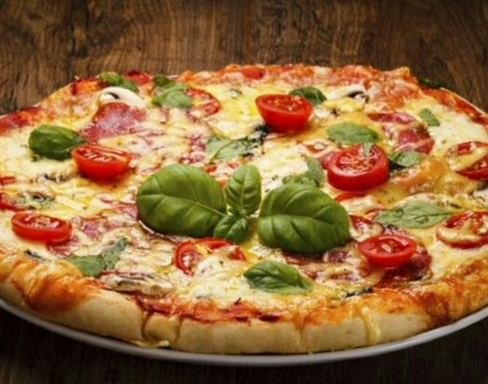
Favorite food
The food I eat frequently, and I like the most is pizza

Slide 6
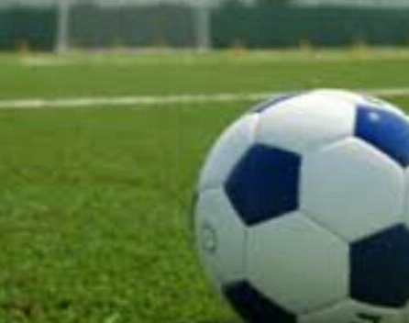
SPORT
My favourite sport is soccer , I do not pratice it but I would like to practice it

