Slide 1
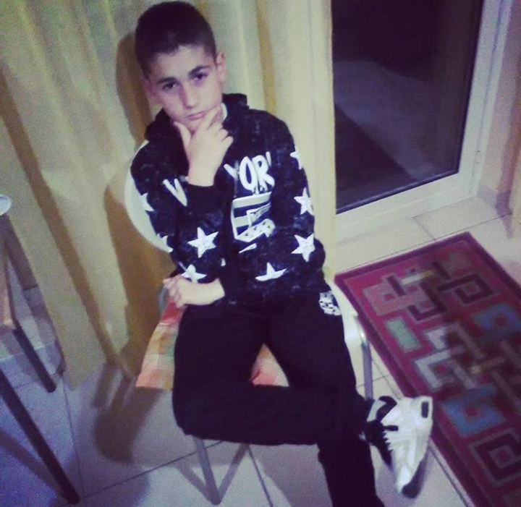
HELLO Etwinners !
My name is Andrea
Cambareri.
I’m twelve
years old.
I have short
brown hair.
I have brown
eyes. I’m tall and thin.

Slide 2
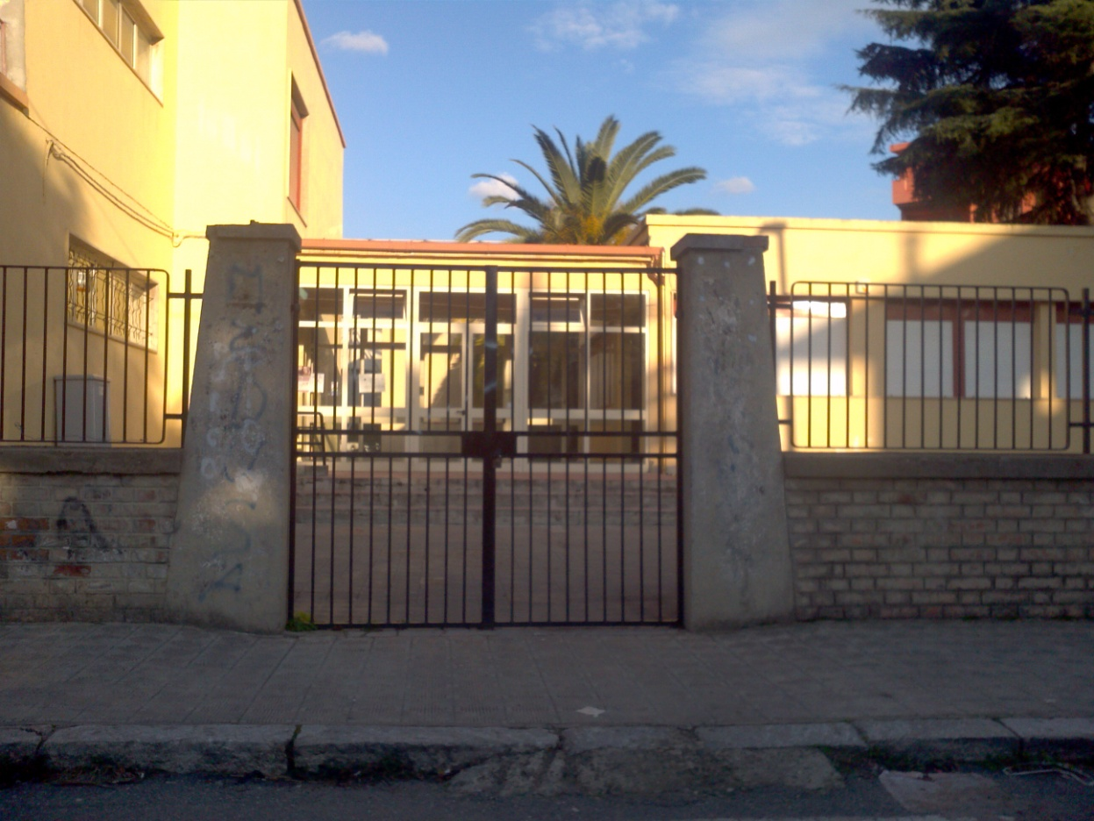
I go to school
Radice-Alighieri in Catona.

Slide 3
My favourite
School subjects are
Maths and English.

Slide 4
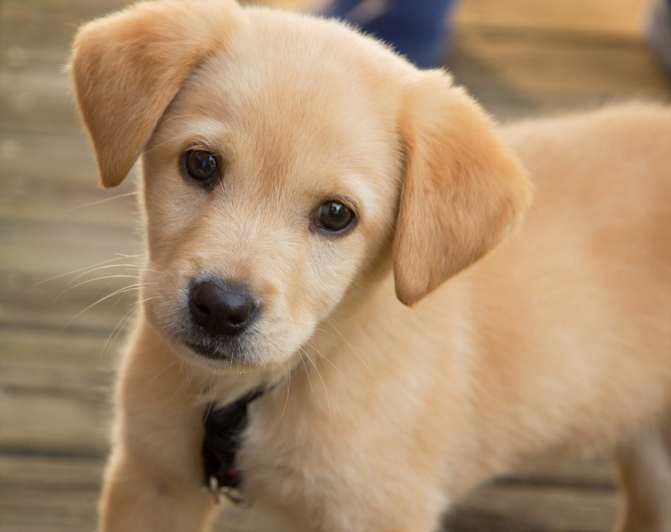
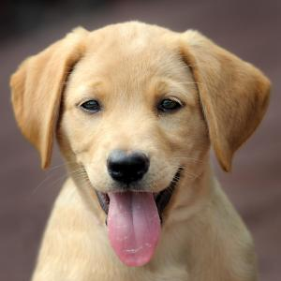
My favourite
Animal is
Dog.

Slide 5
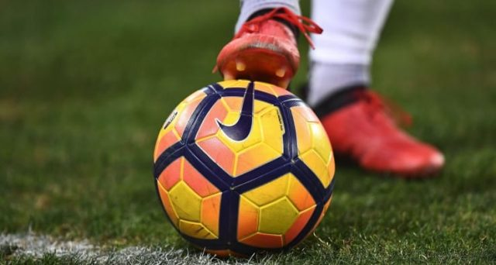
My favourite
Sport is
Football.

Slide 6
My favourite
color is red.

Slide 7
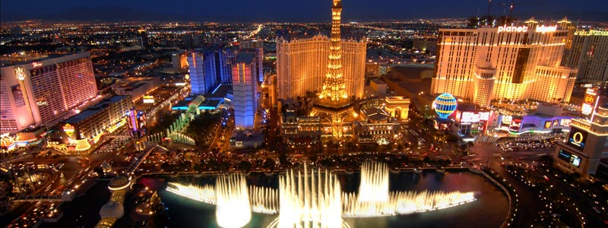
My favourite city
Is Las Vegas.

Slide 8
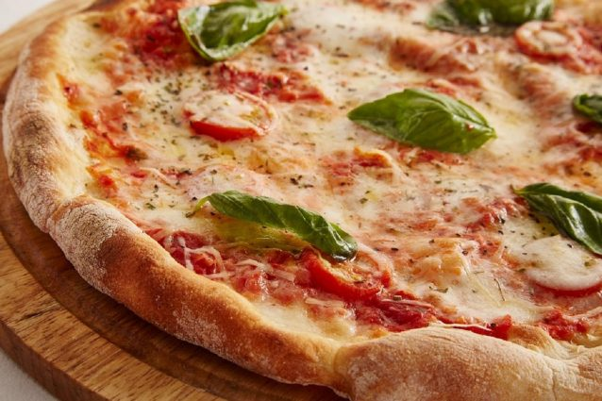
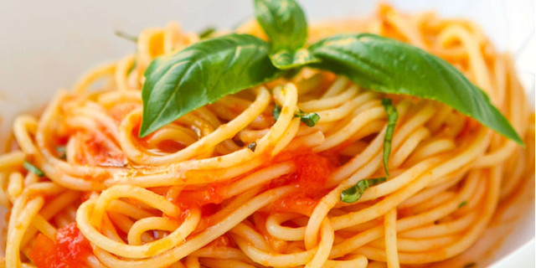
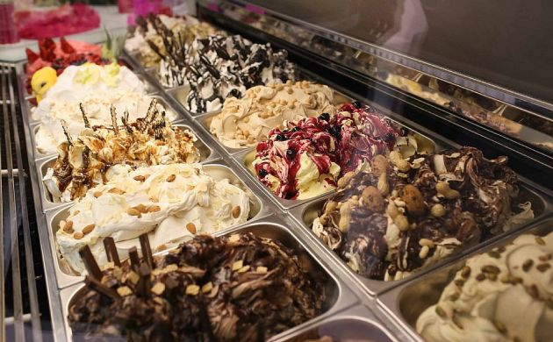
My favourite foods
Are pizza,pasta and
Ice cream.

Slide 9
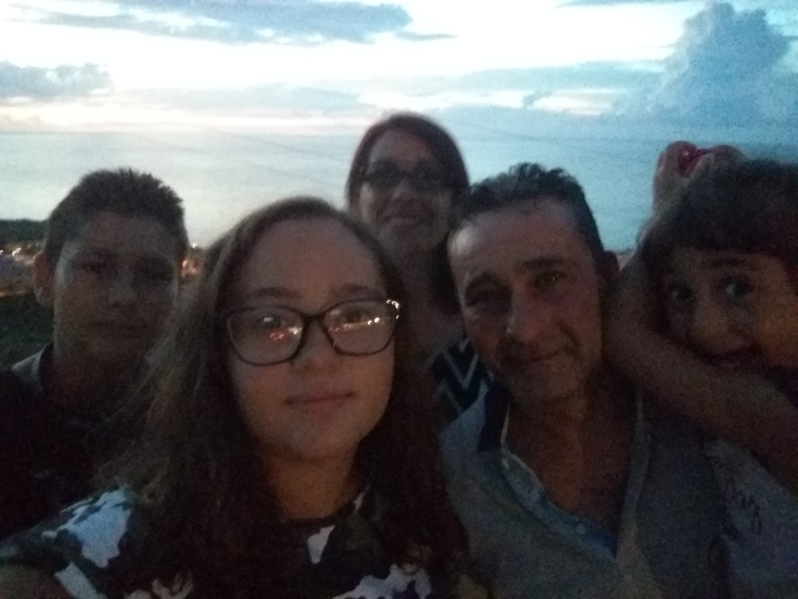
This is my family,
my father’s name
is Francesco,my
mother’s name is
Tiziana,my sisters’
names are Rebecca
and Alessandra

Slide 10
Nice to meet you
eTwinners

