Slide 1
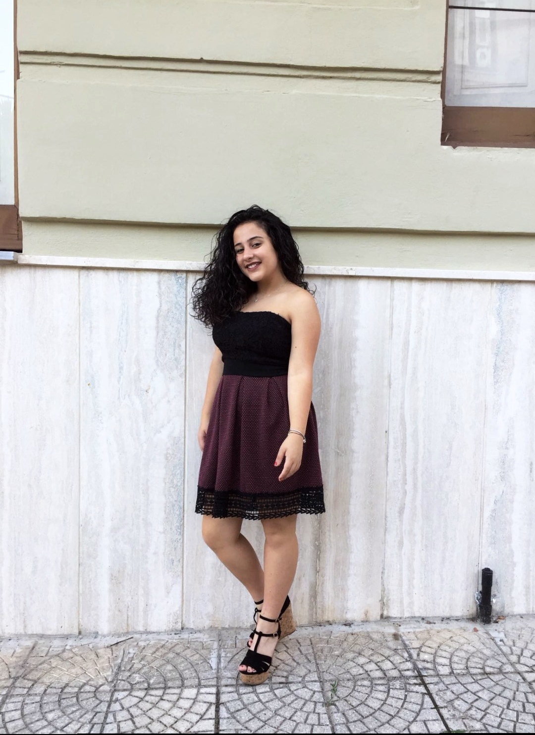
My name is Mariagrazia Postorino

Slide 2
I’m 13 years old.
My birthday is on February 14th

Slide 3
I am short
I have brown eyes and hair
I am not shy

Slide 4
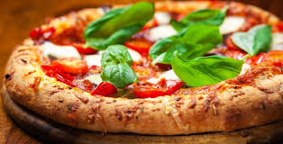
I love pizza

Slide 5
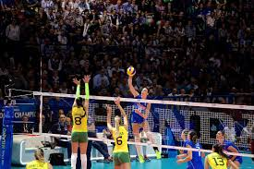
my favourite sport is volleyball

Slide 6
I love listening to music

Slide 7
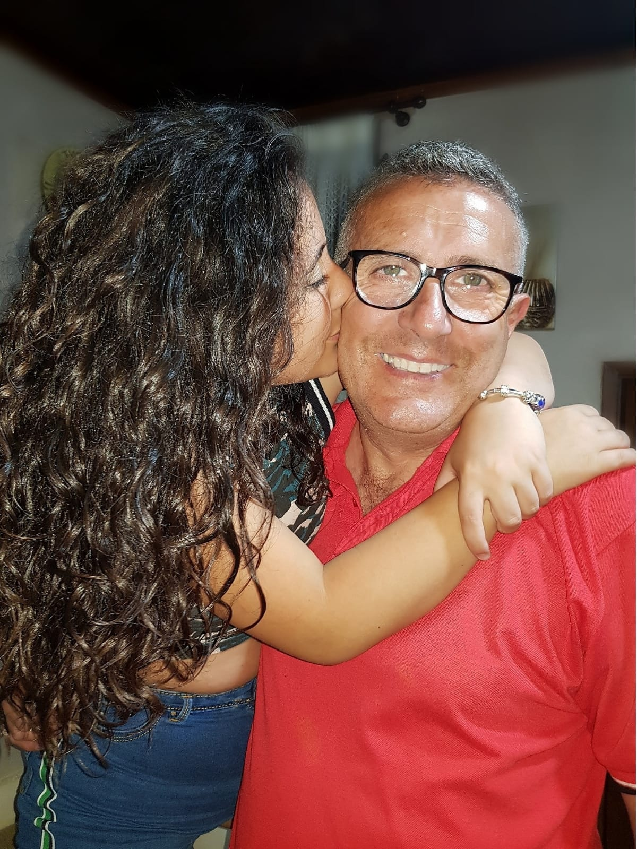
my dad's name is Antonino

Slide 8
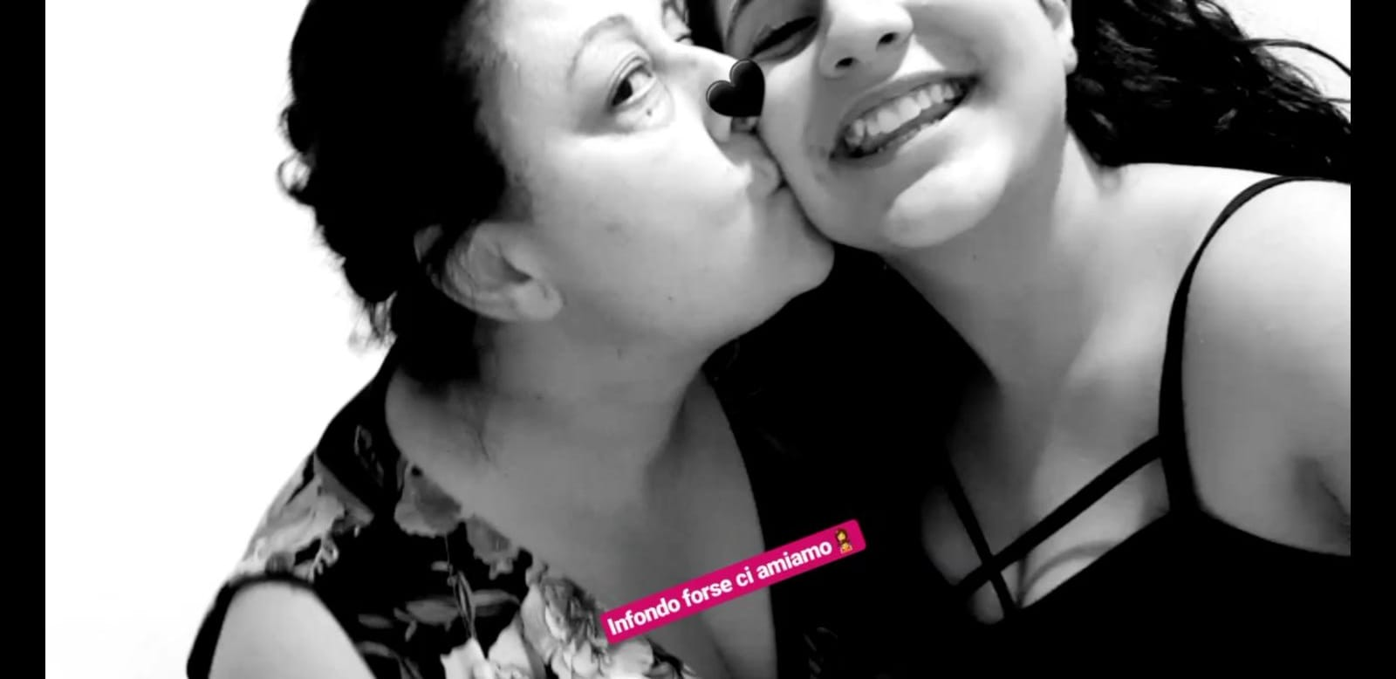
g
my mother's name is Angela

Slide 9
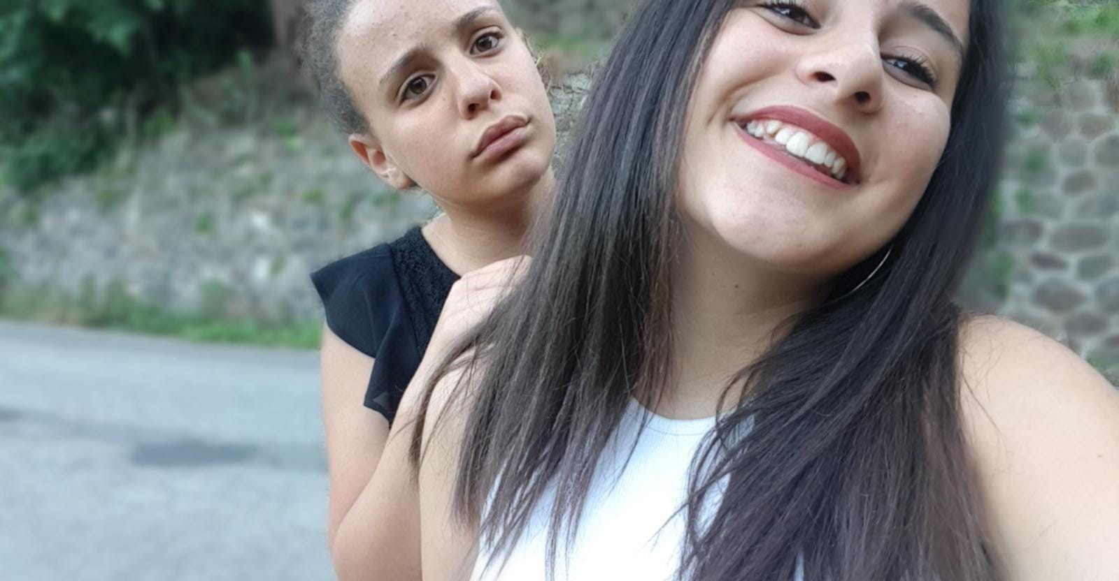
my sister's name is Giusy

Slide 10
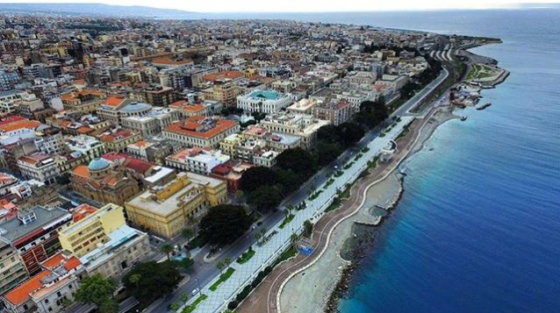
I live in Catona(RC)

Slide 11

I attend the Istituto Comprensivo Radice Alighieri Catona R.C.

Slide 12
Bye bye!

