Slide 1
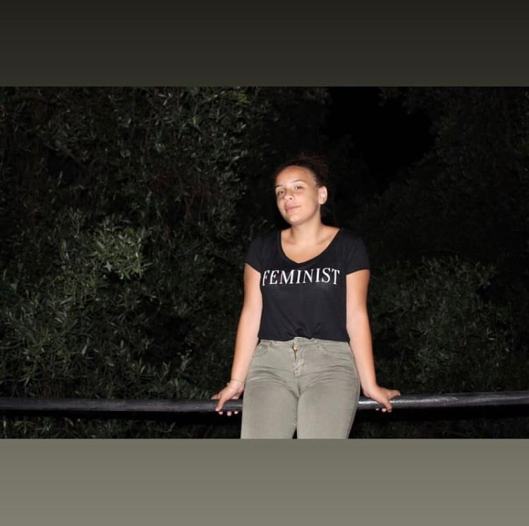
Hi! My name is Giusy Postorino

Slide 2
I’m 11 years old,
my birthday is on February 14th
I am tall and thin

Slide 3
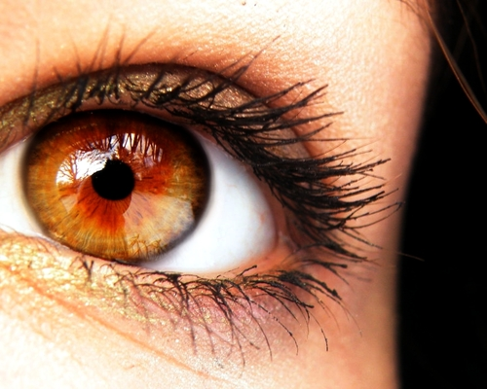
I have brown eyes

Slide 4
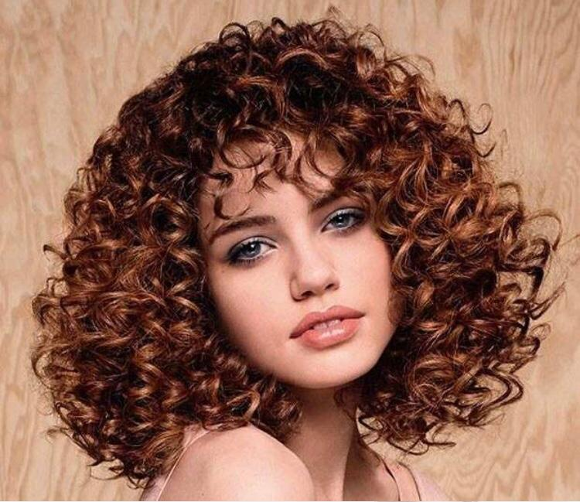
I have curly,brown and long hair

Slide 5
I attend the Instituto Comprensivo Radice Alighieri Catona R.C.

Slide 6
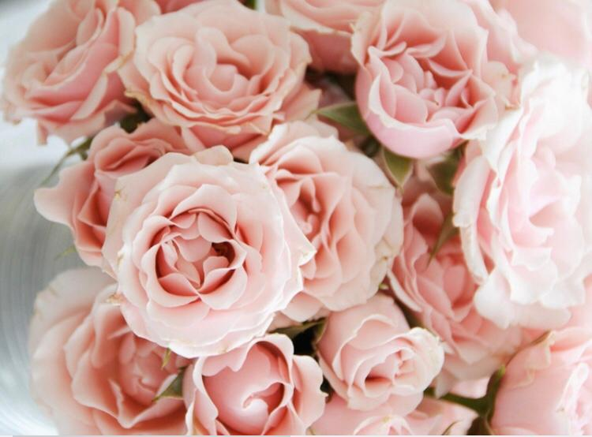
my favourite colour is pink

Slide 7
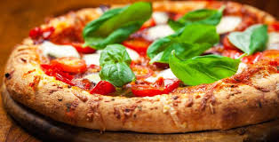
my favourite food is pizza

Slide 8
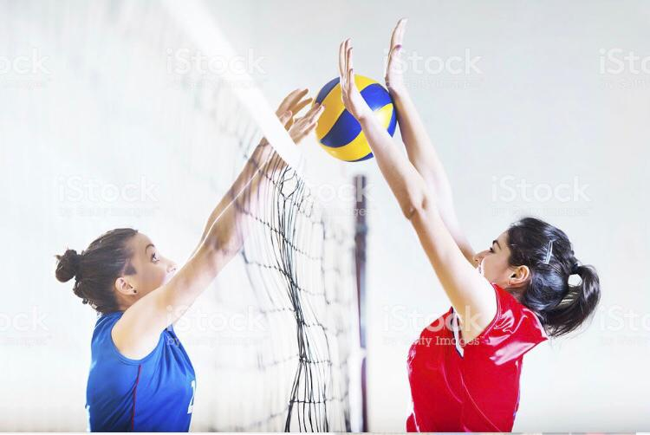
my favourite sport is volleyball

Slide 9
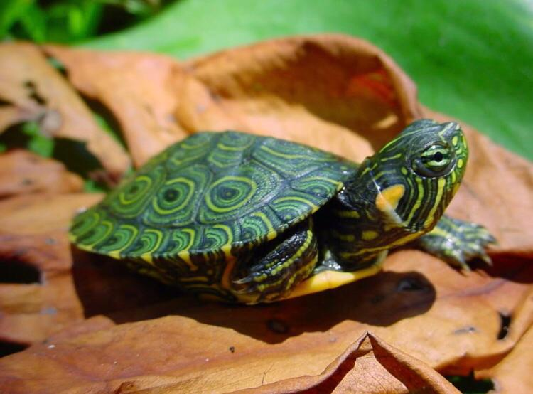
my favourite pet is the turtle

Slide 10
Bye bye!!

