Slide 1
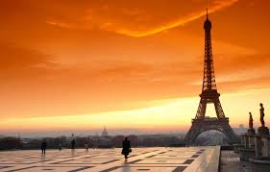
France

Slide 2
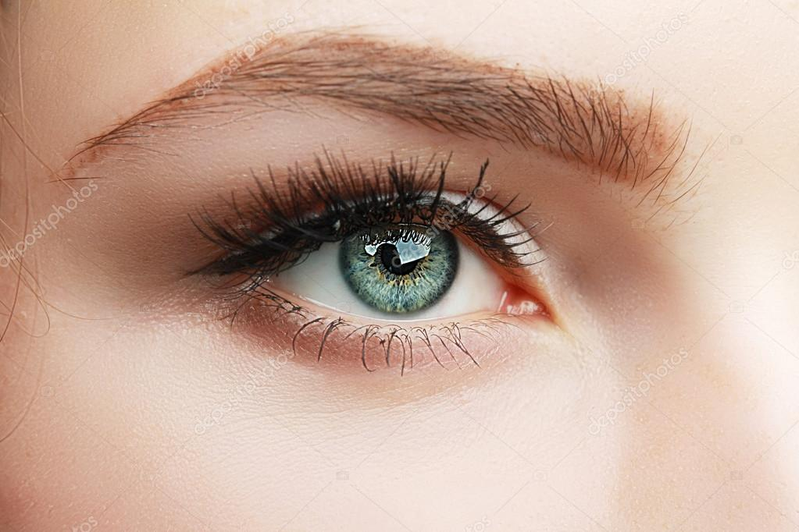
If I were French I would:
be a girl with green eyes and brown hair
be a fashion
designer

Slide 3
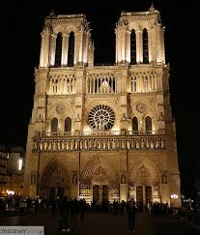
If I were on French I would:
-eat a baguette, live Paris, go to the Eiffle Tower and
cafes
- visit the a Azure Coast and cathedral Notre-Dame

Slide 4
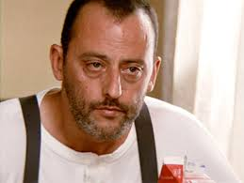
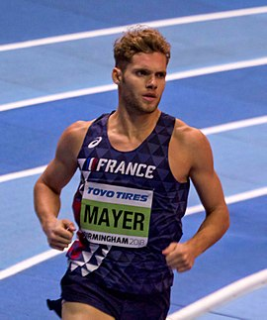
If I were French I would:
like a Jeak Reno and
support Kevin Mayer

Slide 5
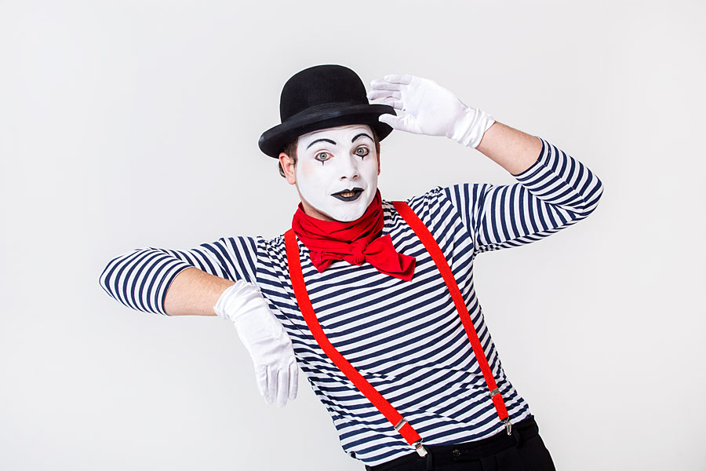
If I were French I would wear a scarf, blouse with long sleeve and roll neck in black-white strip

Slide 6
Italy

Slide 7
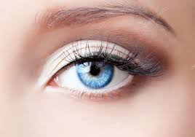
If I were Italian I would:
-be a girl with blue eyes and blond hair
-work in a restaurant

Slide 8
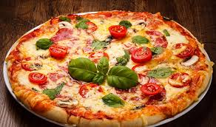
If I were Italian I would:
live a Venezia, visit Rome, ride a motorbike,
eat pizza and pasta

Slide 9
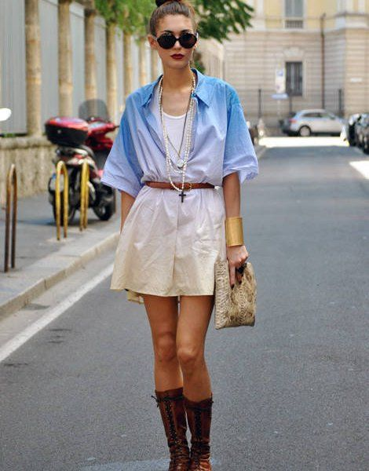
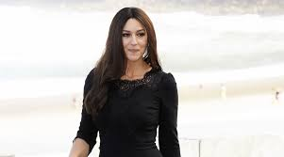
If I were Italian I would:
like a Monica Bellucci and
wear what’s fasionable

Slide 10
By Beata
Szkoła Podstawowa nr 9 im. Mikołaja Kopernika
Dzierżoniów, Poland

