Slide 1
HEALTHYLAND OLYMPICS
TURKISH SPORTS
NALAN UYSAL
TURKEY

Slide 2
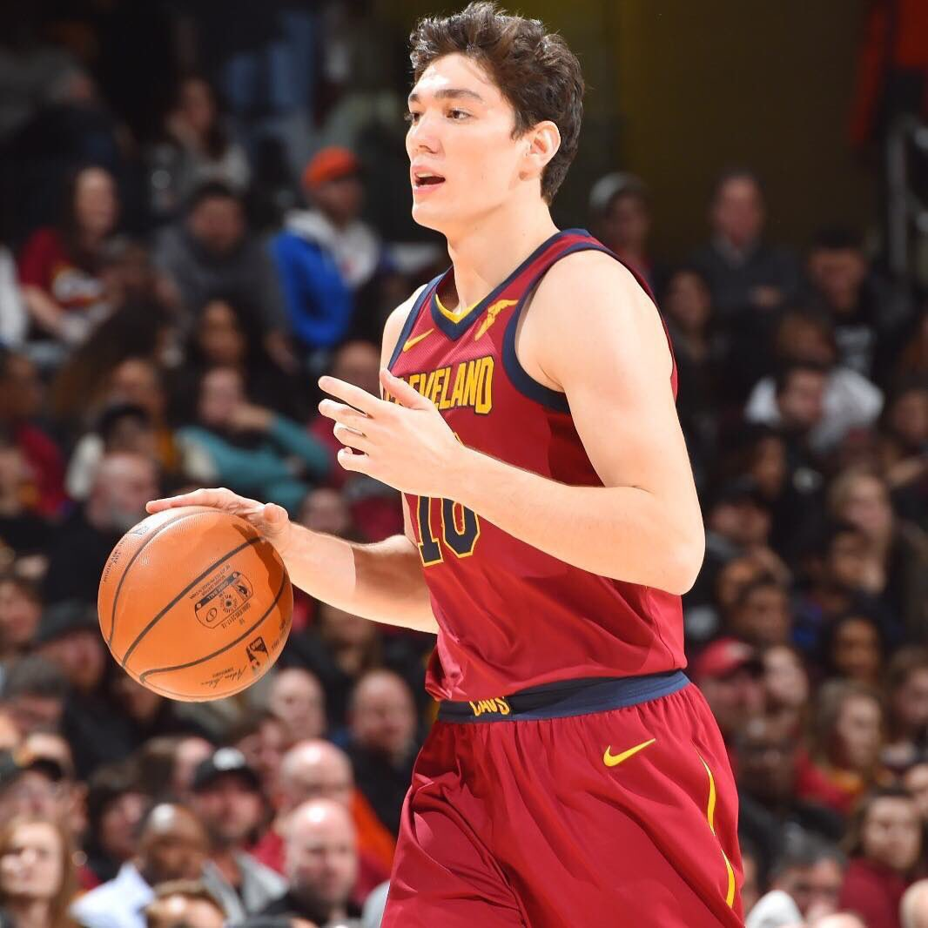
CEDİ OSMAN
BASKETBALL

Slide 3
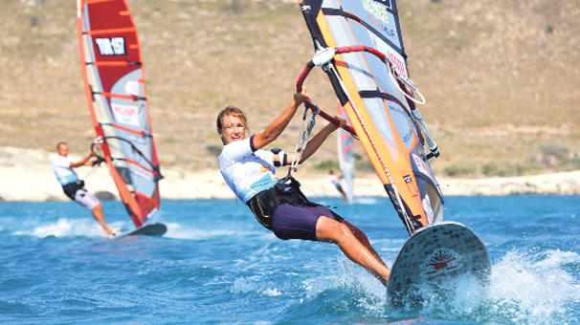
ÇAĞLA KUBAT
SURFING

Slide 4
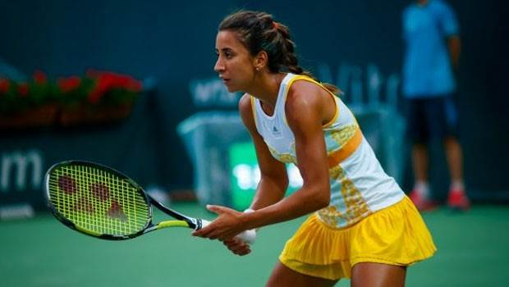
ÇAĞLA BÜYÜKAKÇAY
TENNIS

Slide 5
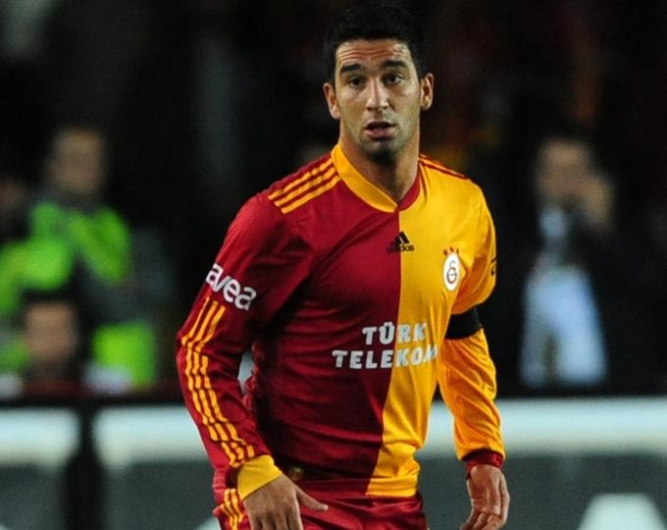
ARDA TURAN
FOOTBALL

Slide 6
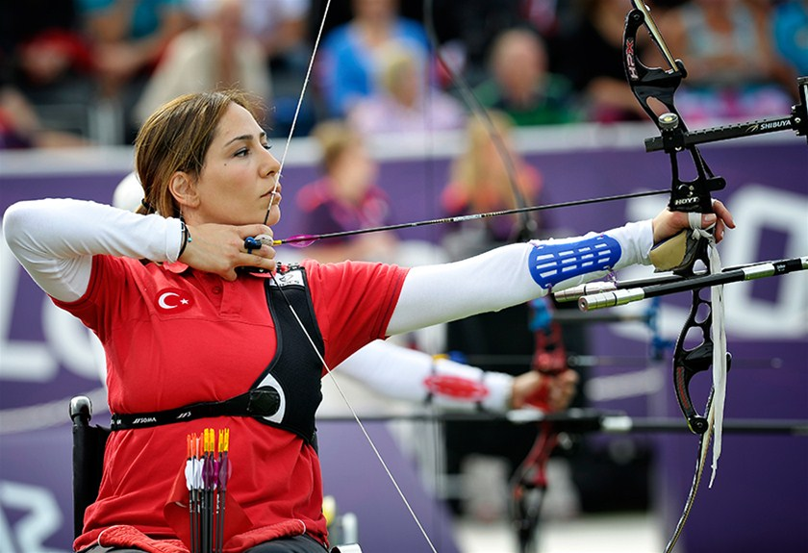
GİZEM GİRİŞMEN
ARCHERY

Slide 7
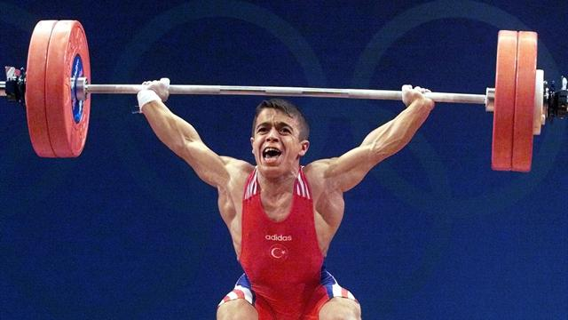
HALİL MUTLU
BARBELL

Slide 8
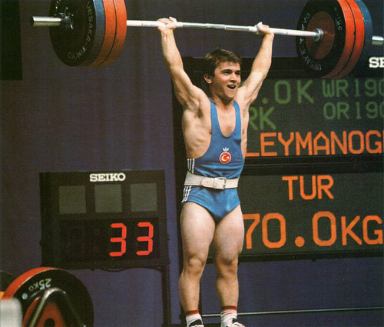
NAİM SÜLEYMANOĞLU
BARBELL

Slide 9
NESLİHAN DARNEL
VOLLEYBALL

Slide 10
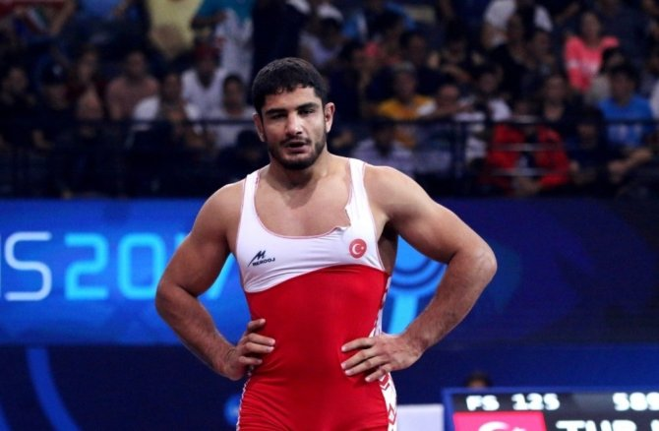
HALİL MUTLU
WRESTLING

Slide 11
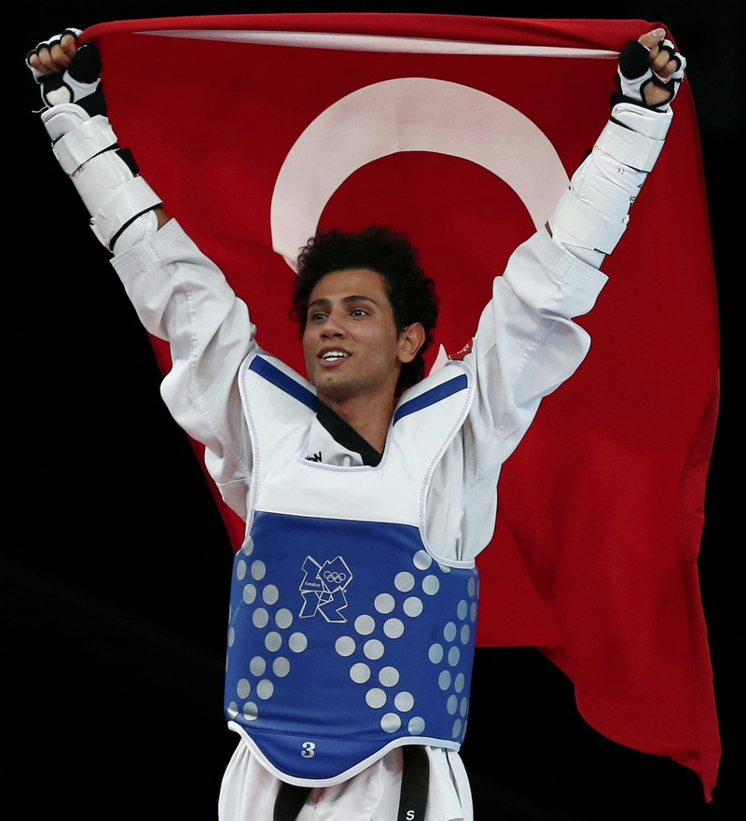
SERVET TAZEGÜL
TAE-KWON-DO

Slide 12
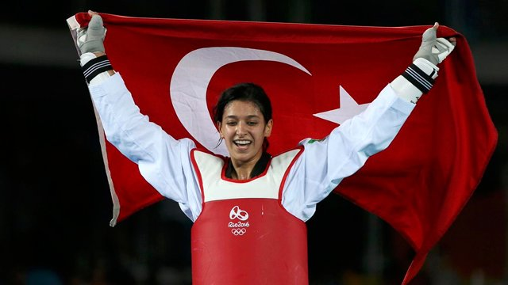
NUR TATAR
TAE-KWON-DO

Slide 13
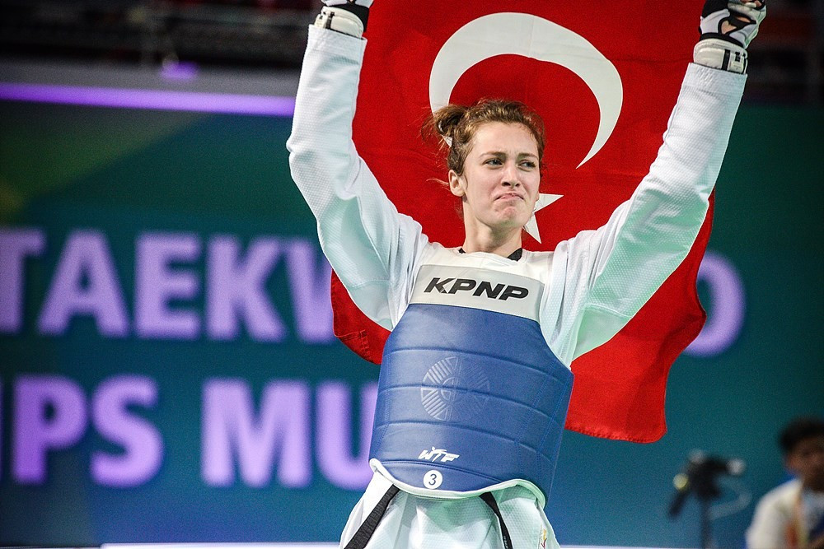
ZELİHA AGRIŞ
TAE-KWON-DO

