Slide 1
CARP
David Lubojacký, Martin Jordán, Milan Machynka

Slide 2
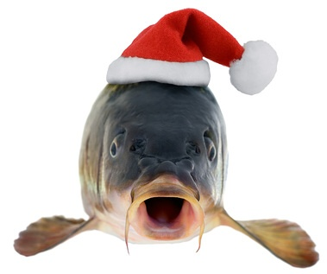
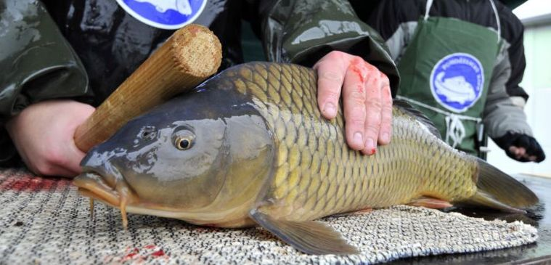
Carp
First you need a carp

Slide 3
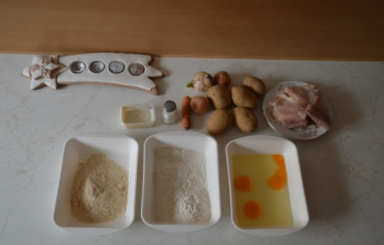
Ingredients
10 potatos, 2 oniones, carrot
Carp meat
mayonnaise
salt
breadcrumbs
flour
4 eggs

Slide 4
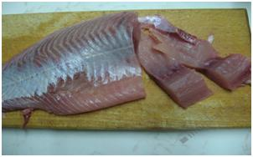
Preparation of carp meat
Slice and salt the carp.
Wrap it in flour, eggs and breadcrumbs.

Slide 5
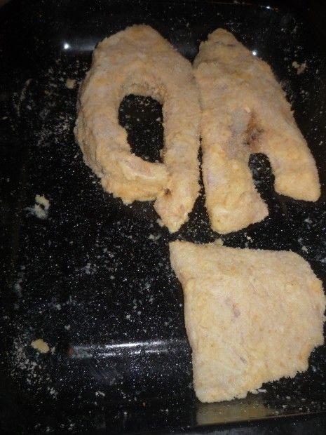
Breaded carp
Fry the pieces of carp.
Then take them out.

Slide 6
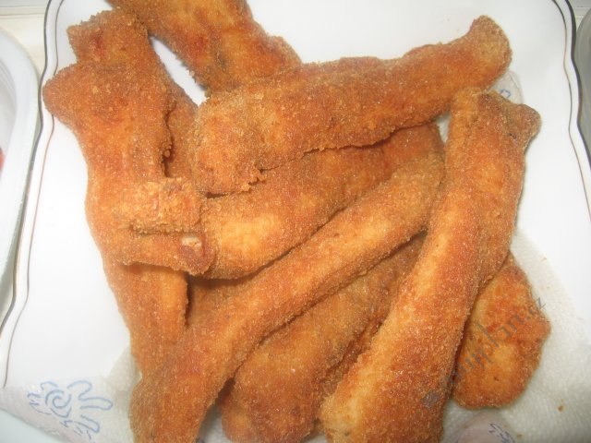
Fried carp
Fried carp is typically served with potato salad.

Slide 7
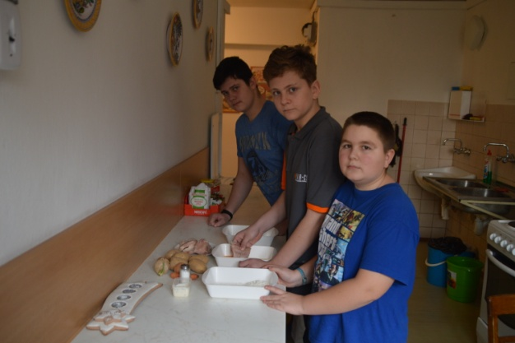
Potato salad
Slice boiled potatoes, chop the onion, cucumber, carrot and we put mayonnaise and stir averything.

Slide 8
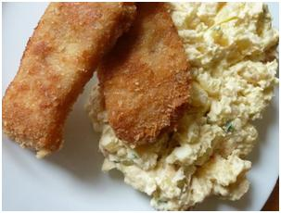
Ready meal
We can serve the meal.
Enjoy it.

Slide 9
Thank you for your attention

