Slide 1
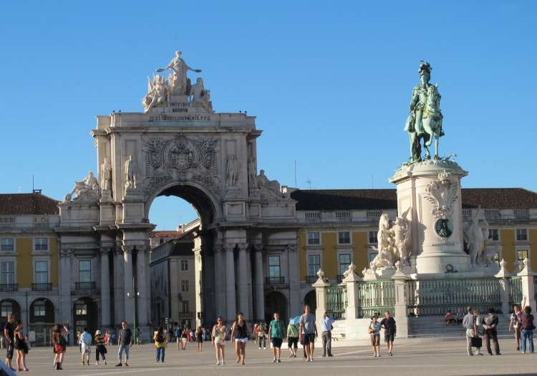
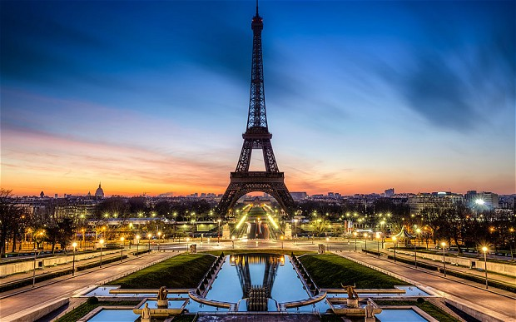
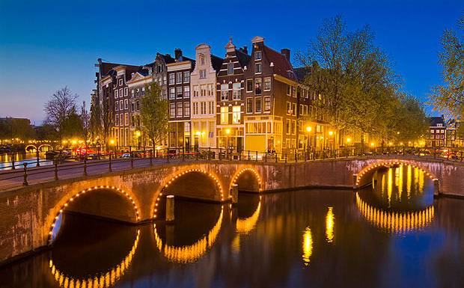
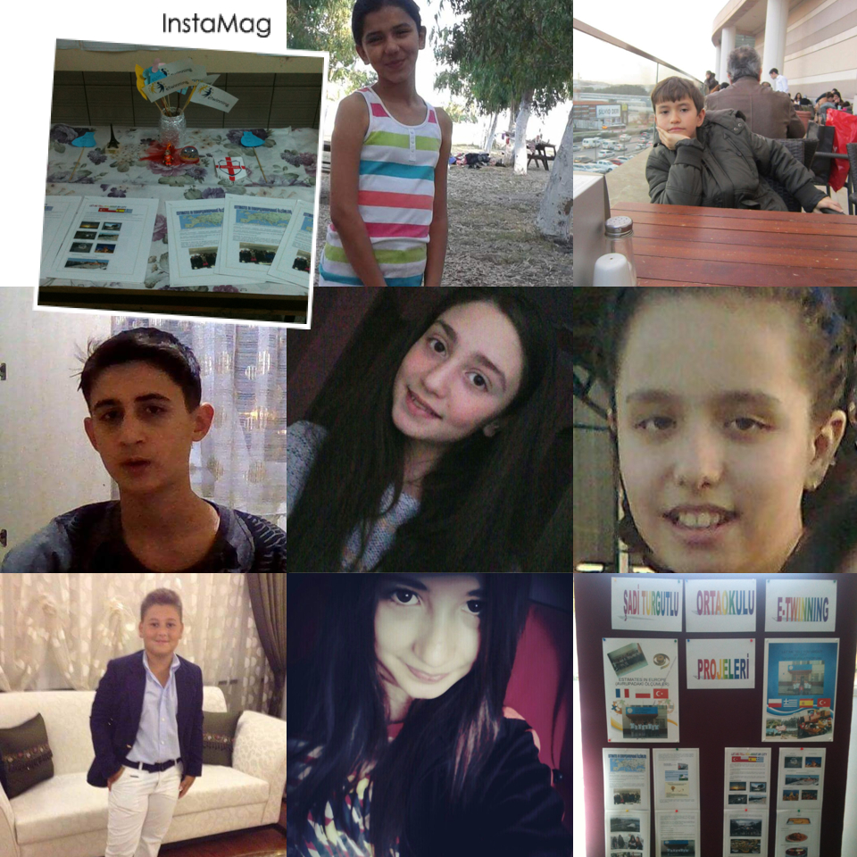
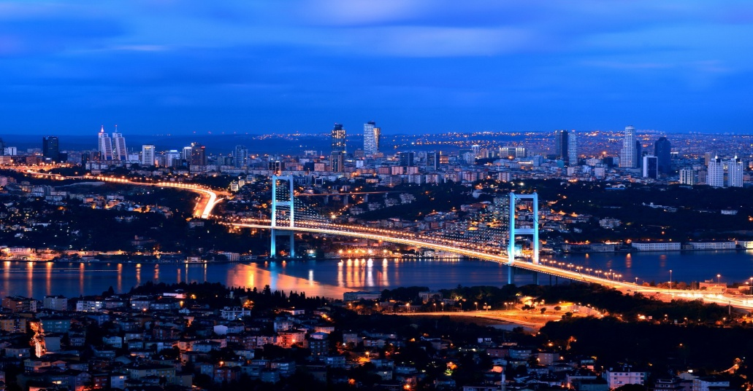
TOURISM IN EUROPE

Slide 2
OUR ROLE IN UNIVERSAL TRAVEL AGENCY
OFFICE WORKERS
EZGİ&GİZEM&SENA

Slide 3
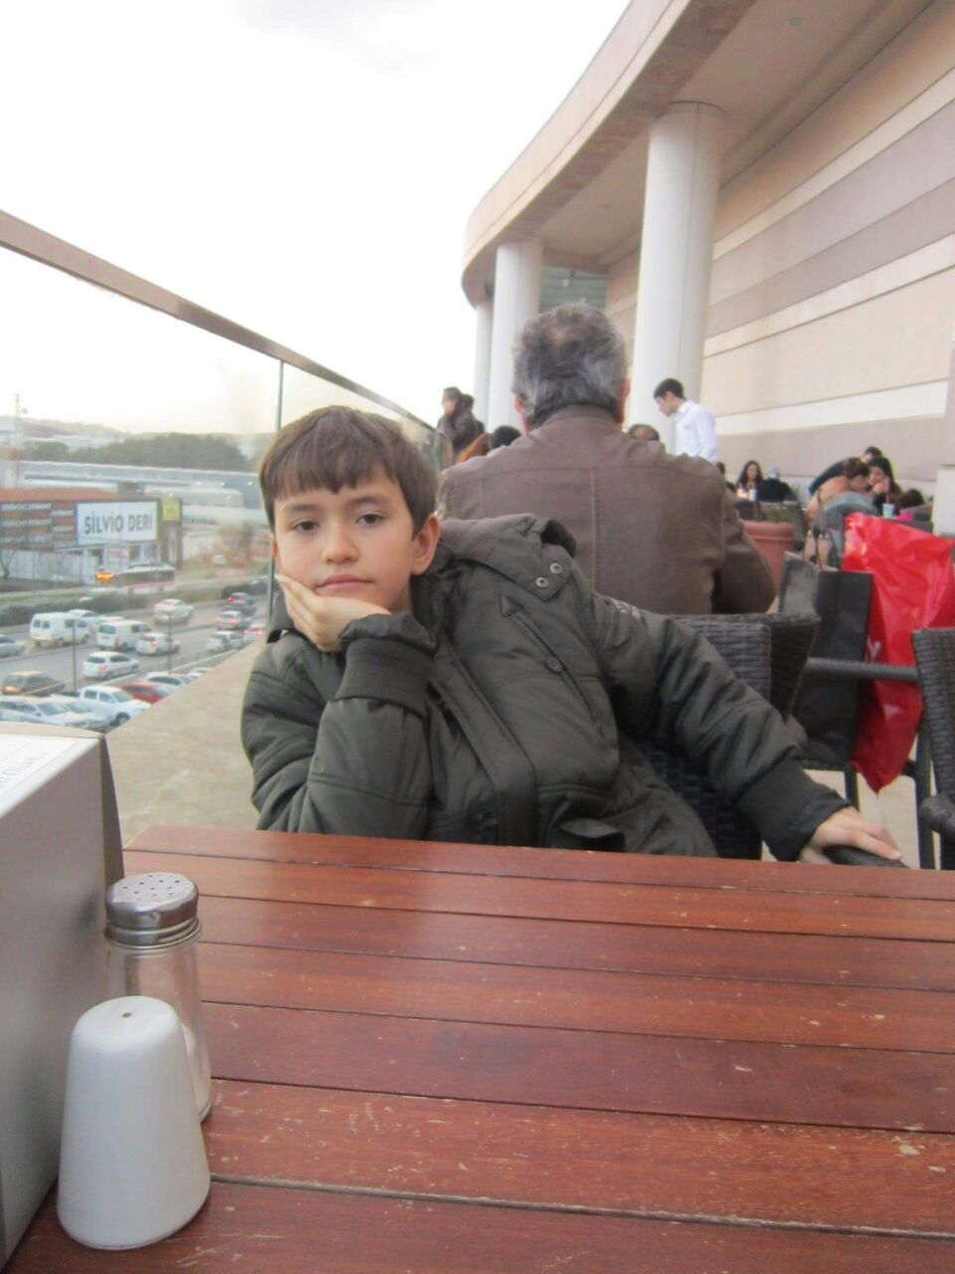
MANAGER&DEPUTY DIRECTOR ALPSU&TALHA

Slide 4
TRANSLATORS BEDİRHAN&BEYZA

Slide 5
THE CITIES WE CHOOSE ARE
ISTANBUL
PRAG
AMSTERDAM
LİSBON
PARİS

Slide 6
OUR TRAVEL TABLE
Travel's budget
Cities | Distances(km) | Cost of transport | City | Hotels | Restaurants | Visits
Turgutlu-İstanbul | 550 | 28 | İstanbul | 987 | 11106 | 80
İstanbul-Prag | 1830 | 500 | Prag | 227 | 2571 | 80
Prag-Amsterdam | 709 | 540 | Amsterdam | 662 | 4213 | 80
Amsterdam-Paris | 506 | 625 | Paris | 350 | 2468 | 40
Paris-Lizbon | 1736 | 242 | lizbon | 1773 | 12939 | 40
 |  | 1935 |  | 3999 | 33297 | 320
Total kms | 5331
Total budget in € | 1935

Slide 7
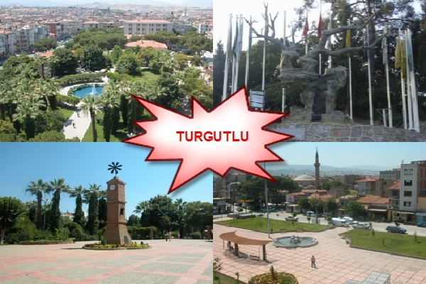
FROM TURGUTLU TO ISTANBUL
The distances from
Turgutlu to İstanbul
is 550 km.
It costs 28 euros by bus
There are 987 hotels
and
11106 restaurants
in Istanbul

Slide 8
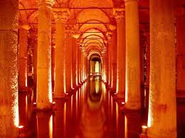
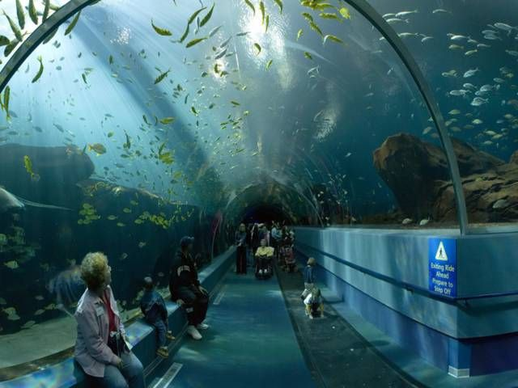
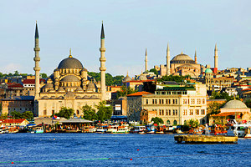
ISTANBUL

Slide 9
FROM ISTANBUL TO PRAG
The distances from
İstanbul to Prag
is 1830 km.
It costs 500 euros by plane
There are 227 hotels
and
2571 restaurants
in Prag

Slide 10
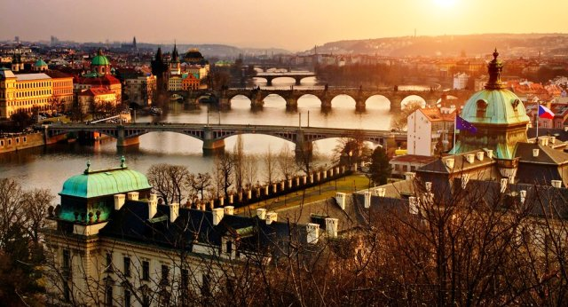
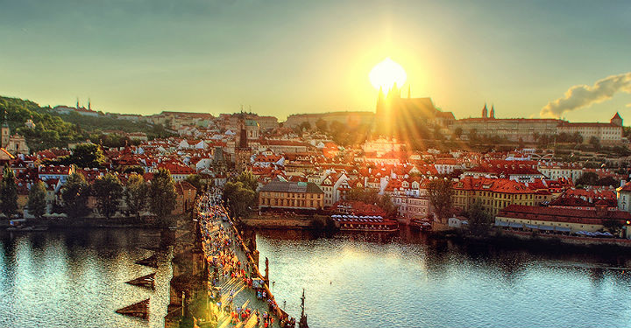
PRAG

Slide 11
FROM PRAG TO AMSTERDAM
The distances from
Prag to Amsterdam
is 709 km.
It costs 540 euros by plane
There are 662 hotels
and
4213 restaurants
in Amsterdam

Slide 12
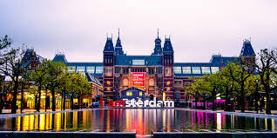
AMSTERDAM

Slide 13
FROM AMSTERDAM TO PARIS
The distances from
Amsterdam to Paris
is 506 km.
It costs 625 euros by plane
There are 350 hotels
and
2468 restaurants
in Paris

Slide 14
PARIS

Slide 15
FROM PARIS TO LISBON
The distances from
Paris to Lisbon
is 1736 km.
It costs 242 euros by plane
There are 1773 hotels
and
12939 restaurants
in Lisbon

Slide 16
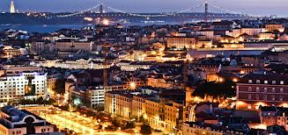
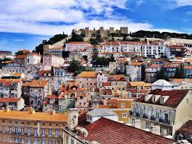
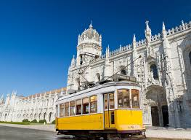
LİSBON

Slide 17
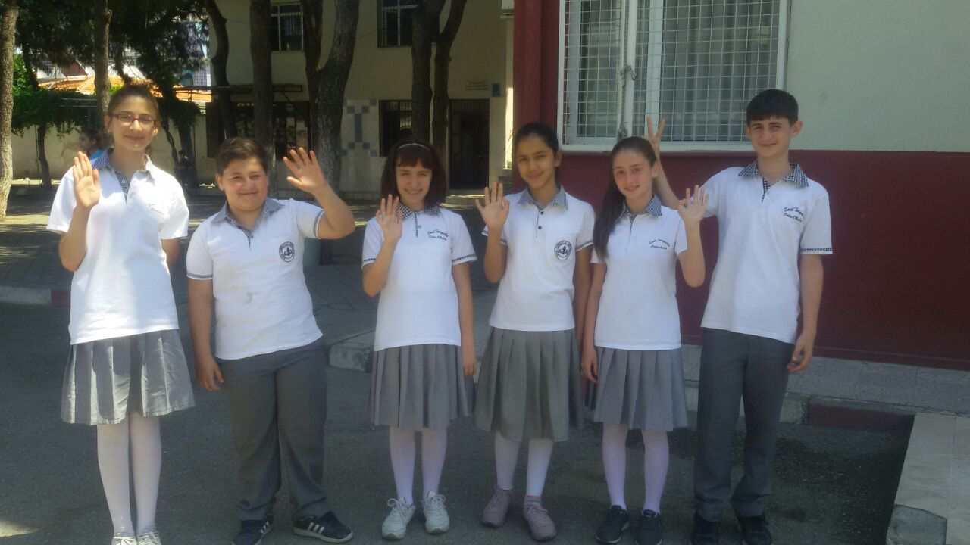
TURKISH PROJECT TEAM

