Slide 1
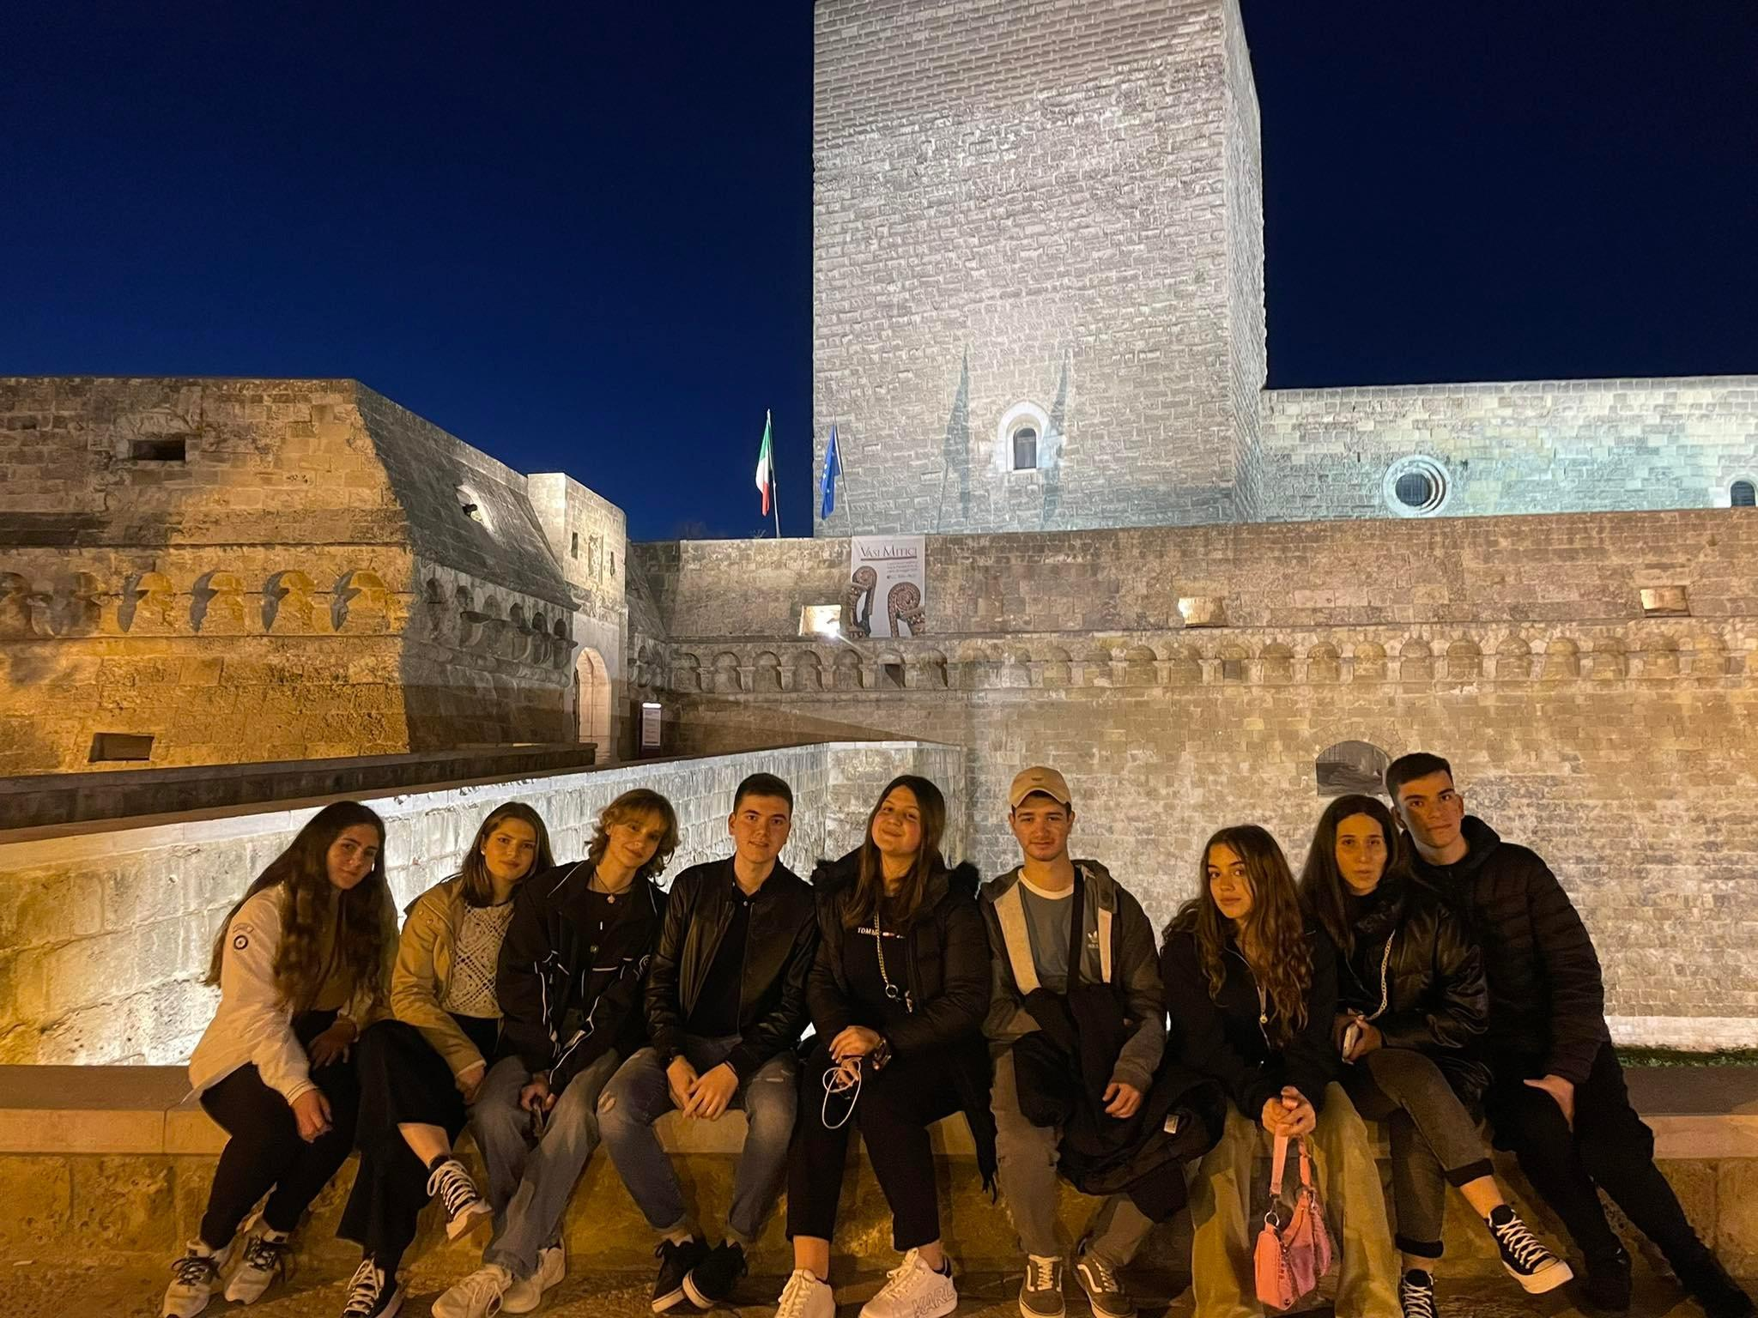
Greek team
Impressions from Bari

Slide 2
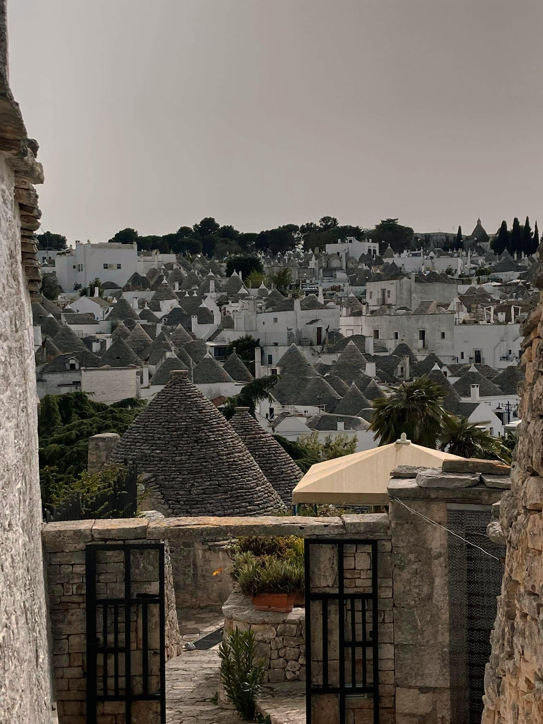
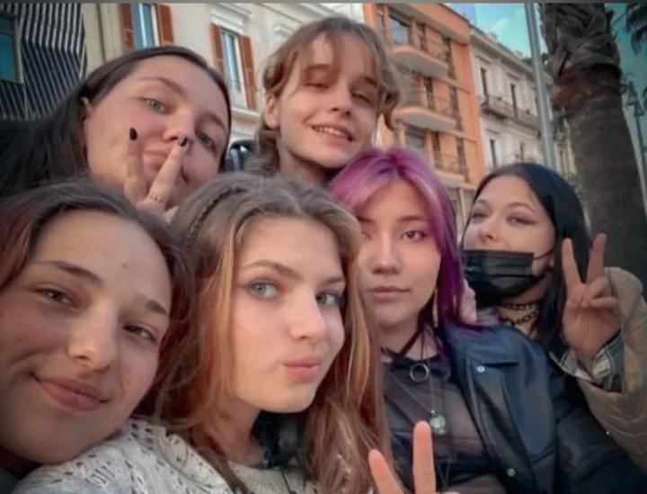
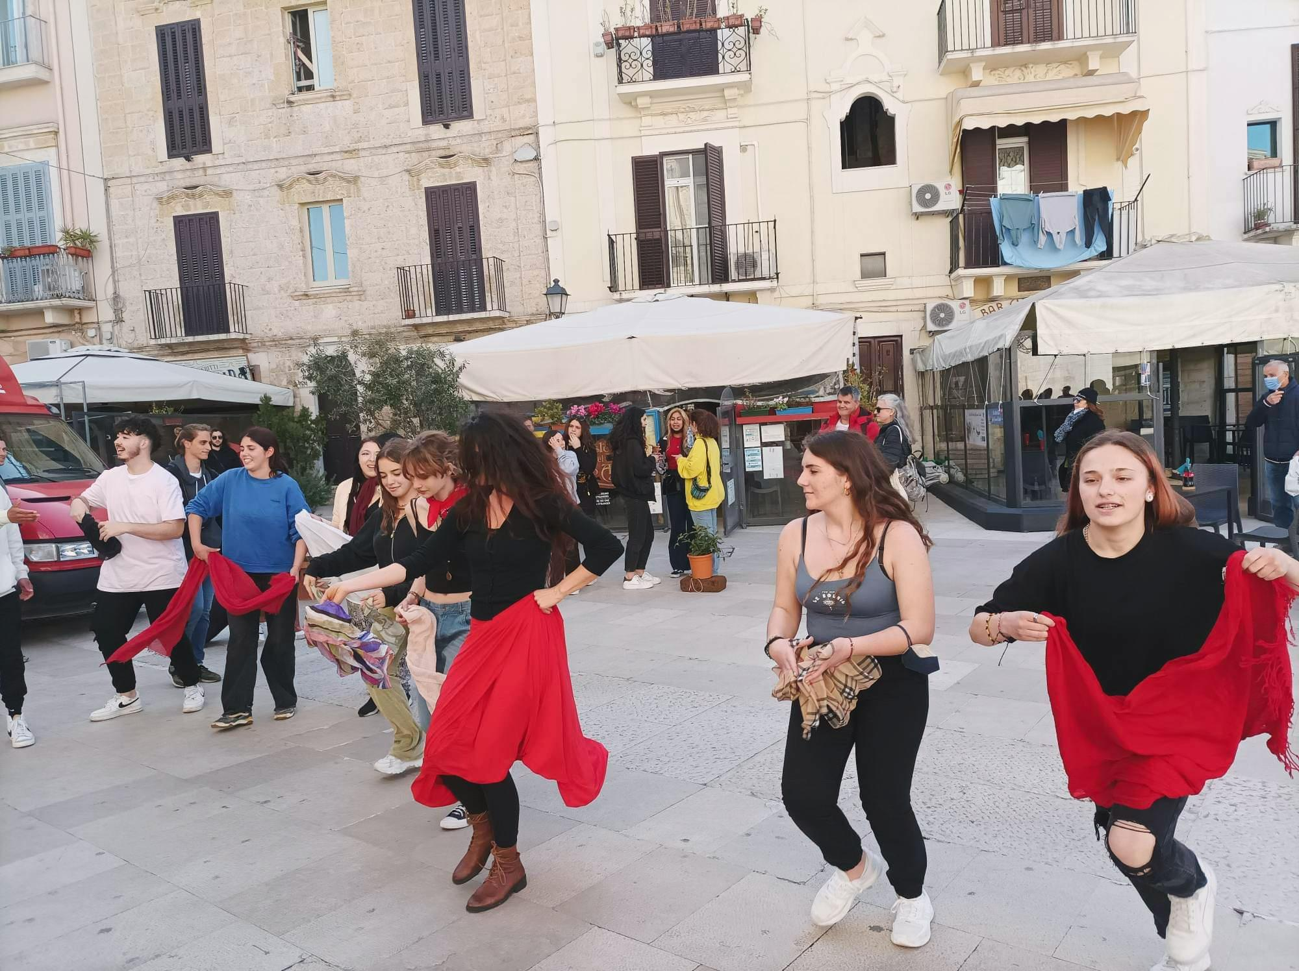
Vicky Sifakaki
The trip to Italy was amazing! I get to reconnect with old friends and meet new ones! The place was so beautiful and I learned a lot of new things regarding the culture and more! I wouldn't change this experience not in life time!

Slide 3
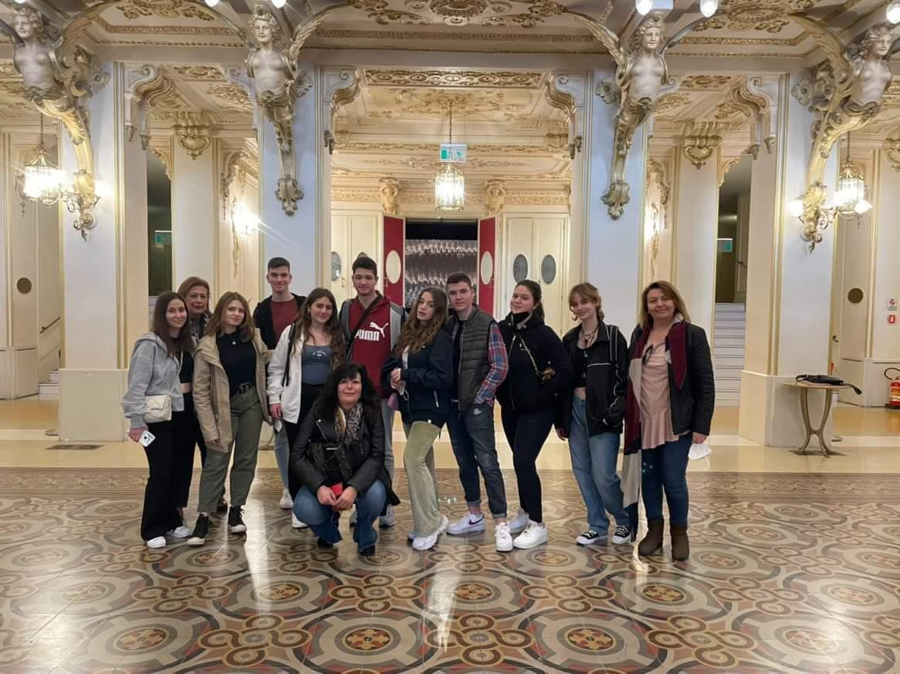
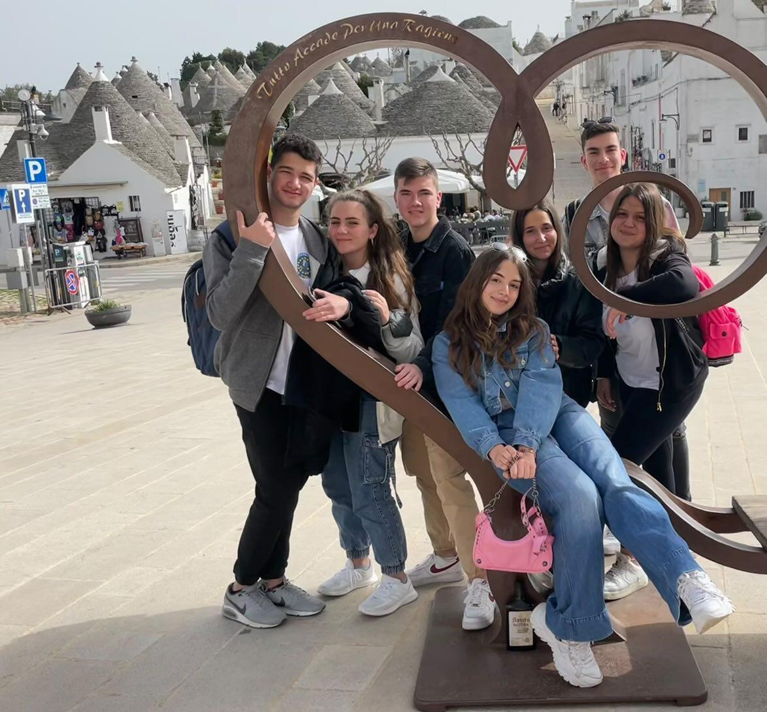
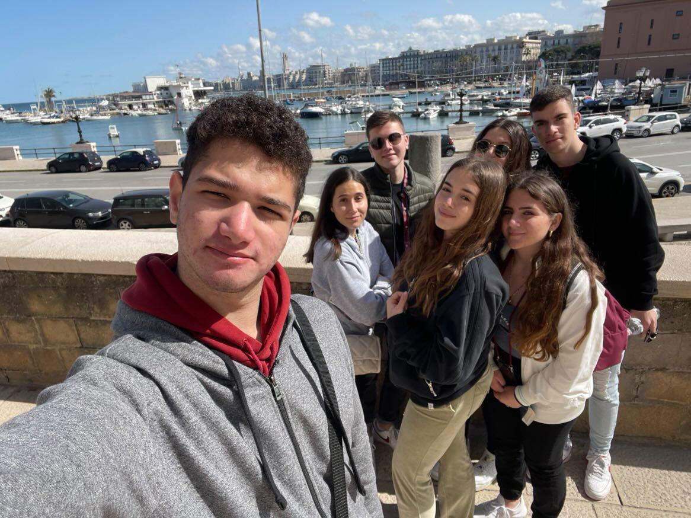
Kostis Mountakis
Erasmus gives you lifetime experiences, and I stand by that. I had the most amazing time when I was in Italy with both my classmates and the children I met there. I am also glad that I got to meet the bulgarian team better because they had also visited my country back in February. I was surprised by the places that I saw , especially with bari which looks like my town. I also enjoyed the drama workshop. I am so grateful that I joined this erasmus this year.

Slide 4
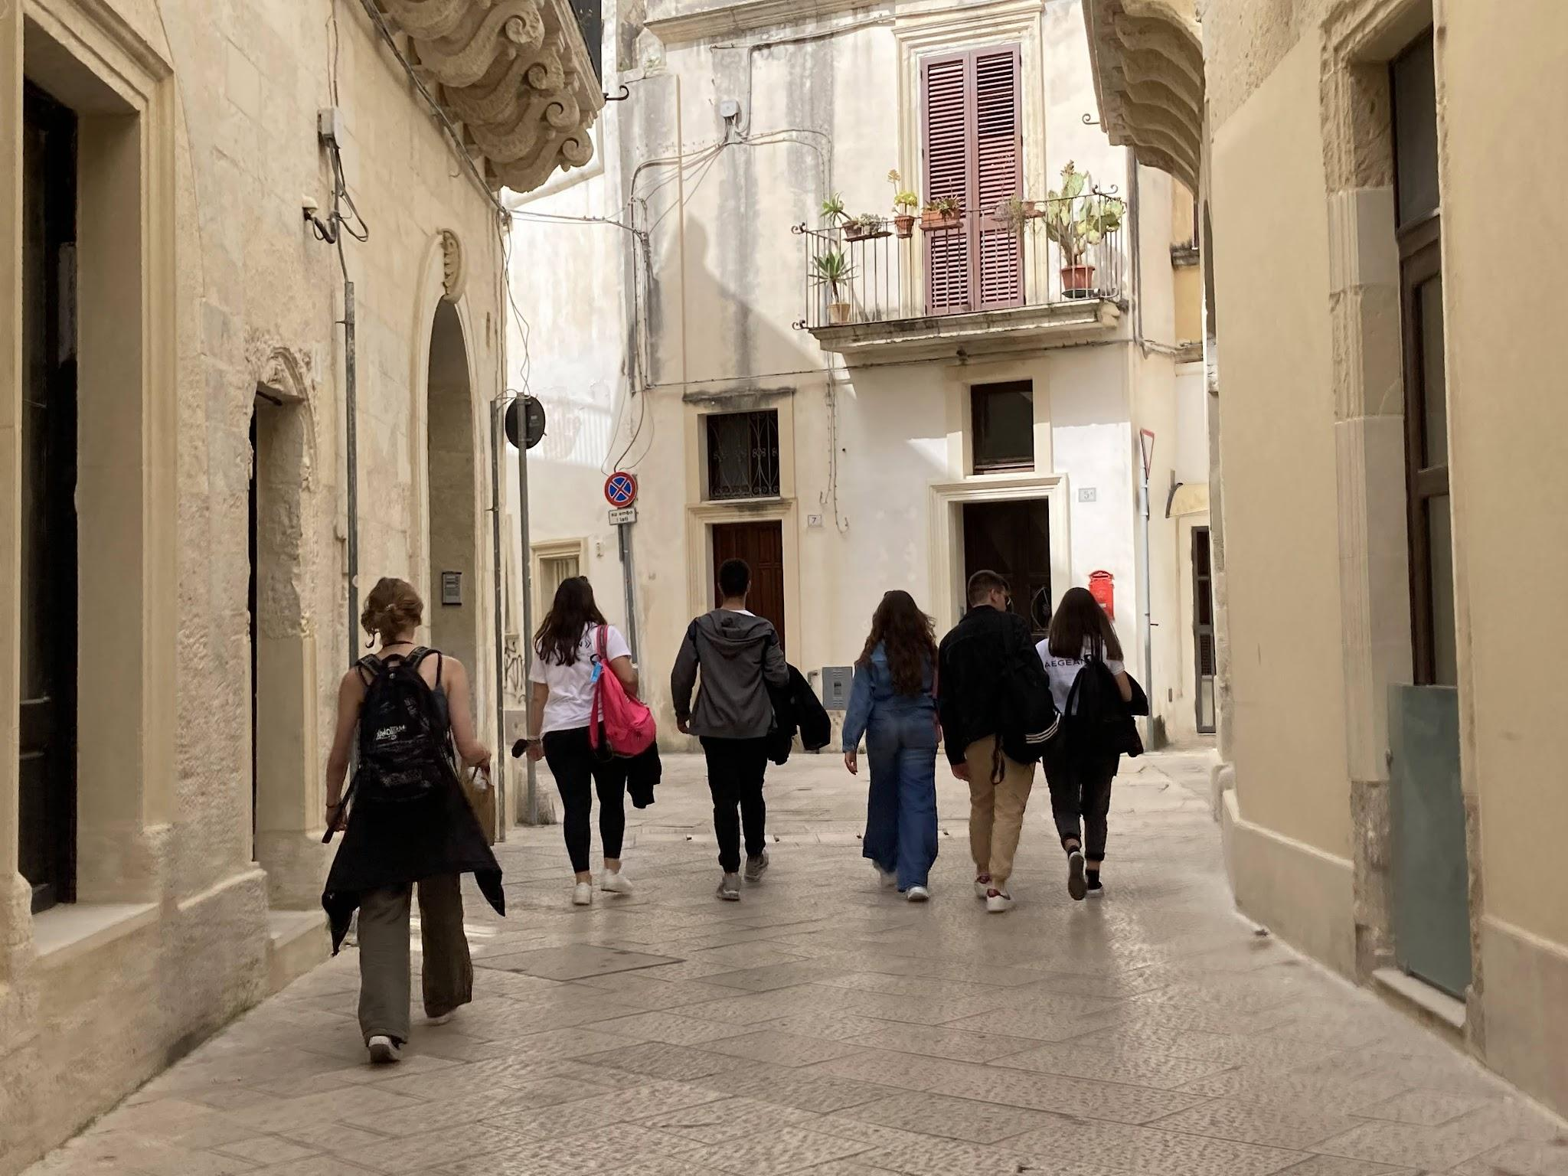
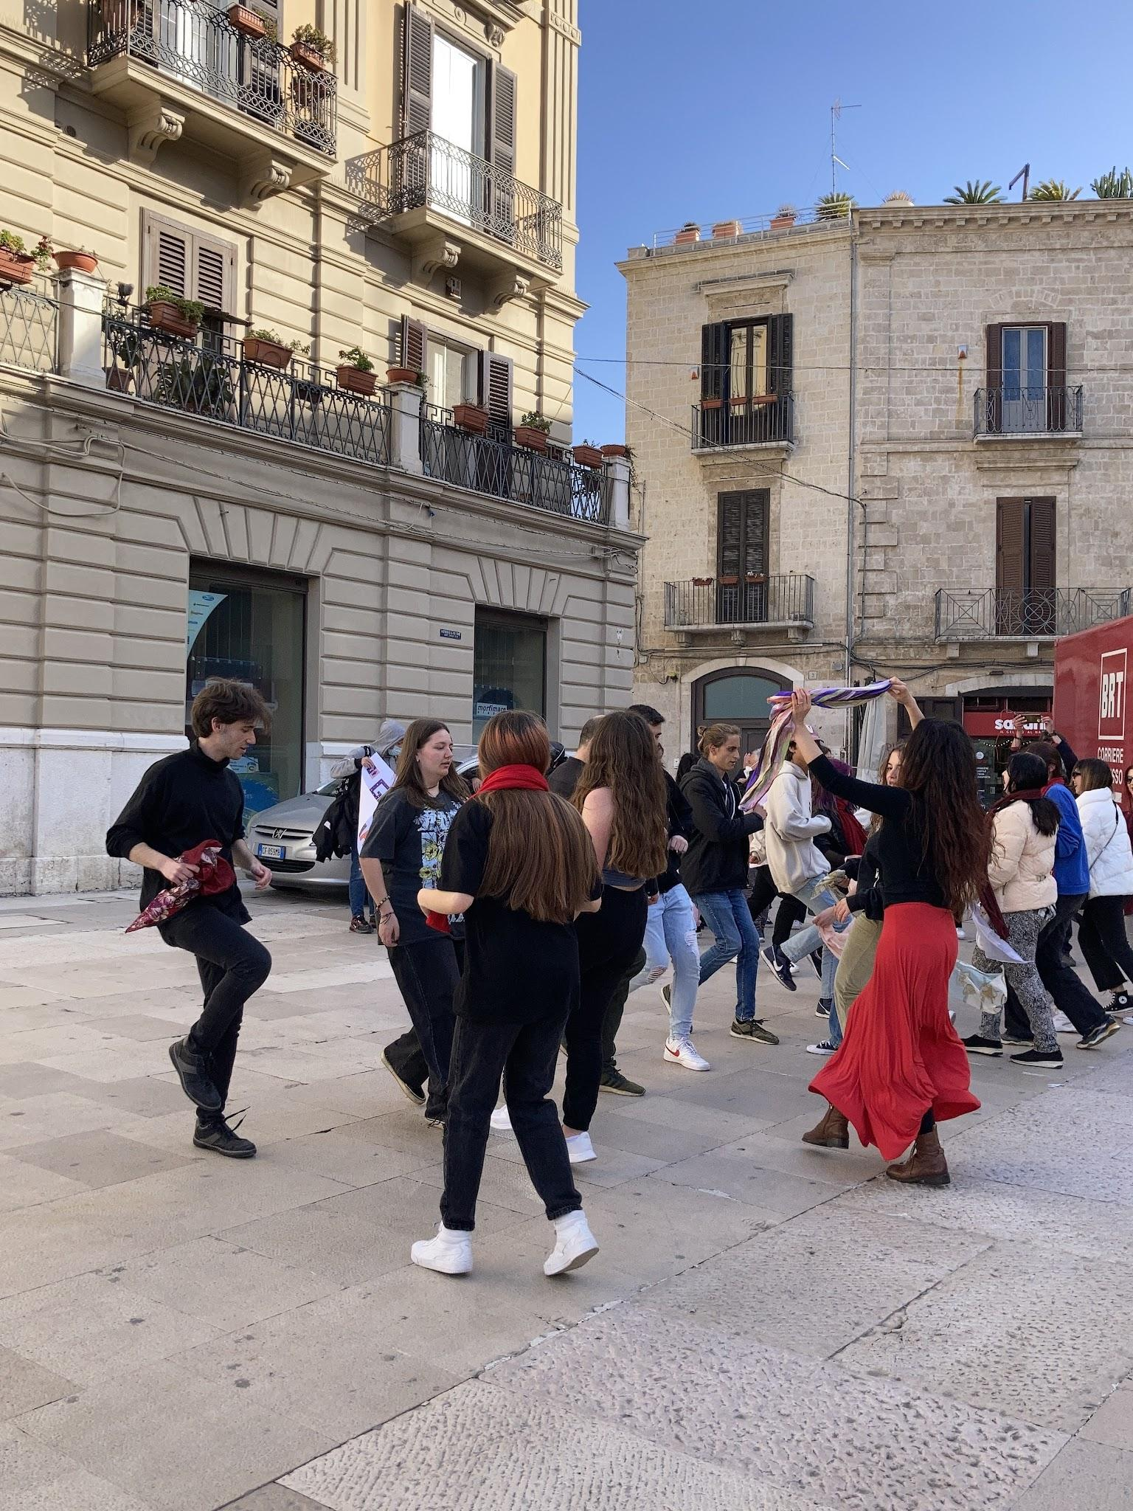
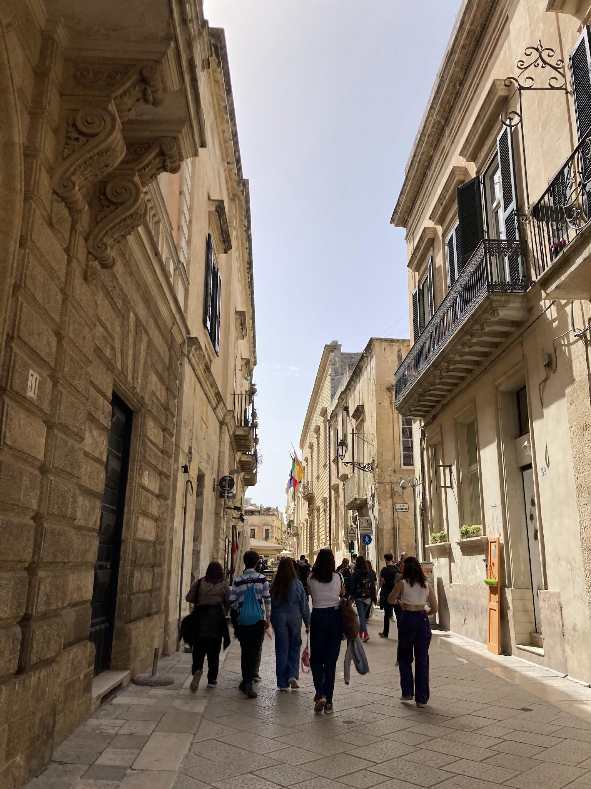
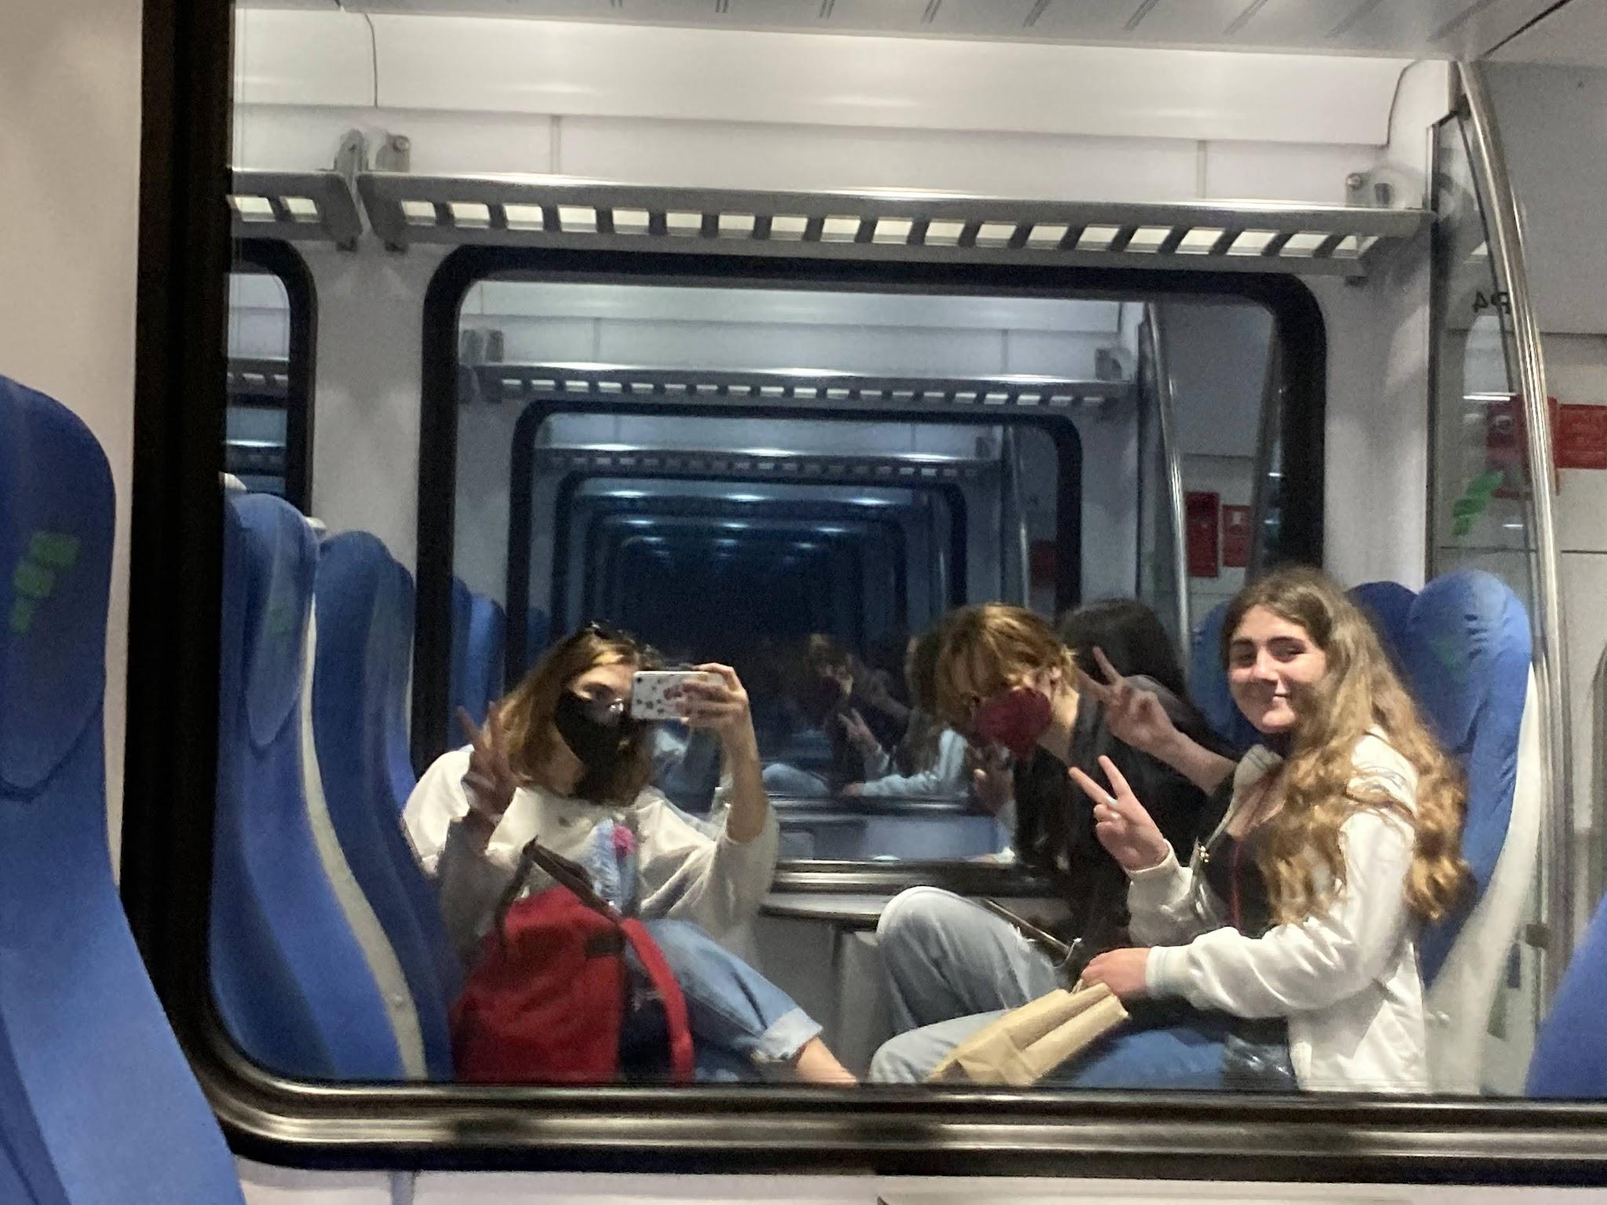
Theodoraki Niki
This trip was so worth it. I got to see old friends and make new ones, also got to see beautiful places and meet Italys culture better. The flash mobs were so fun and even people on the street started to join in! It was amazing. Had an incredible time, I would definitely do it again.

Slide 5
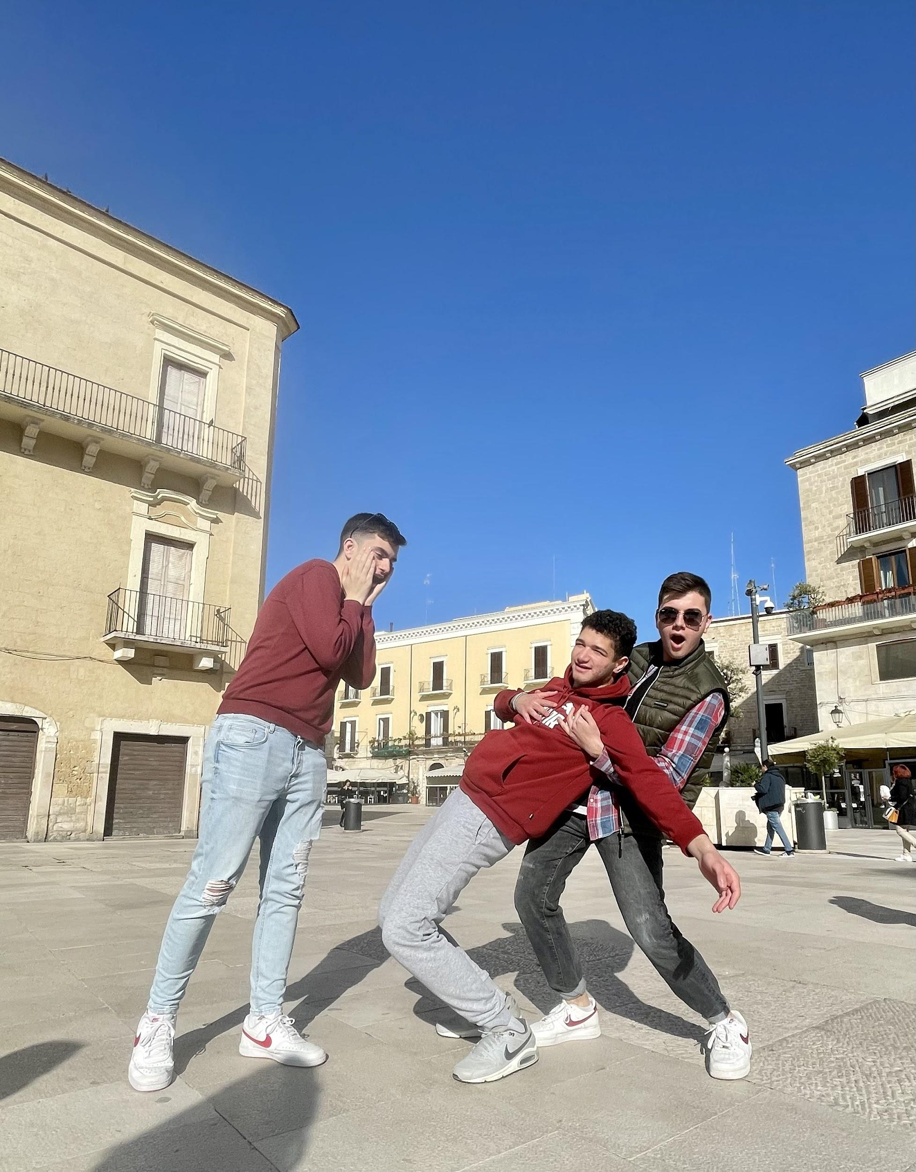
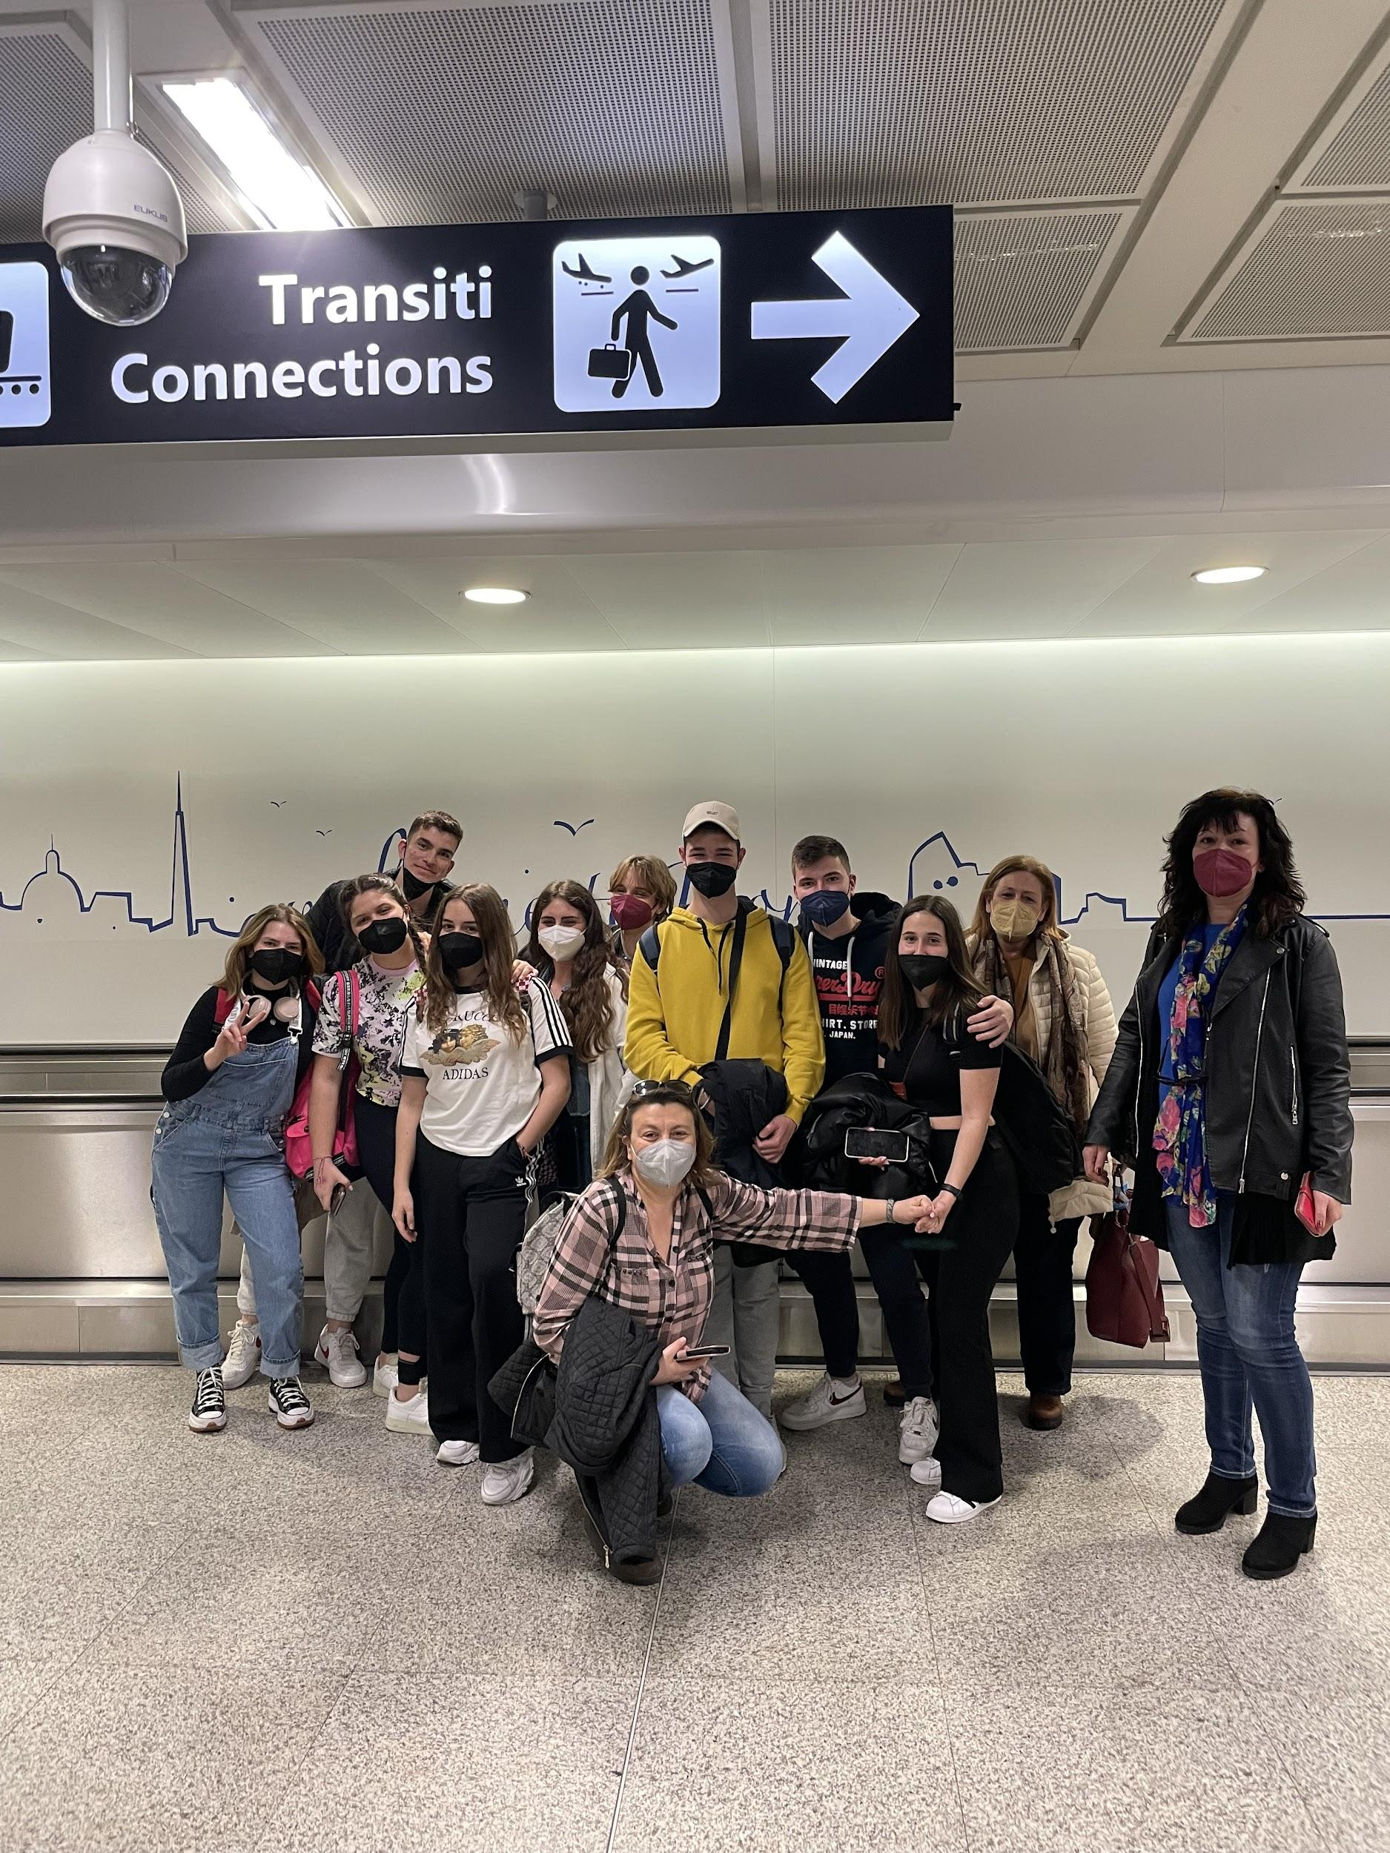
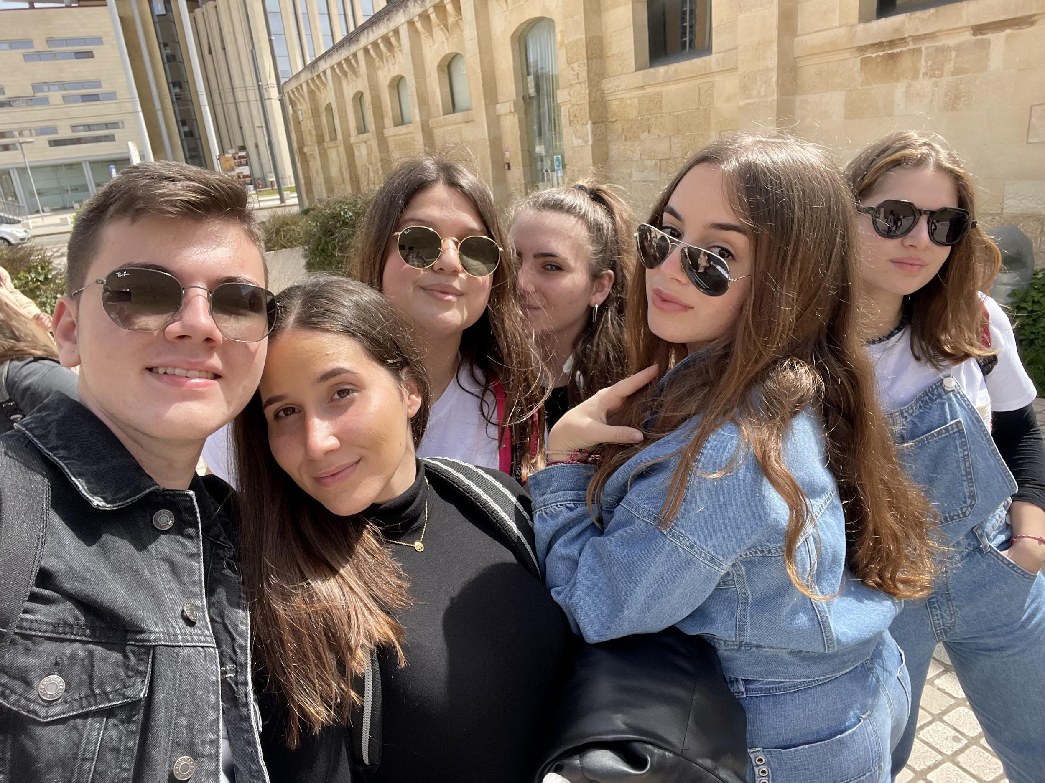
Antonis Koutsakis
The trip to Bari was wonderful! I had the chance to meet other guys from foreign countries and communicate with them. Italians were nice and friendly.
The city of Bari was really beautiful because it combines medieval architecture and Italian tradition. Moreover, I liked Lecce and Alberobello, where the sceneries were breathtaking. I had a great time and I am grateful that I took part in this program… I loved Italy!

Slide 6
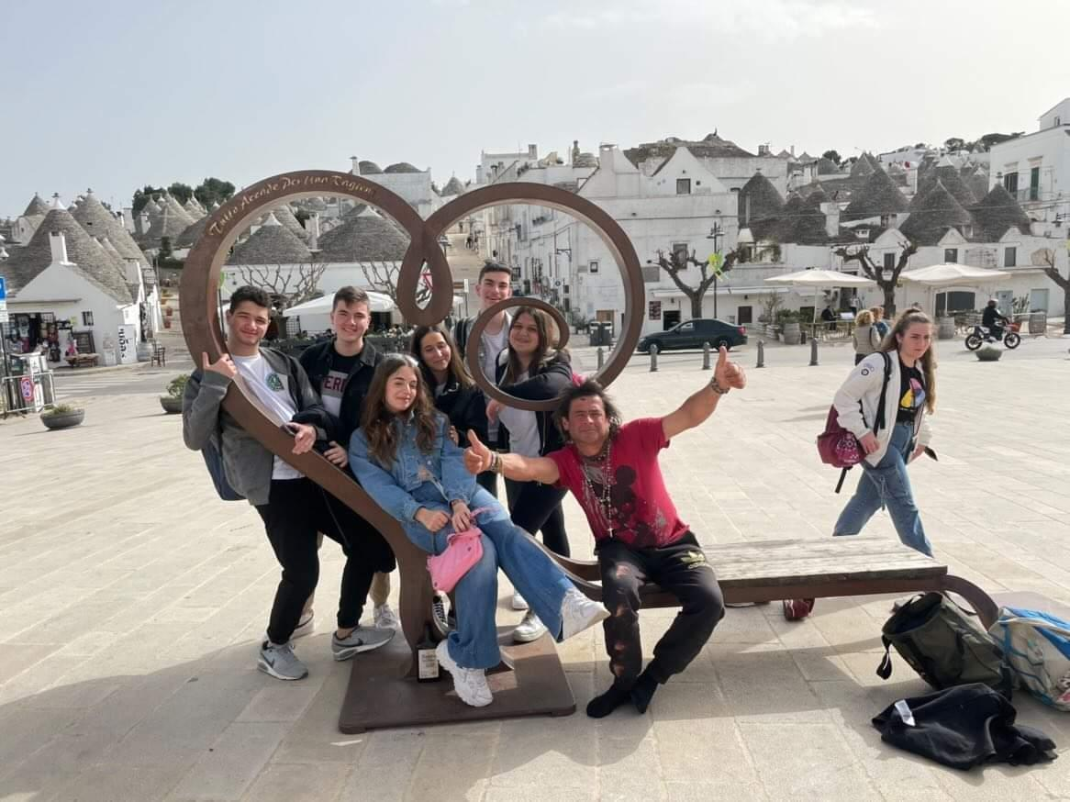
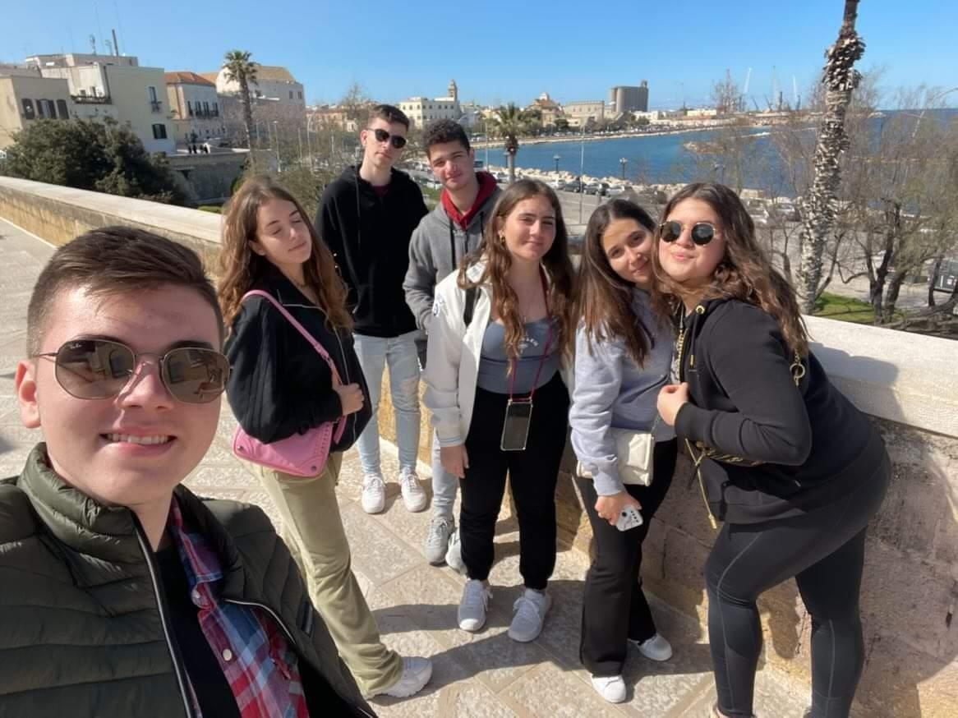
Emily Chalkefs
Our trip to Bari was fantastic! I had the opportunity to meet other people from different countries , to communicate with them and improve my English! The city of Bari was amazing and at the first chance, I would like to go again! I loved Alberobello and houses with this particular architecture. Italians were polite and friendly with us.

Slide 7
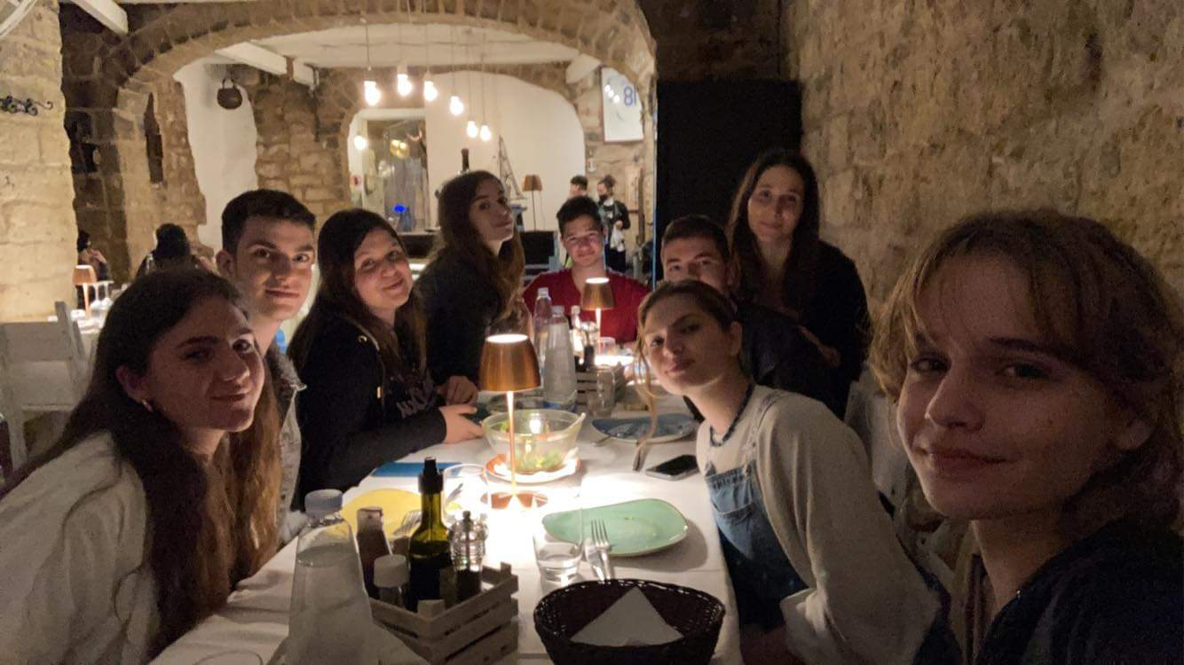
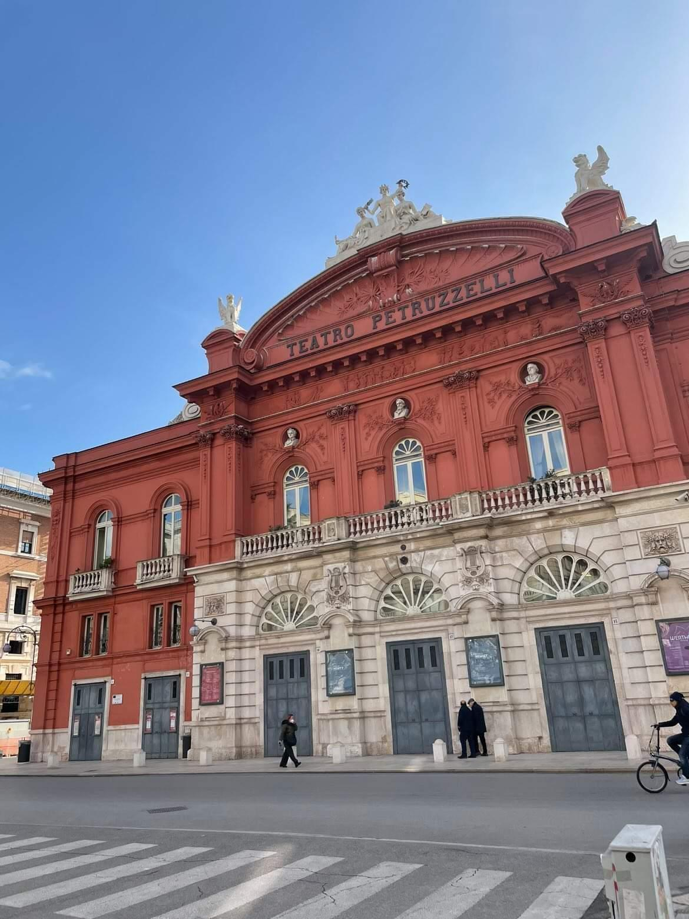
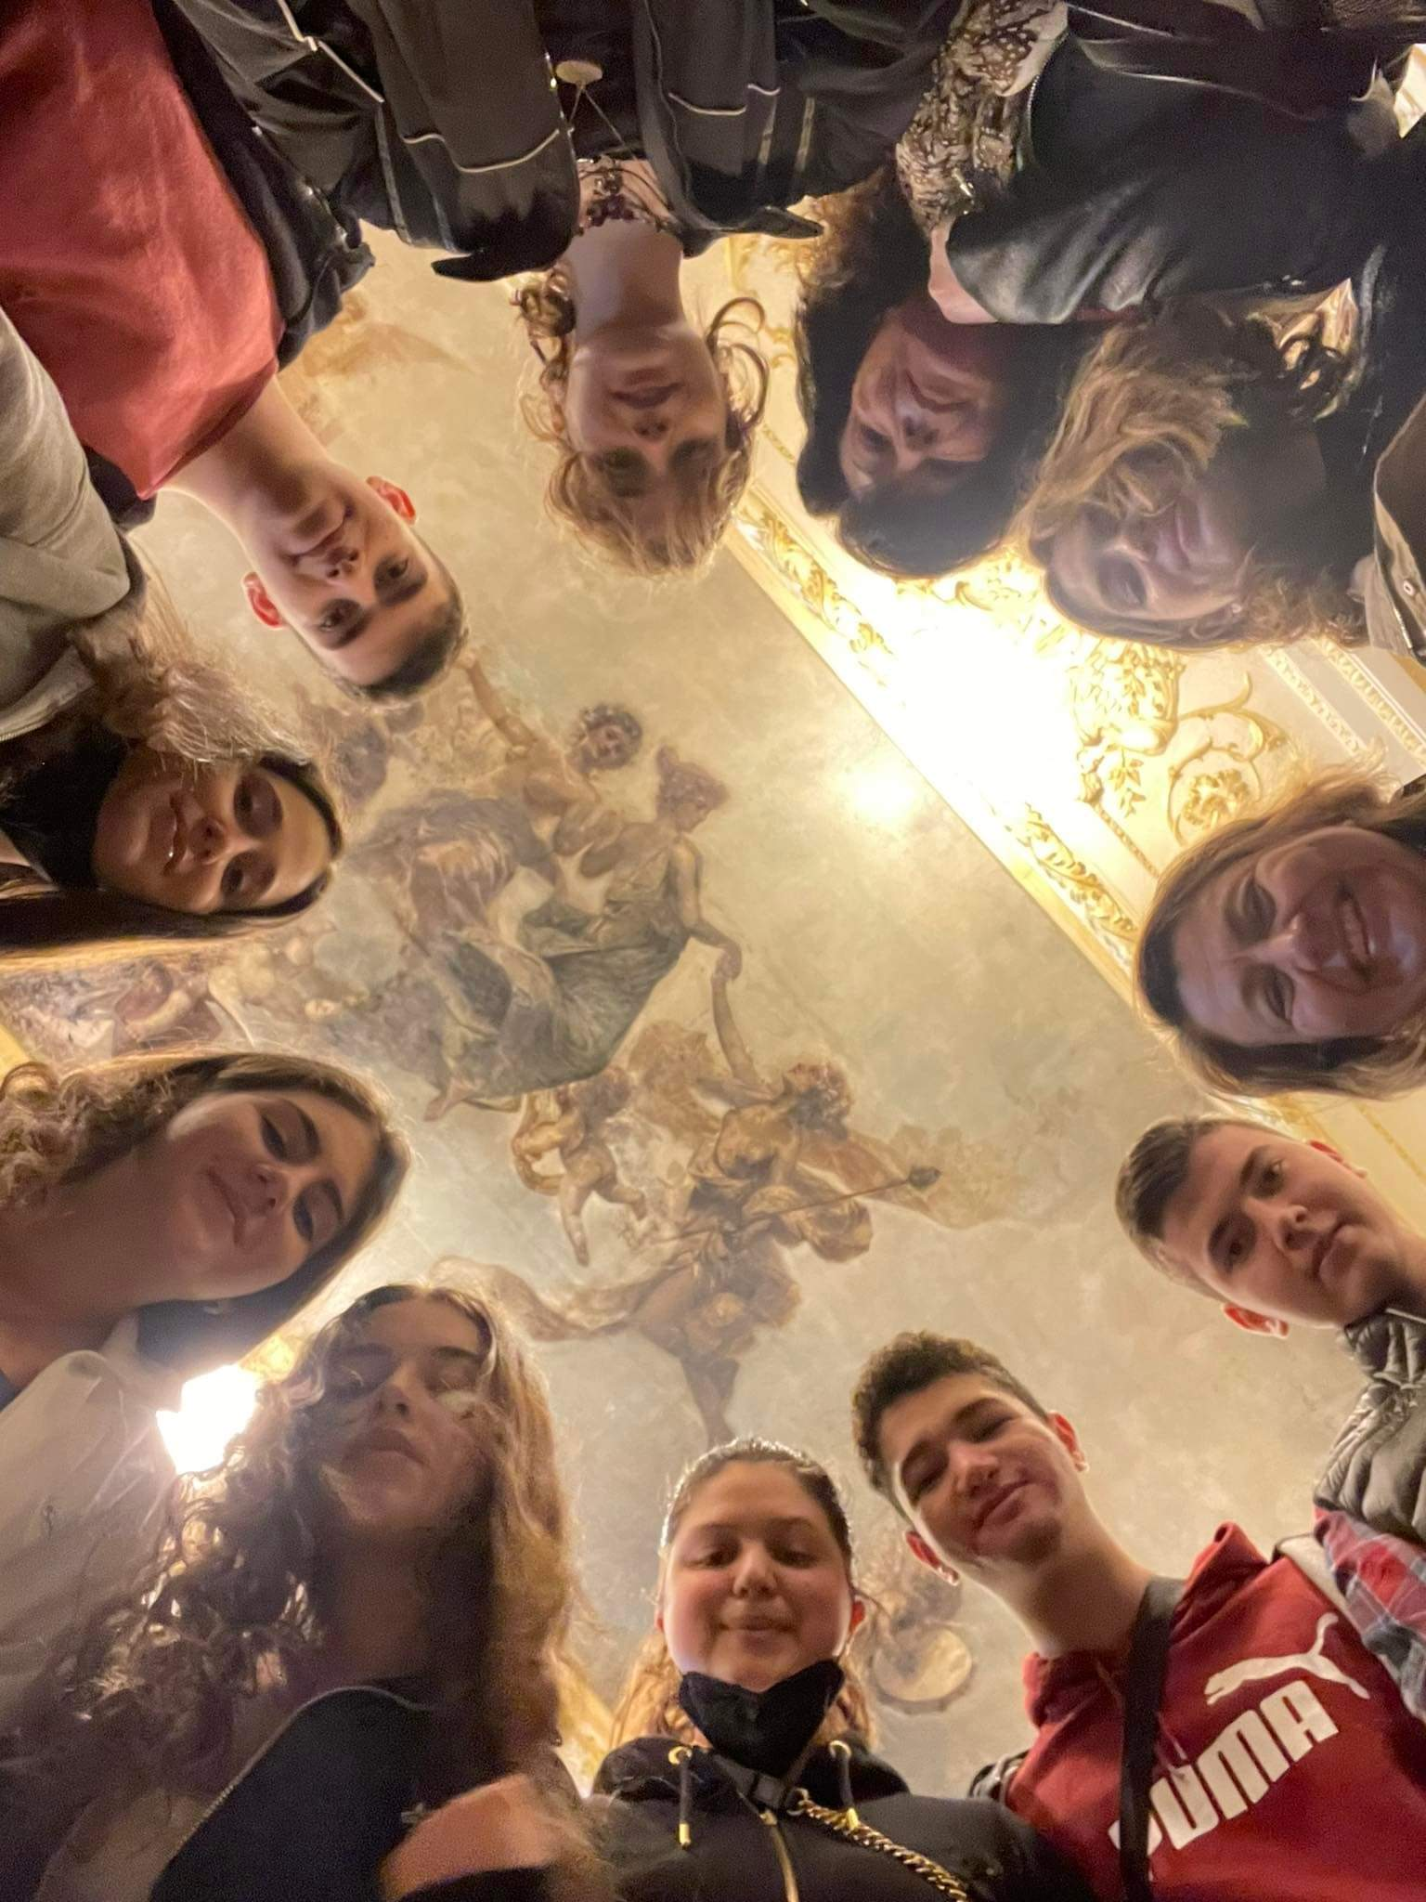
Nikos Xenikos
The trip to Italy was one of the best experiences in our lives! The architecture was fascinating! The Italians were very hospitable.We had so much fun with the Spanish and the Bulgarian kids. If a had the chance I would do it again because not only did we meet people from different countries but also we got to know their culture and their interests.

