Slide 1
THE BIRTH OF
AFRODITE

Slide 2
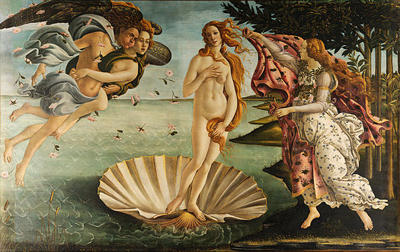
The Birth

Slide 3
Her father was Uranos
Aphrodite was born in Cyprus, well not born exactly because as the story goes, she was "foam born". Her father in a manner of speaking was Uranus (Father Heaven). In fact her conception was caused by her half-brother Cronos.

Slide 4
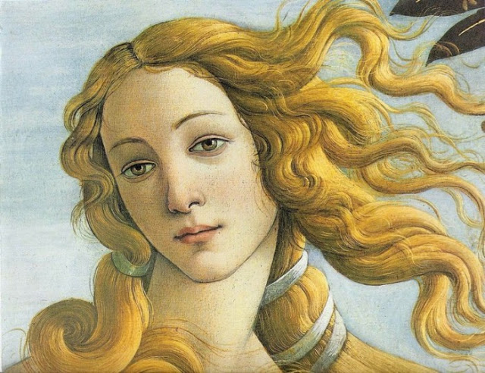

Slide 5
The castration
Cronos was a son of Uranus and Gaea (Mother Earth) and at his mother’s instigation had castrated his father with a sickle. The resultant blood that dripped from his severed organ ( as it was carried off on the shoulder of Cronos) created a race of giants, the nymphs and the furies, as they landed in the sea, white foam was created from the friction of water and flesh.

Slide 6


Slide 7
Aphrodite: “Born from the foam”
This foam formed the shape of a beautiful woman when it came to the island of Cyprus. When Aphrodite stepped on the ground, beautiful flowers blossomed, anemones and bonnets, which to this day still bloom on the rocks in Paphos.

Slide 8
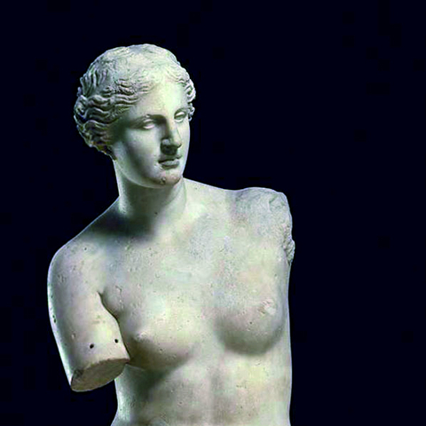
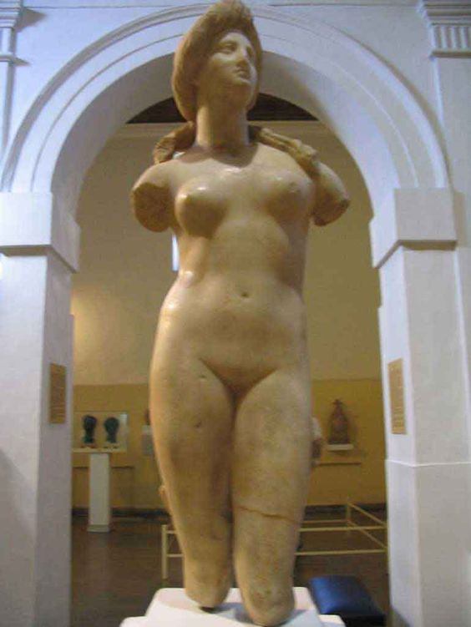
Aphrodite of Milos and from Cyprus

Slide 9
Cypris: Born in Cyprus
She has also been called "Godess of love" "Cytherea," " Cypris," " Cypria," and "the Cypriate". Since then, Cyprus became the favorite island for the goddess of love, where she preferred to spend all of her time.

Slide 10
Explains etymology
This story was handed down to us by Hesiod, one of the earliest Greek poets. He explains that Aphrodite’s name comes from the Greek word αφρός [afrós], meaning “foam,” which could refer to the sea foam or to Uranos’ semen. This myth is etiological, with Aphrodite’s birth from foam explaining the origin of her name. This is a poetic invention, however, and the true etymology of Aphrodite’s name remains unknown.

Slide 11
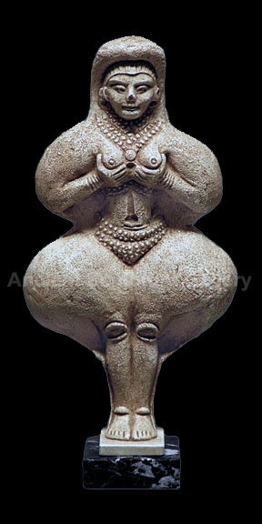
Goddess Ashtart
Although these myths surrounding Aphrodite are Greek, Aphrodite is not a Greek creation, but more of an acquisition. She is a version of the goddess Ashtart, also called Astarte, Ishtar, Isis, and a number of other variants, when she appears in different places around the Mediterranean and throughout the Middle East.

Slide 12
Love and War
As a goddess, Astarte held dominion not only over love, but also heaven and war. Aphrodite’s function was narrowed down to the goddess of love, although she is occasionally depicted with weapons or married to Ares, the Greek god of war, which is evidence of her bellicose beginnings.

Slide 13
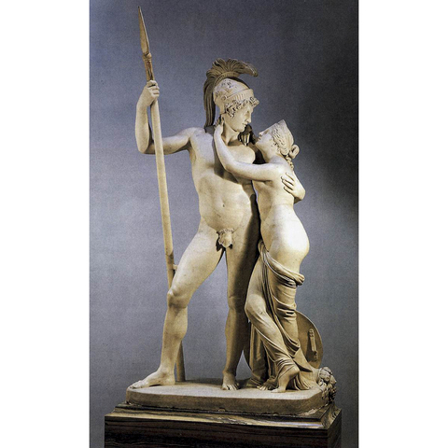

Slide 14


“The legent of Aphrodite”
The task was presented to Croatian team during the first videoconference on 10th of March 2017.
Students:
Elena Anastasiou
Zara Pakalne
Alexandra Andreou
Maria Savva
Teacher:
Sotiria Papamargariti

