Slide 1
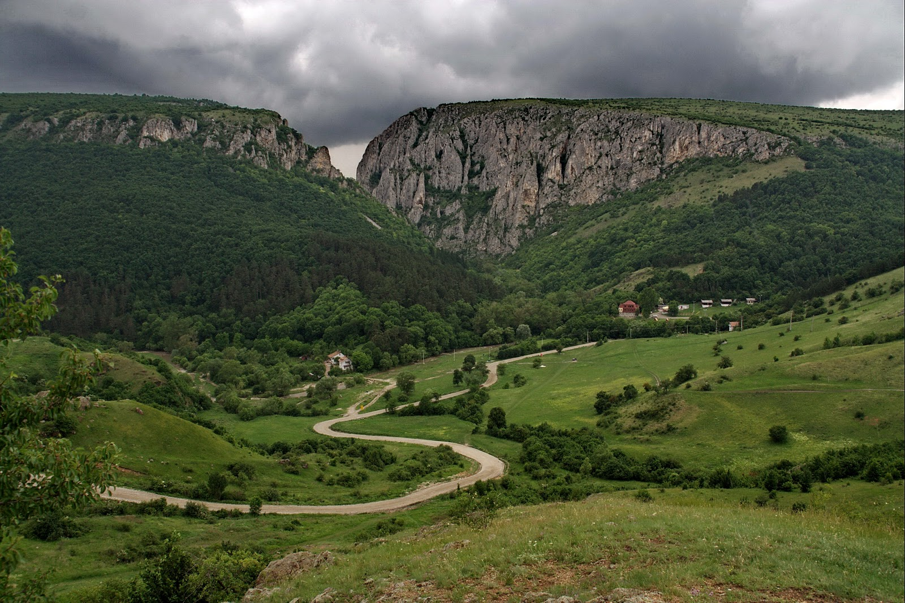
Torda Gorge

Slide 2
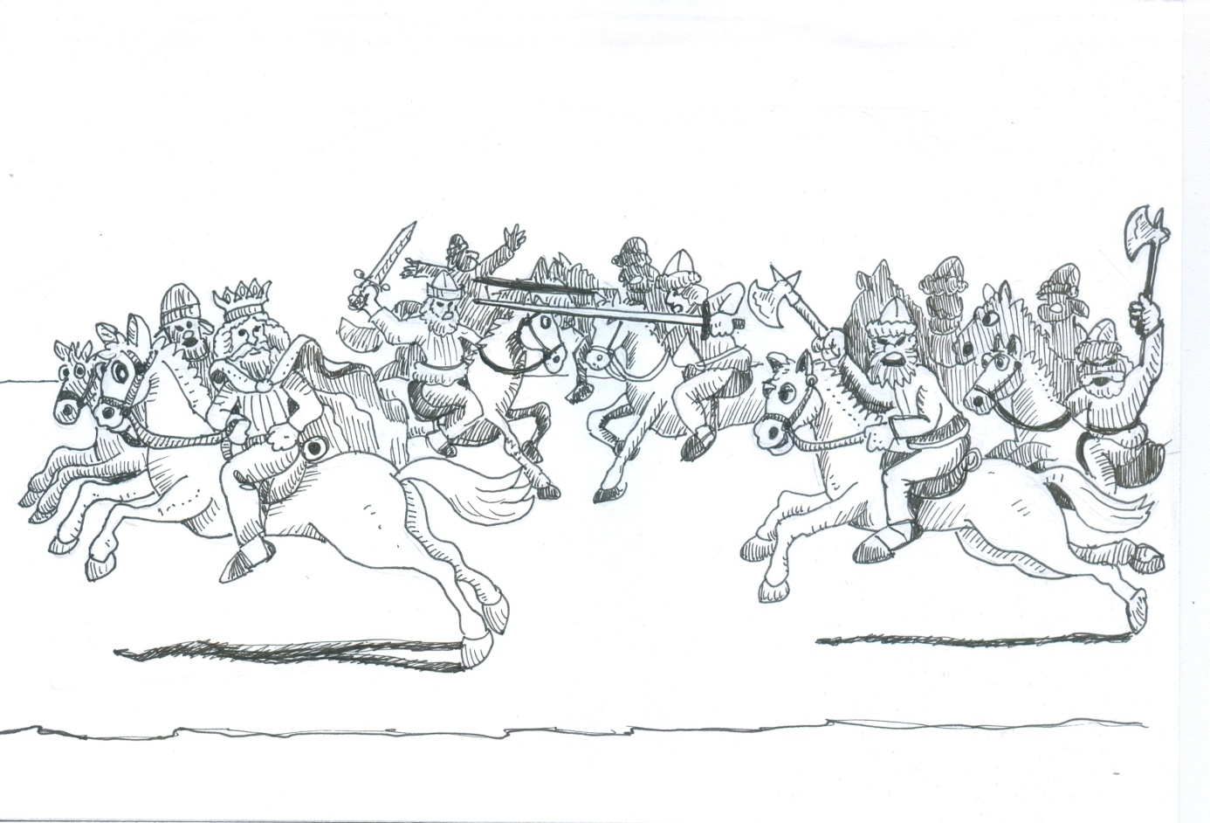
I am going to tell you the legend of how Torda Gorge evolved. In the old days King St Laszlo and his troops had a battle near the town of Torda with the Kun troops. The two armies formed lines opposite each other.

Slide 3
There were lots of Kuns and then the two armies made a move towards each other. They both marched threateningly. The troops started to fight. A bloody battle evolved.
There were less and less soldiers in St Laszlo’s army. Many Hungarian soldiers died and they were just killed.
Laszlo called his people back in order not to lose them all. The Hungarians started to march in the direction of the mountains near Torda. The Kuns started to follow them. „Get them! Get them!” - cried the Kuns. They knew if they get Laszlo, they will get Hungary too. They all started to chase King Laszlo.

Slide 4
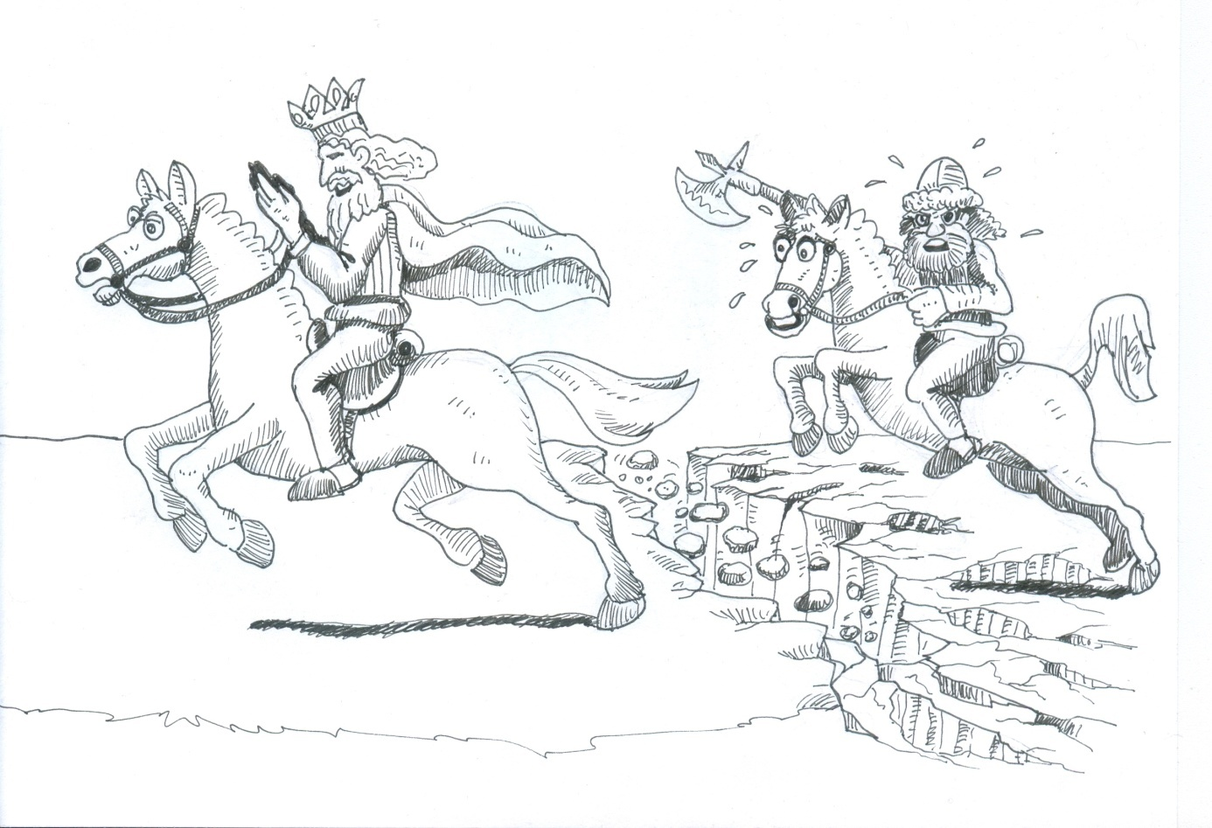
They almost reached him with their axes. Laszlo looked up in the sky and called God. „Help me God, I fought for you”. God listened to Laszlo’s prayer and made a miracle. He divided the mountain behind the King.
Laszlo’s horse was running very fast so it became very very tired and the Kuns got very close to him.

Slide 5
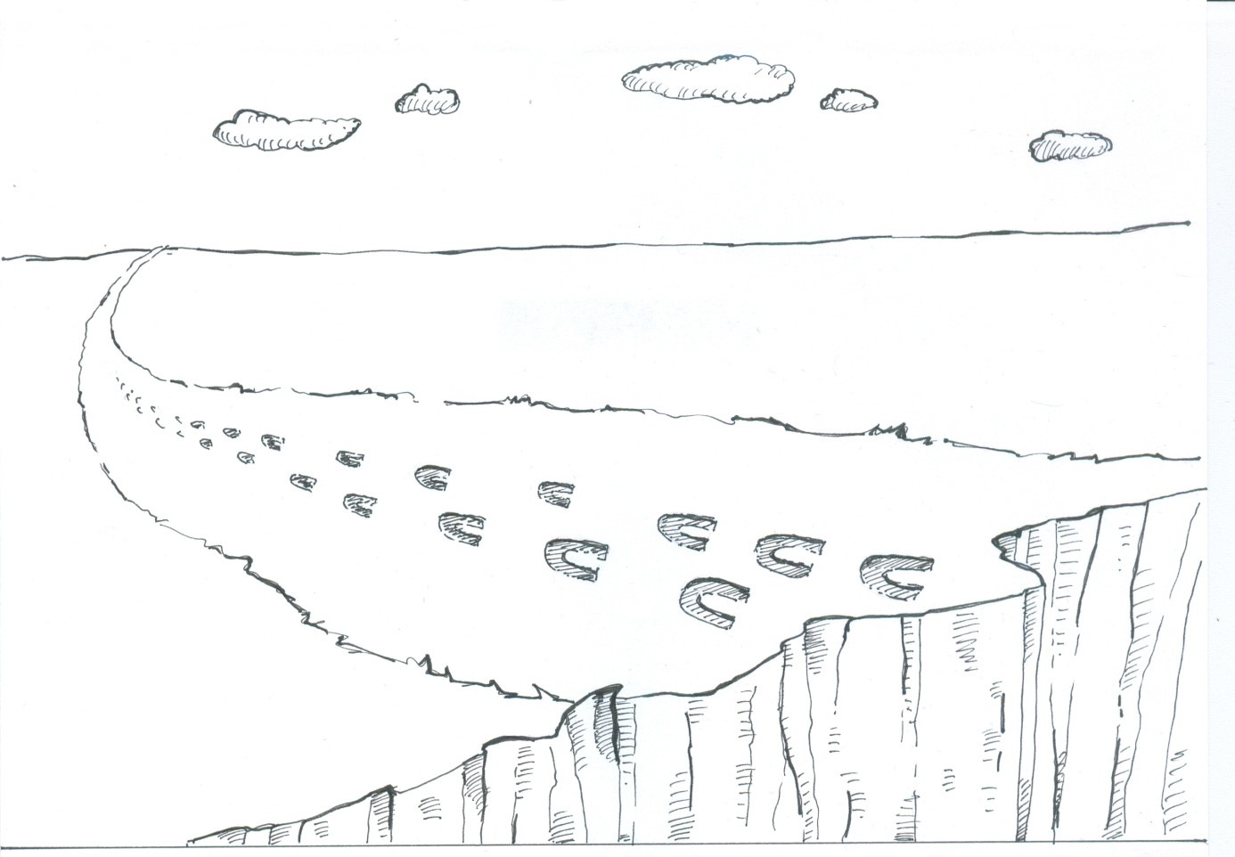
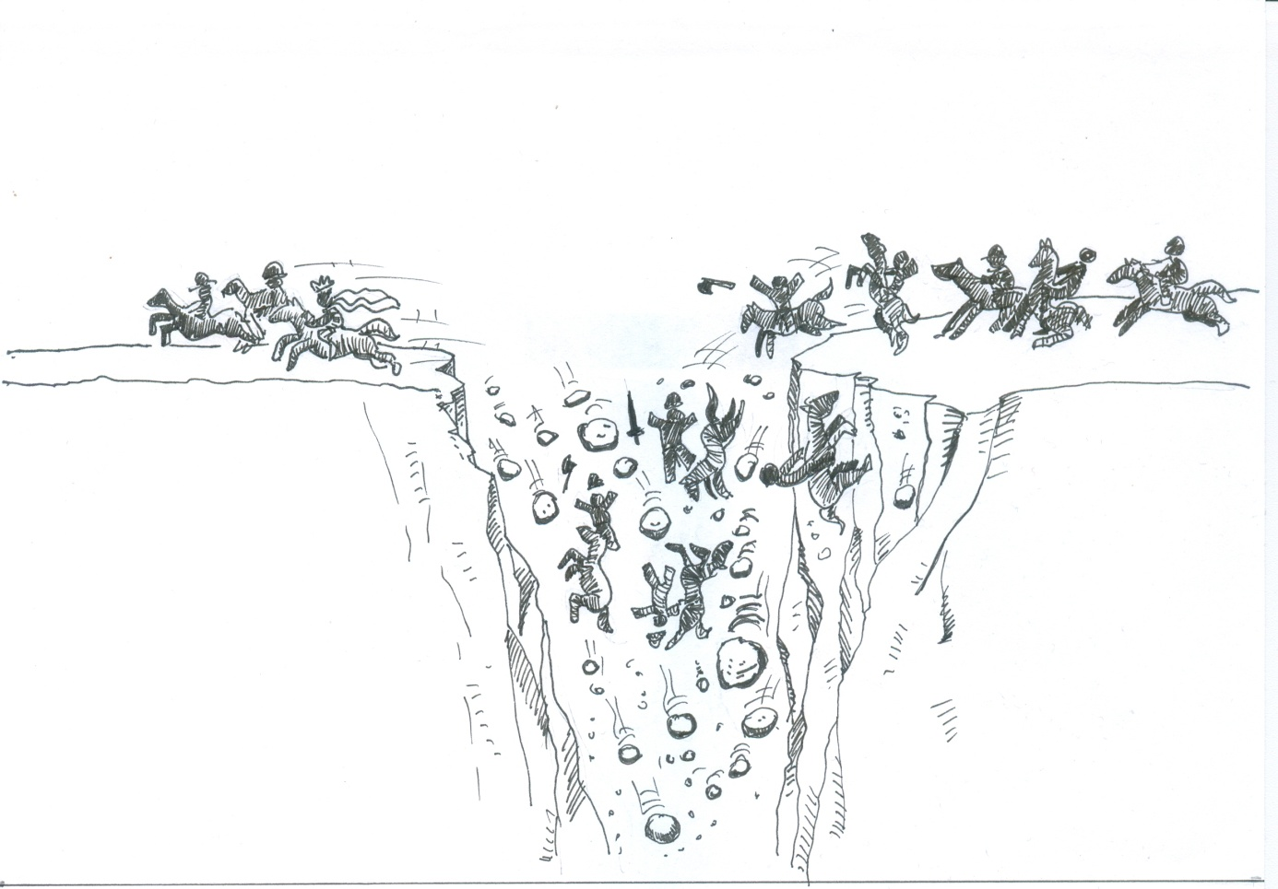
The Kuns and their horses got scared because there was a very big gorge in front of them.
According to the legend this is the true story of how Torda gorge was formed. On the highest peak, the Horseshoe peak you can still see the marks of St Laszlo’s horse.

Slide 6
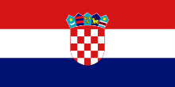
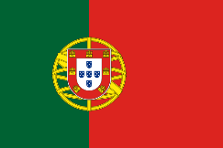
Source: Hungarian Illuminated Chronicle
Disclaimer:
"The European Commission support for the production of this publication does not constitute an endorsement of the contents which reflects the views only of the authors, and the Commission cannot be held responsible for any use which may be made of the information contained therein.„
Erasmus+ BookPals@schools.eu

Slide 7
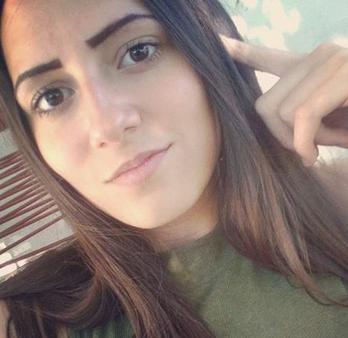
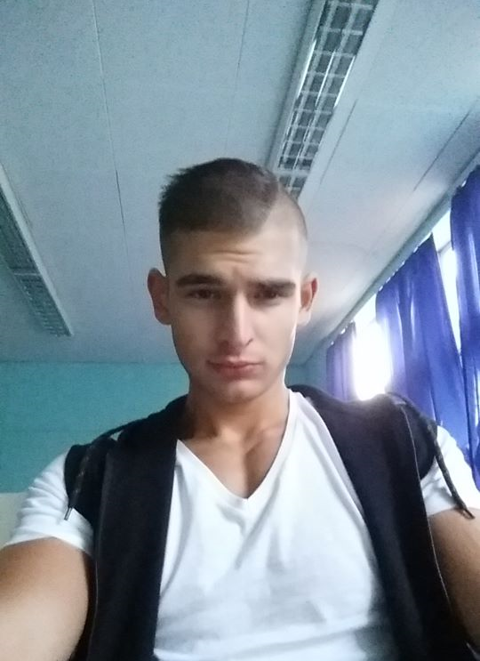
Drawn by
Nóra Kotnyek, 10/B
Edited by György Bánóczki
12/B
The presentation was made by Viktória Vas
Mentor: Katalin, Sándorné Peleskei

